Slide 1

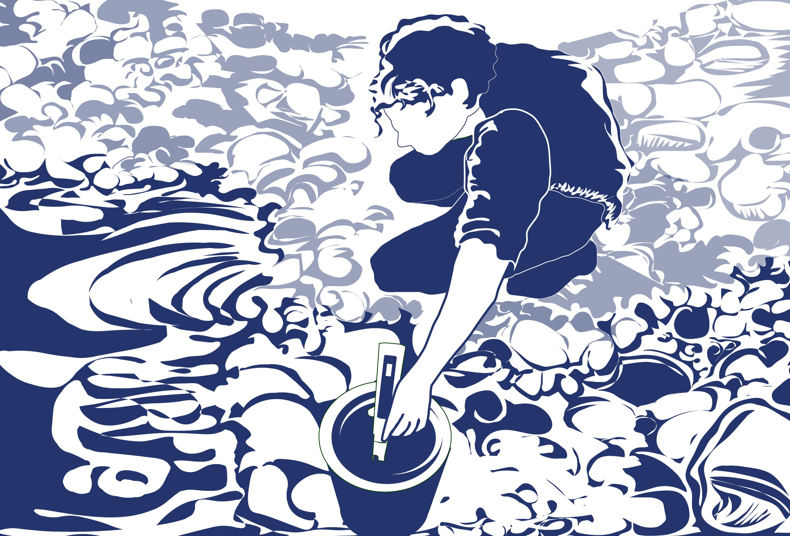
Slide 1

Slide 2

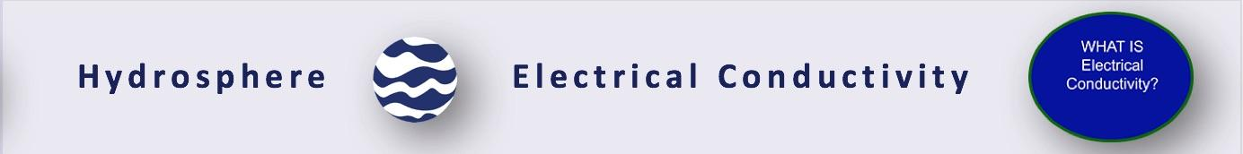
Overview
This module:
Reviews the selection of a GLOBE hydrology site
Reviews the water sampling technique used in GLOBE hydrology protocols
Provides a step by step introduction of the protocol method
Learning Objectives
After completing this module, you will be able to:
Define electrical conductivity and explain how environmental variables result in different measurements
Describe the importance of instrument calibration in the collection of accurate data
Conduct water electrical conductivity measurements
Upload data to the GLOBE portal
Visualize data using GLOBE’s Visualization System
Estimated time to complete this module: 1.5 hours.

Slide 3

The Hydrosphere
The hydrosphere is the part of the Earth system that includes water, ice and water vapor. Water participates in many important natural chemical reactions and is a good solvent. Changing any part of the Earth system, such as the amount or type of vegetation in a region or from natural land cover to an impervious one, can affect the rest of the system. Rain and snow capture aerosols from the air. Acidic water slowly dissolves rocks, placing dissolved solids in water. Dissolved or suspended impurities determine water's chemical composition.
Current measurement programs in many areas of the world cover only a few water bodies a few times during the year. GLOBE Hydrosphere protocols will allow you to collect valuable data to help fill these gaps and improve our understanding of Earth's natural waters.

Slide 4
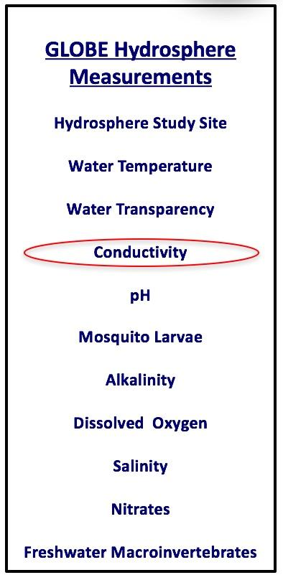
What is Electrical Conductivity?
Electrical conductivity measures the capacity of water to transmit an electrical current. This capacity is directly related to the concentration of salts in the water. We call the amount of mineral and salt impurities in the water the total dissolved solids (abbreviated TDS). We use electrical conductivity as an indirect measure to find the TDS of water.
Salts dissociate into positively and negatively charged ions in solution, and the ions conduct electricity. Inorganic dissolved solids such as chloride, nitrate, sulfate, and phosphate are present in water as negatively charged ions (anions). Sodium, magnesium, calcium, iron and aluminum are present in water as positively charged ions (cations). Pure water is a poor conductor of electricity.
The electrical conductivity meter measures how much electricity is being conducted through a centimeter of water.

Slide 5
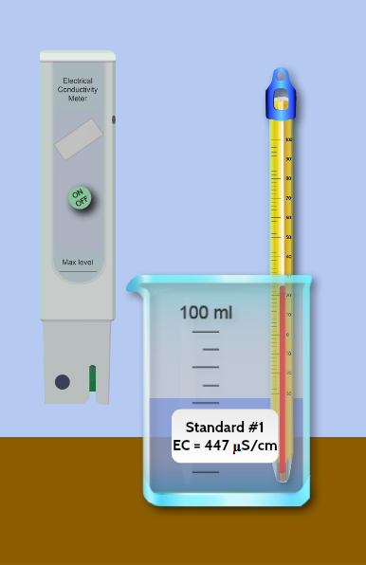
How does temperature affect electrical conductivity?
Temperature also affects electrical conductivity: the higher the water temperature, the higher the electrical conductivity would be. The electrical conductivity of water increases by 2-3% for an increase of 1 degree Celsius of water temperature. This is why water temperature readings are also taken when measuring electrical conductivity.
Many measured properties of water change at different temperatures. This is why water temperature is often called a master variable in water investigation.

Slide 6
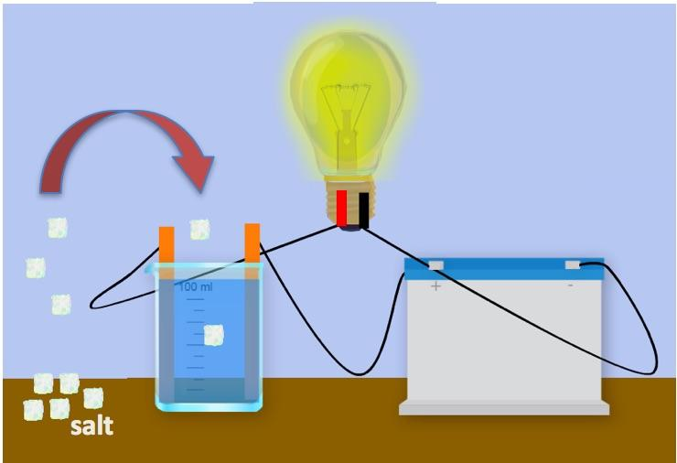
What role do dissolved solids play in the electrical conductivity of water?
As stated earlier, electrical conductivity measures the capacity of water to transmit an electrical current and this capacity is directly related to the concentration of salts in the water. If pure water is in the beaker, the electrical circuit cannot be completed because there are no dissolved ions to conduct the electricity. If salt is added to the water, the dissolved ions of salt can transmit the charge, and the circuit can be completed and the light bulb lights up!

Slide 7

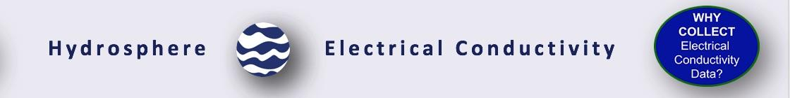
Why is it important to collect electrical conductivity data?
The local geology through which water flows will affect the electrical conductivity. For instance, streams in areas with granite bedrock tend to have lower electrical conductivity because granite is made of components that do not ionize when eroded into water. Streams that run through areas with clay soils tend to have higher electrical conductivity because they contain compounds that ionize when washed into the water.

Slide 8

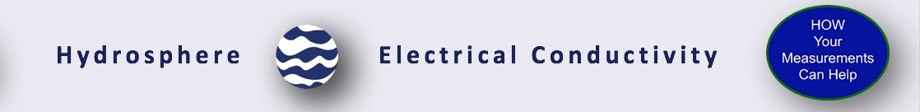
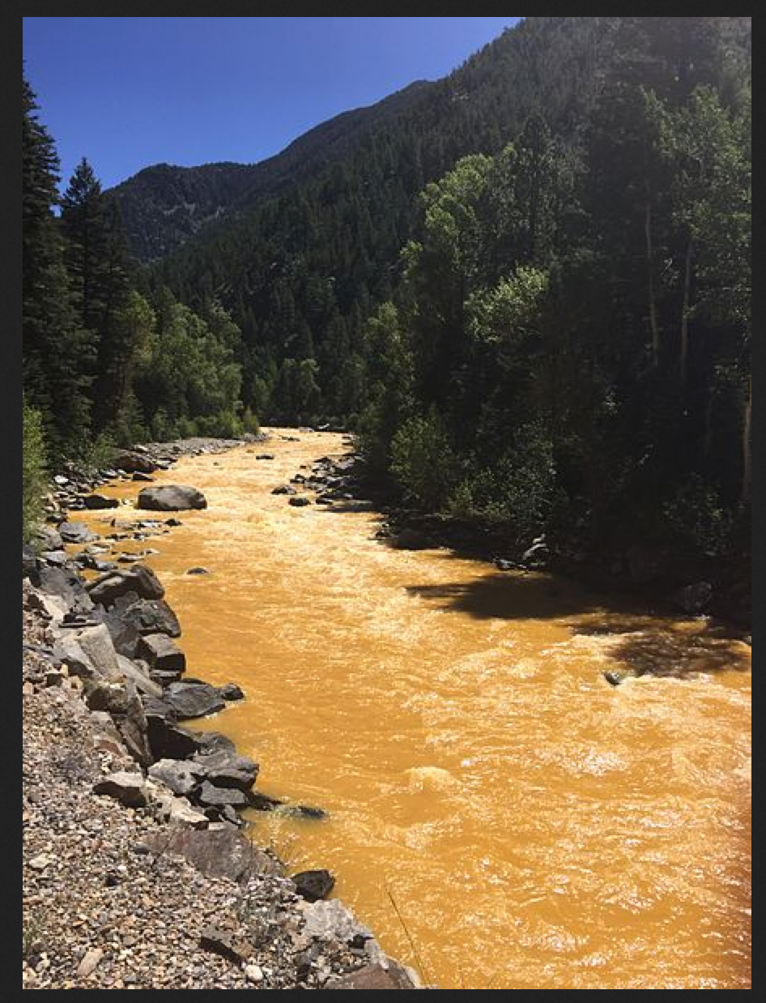
How Your Measurements Can Help
Electrical conductivity provides a general measurement of stream water quality. After baseline measurements have been collected, significant changes in conductivity can be an indication of pollution or discharge into a water body. For instance, an oil spill might lower electrical conductivity, and discharged sewage may raise the electrical conductivity.
A low number from 10 to about 200 µS/cm, could be considered to be drinking-water quality. Specific conductance measurement of mine waters in a Colorado study range from 100 to 38,000 µS/cm (USGS 2013).
The Animas River between Silverton and Durango in Colorado, USA, within 24 hours of the 2015 Gold King Mine waste water spill. Credit: Riverhugger, Wikipedia Commons.

Slide 9

Let’s do a quick review before moving onto data collection! Question 1
Which is considered a master variable of water, that is, a changeable property of water that tends to have an effect on other properties being measured?
Electrical Conductivity
Temperature
What is the answer?

Slide 10
Let’s do a quick review before moving onto data collection! Answer to Question 1
Which is considered a master variable of water, that is, a changeable property of water that tends to have an effect on other properties being measured?
Electrical Conductivity
Temperature – Correct! ☺
Were you correct?

Slide 11
Let’s do a quick review before moving onto data collection! Question 2
A water body with a low electrical conductivity would have:
Higher total dissolved solids
A high salinity
Lower total dissolved solids
A and B only
What is the answer?

Slide 12
Let’s do a quick review before moving onto data collection! Answer to Question 2
A water body with a low electrical conductivity would have:
Higher total dissolved solids
A high salinity
Lower total dissolved solids- ☺ correct!
A and B only
Were you correct?

Slide 13
Let’s do a quick review before moving onto data collection! Question 3
Significant changes in electrical conductivity of a water body could be evidence for:
Pollution or discharge upstream from the sampling site
Increase dissolved solids in a water body
A downed power wire
All of the above
A and B only
What is the answer?

Slide 14
Let’s do a quick review before moving onto data collection! Answer to Question 3
Significant changes in electrical conductivity of a water body could be evidence for:
Pollution or discharge upstream from the sampling site
Increase dissolved solids in a water body
A downed power wire
All of the above
A and B only- ☺ correct!
Were you correct?
Let’s move to GLOBE data collection!

Slide 15

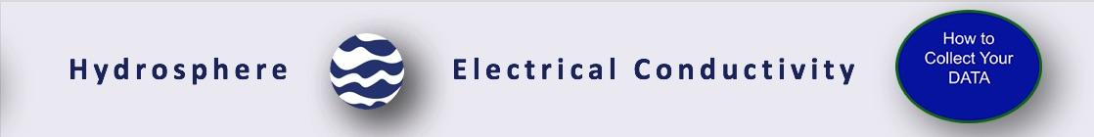
Electrical Conductivity Protocol:
What do you need to start?
When | Weekly, if possible
Where | Hydrosphere Study Site
Time Needed | 10 minutes
Prerequisites | Defined the Hydrosphere Study Site
Key Instrument | Electrical Conductivity Meter
Skill Level | All
References | Electrical Conductivity Field Guide Protocol Hydrosphere Investigation Data Sheet

Slide 16
Simultaneous or Prior Investigations Required
The Electrical Conductivity Protocol will allow you to determine the capacity of your water to transmit an electrical current. This protocol is conducted at your GLOBE Study Site. You will need to define your GLOBE Study Site where you will conduct your Hydrosphere Investigation prior to beginning this protocol. The Hydrosphere Investigation Data Sheet is used to record all the hydrosphere measurements, including alkalinity. You will also want to map your Hydrosphere Site at some point. Since there is a close connection between alkalinity and pH, it would be helpful to collect pH data along with alkalinity. Additionally, atmospheric measurements of temperature and precipitation are helpful in interpreting the data.
Find your documents here:
Electrical Conductivity Data Sheet
GLOBE Study Site Definition Sheet
Hydrosphere All Protocols Data Sheet
Mapping your Hydrosphere Study Site Field Guide

Slide 17
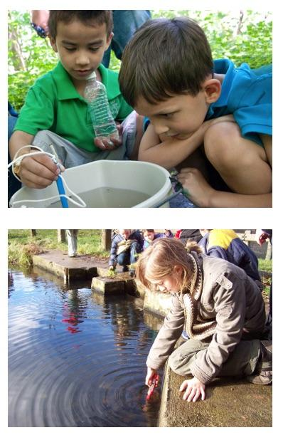
Overview of the Electrical Conductivity Protocol
Your task is to measure the electrical conductivity of your water sample. Before you begin, make sure that the water conditions are right:
All water should be brought to room temperature (20 ̊ - 30 ̊ C) for testing, even if the manufacturer claims that the meter is temperature compensated. It is very important to take the temperature of the water when doing the conductivity measurement.
If the water at your Hydrosphere Study Site is not between 20 ̊ - 30 ̊ C, you need to either let the water warm in the sample bucket or separate container while students take other measurements at the hydrosphere study site, or collect a sample in a water bottle and take back to the classroom. After the water reaches 20 ̊ - 30 ̊ C, then you can take the conductivity measurement.
Never immerse the meter totally in water. Only the part indicated in the instructions for the meter should be immersed in water.
Most conductivity meters cannot measure the high conductivity characteristic of salt waters.

Slide 18
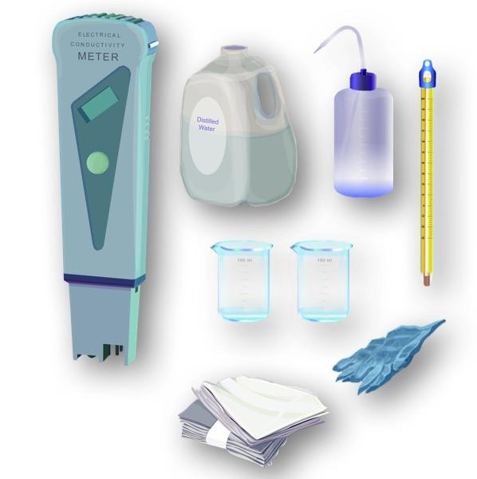
Assemble Equipment for Calibration of the EC Instrument
Your task is to measure the electrical conductivity of your water sample. Before you begin, make sure that the sample has the right temperature and salinity to produce an accurate reading.
You will need:
Electrical conductivity meter
Thermometer
Distilled water in a wash bottle
Paper towels or soft tissue
2 100-mL beakers or plastic cups
Protective gloves
Small screwdriver
Standard Calibration solution
Document Links:
Electrical Conductivity Field Guide Protocol
Electrical Conductivity Data Sheet
Hydrosphere All Protocols Data Sheet

Slide 19
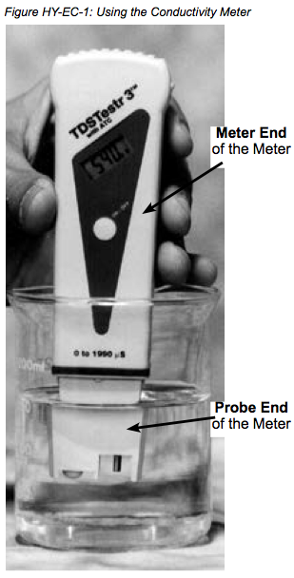

Electrical Conductivity Meter
Your task is to measure the electrical conductivity of your water sample. Before you begin, make sure that the sample has the right temperature and salinity to produce an accurate reading.
The electrical conductivity of a water body can be determined using a portable electrical conductivity meter.
Conductivity is measured with an electrical conductivity meter. Voltage is applied between two electrodes as the probe end of the meter is immersed in the sample water. The drop in voltage caused by the resistance of the water is used to calculate the conductivity per centimeter.
There are several manufacturers and models of conductivity meters. Some models may measure conductivity in increments of 10 µS / cm; others in increments of 1.0 µS /cm. If your model measures in increments of 10 µS /cm, you will have to calibrate it as closely as you can to the standard solution.
Pay close attention to your calibration procedure. Without the calibration step your electrical conductivity data will not be meaningful or comparable to data collected by others!

Slide 20
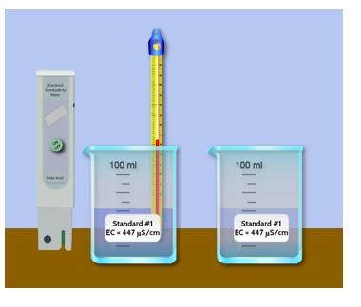
Calibration of the Electrical Conductivity Probe (1/2)
Before you take electrical conductivity measurements, you need to ensure that your meter is calibrated and able to take accurate measurements.
Here are the steps:
Bring the standard solution to room temperature (about 25° C).
Pour standard solution into each of the two clean 100-mL beakers or cups to a depth of about 2 cm.
Remove the cap from the electrical conductivity tester and press the On/Off button to turn it on.
Rinse the electrode at the bottom of the tester with distilled water in the wash bottle.
Gently blot dry with a tissue.
Do not rub or stroke the electrode while drying as it may damage the probe.

Slide 21
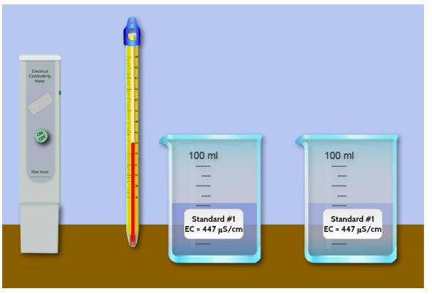
Calibration of the Electrical Conductivity Probe (2/2)
Here are the steps:
Put the probe end of the meter into the first beaker of standard. Stir gently for 2 seconds to rinse off any distilled water.
Take the meter out of the first beaker. DO NOT rinse with distilled water.
Put it into the second beaker.
Stir gently, and then wait for the numbers to stop changing.
If the display does not read the value of your standard solution, you must adjust the instrument to read this number. (For most meters, you can use a small screwdriver to adjust the calibration screw on the meter until the display reads the standard value).
Rinse the electrode with distilled water and blot it dry. Turn off the meter and put the cap on to protect the electrode.
Pour the standard from the beakers into a waste container. Rinse and dry the beakers. You are done with calibration of your EC meter! Now you are ready to measure the Electrical Conductivity of your sample.

Slide 22
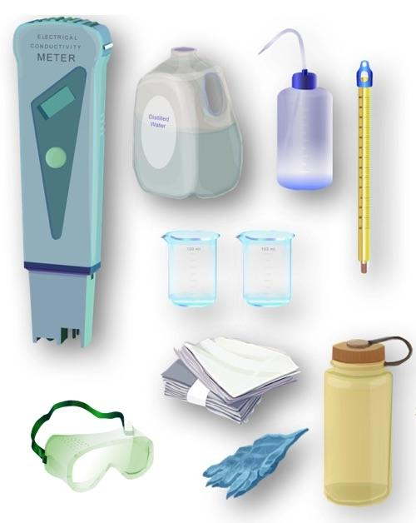
Assemble Equipment for Electrical Conductivity Protocol
You will need:
Electrical conductivity meter
Thermometer
Distilled water in a wash bottle
Paper towels or soft tissue
2 100-mL beakers or plastic cups
Protective gloves and eyewear
Small screwdriver
Links:
Electrical Conductivity Field Guide Protocol
Electrical Conductivity Data Sheet
Hydrosphere All Protocols Data Sheet

Slide 23
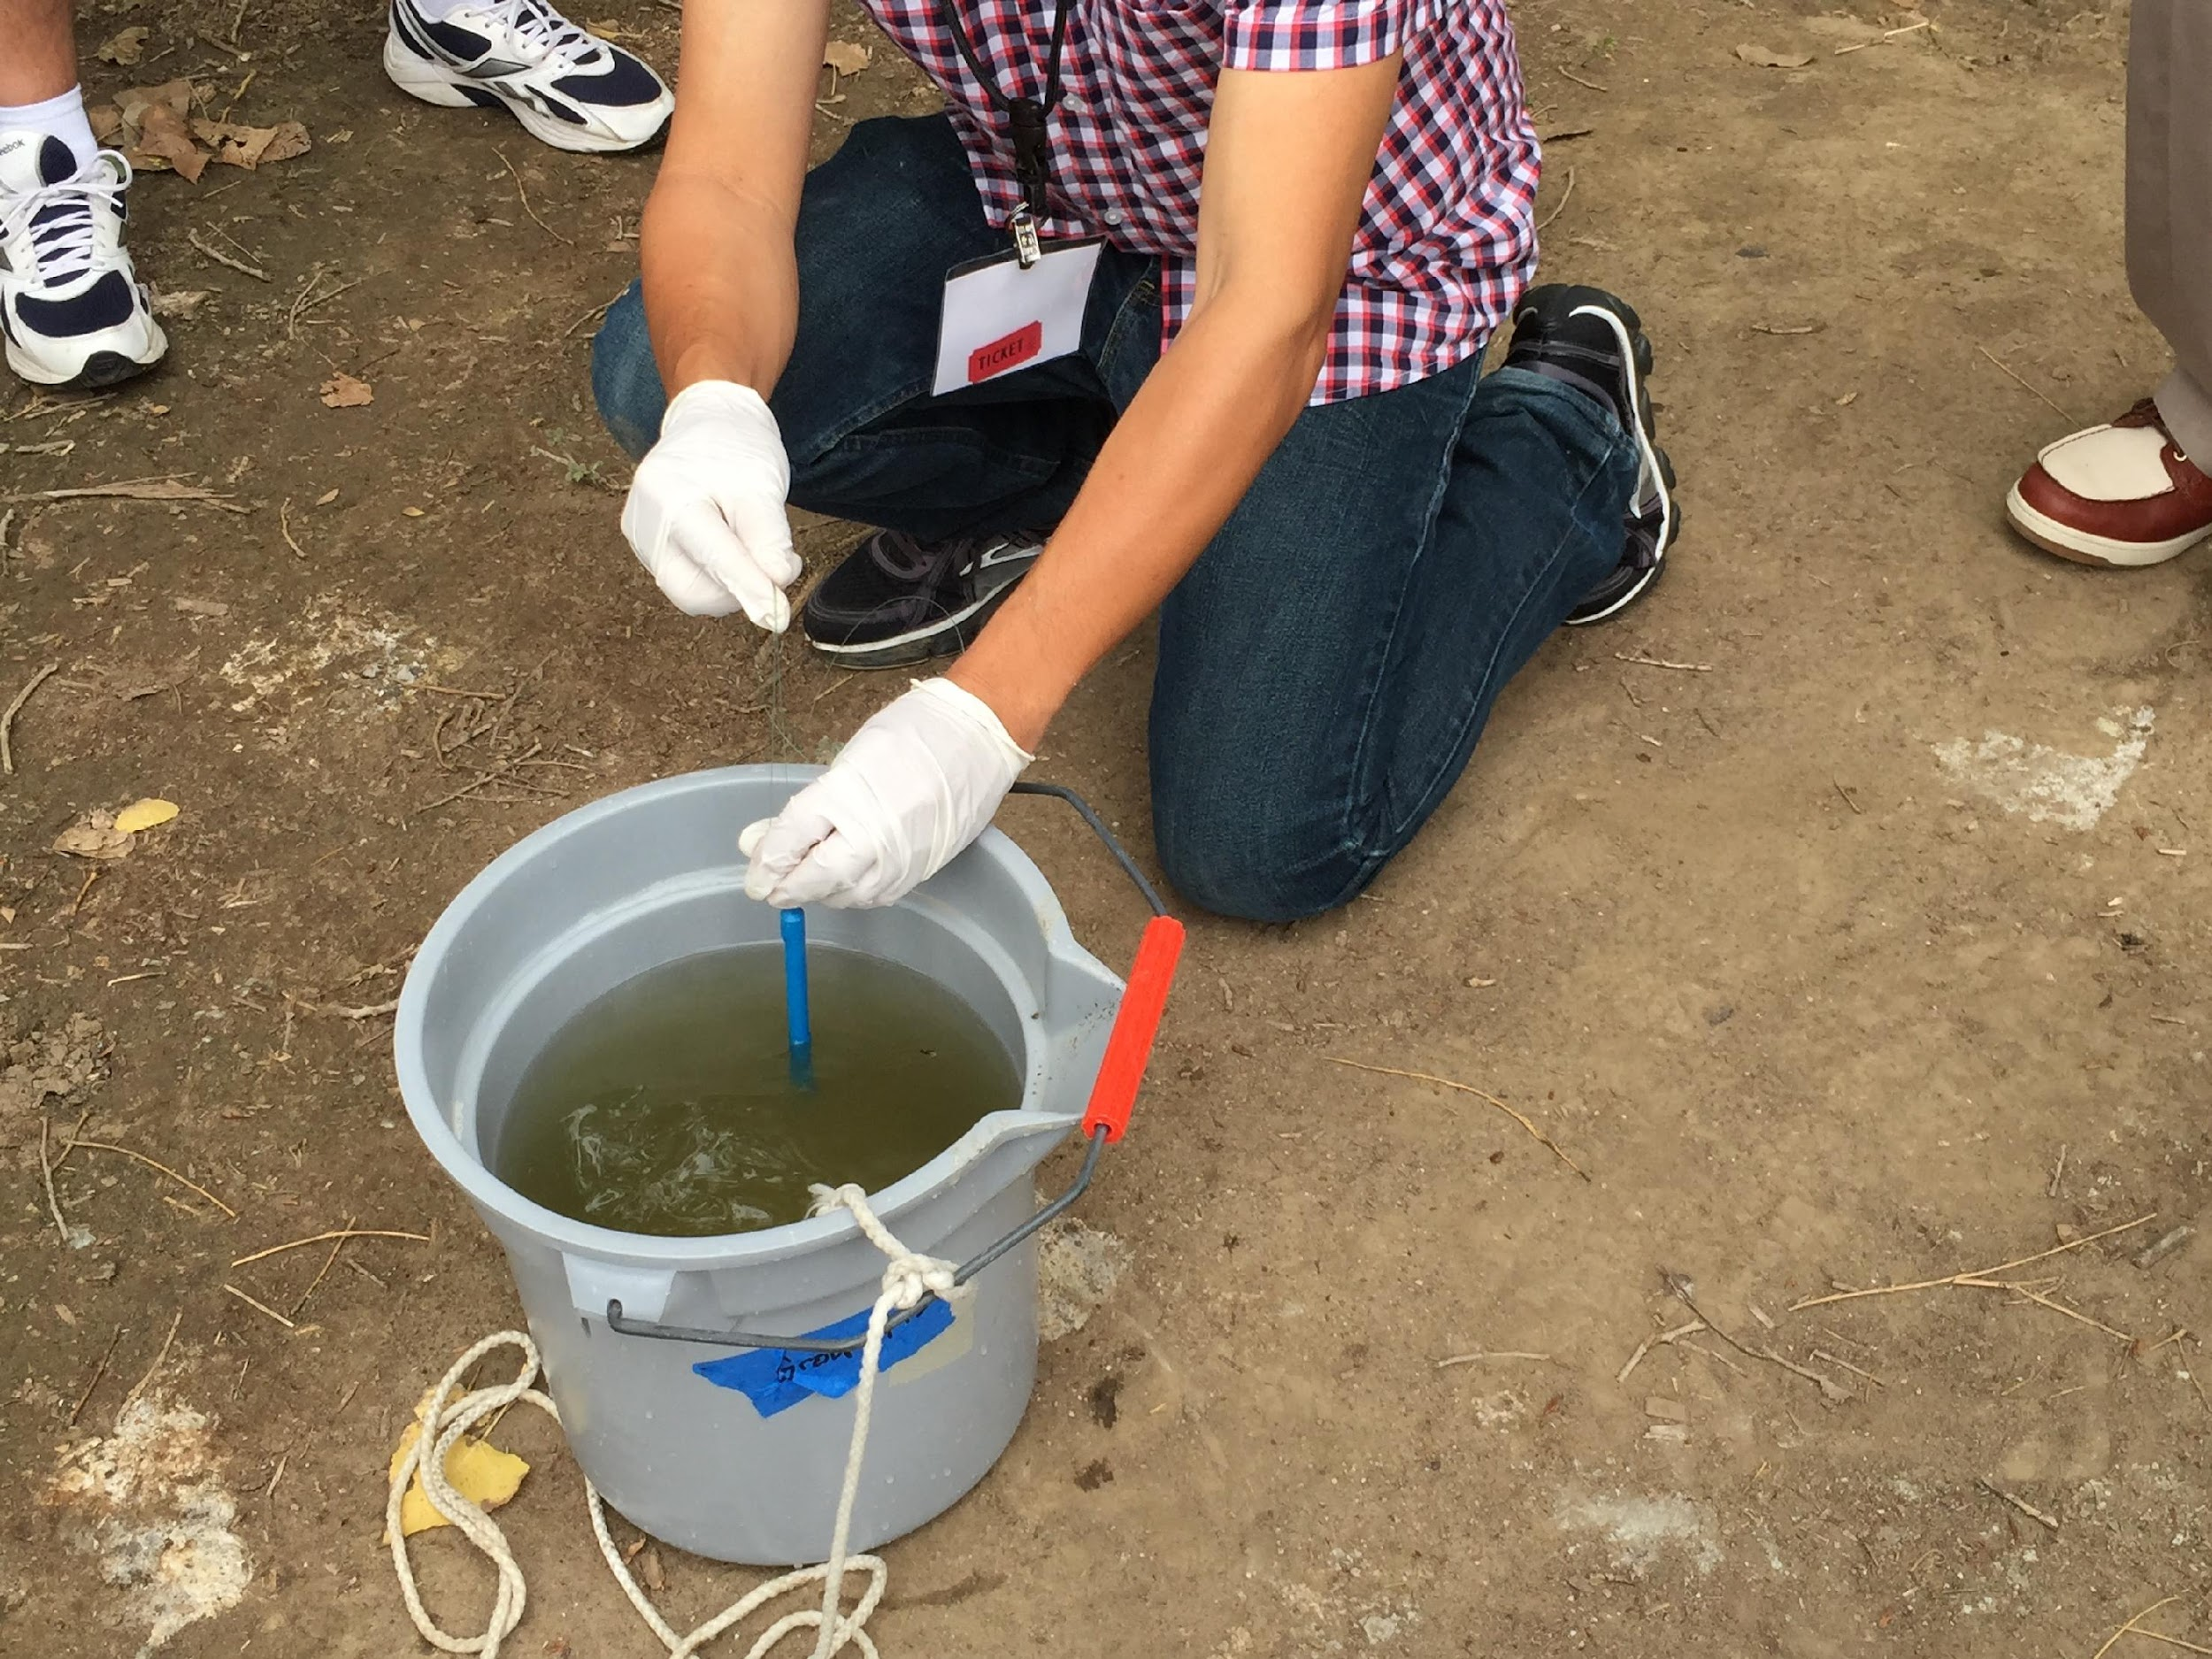
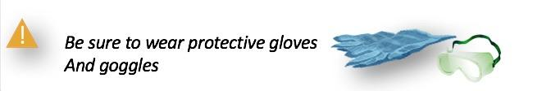
Electrical Conductivity Protocol (1/3)
Fill out the top portion of the Hydrosphere Investigation Data Sheet.
Put on protective gloves.
Record the temperature of the water to be tested. If water is between 20 ̊ – 30 ̊ C, go to step 5.
4. If your water sample is either
below 20 ̊ C or above 30 ̊ C, fill a clean sample bottle (600-700 mL) with the water to be tested. Cap and bring back to the classroom. Allow the water to reach 20 ̊ – 30 ̊ C, record the temperature and then proceed to step 5.

Slide 24
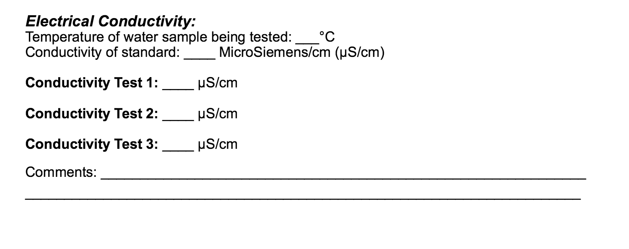
Electrical Conductivity Protocol (2/3)
5. Rinse two 100-mL beakers two times with sample water.
6. Pour about 50 mL of water to be tested into two 100-mL beakers.
7. Remove the cap from the probe end of the meter. Press the On/Off button to turn it on.
8. Rinse the probe with distilled water. Blot it dry. Do not rub or stroke the electrode while drying.
9. Put the probe in the water sample in the first beaker. Stir gently for a few seconds.
10. Take the probe out of the first beaker. Shake gently to remove excess water, then put it into the second beaker. Do not rinse with distilled water.
11. Leave the probes submerged for at least one minute. When the numbers stop changing, record the value on the Hydrosphere Investigation Data Sheet by Conductivity Test 1.
Do not let the probe end of the meter rest on the bottom of the beaker or touch the sides.

Slide 25
Electrical Conductivity Protocol (3/3)
12. Have two other students repeat the measurement using fresh beakers of water each time. The meter does not need to be calibrated for each student. Record these measurements as Observations 2 and 3.
13. Calculate the average of the three observations.
14. Each of the observations should be within 40 µS /cm of the average. If one or more of the values is not within 40 µS /cm, pour a fresh sample and repeat the measurements and calculate a new average.
15. Rinse the probe with distilled water, blot dry, and put the cap on the meter. Rinse and dry the beakers and sample bottle.
You have completed the Electrical Conductivity measurement!

Slide 26
Let’s do a quick review before moving onto GLOBE Data Entry! Question 4
What is a critical step you must complete before doing the Electrical Conductivity measurement on your water body?
Determine that the water sample is at a temperature of 20 ̊ - 30 ̊ C
Calibrate your Electrical Conductivity Meter
Both A and B
What is the answer?

Slide 27
Let’s do a quick review before moving onto GLOBE Data Entry! Answer to Question 4
What is a critical step you must complete before doing the Electrical Conductivity measurement on your water body?
Determine that the water sample is at a temperature of 20 ̊ - 30 ̊ C
Calibrate your Electrical Conductivity Meter
Both A and B- ☺ correct!
Were you correct?

Slide 28
Let’s do a quick review before moving onto GLOBE Data Entry! Question 5
According to the GLOBE protocol, each of the 3 replicate electrical conductivity observations should be within ___ of the average to be considered valid.
within .10 µS /cm
within 1.0 µS /cm
within 10.0 µS /cm
within 40 µS /cm
What is the answer?

Slide 29
Let’s do a quick review before moving onto GLOBE Data Entry! Answer to Question 5
According to the GLOBE protocol, each of the 3 replicate electrical conductivity observations should be within ___ of the average to be considered valid.
within .10 µS /cm
within 1.0 µS /cm
within 10.0 µS /cm
within 40 µS /cm ☺ Correct!
Were you correct?

Slide 30
Let’s do a quick review before moving onto GLOBE Data Entry! Question 6
Pure water:
Has a high electrical conductivity, and high total dissolved solids
Is not a good conductor of electricity
Is not a good conductor of electricity except above or below the 20 ̊ - 30 ̊ C
What is the answer?

Slide 31
Let’s do a quick review before moving onto GLOBE Data Entry! Answer to Question 6
Pure water:
Has a high electrical conductivity, and high total dissolved solids
Is not a good conductor of electricity ☺ Correct!
Is not a good conductor of electricity except above or below the 20 ̊ - 30 ̊ C
Were you correct?
Let’s move on to GLOBE Data Entry and Visualization!

Slide 32

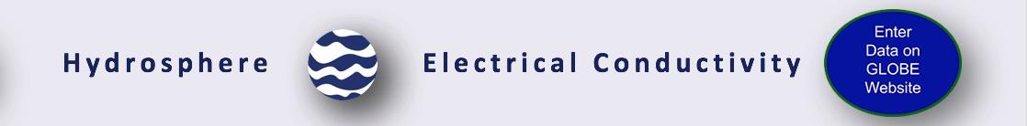
Hydrosphere Site Creation
If this is your first time making hydrosphere observations at this location, you will need to create a new Hydrosphere study site before entering data.
To do this, please review the Introduction to Hydrosphere training.

Slide 33
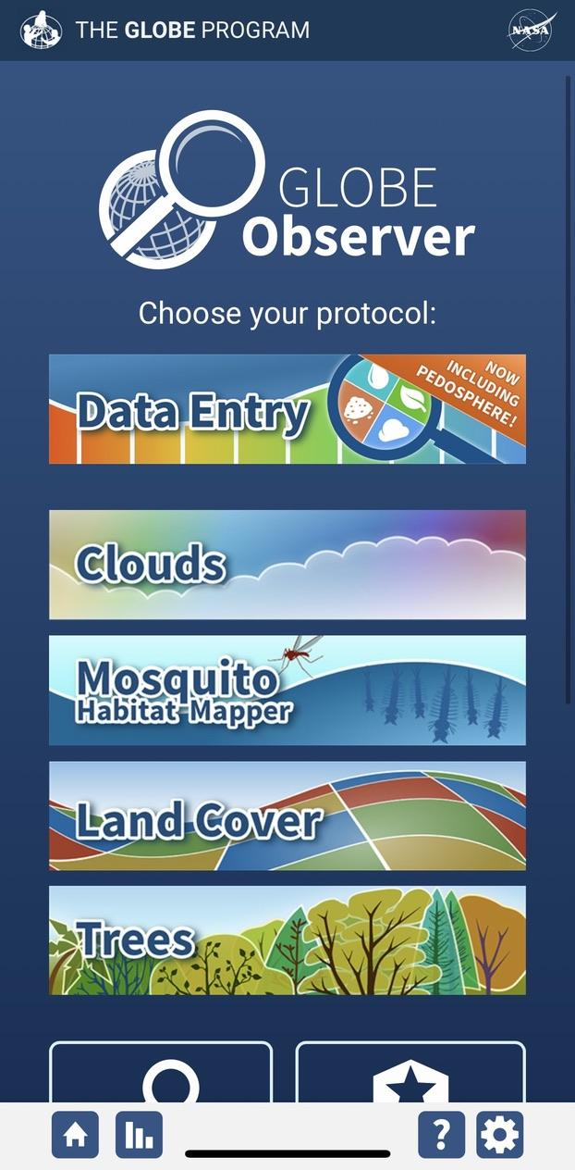
Submit Your Data to GLOBE
1.Desktop Data Entry: Log environmental data directly on the GLOBE website.
2.GLOBE Observer App: The app allows users to enter data directly from an iOS or Android device for any GLOBE protocol.

Slide 34
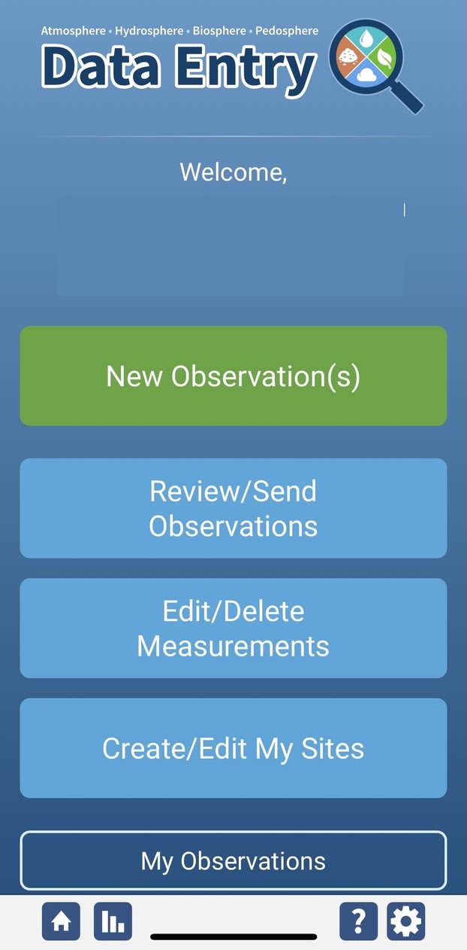
Electrical Conductivity Protocol Data Entry
To enter data, first return to GLOBE Observer main page by clicking the home button in the bottom left.
Select “Data Entry”.
Next, click “New Observation(s)”

Slide 35
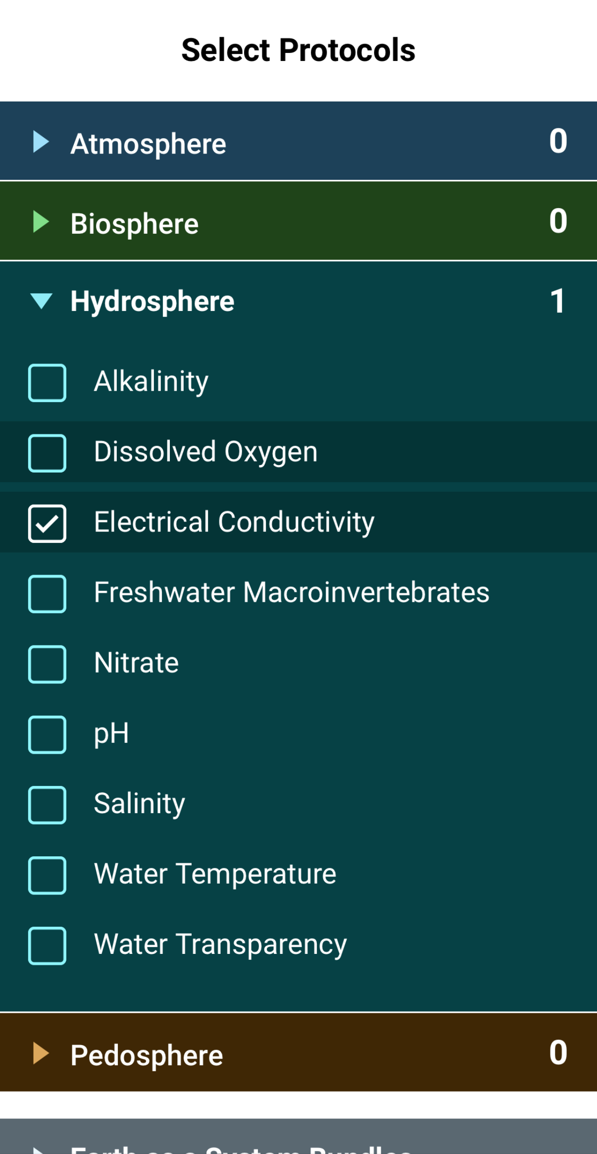
Electrical Conductivity Protocol Data Entry
Select Electrical Conductivity from the list of Hydrosphere protocols. Click Continue at the bottom of the screen.

Slide 36
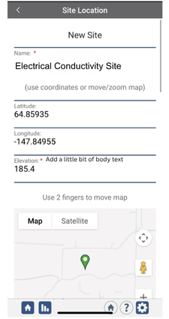
Electrical Conductivity Protocol Site Information
If you have not already created a Hydrosphere site, create one now.
Click “New Site” at the bottom of the site location screen and choose a name for your new site.

Slide 37
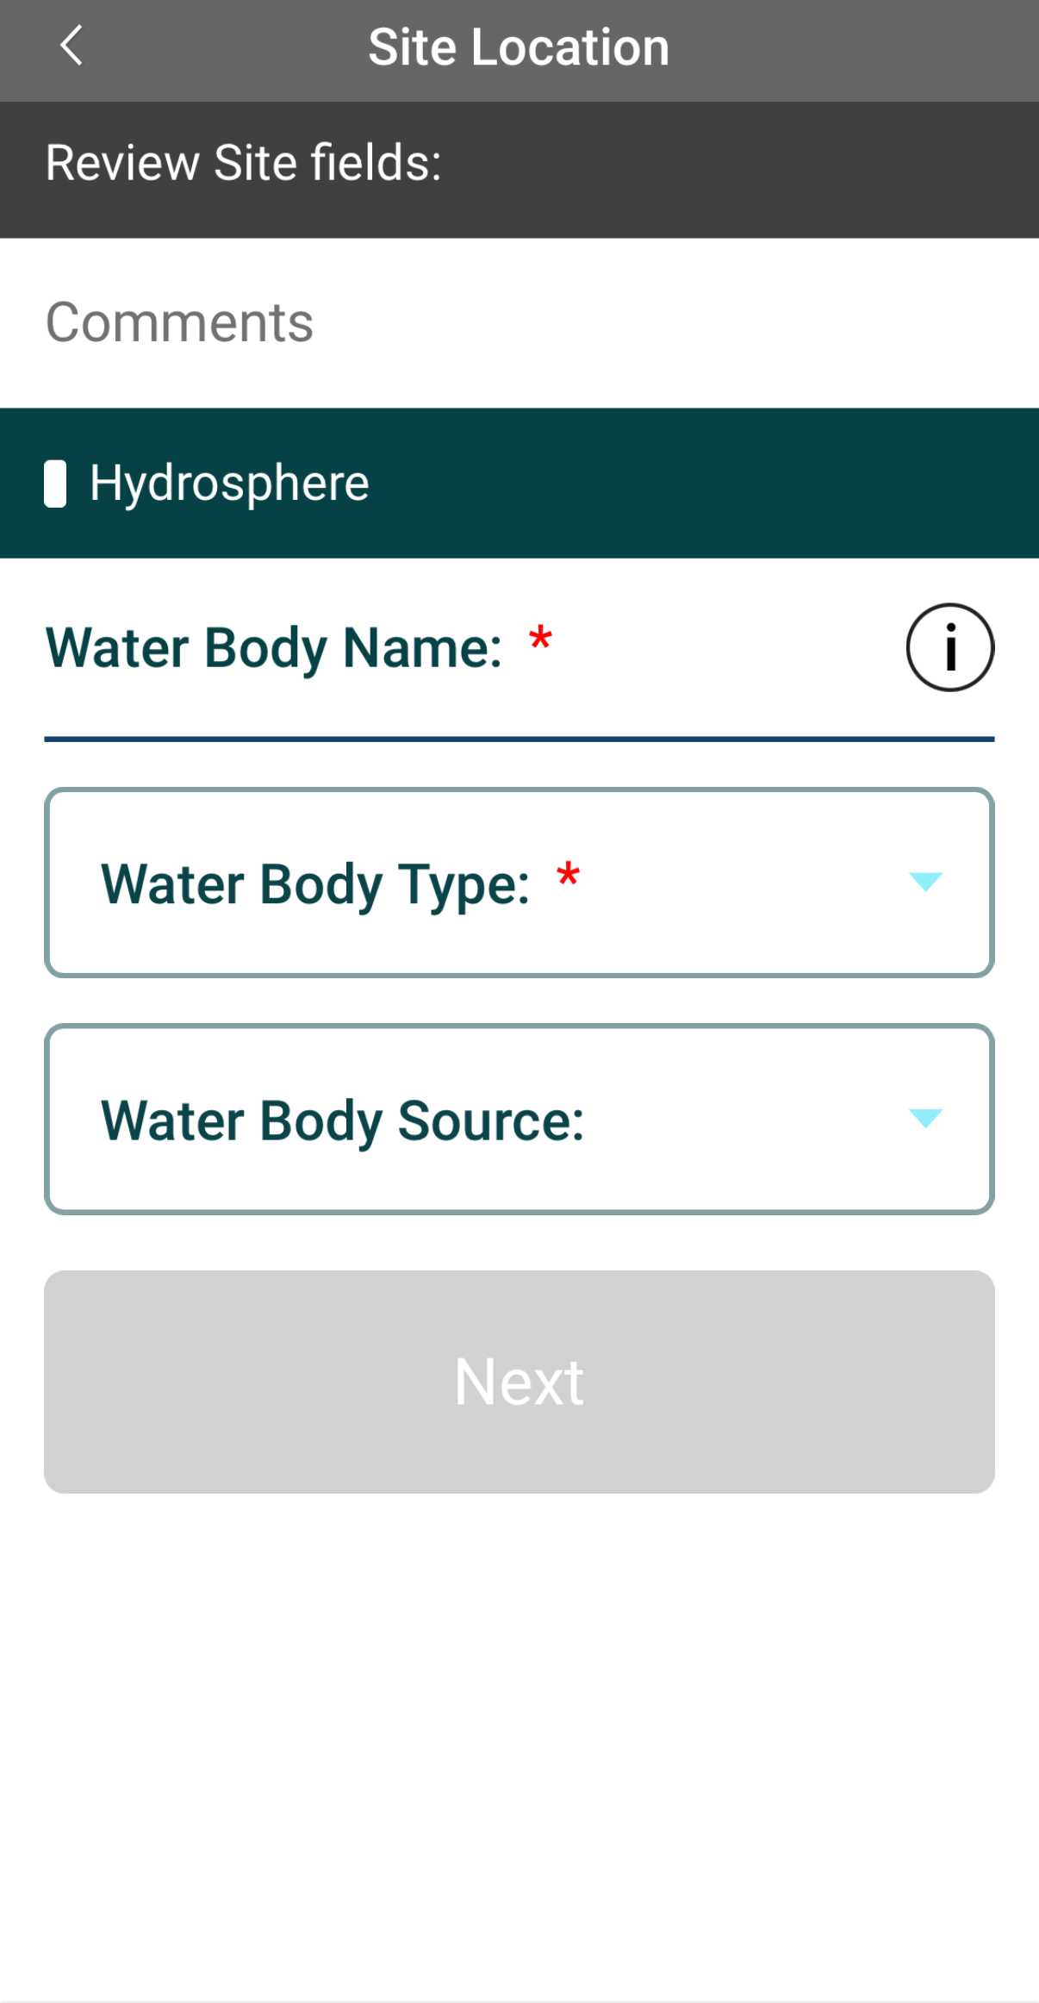
Electrical Conductivity Protocol Site Information
Enter the Water Body Name.
Select the Water Body Type and Water Body Source from the dropdown list of options.

Slide 38
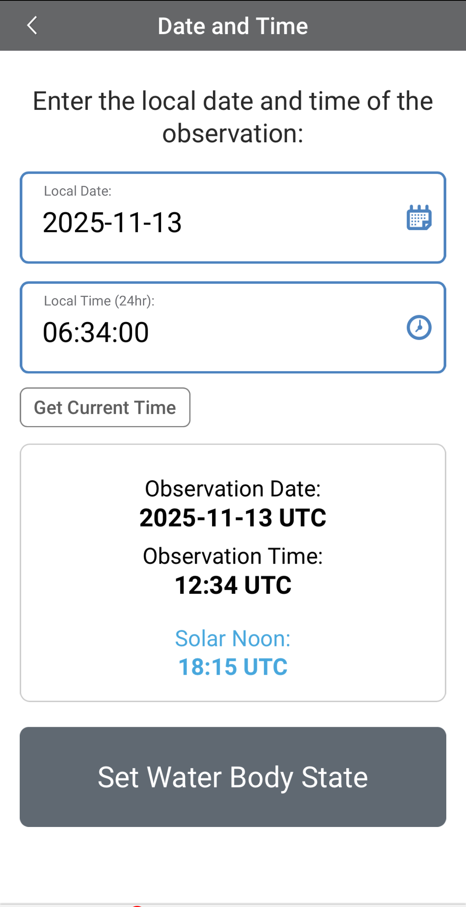
Entering Measurement Data
Enter the date and time you took the measurements.
Once you enter the date, select Set Water Body State to enter your data.

Slide 39
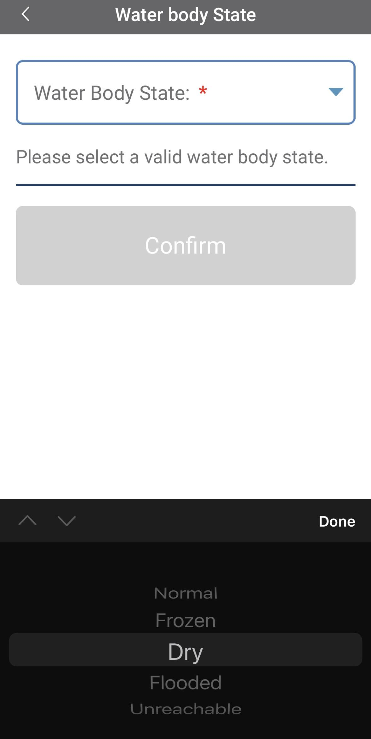
Enter the Water Body State
Select the Water Body State from the dropdown list of options.

Slide 40
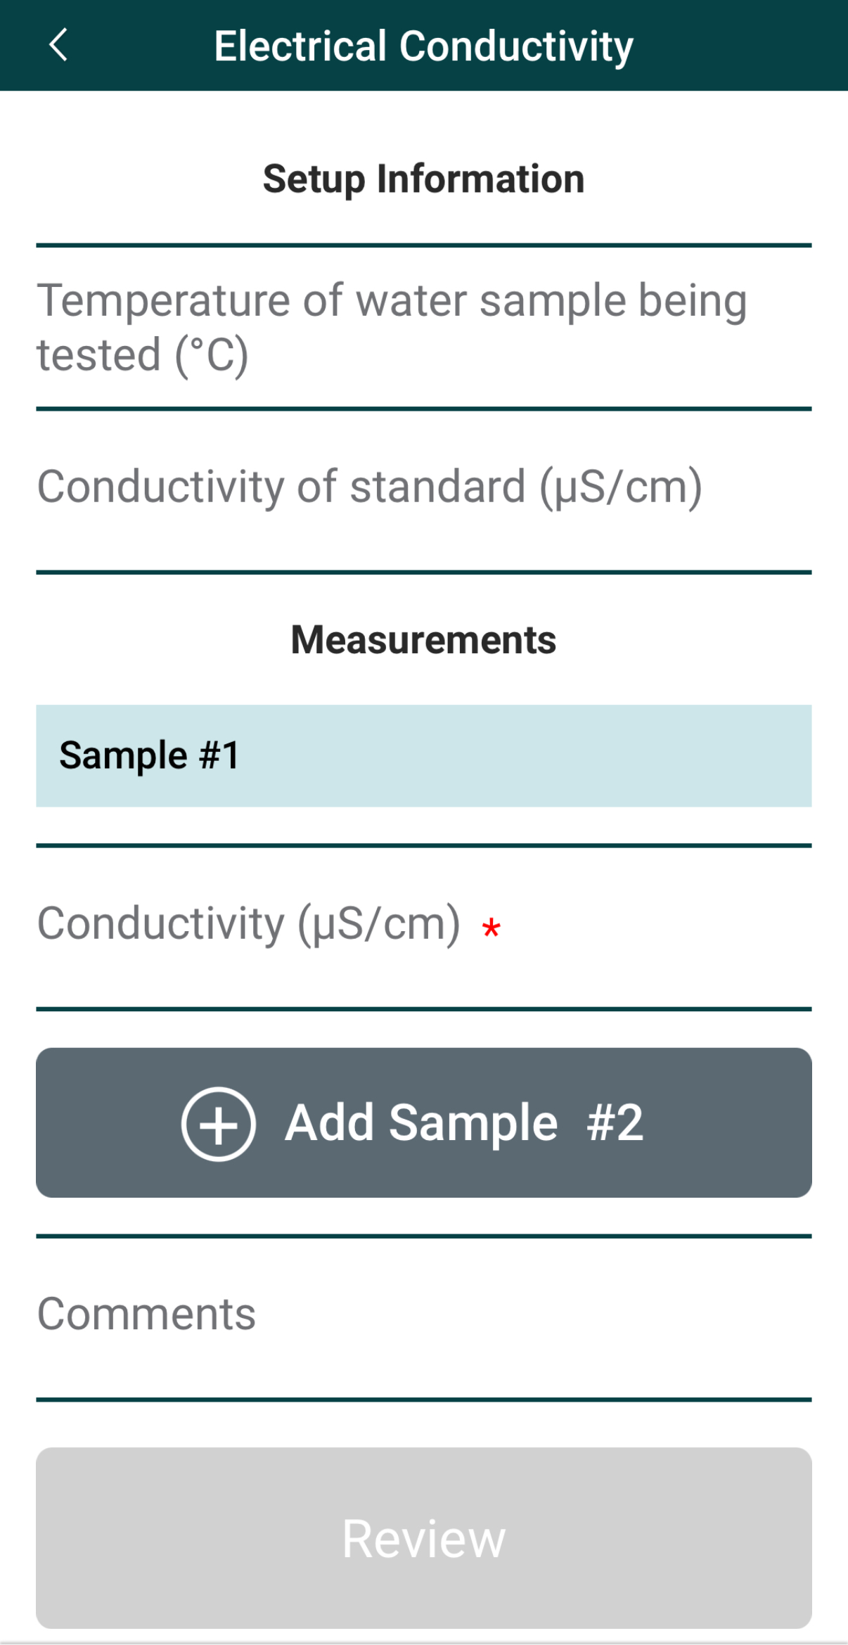
Enter Electrical Conductivity Data
Enter the temperature of the water sample being tested (℃) and the conductivity of the standard.
Enter the conductivity measurement of the sample.

Slide 41
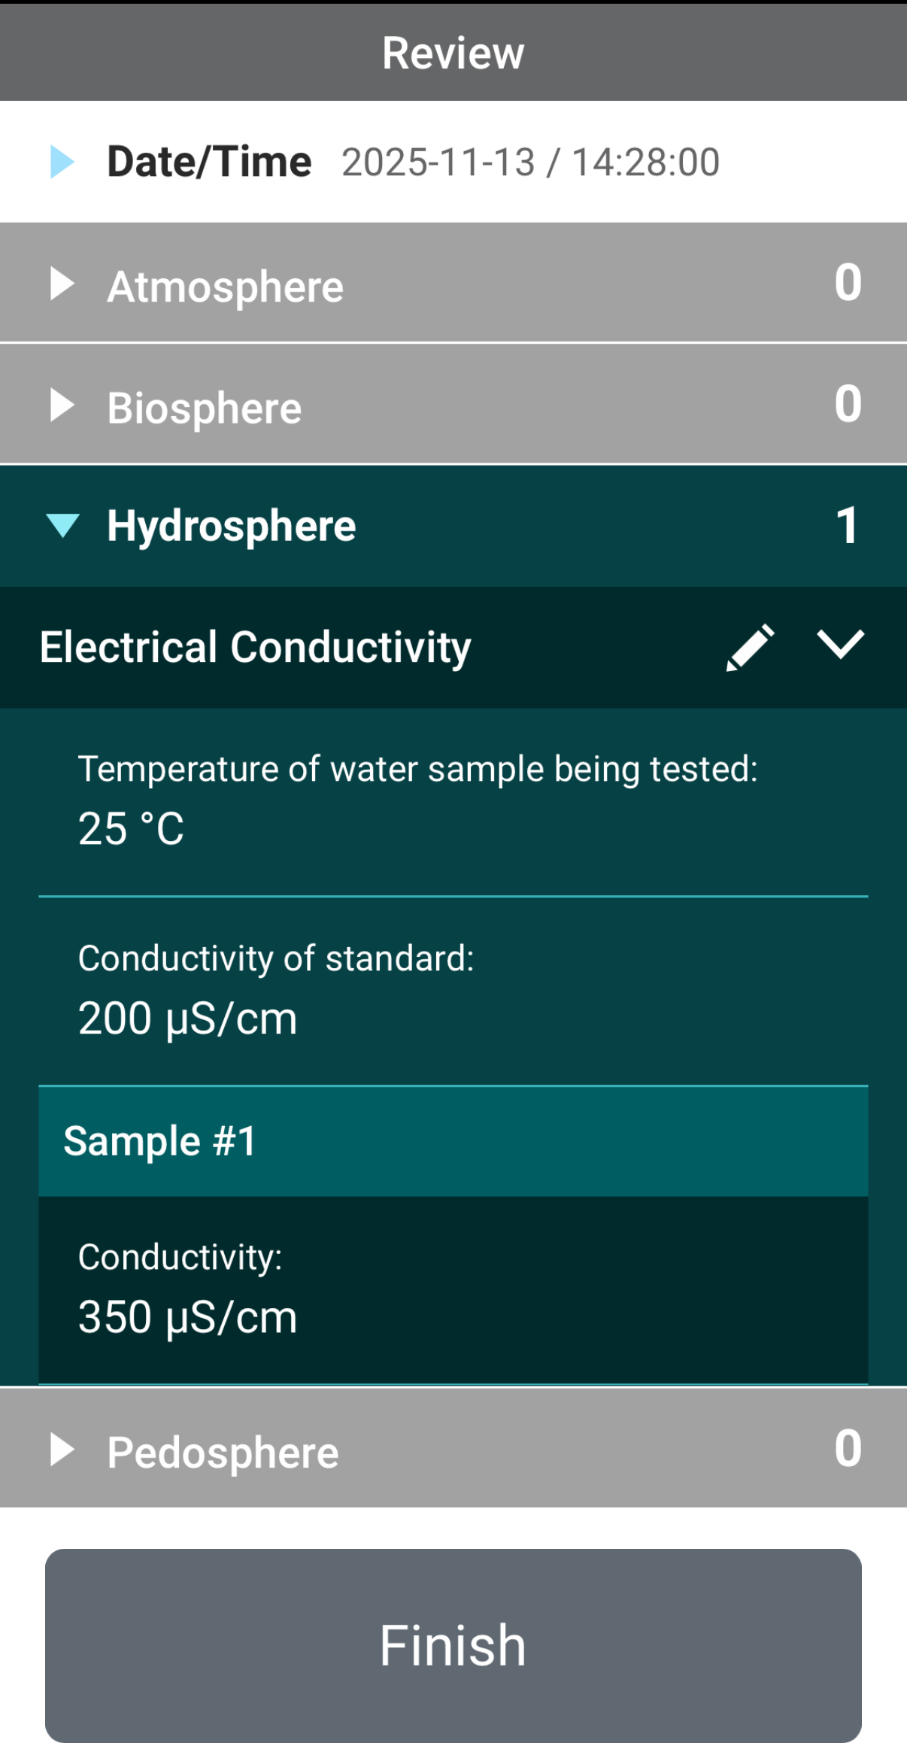
Review Data Entry and Send Data
Review the data you entered and check for errors.
When complete, select Finish to complete the send the observation to GLOBE.

Slide 42
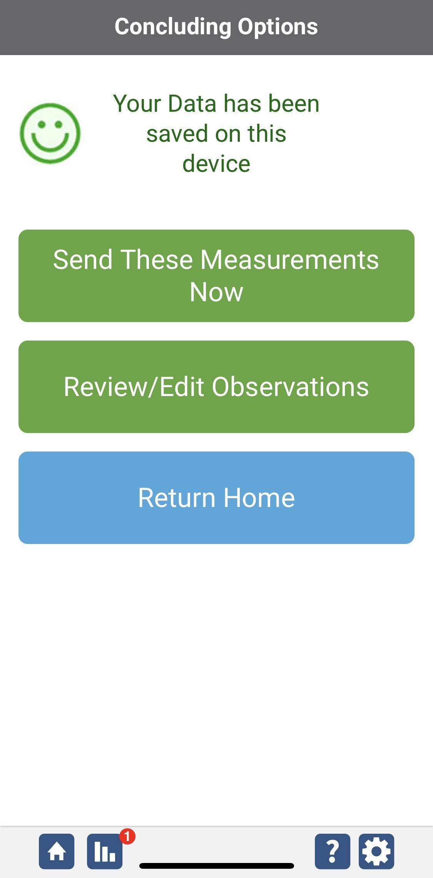
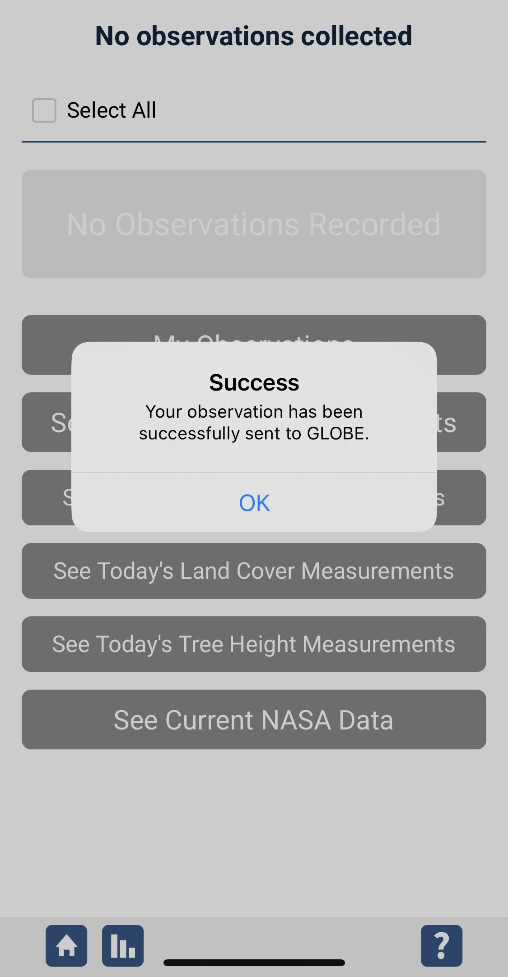
Data System Responses
If your observations are within the appropriate ranges, you will see a green smiley face.
You can review or edit your observation if needed.
When ready, select “Send these measurements now” to send your data to GLOBE. When it has been sent, you will see a “Success” message.

Slide 43

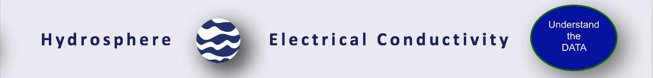
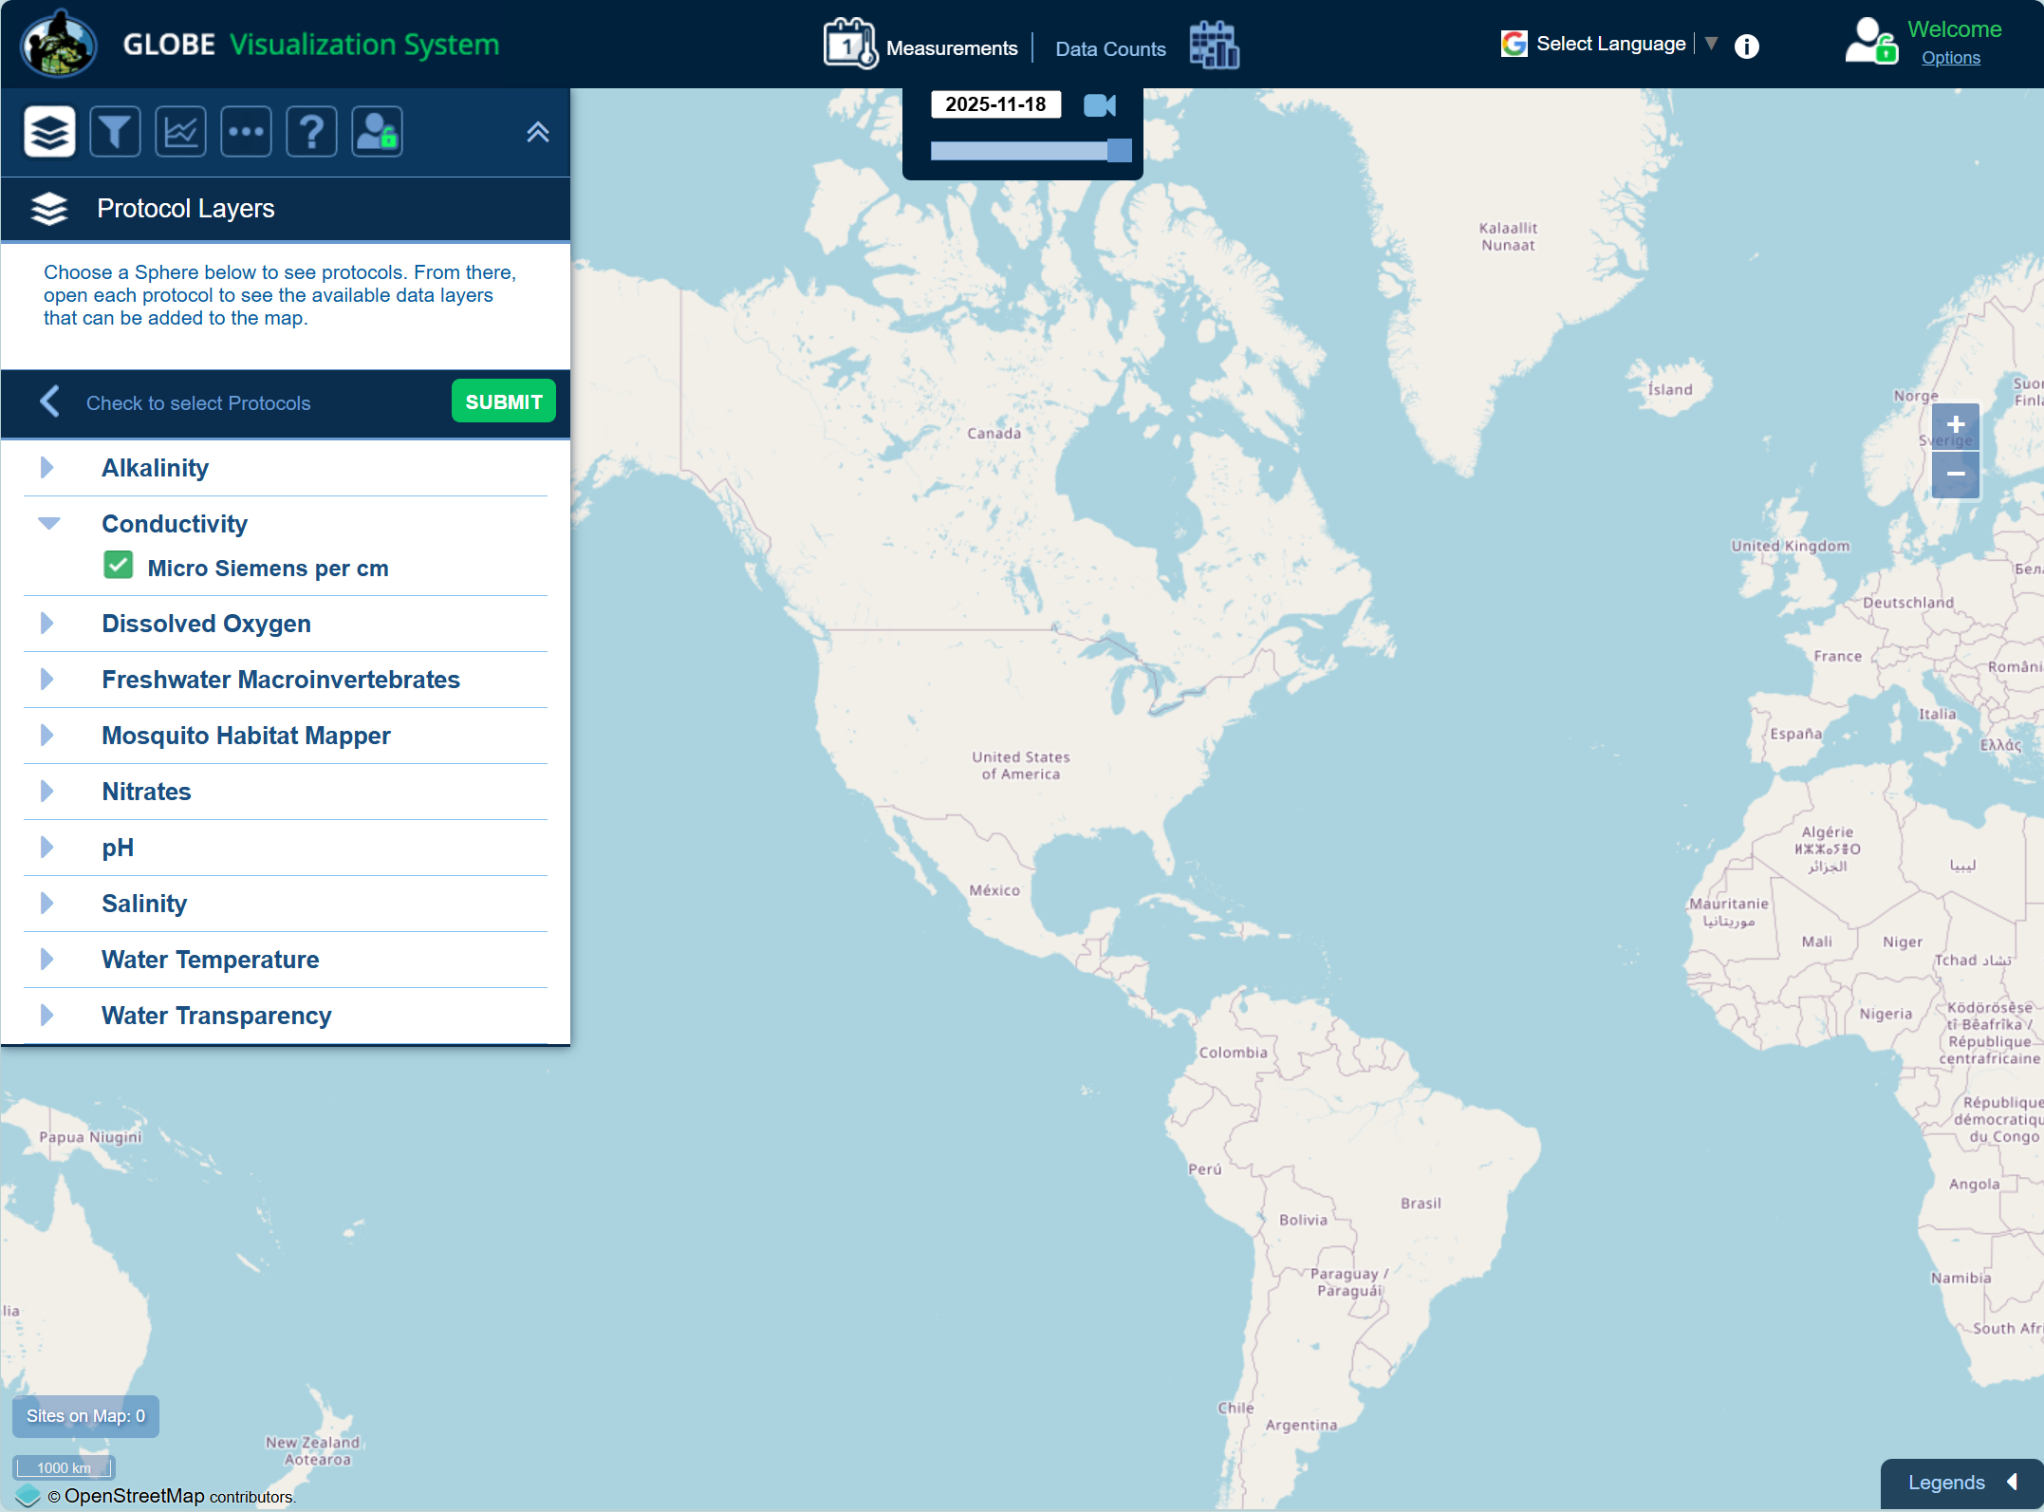
Visualize and Retrieve Water Electrical Conductivity Data-Step 1
GLOBE provides the ability to view and interact with data measured across the world. Select our visualization tool to map, graph, filter and export EC data that have been measured across GLOBE protocols since 1995. Here are screenshots steps you will use when you use the visualization tool:
Link to step-by-step tutorials on Using the Visualization System will assist you in finding and analyzing GLOBE data: PDF version

Slide 44
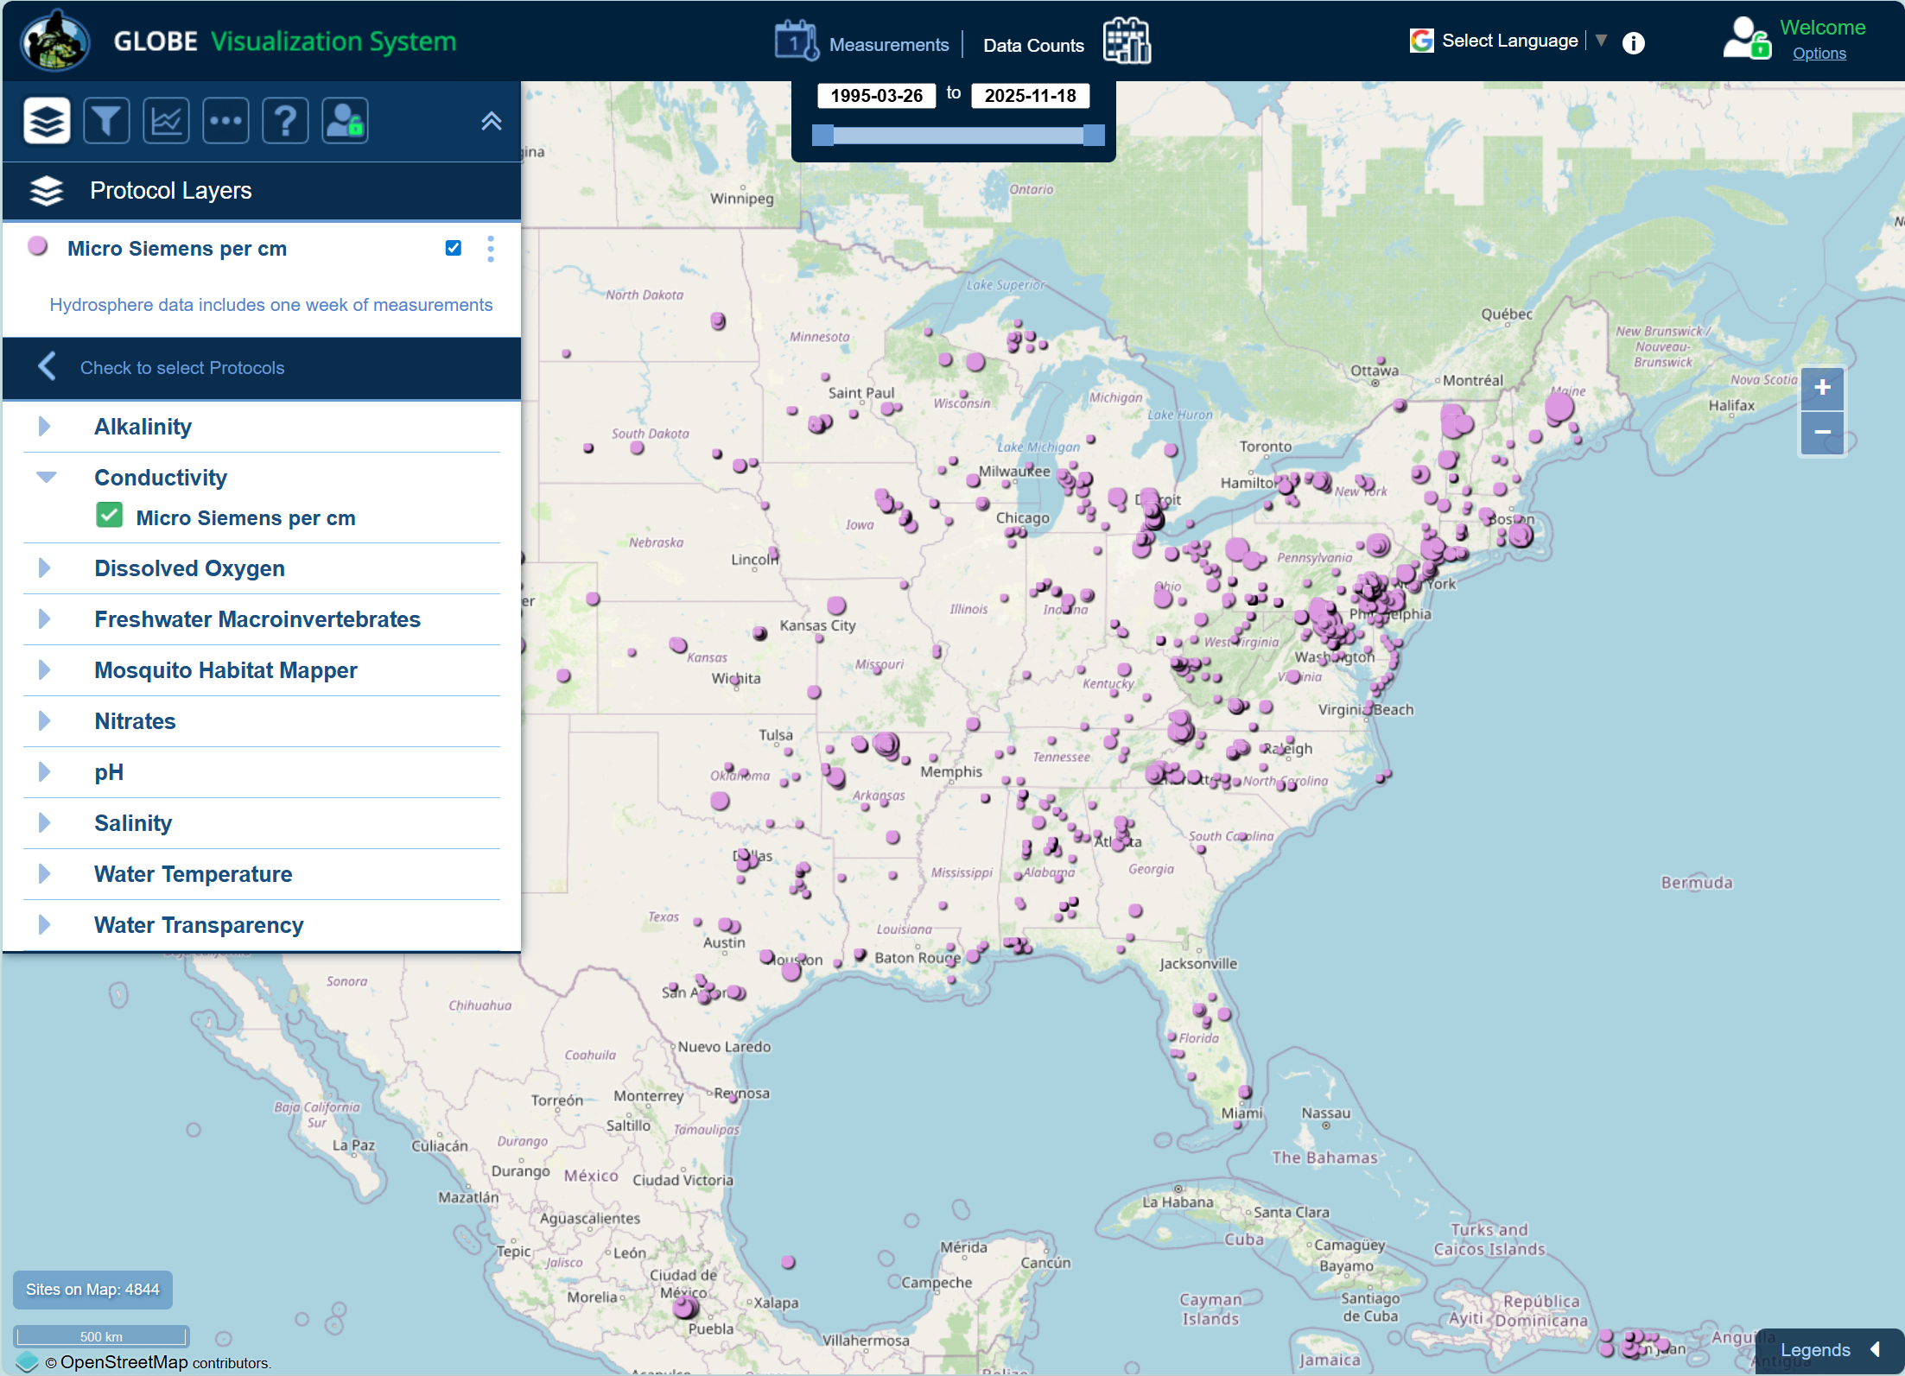
Visualize and Retrieve Water Electrical Conductivity Data- Step 2
Select the date for which you need electrical conductivity data, add layer and you can see where data is available.

Slide 45
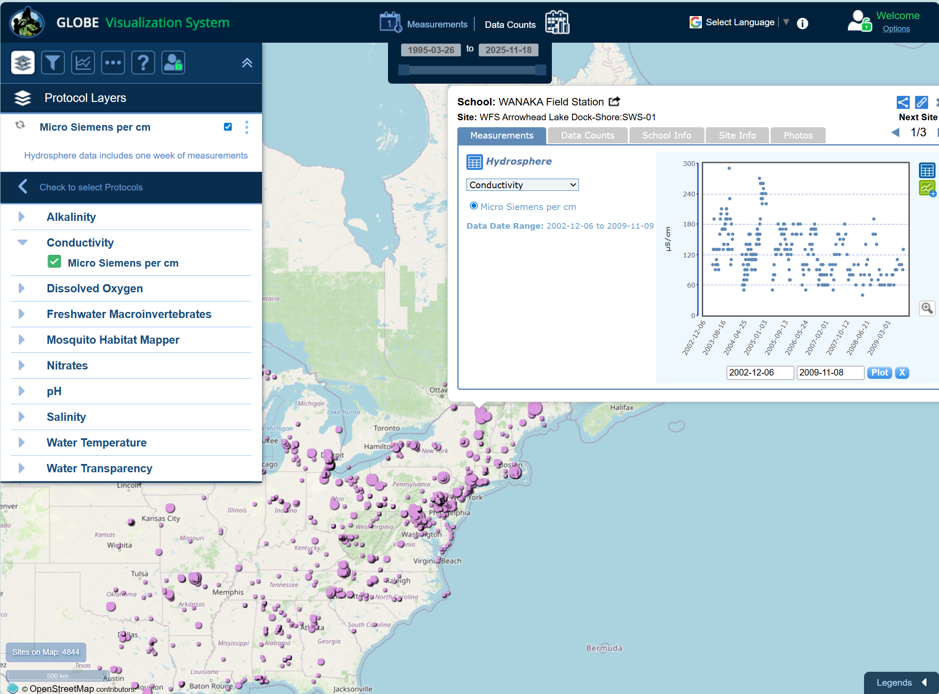
Visualize and Retrieve Water Electrical Conductivity Data- Step 3
Select the sampling site for which you need electrical conductivity data, and a box will open with data summary for that site.
Clicking on a location will open to a map note providing electrical conductivity data for that location and time.

Slide 46
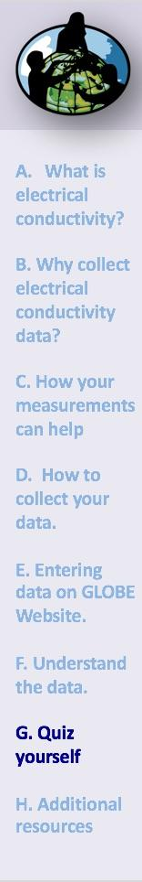
Review questions to help you prepare to conduct the Hydrosphere Electrical Conductivity Protocol
Electrical conductivity meters measure _____ through a centimeter of water.
What is the relationship between electrical conductivity of a solution and the amount of total dissolved solids in solution?
Electrical conductivity of water increases by ____% for an increase of 1 degree Celsius of water.
Would you expect electrical conductivity of a water body to increase or decrease after a large snowmelt?
Drinking water has an electrical conductivity between ______ µS/cm.
Your water sample should be between 20 ̊ - 30 ̊ C when you make your electrical conductivity measurement (true/false).
What are the safety precautions you should take when doing any of the hydrology protocols?
What is the acceptable range of error of the three replicate samples you take, in µS/cm?
What step do you need to complete before starting the Electrical Conductivity protocol?

Slide 47
Are you ready to take the Electrical Conductivity Protocol quiz?
You have now completed the slide stack. If you are ready to take the quiz, sign on and take the quiz corresponding to the Electrical Conductivity Protocol.
When you pass the quiz, you are ready to take Electrical Conductivity Protocol measurements!

Slide 48


Some Research Questions for Further Investigation
Would the conductivity of the water at your site go up or down after a heavy rain? Why?
Would you expect the conductivity to be greater in a high mountain stream that receives fresh snowmelt or in a lake at lower elevations?
Why do you think water with high levels of TDS is harmful to plants?

Slide 49

Please provide us with feedback about this module. This is a community project and we welcome your comments, suggestions and edits! Comment here: Training@nasaglobe.org
Questions about module content? Contact GLOBE: help@nasaglobe.org
Credits
Slides:
Russanne Low, Ph.D., University of Nebraska-Lincoln, USA
Rebecca Boger, Ph.D., Brooklyn College, NYC, USA
Cover Art: Jenn Glaser, ScribeArts
More Information:
GLOBE Program,
NASA Global Climate Change: Vital Signs of the Planet
The GLOBE Program is sponsored by these organizations:
Version 11/17/25. Modified by GLOBE Implementation Office – Science, Training, Education, and Public Engagement. If you edit and modify this slide set for use for educational purposes, please note “modified by (and your name and date)" on this page. Thank you.

