Slide 1

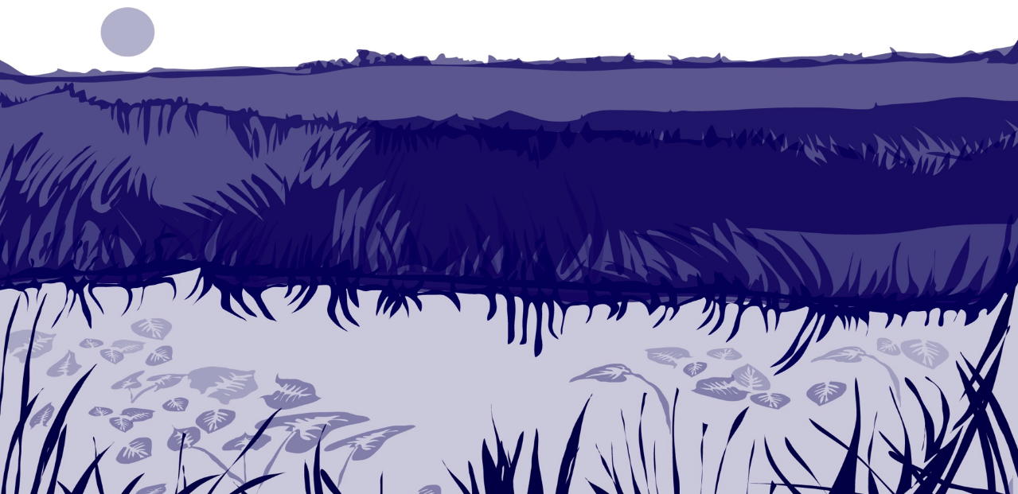
Slide One

Slide 2
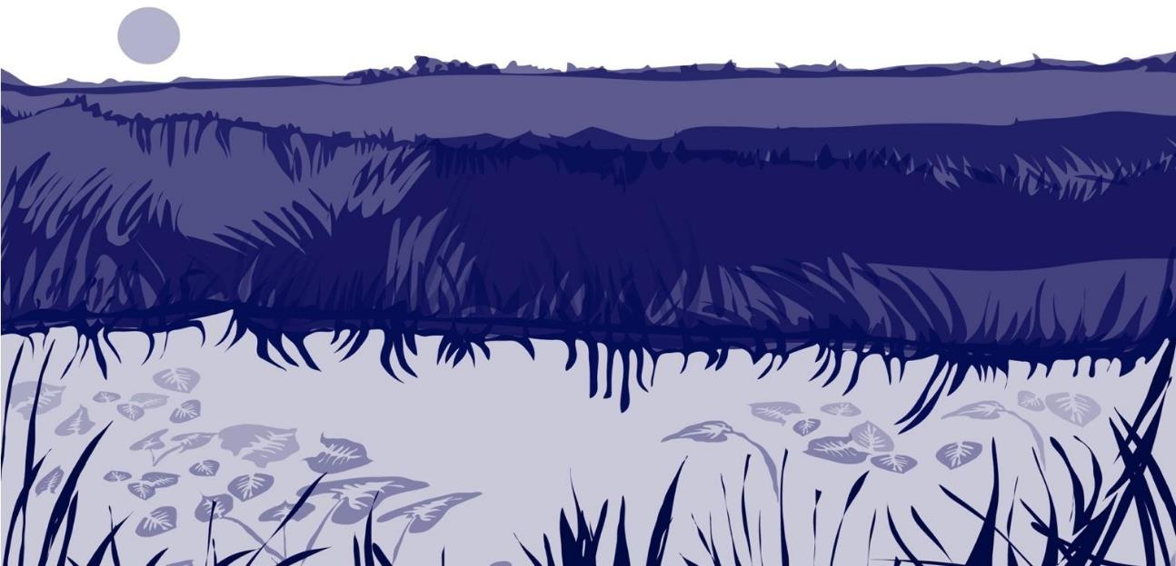
Overview and Learning Objectives
This module:
Introduces the Hydrosphere as a part of the Earth system
Introduces the GLOBE protocols associated with the Hydrosphere
Provides a step by step introduction of the process of documenting a hydrosphere study site
After completing this module, you will be able to:
Describe why it is important to document and monitor the Hydrosphere
Identify the GLOBE protocols associated with the Hydrosphere
Apply the steps required to document a hydrosphere study site
Upload your new Hydrosphere Study Site to the GLOBE database, using the Mobile Data Entry App
Estimated time of completion of this module: 1.5 hours

Slide 3

1. Introduction: The Hydrosphere and the Earth System
The Earth system refers to Earth´s interacting physical, chemical, and biological processes. The system consists of the atmosphere (air), hydrosphere (water), lithosphere- which includes soil (pedosphere) (land) and biosphere (life). Changing any part of the Earth system, such as water chemistry or water transparency can affect the rest of the system. That is where GLOBE’s Hydrosphere Investigation is important- to document the chemical and physical characteristics of our water bodies, so important to life, and to document when and where changes in our Earth’s water bodies are found.
The Earth System: Energy flows and matter cycles: Everything is connected to everything else.

Slide 4
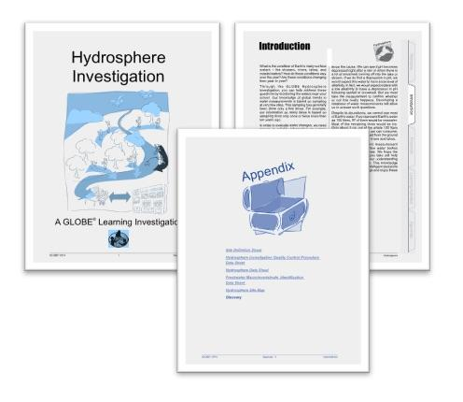
What is the Hydrosphere?
Students, volunteers, and scientists investigate Earth’s water bodies- our hydrosphere-through the collection of data using GLOBE protocols. These instructions ensure that you will use the right instruments and procedures so that the data you or your students collect will be comparable to data collected by others around the world.
You also have access to Learning Activities, which aid in the understanding of important scientific concepts, data collection methodologies, and procedures for analysis. The Hydrosphere Investigation Appendix contains data sheets for all hydrology protocols, a hydrology site map template and a glossary of terms. Additionally, data sheets (from the Appendix) and field guides (from the individual protocols) are available individually.
Link to GLOBE Hydrosphere Protocols

Slide 5
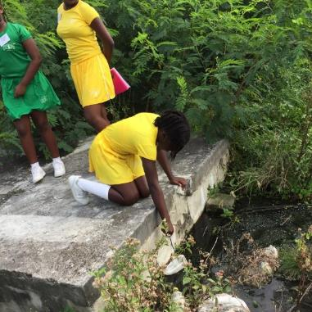
Why are GLOBE Hydrosphere Investigations Important?
Current measurement programs in many areas of the world cover only a few water bodies a few times during the year. GLOBE students and volunteers conducting Hydrosphere Investigations provide valuable data to help fill these gaps and improve our understanding of Earth's natural waters, and their role in preserving our ecosystems as well as human health.
Scientists use GLOBE data, but it’s important for teachers to stress that GLOBE students are scientists themselves. They ask questions about the world around them, collect data, conduct analyses and examine the validity of their hypotheses. What questions are explored in GLOBE Hydrosphere Investigations is up to you and your students.
GLOBE Mosquito Protocol: Netting mosquito larvae, Barbuda.

Slide 6
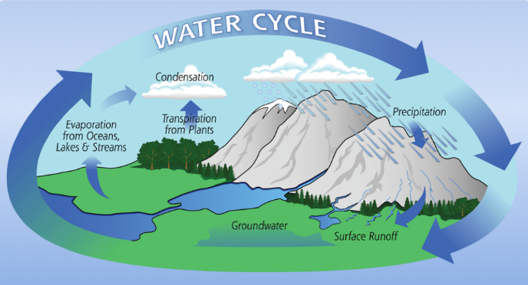
The Hydrologic (Water) Cycle
The hydrologic (water) cycle actively connects all parts of the Earth system. The hydrologic cycle is one of the basic processes in nature. Responding to heat from the sun and other influences, water from oceans, rivers, lakes, soils and vegetation evaporates into the air and becomes water vapor. Water vapor rises into the atmosphere, cools, and turns into liquid water or ice to become clouds. When water droplets or ice crystals get large enough, they fall back to the surface as rain or snow.
As water cycles, it changes state between its forms of liquid, gas and ice.
Source: NASA Global Precipitation Mission

Slide 7
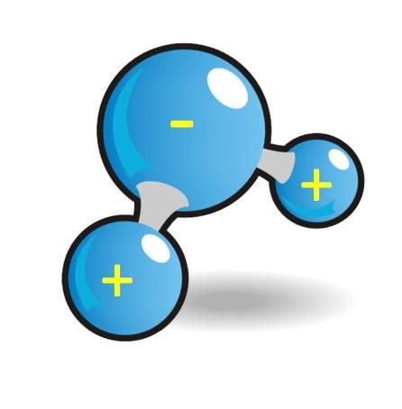
What Can GLOBE Hydrosphere Data Tell Us?
Water participates in many important chemical reactions. Completely pure water rarely occurs in nature because it carries impurities as it travels through the hydrologic cycle. Rain and snow capture aerosols from the air. Acidic water slowly dissolves rocks, placing dissolved solids in water. Small but visible pieces of rocks and soils also can become suspended in water and make some waters turbid.
Water is a good solvent. Because of its molecular polarity, it dissolved more substances than any other liquid. When water percolates into the ground, more minerals dissolve into water. Dissolved or suspended impurities determine water’s chemical composition. By studying changes in the quality and composition of water bodies, we are also gathering clues about changes in other parts of the Earth system.

Slide 8

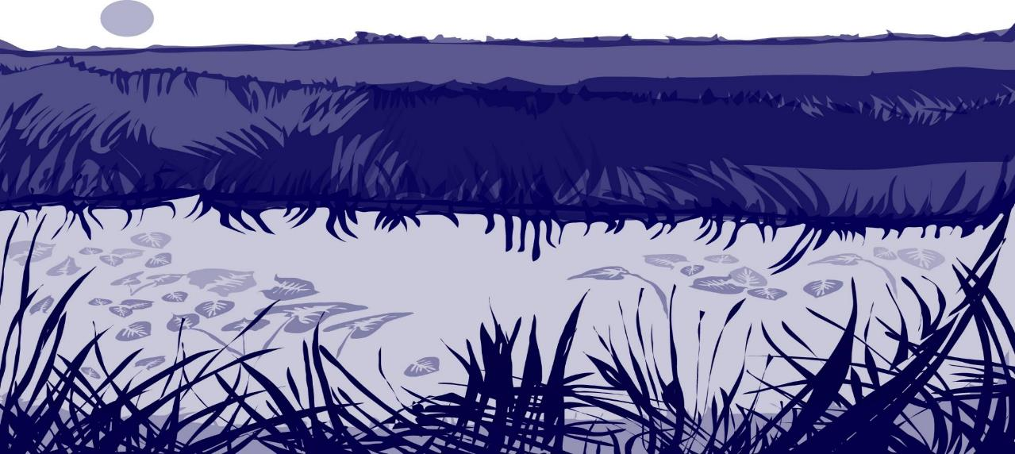
Review your Understanding! Question 1
When we say that in the Earth system, everything is connected to everything else, we can be referring to:
a. Earth’s interacting, physical, chemical and biological processes
b. The connections between the atmosphere, hydrosphere, lithosphere and biosphere
c. System where energy flows and matter cycles
d. The way the hydrologic cycle moves water through air, land and life
e. A and B
f. All of the above
What is your answer?

Slide 9
Review your Understanding! Answer to Question 1
When we say that in the Earth system, everything is connected to everything else, we can be referring to:
a. Earth’s interacting, physical, chemical and biological processes
b. The connections between the atmosphere, hydrosphere, lithosphere and biosphere
c. System where energy flows and matter cycles
d. The way the hydrologic cycle moves water through air, land and life
e. A and B
f. All of the above ☺- correct!
Were you correct? Proceed to the next question!

Slide 10
Review your Understanding! Question 2
What is true about GLOBE protocols ?
a. It is recommended to use them when collecting data, unless you or the teacher wants to use a more scientific procedure learned in college
b. They ensure that the data collected by GLOBE schools and volunteers around the world can be compared because the data collection procedures are the same
c. GLOBE protocols are only a suggestion how to collect data. As long as you report the data to the GLOBE database, it is up to you how you want to collect it
d. A and B
e. All of the above
What is your answer?

Slide 11
Review your Understanding! Answer to Question 2
What is true about GLOBE protocols ?
a. It is recommended to use them when collecting data, unless you or the teacher wants to use a more scientific procedure learned in college
b. They ensure that the data collected by GLOBE schools and volunteers around the world can be compared because the data collection procedures are the same
c. GLOBE protocols are only a suggestion how to collect data. As long as you report the data to the GLOBE database, it is up to you how you want to collect it
d. A and B
e. All of the above
Were you correct? Proceed to the next question!

Slide 12

Review your Understanding! Question 3
GLOBE Hydrosphere Investigations are important because
a. In many areas of the world there are only a few water bodies that are monitored
b. They provide a way for students and volunteers to collect data and ensure the data that they collect can be used by scientists around the world
c. Students and volunteers can identify their own concerns and those of their community and conduct research investigations to solve local problems
d. A and B
e. All of the above
What is your answer?

Slide 13
Review your Understanding! Answer to Question 3
GLOBE Hydrosphere Investigations are important because
a. In many areas of the world there are only a few water bodies that are monitored
b. They provide a way for students and volunteers to collect data and ensure the data that they collect can be used by scientists around the world
c. Students and volunteers can identify their own concerns and those of their community and conduct research investigations to solve local problems
d. A and B
e. All of the above ☺ correct!
Were you correct? Let’s now look at the different measurement protocols supported in the Hydrosphere investigation area.

Slide 14
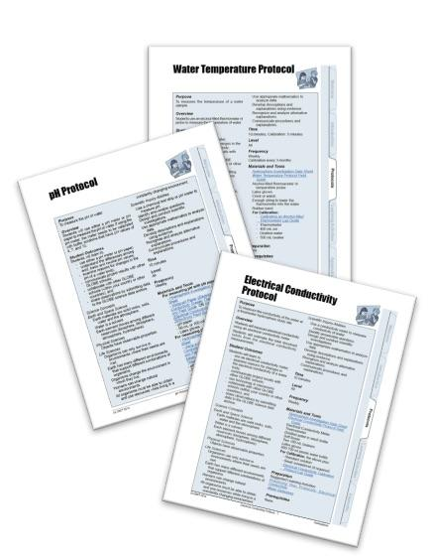
2. Introduction to GLOBE Hydrosphere Protocols
GLOBE protocols are designed so that you will obtain accurate data if you follow all the instructions. The protocols also include all the instrument calibration steps necessary so that your data are comparable with data collected by others around the world.
You remember from Earth system science that “everything is connected to everything else.” In the hydrosphere, it’s no different! Often, you need to follow more than one protocol, because the different characteristics of water influence each other.
You don’t need to worry, however, the Hydrosphere investigations inform you when you need to take additional measurements- such as the need to do the Water Temperature Protocol when you conduct the Electrical Conductivity Protocol, or the need to conduct the Electrical Conductivity Protocol prior to testing for Water pH to ensure the accuracy of your research. You will find all the information you need in the GLOBE Guide.

Slide 15

When to Conduct Hydrosphere Protocols
What is the condition of Earth’s many surface waters – the streams, rivers, lakes, and coastal waters? How do these conditions vary over the year? Are these conditions changing from year to year? Through the GLOBE Hydrosphere Investigation, you can help address these questions by monitoring the waters near you or your school.
It’s recommended that you conduct most of the hydrosphere data collection protocols weekly. Most of the protocols take 20 minutes or less to complete. Freshwater invertebrates is a more time consuming protocol, and it is suggested that this investigation take place twice a year, during spring and fall, or once during the wet and once during a dry season. The Mosquito Larvae Protocol can be conducted anytime that mosquitoes are in an active part of their life cycle.
Sampling for mosquito larvae, Barbuda, Caribbean.

Slide 16
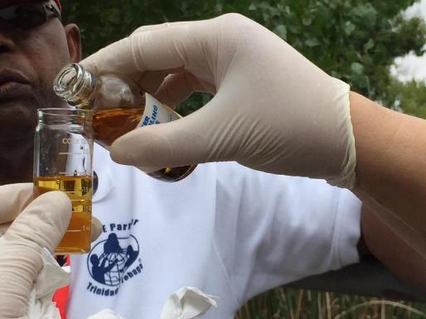

GLOBE Hydrosphere Protocols Safety Precautions
With all the GLOBE Hydrosphere Protocols, you need to make sure to take appropriate safety precautions. Be sure to wear eye and hand protection. In regions with active mosquitoes, it is also important to cover the skin with clothing and use insect repellent.

Slide 17
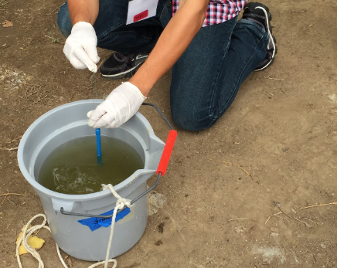
Water Temperature Protocol
The measurement of water temperature determines how hot or cold the water is. Sudden increases or decreases of water temperature are unusual. Water has a higher heat capacity (specific heat) than air, thus it heats and cools more slowly.
Water temperature is sometimes called a master variable because almost all properties of water, as well as chemical reactions taking place in it, are affected by it.
Other GLOBE Hydrosphere Protocols, such as electrical conductivity and dissolved oxygen, require water temperature data, because these properties are temperature dependent. Water temperature is also an important variable determining what organisms can live in a water body.

Slide 18
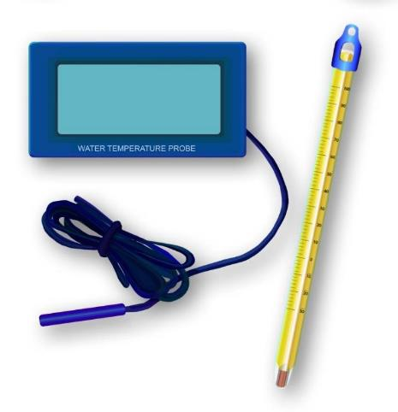
How to Collect Water Temperature Data
There are two ways to ways to collect water temperature for GLOBE: Using an alcohol-filled thermometer or using a temperature probe. You will find instructions for both procedures in the GLOBE Teacher’s Guide: choose the one that is most convenient for you or your students.

Slide 19
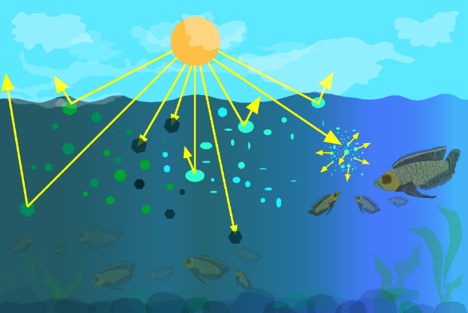
Water Transparency Protocols
Water transparency is one of the measurements used by GLOBE to describe the status of a water body. Water transparency measures depth of light penetration into the water.
Water transparency depends on the amount of suspended particles. These can be organic, such as phytoplankton and algae, or inorganic, such as sediments, as well as other dissolved impurities such as organic or inorganic carbonates. These particles limit the penetration of light through the water column and contribute to both the color and the transparency of the water.
Suspended particles interact with light’s penetration through the water column. Particles in the water will reflect, absorb or scatter light, thus determining the depth at which more light can’t penetrate.

Slide 20
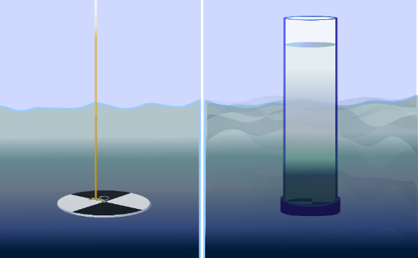
Water Transparency Protocols: Should I use a Secchi Disk or a Transparency Tube to measure water transparency?
There are two techniques to choose from. A Secchi Disk is used to measure transparency of deep or still water. The transparency tube is used to measure transparency with shallow or flowing water.
Both instruments can be built easily using household materials by following instructions in the GLOBE Teacher’s Guide.
Secchi Disk is used with deep
and still water
Transparency Tube used with shallow or Flowing water

Slide 21
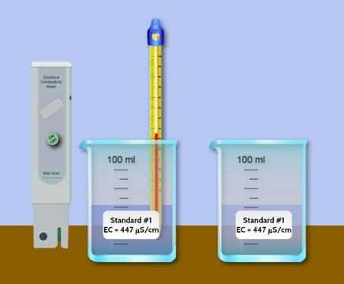
Electrical Conductivity Protocol
Electrical conductivity measures the capacity of water to transmit an electrical current. This capacity is directly related to the concentration of salts in the water. Since we lack the time or money to analyze water for each substance, we have found a good indicator of the total level of impurities in fresh water to be its electrical conductivity. We call the amount of mineral and salt impurities in the water the total dissolved solids (abbreviated TDS). We use electrical conductivity as an indirect measure to find the TDS of water.
Electrical conductivity provides a general measurement of stream water quality. After baseline measurements have been collected, significant changes in conductivity can be an indication of pollution or discharge into a water body. For instance, an oil spill might lower electrical conductivity, and discharged sewage may raise the electrical conductivity.
A low Electrical Conductivity value from 10 to about 200 µS/cm, suggests that the water may be drinking-water quality.

Slide 22

Electrical Conductivity Protocol- slide 2
Remember that when you learned about the Water Temperature Protocol, you learned that water temperature is sometimes referred to as a master variable?
Temperature also affects electrical conductivity: the higher the water temperature, the higher the electrical conductivity would be. The electrical conductivity of water increases by 2-3% for an increase of 1 degree Celsius of water temperature. This is why temperature readings are also taken when measuring electrical conductivity.
As you will see, it is necessary to know the electrical conductivity of your water sample to make sure that your water pH measurements are accurate. You don’t need to remember this now, the GLOBE Protocols let you know when additional measurements are necessary!

Slide 23
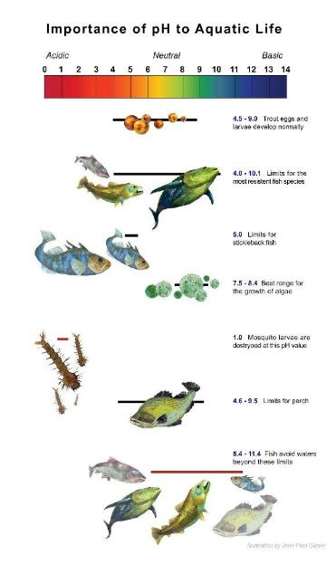
Water pH Protocols
The concentration of the hydrogen ion [H+] activity in a solution determines the pH. pH is reported in negative logarithmic units from 0-14, with 0 as the most acidic and 14 as the most basic. A pH of 7 is neutral. Each number represents a 10x change in the acidity or alkalinity of the water.
Water pH affects most chemical and biological processes that take place. The pH affects the solubility (amount that can be dissolved in water) and biological availability of nutrients. It also determines the degree to which potentially toxic materials, such as heavy metals, are soluble.
Since most organisms are sensitive to changes in water pH, scientists monitor unusual decreases or increases in the pH of water bodies. pH does not normally change a great deal, although you may find some seasonal trends due to changes in temperature, rainfall patterns, or land cover.

Slide 24
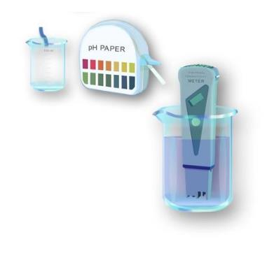
Which Protocol Should I Use: Water pH Using pH Paper or Water pH using a meter?
It is your choice! The pH of a water body can be measured using either a pH meter or pH paper. The accuracy of either method depends on the electrical conductivity of the water. The electrical conductivity needs to be at least 200 µS/cm for these methods to report accurately.
If you are sampling ocean or brackish water, you can assume that the electrical conductivity of your sample is greater than 200 µS/cm. If you are not sure if the fresh water at your Hydrosphere Study Site has a conductivity value high enough for the measurement technique (paper or meter), you will need to measure the electrical conductivity of your sample before taking your pH measurements. After you know the electrical conductivity value of the water, follow the pH field guide of your choice.

Slide 25
Review your Understanding! Question 4
If you are interested in the pH of a water body because you want to know whether the water is suitable for a certain fish, why would you need to take water temperature and electrical conductivity measurements?
You don’t- you can always just choose the one protocol you want to
You must determine the electrical conductivity and know the temperature to get an accurate pH measurement
What is your answer?

Slide 26
Review your Understanding! Answer to Question 4
If you are interested in the pH of a water body because you want to know whether the water is suitable for a certain fish, why would you need to take water temperature and electrical conductivity measurements?
You don’t- you can always just choose the one protocol you want to do
You must determine the electrical conductivity and know the temperature to get an accurate pH measurement ☺ correct!
Were you correct? Proceed to the next question!

Slide 27
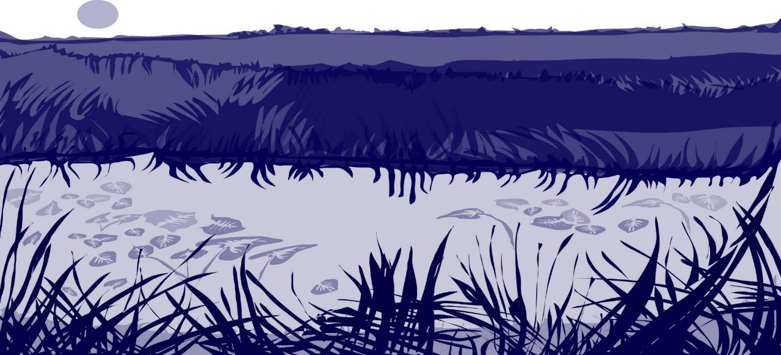
Review your Understanding! Question 5
What would you use to measure water transparency?
a. Secchi disk
b. transparency tube
c. electrical conductivity meter
d. commercial chemical test kit
e. A and B only
f. All of the above
What is your answer?

Slide 28
Review your Understanding! Answer to Question 5
What would you use to measure water transparency?
a. Secchi Disk
b. transparency tube
c. electrical conductivity meter
d. commercial chemical test kit
e. A and B only –correct ☺
f. All of the above
Were you correct?

Slide 29

Review your Understanding! Question 6
Which of the following water properties is described as a master variable, because if affects almost all other properties of water?
a. pH
b. electrical conductivity
c. dissolved oxygen
d. temperature
e. transparency
f. all variables affect other properties of water equally
What is your answer?

Slide 30
Review your Understanding! Answer to Question 6
Which of the following water properties is described as a master variable, because if affects almost all other properties of water?
a. pH
b. electrical conductivity
c. dissolved oxygen
d. Temperature ☺ Correct!
e. transparency
f. all variables affect other properties of water equally
Were you correct? Now, Let’s look at the rest of the Hydrosphere Protocols!

Slide 31
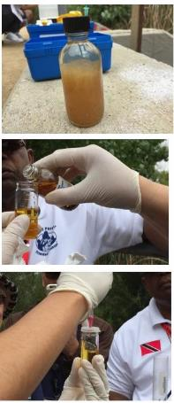
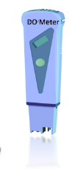
Dissolved Oxygen Protocol
An important GLOBE hydrosphere measurement is dissolved oxygen. Aquatic animals, such as fish and the zooplankton they feed on, do not breathe the oxygen atom in water molecules. Rather, they breathe the oxygen molecules dissolved in the water. Without sufficient levels of dissolved oxygen in the water, aquatic life suffocates.
The amount of oxygen gas that is soluble in water is dependent on many factors, including water temperature, atmospheric pressure, and salinity. Colder water can dissolve more oxygen than warmer water. Water at higher elevations holds less dissolved oxygen since the atmospheric pressure is less. And as salinity increases, the solubility of oxygen decreases.

Slide 32

Which Protocol for Dissolved Oxygen Should I Use?
GLOBE has two Protocol Methods for Dissolved Oxygen. One involves the use of a probe. Like all scientific measuring equipment, you will need to calibrate the probe before use. You can also use a commercial dissolved oxygen test kit. Both methods provide reliable results. Specifications for both methods are listed in the GLOBE Teacher’s Guide Toolkit.
It’s important to remember with either method that the amount of DO can change rapidly after a sample is collected. It’s important to preserve the water sample shortly after collecting. After sample preservation, sample testing can be done either in the field or taken back to the lab to determine the amount of DO in the water.
Toolkit

Slide 33

Water Alkalinity Protocol 1
Alkalinity and pH are properties of water that are related, but different. Alkalinity is the measure of the pH buffering capacity of the water. pH, on the other hand, is the acidity of water.
Alkalinity is the measure of a water’s resistance to the lowering of pH when acids are added to the water. Acid additions generally come from rain or snow, though soil sources are also important in some areas. Alkalinity is generated as water dissolves rocks containing calcium carbonate such as calcite and limestone. When a lake or stream has low alkalinity, typically below about 100 mg/L as CaCO3, a large influx of acids from a big rainfall or rapid snowmelt event could (at least temporarily) drop the pH of the water to levels harmful for amphibians, fish or zooplankton. If a water body is well-buffered, then it is less sensitive to chemical changes that could result in a change in acidity. The GLOBE protocol for water alkalinity uses a commercial test kit.
‹#›

Slide 34
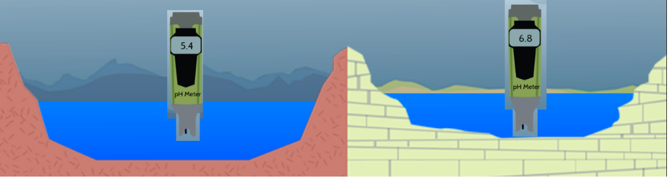
Water Alkalinity Protocol 2
When water has high alkalinity, we say that it is well buffered. It resists a decrease in pH when acidic water, such as rain or snowmelt, enters it. Alkalinity comes from dissolved rocks, particularly limestone (CaCO3), and soils. It is added to the water naturally as water comes in contact with rocks and soil. Water dissolves the CaCO3, carrying it into streams and lakes. Lakes and streams in areas rich in limestone bedrock will tend to have a higher alkalinity than those in regions with non-carbonate bedrock.
Two hypothetical lakes and a pH meter. The lake on the right is surrounded by limestone which weather to produce carbonate and bicarbonate ions. These raise the water’s alkalinity. The lake on the left is formed in igneous rock, which does not produce carbonates when weathered. The lake on the right is resistant to change when acid is added, whereas the lake on the left will change more readily.

Slide 35
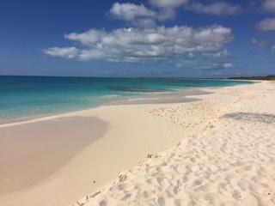
Water Salinity Protocol, 1 (deactivated) 2
The water salinity protocol has been deactivated but salinity data is still useful to measure and understand. Most water on Earth is seawater.
Water in seas and oceans is salty and has a much higher dissolved solids content than in freshwater lakes, streams and ponds. Salinity is a measure of that saltiness and is expressed in parts impurity per thousand parts water. The average salinity of Earth’s oceans is 35 parts per thousand (35 ppt). Sodium and chloride, the components of common table salt (NaCl), contribute most to the salinity. In bays and estuaries we can find a wide range of salinity values since these are the regions where freshwaters and seawater mix. The salinity of these brackish waters is between that of freshwater, which averages 0.5 ppt, and seawater.

Slide 36
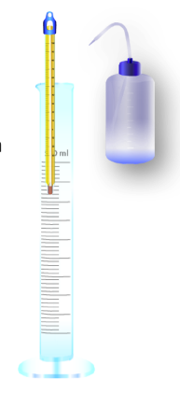
Water Salinity Protocol, 2 (deactivated) 2
The water salinity protocol has been deactivated but salinity data is still useful to measure and understand in order to interpret other hydrosphere parameters, such as dissolved oxygen.
To measure salinity you need to determine the times of the high tide and low tide that occur before and after your salinity measurement is taken.
There are different ways to measure salinity. GLOBE provides instructions using a hydrometer
The hydrometer method is quick and easy to to use, and does not create chemical byproducts that must be disposed of as chemical waste. However, hydrometers are relatively expensive and breakable.

Slide 37
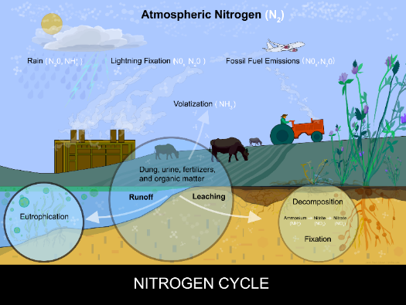
Water Nitrate Protocol
Plants in both fresh and saline waters require three major nutrients for growth: carbon, nitrogen and phosphorus. In fact, most plants tend to use these three nutrients in the same proportion, and cannot grow if one is in short supply. Nitrogen exists in water bodies in numerous forms: dissolved molecular nitrogen (N2), organic compounds, ammonium (NH4 +), nitrite (NO2-) and nitrate(NO3-). Water nitrate is often a limiting factor for plant growth. Excessive nitrogen in a water body can cause overgrowth of plant life, ultimately creating poor oxygenation for aquatic organisms.
To test for nitrates, you will use a commercial test kit. Nitrates are a common pollutant that is transferred from overfertilized agricultural fields by runoff.

Slide 38
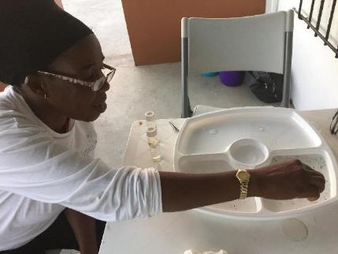
Freshwater Macroinvertebrates Protocol 1
Millions of small creatures inhabit fresh waters of lakes, streams, and wetlands. Macroinvertebrates, consisting of a variety of insects and insect larvae, crustaceans, mollusks, worms, and other small, spineless animals live in the mud, sand, or gravel of the substrate or on submersed plants and logs. They play a crucial role in the ecosystem. They provide an essential link in the food chain and are the source of food for many larger animals. Macroinvertebrates, such as freshwater mussels, help to filter water. Other types are scavengers and feed on decaying matter in the water, while certain macroinvetebrates prey on smaller organisms.

Slide 39
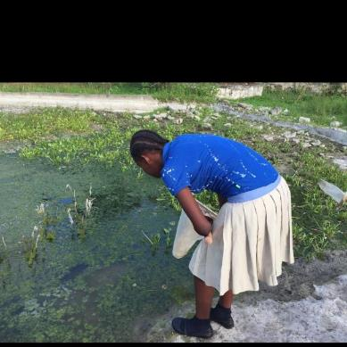
Freshwater Macroinvertebrates Protocol 2
Macroinvertebrates can tell us a lot about the conditions within a water body. Many macroinvertebrates are sensitive to changes in pH, dissolved oxygen, temperature, salinity, transparency, and other changes in their habitat. Habitat is a place that includes everything that an animal needs to live and grow. Macroinvertebrate samples allow us to estimate biodiversity, examine the ecology of the water body and explore relationships among water chemistry measurements and organisms at your Hydrosphere Study Site.
Ideally, you will sample freshwater macroinvertebrates twice a year, about 6 months apart, during the spring and the fall, or during the wet and dry seasons, about 6 months apart.

Slide 40
Review your Understanding! Question 7
When should a GLOBE teacher require students to wear protective gloves and eye gear?
a. When you use commercial chemical test kits
b. Whenever you conduct any hydrosphere protocol
c. Whenever your principal is looking
What is your answer?

Slide 41
Review your Understanding! Answer to Question 7
When should a GLOBE teacher require students to wear protective gloves and eye gear?
a. When you use commercial chemical test kits
b. Whenever you conduct any hydrosphere protocol ☺ correct!
c. Whenever your principal is looking
Were you correct? Proceed to the next question!

Slide 42
Review your Understanding! Question 8
Where can you find information about which instruments to use, and what specifications are necessary?
a. Any distributor of commercial water test kits meet GLOBE specifications
b. GLOBE Teacher’s Guide Learning Activities
c. The GLOBE Teacher’s Guide Toolkit
d. Hydrology Study Site Data Sheet
What is your answer?

Slide 43
Review your Understanding! Answer to Question 8
Where can you find information about which instruments to use, and what specifications are necessary?
a. Any distributor of commercial water test kits meet GLOBE specifications
b. GLOBE Teacher’s Guide Learning Activities
c. The GLOBE Teacher’s Guide Toolkit ☺ correct!
d. Hydrology Study Site Data Sheet
Were you correct? Proceed to the next question!

Slide 44
Review your Understanding! Question 9
Which of the following protocols must be conducted using a commercial test kit?
a. Water pH Protocol
b. Dissolved Oxygen Protocol
c. Electrical Conductivity Protocol
d. Water Nitrate Protocol
e. Mosquito Protocol
What is your answer?

Slide 45
Review your Understanding! Answer to Question 9
Which of the following protocols must be conducted using a commercial test kit?
a. Water pH Protocol
b. Dissolved Oxygen Protocol
c. Electrical Conductivity Protocol
d. Water Nitrate Protocol ☺ correct!
e. Mosquito Protocol
Were you correct? Let’s move on now to learn how to describe your GLOBE Hydrosphere Study Site.

Slide 46
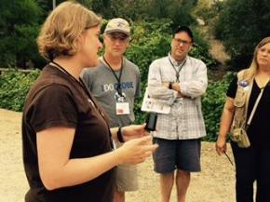
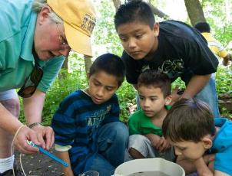
3. Establishing your Hydrosphere Study Site
Information about your GLOBE Hydrosphere Study Site is essential for students, citizen scientists and scientists to interpret water data. Students and citizen scientists need to keep current and accurate science logs, report unusual findings, and attempt to understand the data they are collecting both spatially and temporally. This means understanding what is in their entire watershed and how their area changes over time. Research may reveal seasonal patterns and longer-term changes or trends.

Slide 47
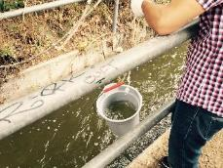
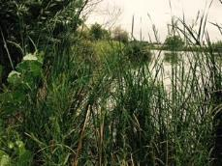
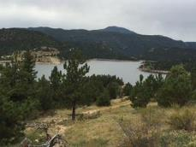
Selecting your Hydrosphere Study Site
All your hydrosphere measurements are taken at the same Hydrosphere Study Site. This may be any surface water site that can be safely visited and monitored regularly, although natural waters are preferred. Sites may include (in order of preference):
1. Stream or river
2. Lake, reservoir, bay or ocean
3. Pond
4. An irrigation ditch or other water body, if natural body is not available

Slide 48
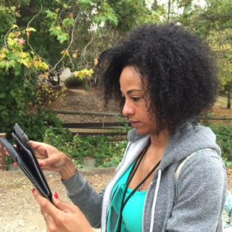
Documenting your Hydrosphere Study Site: Notes
Information on your site are provided in three ways: through written comments, photographs, and a field map.
1. Written: You are asked to provide specific information when you define your site, by filling out the Site Definition Sheet. In addition to supplying this information, you must also carefully observe and report other things that may affect the water at your site. For example, you may observe migratory waterfowl in the pond, a large storm may have caused trees to fall into the stream or a new bridge is being built slightly up the stream from where you are sampling.

Slide 49
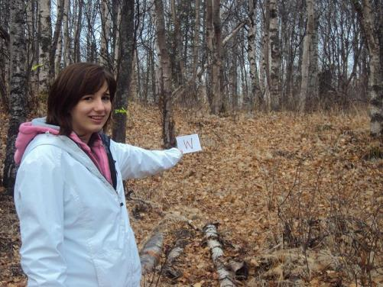
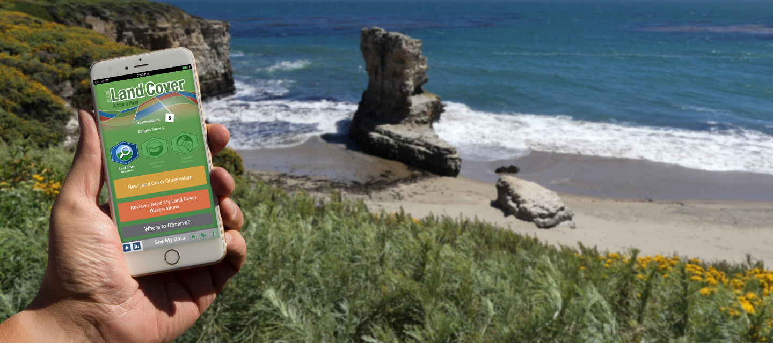
Documenting your Hydrosphere Study Site: Photos
2. Photos: Once each year, take photographs of your Hydrosphere Study Site. Take four photographs, one in each cardinal direction (north, south, east, and west) while standing where you normally stand to collect your water sample.
Slide 78 and 79 show how to take
photos using the GLOBE Observer
app Land Cover Tool.

Slide 50
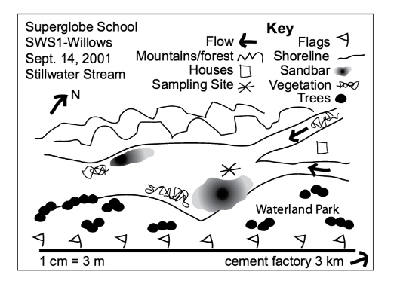
Documenting your Hydrosphere Study Site: Map
3. Field Map: Sketch a field map of your Hydrosphere Study Site each year following the guidelines in the Mapping Your Hydrosphere Study Site Field Guide. The field map will help you become familiar with your site and identify micro habitats as well as surrounding land cover that may affect the water.

Slide 51
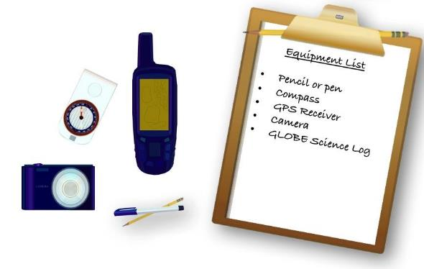
Equipment Needed to Document your Hydrosphere Study Site
Assemble Equipment:
Pencil or pen
Compass
GPS receiver
Camera
GLOBE Science Log
Assemble Necessary Documents:
Selecting and Documenting your Hydrosphere Study Site
GPS Protocol
Time: 10 minutes
Suggested Frequency: one time; update if the site changes

Slide 52
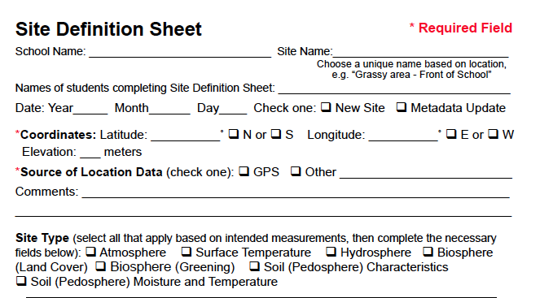
The Site Definition Sheet
Fill in the information on the top of your Site Definition Sheet.
Locate your Hydrosphere Study Site following the GPS Protocol Field Guide, shown in the next two slides.

Slide 53
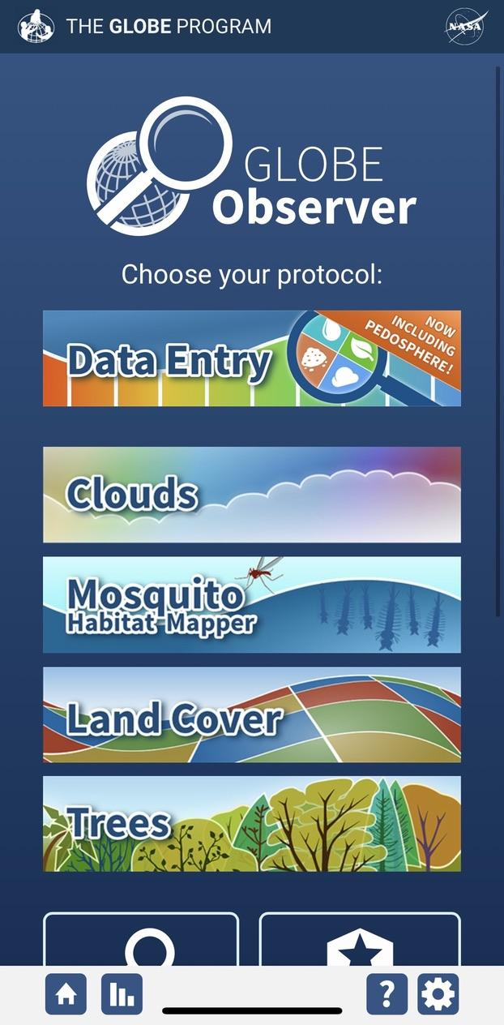
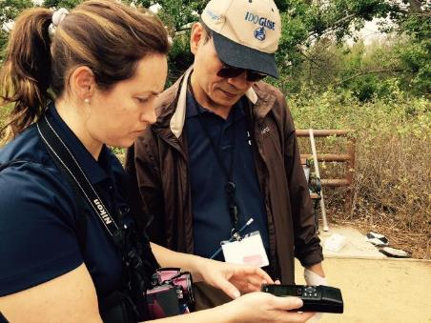
Determining your Location using a GPS Receiver or the GLOBE Observer app’s Smart Phone Location Settings
1a. Collect positional data using a GPS receiver.
Identify the latitude, longitude and elevation of the center following instructions from the GPS field guide, below:
Turn on the receiver, making sure that you are holding it vertical and you are not blocking the antenna’s view of the sky. In most receivers the antenna is internal and is located at the top of the receiver.
After an introduction message, the receiver will start to search for satellites. Some receivers may display the previous latitude, longitude, and elevation values while it is locking onto satellite signals.
1b. If using the GLOBE Observer app, check the accuracy of the location pin and move it if necessary.

Slide 54
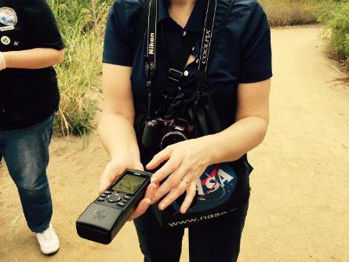
Using the GPS Receiver
Wait for the receiver to indicate that at least four satellites have been acquired and that a good measurement is available. In most receivers, this is indicated by the appearance of a “3-D” message.
At one minute intervals and without moving the receiver more than one meter, make five readings on a copy of the GPS Investigation Data Sheet of all digits and symbols for the following displayed values:
a. Latitude
b. Longitude
c. Elevation
d. Time
e. Number of satellites
f. “2-D’ or “3-D” status icons

Slide 55
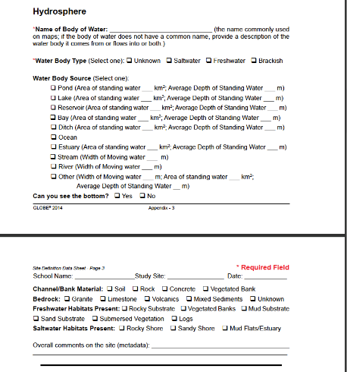
Adding Data to the Hydrosphere Fields-1
Record the name of the water body you are sampling, using the name commonly used in maps. If your water body does not have a common name, then provide the name of the water body your water site comes from or flows into or both. For example, Unnamed Stream, Tributary to Green River; Unnamed Stream, Outlet from Whiterock Lake; Unnamed Stream, Outlet from Bear Lake, Tributary to Black Creek.
Record whether the water is salt water or fresh water.
If your water site is moving water, record whether it is a stream, river, or other and its approximate width in meters.

Slide 56
Adding Data to the Hydrosphere Fields-2
If your water site is standing water, record whether it is a pond, lake, reservoir, bay, ditch, ocean or other and whether it is smaller than, larger than, or about equal to a 50 m x 100 m area. If known, indicate the approximate area (km2) and depth (meters).
Record whether your sample location is an outlet, bank, bridge, boat, inlet or pier.
Record whether you can see the bottom.
Record the material from which the bank or channel is made.
Record the type of bedrock, if known.
Record the manufacturer and model number for each chemical test kit you are using, if any.

Slide 57
Adding Data to the Hydrosphere Fields-3
Record in the Comments Section any information that may be important for understanding the water at your site. Some possible observations might be:
  Any upstream discharge into your body of water
  Whether the flow (streams) or water level (lakes) is regulated or is natural (for example, flow is regulated downstream of dams).
  Types of plants and animals observed
  Amount of vegetation in the stream
  Human uses of the water: fishing, swimming, boating, drinking water, irrigation, etc.
  Other information about why this specific site was selected.
  Human activities can often be the cause for changes you measure in your water body, so it’s important to make notes that may help you understand your data.

Slide 58

Adding Data to the Hydrosphere Fields-4
Standing where you will be collecting your water sample, take four photographs of your sampling area, one in each cardinal direction (N, S, E, W). Use a compass to determine the direction.
If you’ve taken photographs of your site label each photo with your school’s name (if you are associated with a school), the name of the study site name, and cardinal direction. Keep an electronic copy to provide to any collaborators.

Slide 59
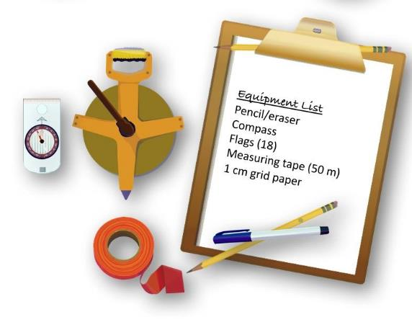
Mapping your Hydrosphere Study Site
Assemble Equipment:
Pencil/eraser
Compass
Flags (18)
Measuring tape (50 m)
1 cm grid paper
Assemble Necessary Documents:
Mapping Your Hydrosphere Study Site Field Guide
Hydrosphere Study Site Mapping Sheet
Time: 30 -45 minutes
Suggested Frequency: one time; update if the site changes

Slide 60
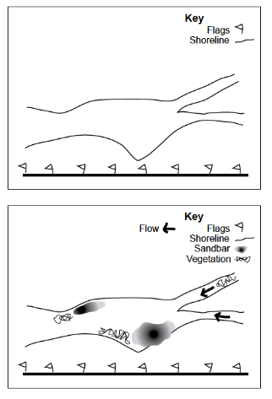
Creating Your Site Map
1. Select a section of the bank at least 50 meters long as your study area, if possible. You may consider the entire water body as your study area if it is small enough. The area should contain the sampling site where you collect your water measurements as well as a variety of habitats.
2. Use the measuring tape to measure a straight transect, at least 50 meters long, parallel to the shoreline, and within 10 meters of the bank. The transect will be varying distances from the water if the bank is not straight.
3. Place flags at the two ends and at every 2 meters along the transect.
4. Start drawing your map using the flags to help keep it to scale.
Note: Use the Mapping Field Sheet or graph paper with 1 cm squares,
each square should represent 2 meters. Put the scale on your graph.

Slide 61
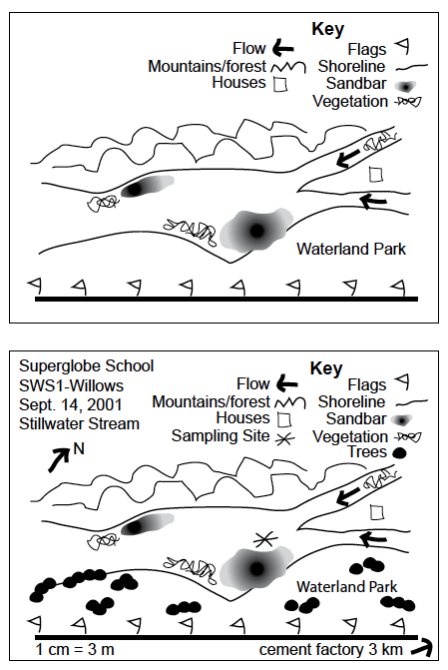
Drawing your Site Map
5. Mark the transect and flag positions on the map.
6. Draw the waterline or bank by measuring from each flag directly to the water, placing a small dot on the map to show the waterline, then connect the dots with a dotted line to indicate the bank.
7. Put in the opposite bank or indicate the approximate distance to the opposite bank if known.
8. Use an arrow to indicate the direction of water flow or the inlet and outlet of your water body.

Slide 62
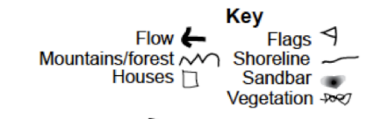
Create a Key for your Map
9. Create a key with symbols for special features found at your site. Use these symbols to indicate where special features are located on the map. Suggested features include:
Within the sampling area: riffle areas, pools, vegetated areas, logs, rocky areas, gravel bars, bridges, docks, jetties, dams, etc.
Around the sampling area: land cover (or MUC codes), geological features such as cliffs or rocky outcrops, man-made features such as houses, parks, parking lots, factories, roads, dumps or debris, etc.
10. Show the location of your Hydrosphere Sampling Site.
11. Include the following information on the map:
• Name of site
• Name of water body
• North arrow
• Date
• Scale (e.g., 1 cm = 3 m)
• Key to all symbols used on the map
12. Scan your map to have an electronic version to keep for your reference and to share with others.
Let’s now check our understanding!

Slide 63
Review Your Understanding! Question 11
If you have three potential sites close to choose from, which of the following is the most preferable Hydrosphere Study Site for your GLOBE investigation?
a. Irrigation ditch
b. Pond
c. Stream or River
What is your answer?

Slide 64
Review Your Understanding! Answer to Question 11
If you have three potential sites close to choose from, which of the following is the most preferable Hydrosphere Study Site for your GLOBE investigation?
a. Irrigation ditch
b. Pond
c. Stream or River ☺ correct!
Were you correct? Proceed to the next question!

Slide 65
Review Your Understanding! Question 12
When using a GPS receiver, how many measurements should you make at one minute intervals? You will average these measurements.
a. 2 or 3 (either 2D or 3D)
b. 4
c. 5
What is your answer?

Slide 66
Review Your Understanding! Answer to Question 12
When using a GPS receiver, how many measurements should you make at one minute intervals? You will average these measurements.
a. 2 or 3 (either 2D or 3D)
b. 4
c. 5 ☺ correct!
Were you correct? Proceed to the next question!

Slide 67
Review Your Understanding! Question 13
If your water body does not have a name, what do you record on the Hydrosphere or your data sheet and upload to the GLOBE Mobile Data Entry App?
a. Leave this field blank
b. Create a descriptive name, such as “Unnamed Stream, north tributary to Bear Creek”.
What is you answer?

Slide 68
Review Your Understanding! Answer to Question 13
If your water body does not have a name, what do you record on the Hydrosphere or your data sheet and upload to the GLOBE Mobile Data Entry App?
a. Leave this field blank
b. Create a descriptive name, such as “Unnamed Stream, north tributary to Bear Creek”. ☺ correct!
Were you correct? Proceed to the next question!
In the next section, we will learn how to upload data to GLOBE’s data portal, and how to use GLOBE’s Scientific Visualization System.

Slide 69

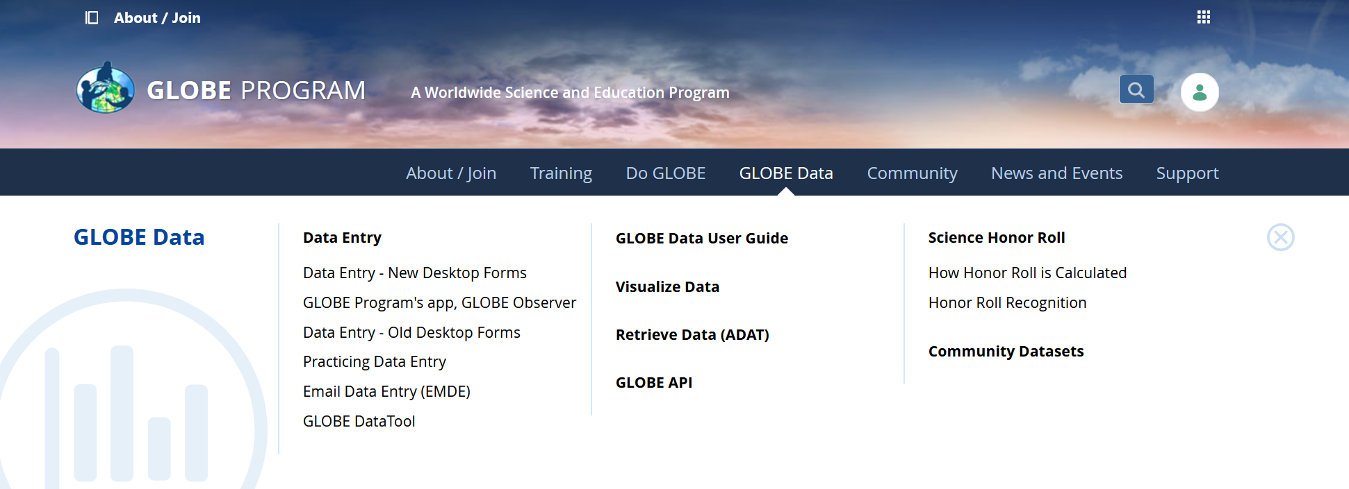
4. Entering Data in the GLOBE Observer app or on the GLOBE Website
Two Options for Uploading Data:
These methods all allow users to submit environmental data – collected at defined sites, according to protocol, and using approved instrumentation – for entry into the official GLOBE science database.
Download the GLOBE Observer mobile app from the App Store.
Data Entry: Visit globe.gov, click on the “GLOBE Data” tab, then underneath “Data Entry” click on “Data Entry – New Desktop Forms”.

Slide 70
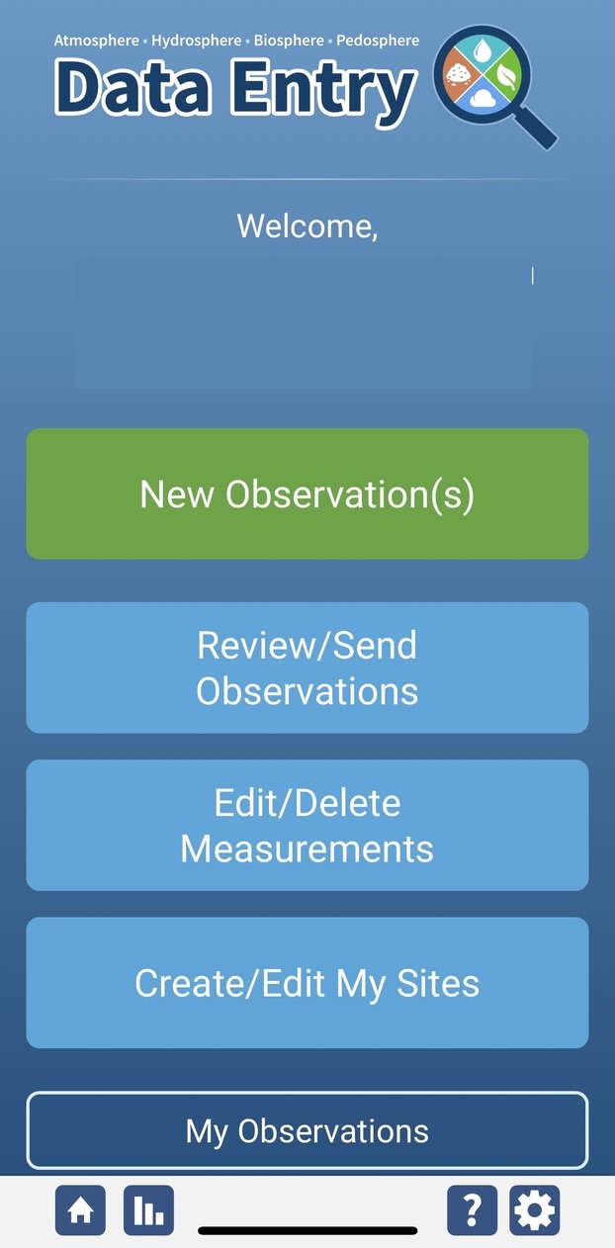
Steps to Add your Hydrosphere Study Site: Step 1, Create Site
To enter data on the GLOBE Website, go to “New Data Entry.” A screen will open that looks like the Data Entry Screen within the GLOBE Observer app.
To enter data in GLOBE Observer, first return to GLOBE Observer main page by clicking the home button in the bottom left.
Select “Data Entry”.
Next, “Create/Edit My Sites”
Select “Create/Edit My Sites”

Slide 71
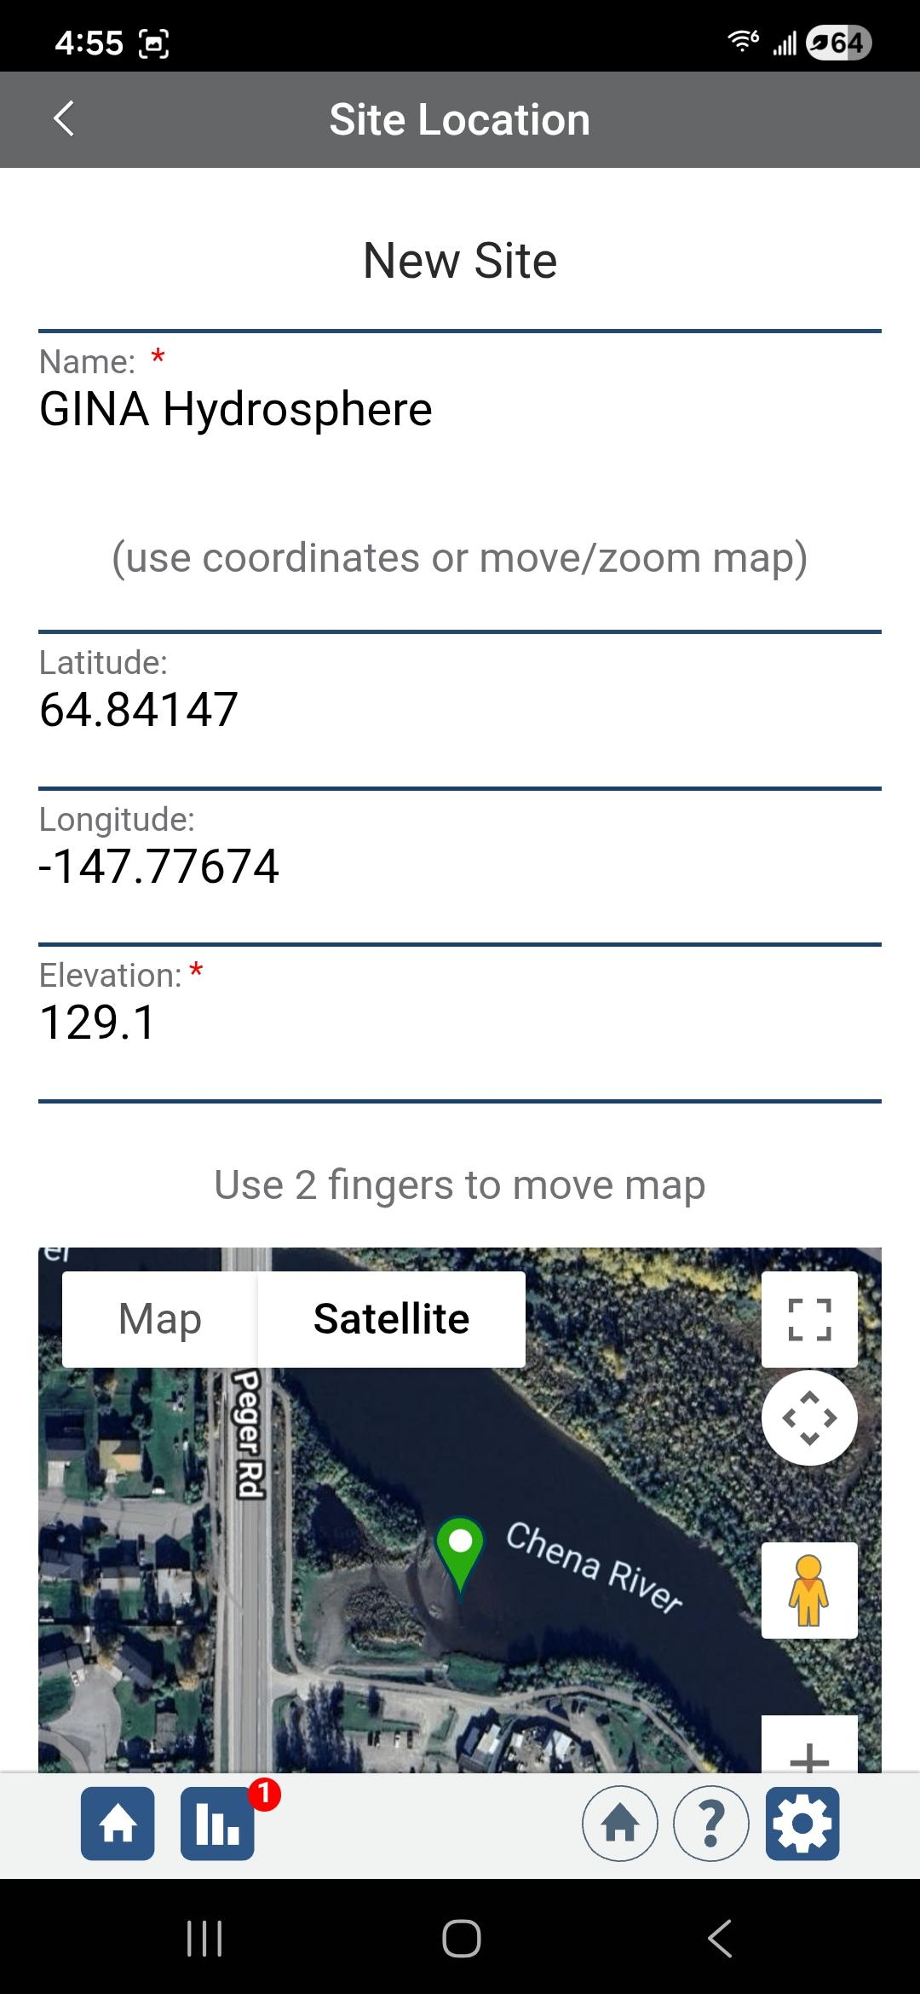
Set Up your Hydrosphere Study Site: Step 2, Name and Location
Choose a name for the new site.
Use the phone GPS to get location or use two fingers to move the map.
It’s helpful to turn on “Satellite” to see the location, especially if using the new desktop forms on the GLOBE website.
Be sure to zoom in to make sure the location pin is actually on or immediately next to a water body.

Slide 72
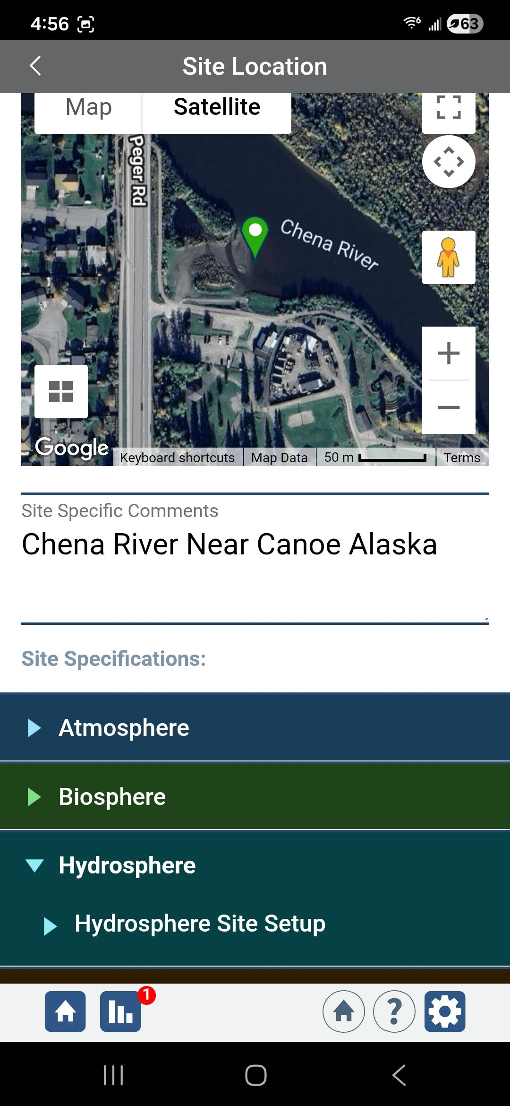
Set Up your Hydrosphere Study Site: Step 3, Comments
Add Site Specific Comments to help people find or access the site. Be specific. Add local place names that might not be found on a map or describe why the site is locally relevant.
Click on Hydrosphere and Hydrosphere Site Set Up.

Slide 73
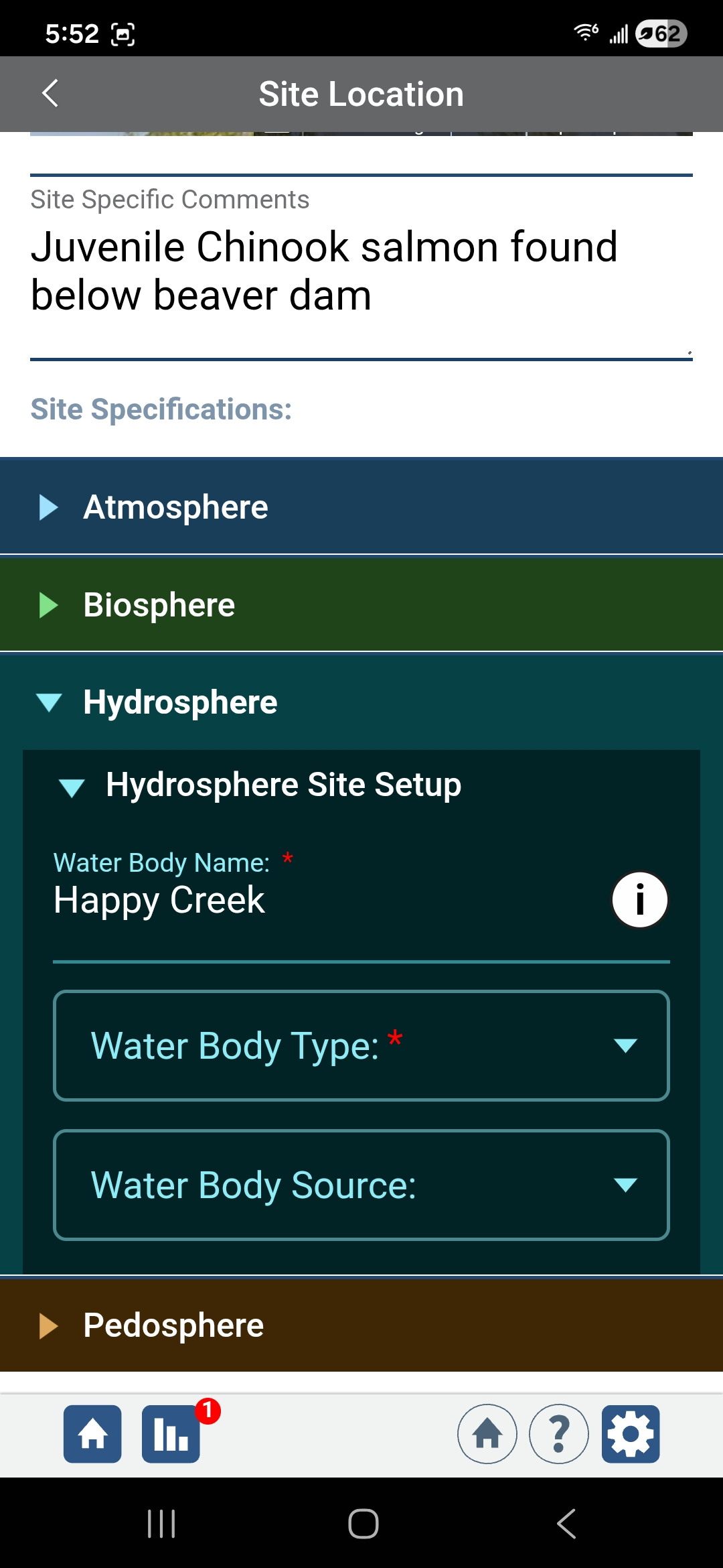
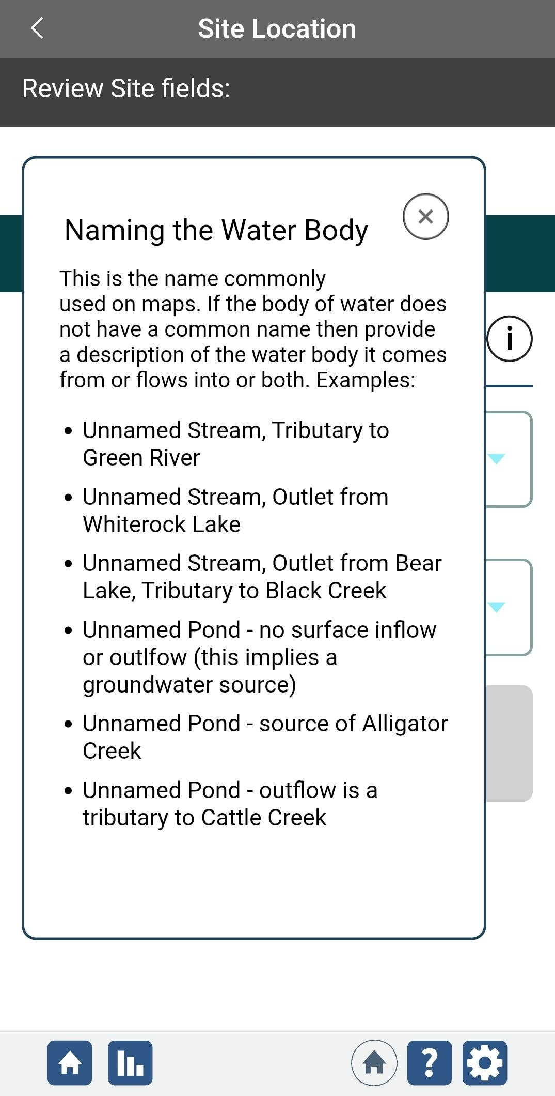
Set Up your Hydrosphere Study Site: Step 4, Water Body Name
Enter the Name of the Water Body. This is different from your site name or Site Specific Comments.
Click on the i button (information button) for tips on naming the water body if it does not have a common name.
Comments
Water Body Name and information button

Slide 74

Set Up your Hydrosphere Study Site: Step 5, Type
Enter the Water Body Type:
unknown, salt water, fresh water, or brackish.

Slide 75



Set Up your Hydrosphere Study Site: Step 6, Location Information
If you can measure the width of moving water, such as a river, stream, or ditch enter it. If you do not know, you can use a measuring tool on a map and edit the site information later.
Click on the Water Sample Location button. A drop-down will show the following options: pond, lake, reservoir, bay, ditch, ocean, estuary, river, stream, marsh/swamp, agriculture, puddles, animal or vehicle tracks, or other.
Puddles, animal or vehicle tracks are not water bodies. If you do collect data about such sites, the water body type in step 6 should have been selected.

Slide 76

Set Up your Hydrosphere Study Site: Step 7, Site Information
Record information about whether you can see the bottom, the channel/bank material, bedrock or parent material (if known), and the freshwater or saltwater habitats present.
Choose the most appropriate response. If a selection is not available, add a comment when you review site information.
After clicking Next, your Hydrosphere site set-up is complete after you click on Send Site!

Slide 77




Set Water Body State Before Entering Data
Before entering an observation for all hydrosphere protocols, you will be asked to Set Water Body State.
Data can be entered if the water body is in its “normal” state and safe to sample, but not if it is frozen, dry, flooded or unreachable. Frozen water prevents the collection of surface samples.

Slide 78
Photograph your Hydrosphere Study Site: Use GLOBE Observer
Land Cover tool to Take and/or Upload Photos

Slide 79



Add Photos in Each Cardinal Direction: Use GLOBE Observer
Land Cover tool to Take and/or Upload Photos
The GLOBE Observer Land Cover Tool allows users to take pictures in each cardinal directions and up and down using the app or to take pictures manually and upload them.
Add Field Notes, including the name of your water body or Hydrosphere Study site. Describe historical, recent or planned changes.
Note that you cannot link your Land Cover site to your Hydrosphere study site, but they will show up in your “My Observations” page.
Happy Creek - flow was returned in 2022 after 86 years.

Slide 80


Visualize and Retrieve Data-Step 1
GLOBE provides the ability to view and interact with data measured across the world. Enter the GLOBE Visualization System to map, graph, filter and export data that have been measured across GLOBE protocols since 1995. Here are screenshots steps you will use when you use the visualization tool for data you collect at your hydrosphere study site. As an example, let’s plot water temperature data.
Enter the GLOBE Visualization System at https://vis.globe.gov/GLOBE/
In Protocol Layers Menu, click on the arrow next to Hydrosphere
Select water temperature from drop down menu

Slide 81

Visualize and Retrieve Data-Step 2
Select the date range for which you need water temperature data and you can see where data are available.
Locations where water temperature data are available for the dates you selected.
The size of the circles correspond to the number of measurements in that location.

Slide 82

Visualize and Retrieve Data-Step 3
In the box with the data for the location you have selected, there are several tabs. The Measurements tab plots the data in a graph.
Clicking on a location will open to a map note providing water temperature data for that location and time.
This site, Vela Luka, has water temperature data since 2013. To make a custom plot of the data, click “custom plot” and enter the desired date range. To compare sites or download data as a .csv file for analysis, follow instructions in the tutorials.
GLOBE Visualization System Tutorials
https://www.globe.gov/globe-data/visualize-and-retrieve-data

Slide 83
We are now at the end of the module. Before you take the quiz about the Introduction to the Hydrosphere Investigations, stop and think about these questions!
One of the preferred water bodies for a hydrosphere study site is ________________________. (slide 46)
What scientific instrument is used to locate the latitude and longitude of your study site? (slide 53)
Why do you think it is important to identify the ways in which a water body is used by humans as part of your metadata description? (slide 56)
Which of the Hydrosphere protocol measurements is referred to as a “master variable,” whose properties affect other measurements? (slide 16)
Which of the following kinds of documentation do you need for your hydrosphere study site: photographs, map, written description, or all of these? (slide 50-61)
Thinking about the nitrogen cycle, where do excess nitrates in water bodies tend to come from? (slide 33)
If you are unsure of any of the answers to these questions, you can find them by reviewing the slide set.
Other questions? Take a look at the Frequently Asked Questions, next slide.

Slide 84
FAQ-Frequently Asked Questions-Page 1
Is it acceptable to use a man-made site, e.g. a pond built near the school?
Answer: Although natural sites are first in the order of preference, man-made sites may be used. Many lakes and ponds are man-made.
My coastline curves. Is this an appropriate site?
Answer: You will seldom find a perfectly straight coastline. Try to pick as straight a stretch of coast as possible or an area of coast representative of the water body.
There are agricultural fields to the north of my site. How should I indicate them?
Answer: In the Comments section, note anything within your watershed that you think might affect the water. On the field map, note direction and approximate distance to major land cover features of the surrounding area.
My beach has both rocky and sandy shores. Should I choose a mix or try to find a site with just one type of habitat?
Answer: Try and find a site with just one type of habitat. The sampling procedures for different types of coast are different.

Slide 85
FAQ-Frequently Asked Questions-Page 2
We live fairly near to a river, but my class can’t go that far for sampling every week. Should we choose a less preferable, but closer site?
Answer: Try to sample water bodies that are significant to your area, even if you have to use a less frequent sampling strategy. Sites closer to you that can be sampled weekly, can also be chosen as a second sampling site. This often makes for interesting comparisons between the sites.
Can I choose a site that is sometimes dry?
Answer: Water sites may sometimes dry up, be frozen, or become flooded so that data cannot be collected. If one of these situations occurs, check ‘dry’, ‘frozen’ or ‘flooded’ on the data entry page for each week that you cannot collect a water sample. This will indicate to researchers that the site is still being monitored even though water data cannot be collected.
Can I have more than one site on a river or lake?
Answer: Multiple sites along a watershed are desirable. Significant differences might be found at sites with different depths, near different land cover, or in tributaries of a larger river or body of water.

Slide 86

You are Done!
You have now completed the slide stack. If you are ready to take the quiz, sign on and take the quiz corresponding to Introduction to the Hydrosphere.
Welcome to the GLOBE Hydrosphere Investigation!
For More Information Contact
The GLOBE Program

Slide 87

Please provide us with feedback about this module. This is a community project and we welcome and need your comments, suggestions and edits! Please comment here: training@nasaglobe.org
Questions about the content of this module? Contact GLOBE: help@nasaglobe.org
Credits
Slides:
Russanne Low, Ph.D., University of Nebraska, Lincoln, USA
Rebecca Boger, Ph.D., Brooklyn College, NYC, USA
Photo Credits: Russanne Low
Illustrations and Cover Art: Jenn Glaser, ScribeArts
Additional Information:
The GLOBE Program
NASA Global Climate Change: Vital Signs of the Planet
The GLOBE Program is sponsored by these organizations:
Version November 2025. Modified by GLOBE Implementation Office Science, Training, Education and Public Engagement Team. If you edit and modify this slide set for use for educational purposes, please note “modified by (and your name and date)“ on this page. Thank you.

