Slide 2
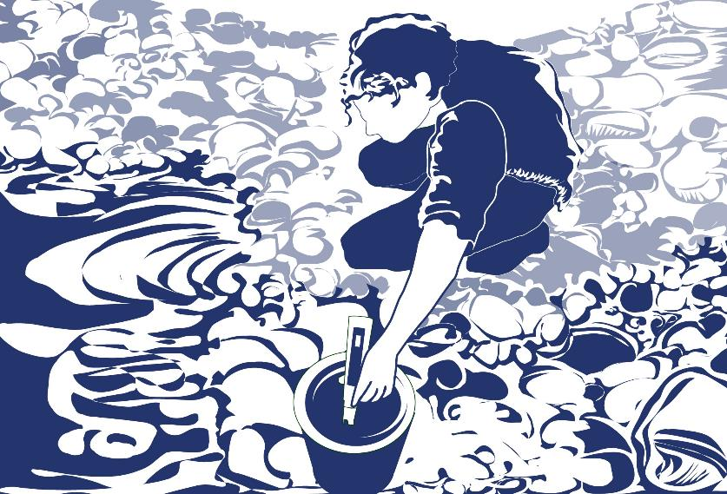
Overview
This module:
Reviews the selection of a GLOBE hydrology site
Reviews the water sampling technique used in GLOBE hydrology protocols
Provides a step by step introduction of the protocol method
Learning Objectives
After completing this module, you will be able to:
Define water pH and explain how environmental variables result in different measurements
Describe the importance of instrument calibration in the the collection of accurate data
Conduct water pH measurements using a pH meter
Upload data to the GLOBE portal
Visualize data using GLOBE’s Visualization Site

Slide 3
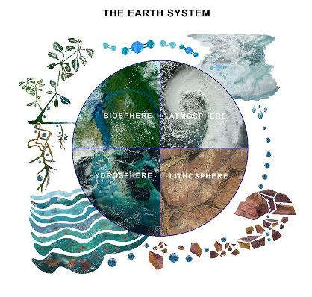
The Hydrosphere
The hydrosphere is the part of the Earth system that includes water, ice and water vapor. Water participates in many important natural chemical reactions and is a good solvent. Changing any part of the Earth system, such as the amount or type of vegetation in a region or from natural land cover to an impervious one, can affect the rest of the system. Rain and snow capture aerosols from the air. Acidic water slowly dissolves rocks, placing dissolved solids in water. Dissolved or suspended impurities determine water's chemical composition.
Current measurement programs in many areas of the world cover only a few water bodies a few times during the year. GLOBE Hydrosphere protocols will allow you to collect valuable data to help fill these gaps and improve our understanding of Earth's natural waters.
The Earth System: Energy flows and matter cycles.

Slide 4
Hydrosphere Protocols
pH is one of the hydrosphere protocols used by GLOBE to describe the status of a water body. The pH of a lake or stream measures water acidity, which influences how much oxygen is dissolved in the water.
Measures of pH directly indicate how hospitable a body of water is to aquatic life. It is interesting to both follow the annual cycle of water parameters, such as dissolved oxygen, alkalinity and pH, and to make comparisons between different water bodies. We can see if pH becomes depressed right after a rain or when there is a lot of snowmelt running off into the lake or stream. If we do find a depression in pH, we would expect this water to have a low level of alkalinity.
GLOBE Hydrosphere Measurements
Hydrosphere Study Site
Water Temperature
Water Transparency
Conductivity
pH
Mosquito Larvae
Alkalinity
Dissolved Oxygen
Salinity
Nitrates
Freshwater Macroinvertebrates

Slide 5

What is Water pH?
PH is a measure of the relative amount of free hydrogen ions there are in the water, which determines the acidity of the water body
The concentration of the hydrogen ion [H+] activity in a solution determines the pH. Mathematically this is expressed as:
pH = - log [H+]
pH is reported in logarithmic units form 0-14, with 7 being neutral. Each number represents a 10x change in the acidity or alkalinity of the water.
The pH values for your water site will depend on the geology, soil and vegetation of your area as well as other inputs into your water body. Where the air masses come from that precipitate into your water body may affect the pH of the water. Most lakes and streams have pH values that range between 6.5 and 8.5. Oceans have a pH value of 8.2. Pure water not in contact with the air has a neutral pH value of 7.0.
Naturally occurring basic waters are found typically in areas where the surrounding geology is rich in minerals such as calcite or limestone.

Slide 6
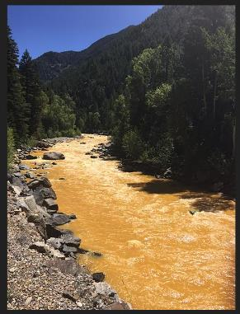
Why Collect Water pH Data?
There are waters that are naturally more acidic when there are certain types of minerals in the water, such as sulfides. Mining can also release acid forming compounds to water bodies.
Pollution can change a water's pH, which in turn can harm animals and plants living in the water. For instance, the 2015 spill of mine waste into the Animas River, caused the Animas to have a pH of 5- acidic. By using the logarithm scale, this mine-drainage water would be 100 times more acidic than neutral water.
A change in pH in a water body can be an indicator of increasing pollution or other environmental factor.
The Animas River between Silverton and Durango in Colorado, USA, within 24 hours of the 2015 Gold King Mine waste water spill Credit: Riverhugger, Wikipedia Commons.

Slide 7
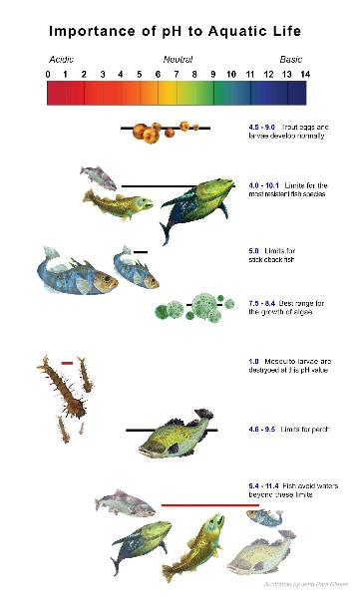
How Your Data Can Help
pH affects most chemical and biological processes that take place in water. pH affects the solubility (amount that can be dissolved in water) and biological availability of nutrients. It also determines the degree to which potentially toxic materials, such as heavy metals, are soluble.
pH has a strong influence on what can live in the water; aquatic organisms have certain pH ranges they prefer or require. Salamanders, frogs and other amphibian life, as well as many macroinvertebrates, are particularly sensitive to extreme pH levels. Most insects, amphibians and fish are absent in water bodies with pH below 4.0 or above 10.0.
Since most organisms are sensitive to changes in water pH, scientists monitor unusual decreases or increases in the pH of water bodies. pH does not normally change a great deal, although you may find some seasonal trends due to changes in temperature, rainfall patterns, or land cover.

Slide 8
Simultaneous or Prior Investigations Required to do Water pH Measurements
You will need to define your Hydrosphere Study Site. A Hydrosphere Study Site can be any surface water site that can be safely visited, although natural waters are preferred.
The Hydrosphere Investigation Data Sheet is used to record all the hydrosphere measurements, including Water Transparency. You will also want to map your Hydrosphere Site at some point.
To define you study site you will need these documents:
Selecting and Documenting your Hydrosphere Study Site
Hydrosphere Investigation Data Sheet
Mapping your Hydrosphere Study Site Field Guide

Slide 9
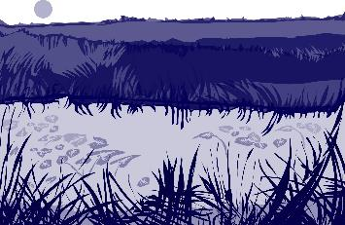
SITE
selection
Site Selection: Hydrosphere Study Site
Ideally, your Hydrosphere Study Site should be within the major watershed of the 15 km by 15 km GLOBE Study Site and connected to water systems that flow into larger river or estuary systems.
All your hydrosphere measurements are taken at the same Hydrosphere Study Site. This may be any surface water site that can be safely visited and monitored regularly, although natural waters are preferred. Sites may include (in order of preference):
1. stream or river
2. lake, reservoir, bay or ocean
3. pond
4. an irrigation ditch or other water
body, if natural body is not available

Slide 10
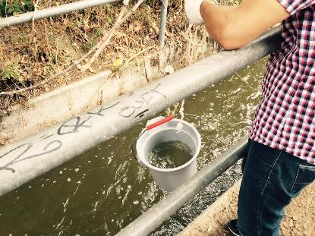
SITE
selection
Site Selection and Sampling- Hydrosphere Study Site
If the selected study site is a moving body of water (i.e. stream or river), locate your sampling site at a riffle area as opposed to still water or rapids. This will provide a more representative measurement of the water in the stream or river. If the selected study site is a still body of water i.e. a lake or reservoir), find a sampling site near the outlet area or along the middle of the water body.
Avoid inlet areas. A bridge or a pier are good choices. If your water body is brackish or salty, you will need to know the times of high and low tide at a location as close as possible to your study site.

Slide 11
Overview of Water pH Protocol
pH of a water body can be measured using either a pH meter or pH paper. The accuracy of either method depends on the electrical conductivity of the water. The electrical conductivity needs to be at least 200 µS/cm for these methods to report accurately.
If you are sampling Ocean or brackish water, you can assume that the electrical conductivity of your sample is greater than 200 µS/cm. If you are not sure if the fresh water at your Hydrosphere Study Site has a conductivity value high enough for the measurement technique (paper or meter), you will need to measure the electrical conductivity before taking your pH measurements. After you know the electrical conductivity value of the water, use the appropriate pH field guide.
For more information, see the Electrical Conductivity Field Guide Protocol

Slide 12

Sources for Equipment You Need for the pH Meter Protocol
The following resources summarize the measurements associated with each protocol, associated skill level, scientific specifications for the instruments, and how to access the equipment you need (purchase, build, or download).
Where to find specifications for instruments used in GLOBE investigations
Where to find scientific instruments used in GLOBE investigations

Slide 13









pH Water Protocol using a pH Meter
Electrical Conductivity Less than 200 mS/cm (1/8)
Time: 10 minutes
Suggested Frequency: weekly
Assemble Necessary Equipment:
Assemble Necessary Documents:
Water pH Data Sheet
Electrical Conductivity Field Guide
pH Water Protocol using pH Meter:
Electrical Conductivity Less than 200 mS/cm
pH meter
Electrical conductivity meter
2 100-ml beakers or cups
Protective gloves and goggles
Thermometer
Tweezers
Stirring rod or spoon
Salt crystals or table salt
Distilled water in wash bottle
Paper towel or soft tissues
Pen or Pencil
Salt
mL of pH 4.0 buffer solution in a jar with a lid: labeled pH 4.0*
25 mL of pH 7.0 buffer solution in a jar with a lid: labeled pH 7.0
25 mL of pH 10.0 buffer solution in a jar with a lid: labeled pH 10.0
Standard solution for electrical conductivity tester

Slide 14







1. pH Water Protocol using a pH Meter Electrical Conductivity Less than 200 mS/cm (2/8)
Fill in the top part of the Hydrosphere Investigation,
and check the box next to “pH meter”
2. Put on protective gloves.
Rinse tweezers in sample water and dry with paper towel.
Rinse two beakers or cups with sample water three times.
SAFTEY be sure to wear gloves and goggles during your investigation

Slide 15
1. pH Water Protocol using a pH Meter: Electrical Conductivity Less than 200 mS/cm (3/8)
Fill one beaker or cup with about 50 mL of sample water
Using the tweezers, place one crystal of salt in the sample water. (If you do not have salt crystals, use a few grains of table salt and pour that into the sample water)*
Stir thoroughly with stirring rod or spoon.
*Crystal of about 0.5 – 2.0 mm in diameter is much easier to work with than the very finely ground “table salt” used is some countries. In North America, the larger salt crystals are often marketed as “sea salt”

Slide 16


I. pH Water Protocol using a pH Meter: Electrical Conductivity Less than 200 mS/cm (4/8)
8. Measure the electrical conductivity of the treated sample water (with the added salt) using the Electrical Conductivity Protocol.
a. If the electrical conductivity is at least 200 mS/cm, record value on Data Sheet. Go to step 9.
b. If the electrical conductivity is still less than 200 mS/cm, go to step 6 and repeat until you get a value that is at least 200 mS/cm.

Slide 17



I. pH Water Protocol using a pH Meter: Electrical Conductivity Less than 200 mS/cm (5/8)
9. Remove the cap from the meter that covers the electrode (the glass bulb on the pH meter)
10. Rinse the electrode on the meter and the area around it with distilled water in the wash bottle. Blot the meter dry with a clean paper towel or tissue. Note: Do not rub the electrode or touch it with your fingers.
11. Rinse the electrode with distilled water and blot dry again.

Slide 18
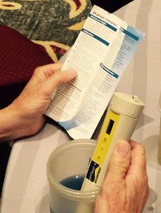
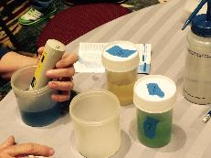
I. How to Collect your Data: pH Water Protocol using
a pH Meter: Electrical Conductivity Less than 200 mS/cm
(6/8)
12. Calibrate the pH meter according to the manufacturer’s directions, using the three buffer solutions.
13. Put the electrode part of the meter into the water.
14. Stir once with the meter. Do not let the meter touch the bottom or sides of the beaker. Wait one minute. If the pH meter is still changing number,
wait another minute.

Slide 19
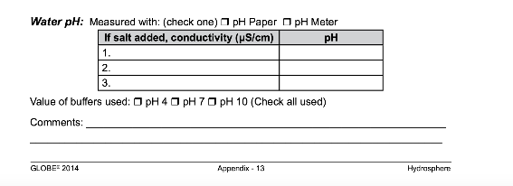
I. How to Collect your Data: pH Water Protocol using
a pH Meter: Electrical Conductivity Less than 200 mS/cm (7/8)
15. Record the pH value on the Hydrosphere Data Sheet (see inset below).
16. Repeat steps 3-10 twice using new water samples. You do NOT need to calibrate the pH meter again. Record conductivity and pH values on the Data Sheet.
17. Check to see if each of the three observations is within 0.2 of the average. If all three are within 0.2, record the average on the Data Sheet. If all three observations are not within 0.2, repeat the measurements.
x

Slide 20
I. How to Collect your Data: pH Water Protocol using
a pH Meter: Electrical Conductivity Less than 200 mS/cm (8/8)
18. Calculate the average of the three observations and record on the Data Sheet.
Calculate Average: Observer 1 + Observer 2 + Observer 3
3
19. Rinse the electrode with distilled water and blot dry. Turn off the meter and put on cap to protect the electrode.
20. Enter your data on the GLOBE Website.
*End of data collection for this pH Water Protocol*
If you cannot get all three measurements within 0.2 of one another, talk to a master trainer about possible problems

Slide 21


II. pH Water Protocol using a pH Meter: Electrical Conductivity Greater than 200 mS/cm (1/5 slides)
If your study site is brackish or the Ocean, you can assume that the Electrical Conductivity is Greater than 200 mS/cm.
Assemble Water pH Equipment
pH meter
100-ml beaker
Protective gloves
Pen or Pencil
Distilled water in wash bottle
Clean paper towels or tissue
mL of pH 4.0 buffer solution in a jar with a lid: labeled pH 4.0
25 mL of pH 7.0 buffer solution in a jar with a lid: labeled pH 7.0
25 mL of pH 10.0 buffer solution in a jar with a lid: labeled pH 10.0
Water pH Data Sheet
Electrical Conductivity Field Guide
pH Water Protocol using a pH Meter: Electrical Conductivity Greater than 200 mS/cm
Note: jars should have an opening large enough to immerse the pH meter

Slide 22


IV. pH Water Protocol using a pH Meter: Electrical Conductivity Greater than 200 mS/cm (2/5)
1.. Fill in the top part of the Hydrosphere Investigation. In the pH section of the Data Sheet, check the box next to “pH meter”.
2. Put on protective gloves.
3. Remove the cap from the meter that covers the electrode (the glass bulb on the pH meter)
4. Rinse the electrode on the meter and the area around it with distilled water in the wash bottle. Blot the meter dry with a clean paper towel or tissue. Note: Do not rub the electrode or touch it with your fingers.
5. Rinse the electrode with distilled water and blot dry again.
SAFTEY be sure to wear gloves and goggles during your investigation

Slide 23


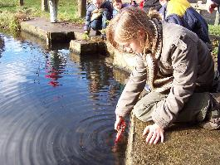
II. How to Collect your Data: pH Water Protocol using
a pH Meter: Electrical Conductivity Greater than 200 mS/cm (3/5)
6. Calibrate the pH meter according to the manufacturer’s directions, using the three buffer solutions.
7. Rinse a 100-mL beaker three times with sample water.
8. Pour 50 mL of sample water into the 100-mL beaker.
9. Put the electrode part of the meter into the water.
10. Stir once with the meter. Do not let the meter touch the bottom or sides of the beaker. Wait one minute. If the pH meter is still changing numbers, wait another minute.
Pay close attention to your calibration procedure. Without the calibration step your pH data will not be meaningful or comparable to data collected by others!

Slide 24
II. How to Collect your Data: pH Water Protocol using
a pH Meter: Electrical Conductivity Greater than 200 mS/cm (4/5)
.
Record your data from your first measurement on the Hydrology Data Sheet.
12. . Repeat steps 3-10 using new water samples. You do NOT need to calibrate the pH meter again. Record conductivity and pH values on Data Sheet as Observer 2 and Observer 3.
13. Check to see if each of the three observations is within 0.2 of the average. If all three are within 0.2, record the average on the Data Sheet If all three observations are not within 0.2, repeat the measurements.
x
If you cannot get all three measurements within 0.2 of one another, contact a GLOBE Master Trainer

Slide 25
II. How to Collect your Data: pH Water Protocol using
a pH Meter: Electrical Conductivity Greater than 200 mS/cm (5/5)
.
14.. Calculate the average of the three observations and record on the
Data Sheet:
Calculate Average: Observer 1 + Observer 2 + Observer 3
3
15. . Rinse the electrode with distilled water and blot dry. Turn off the meter. Put on the cap to protect the electrode
16. Enter your data on the GLOBE Website.
*End of data collection for this pH Water Protocol*

Slide 26
Hydrosphere Site Creation
If this is your first time making hydrosphere observations at this location, you will need to create a new Hydrosphere study site before entering data.
To do this, please review the Introduction to Hydrosphere training.

Slide 27
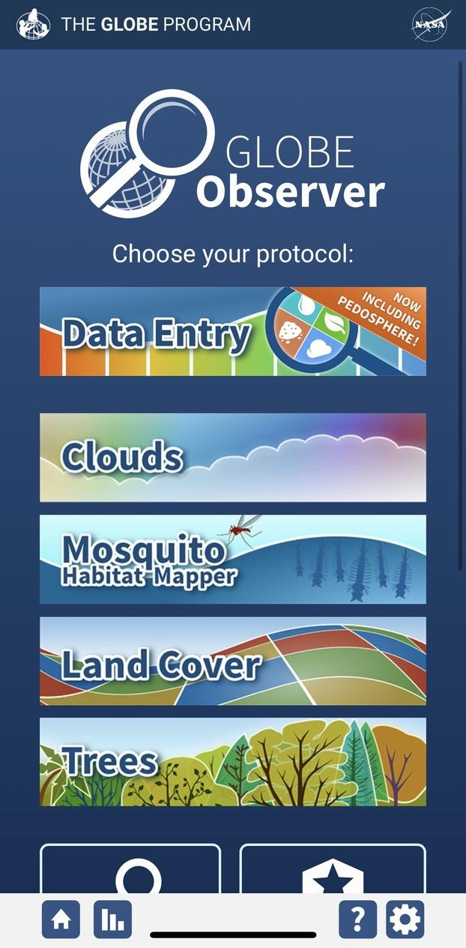
Submit Your Data to GLOBE
1.Desktop Data Entry: Log environmental data directly on the GLOBE website.
2.GLOBE Observer App: The app allows users to enter data directly from an iOS or Android device for any GLOBE protocol.

Slide 28
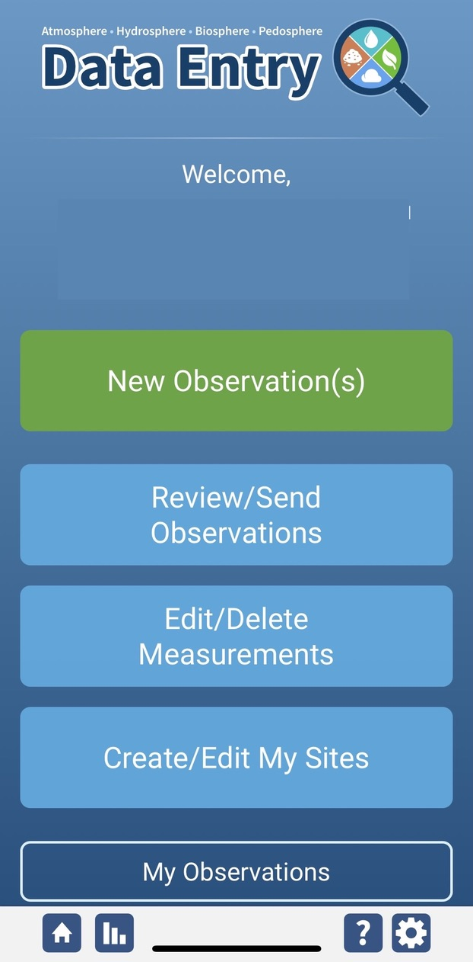
Water pH Protocol Data Entry
To enter data, first return to GLOBE Observer main page by clicking the home button in the bottom left.
Select “Data Entry”.
Next, click “New Observation(s)”

Slide 29
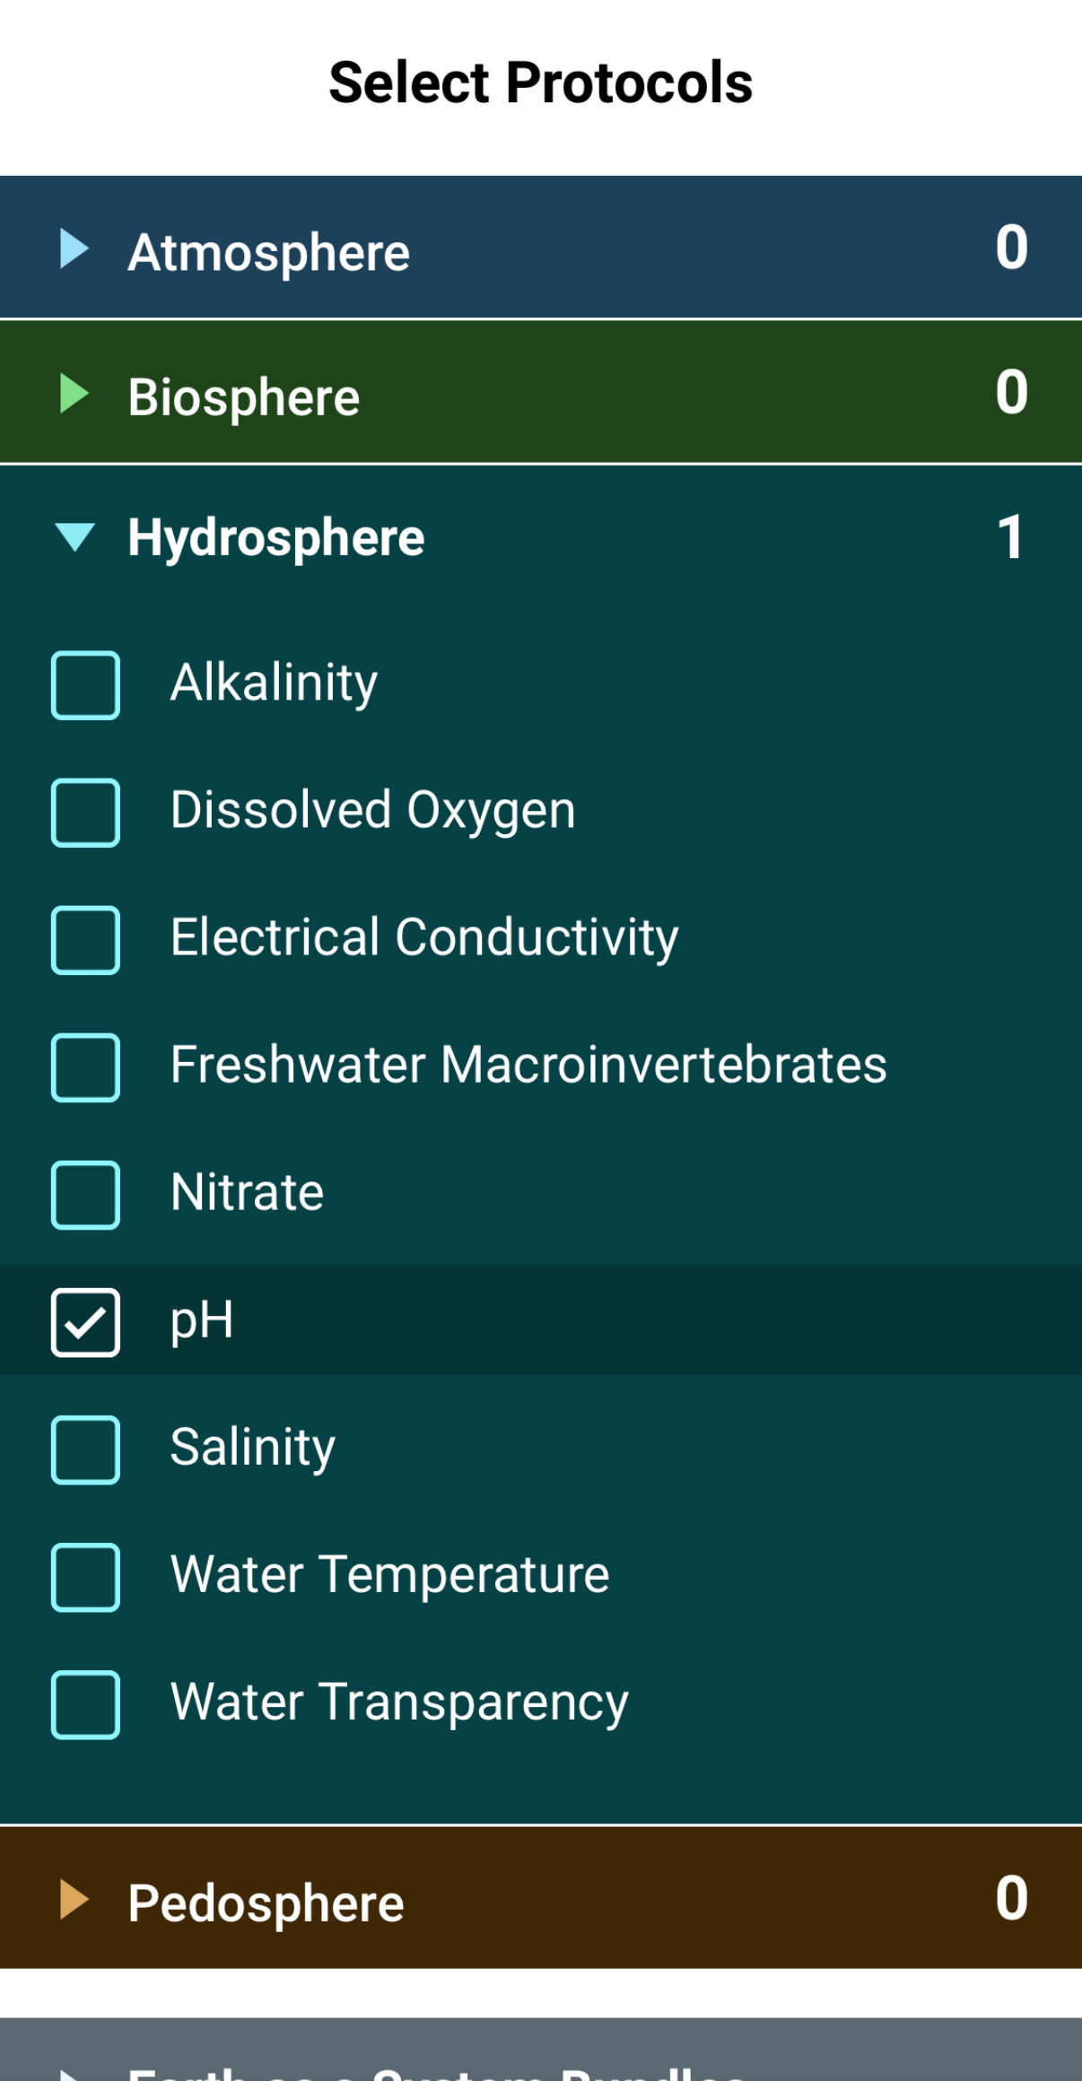
Water pH Protocol Data Entry
Select Water pH from the list of Hydrosphere protocols. Click Continue at the bottom of the screen.

Slide 30
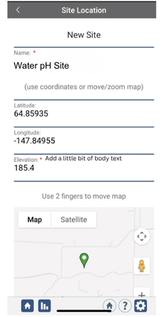
Water pH Protocol Site Information
If you have not already created a Hydrosphere site, create one now.
Click “New Site” at the bottom of the site location screen and choose a name for your new site.

Slide 31
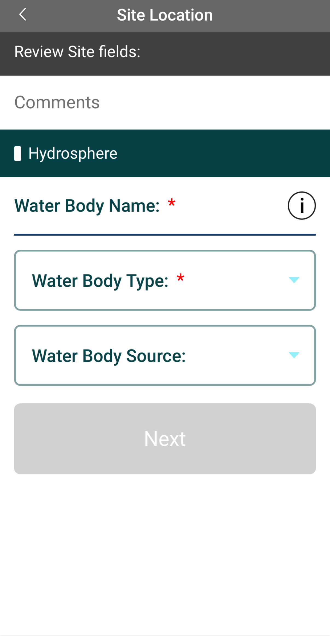
Water pH Protocol Site Information
Enter the Water Body Name.
Select the Water Body Type and Water Body Source from the dropdown list of options.

Slide 32
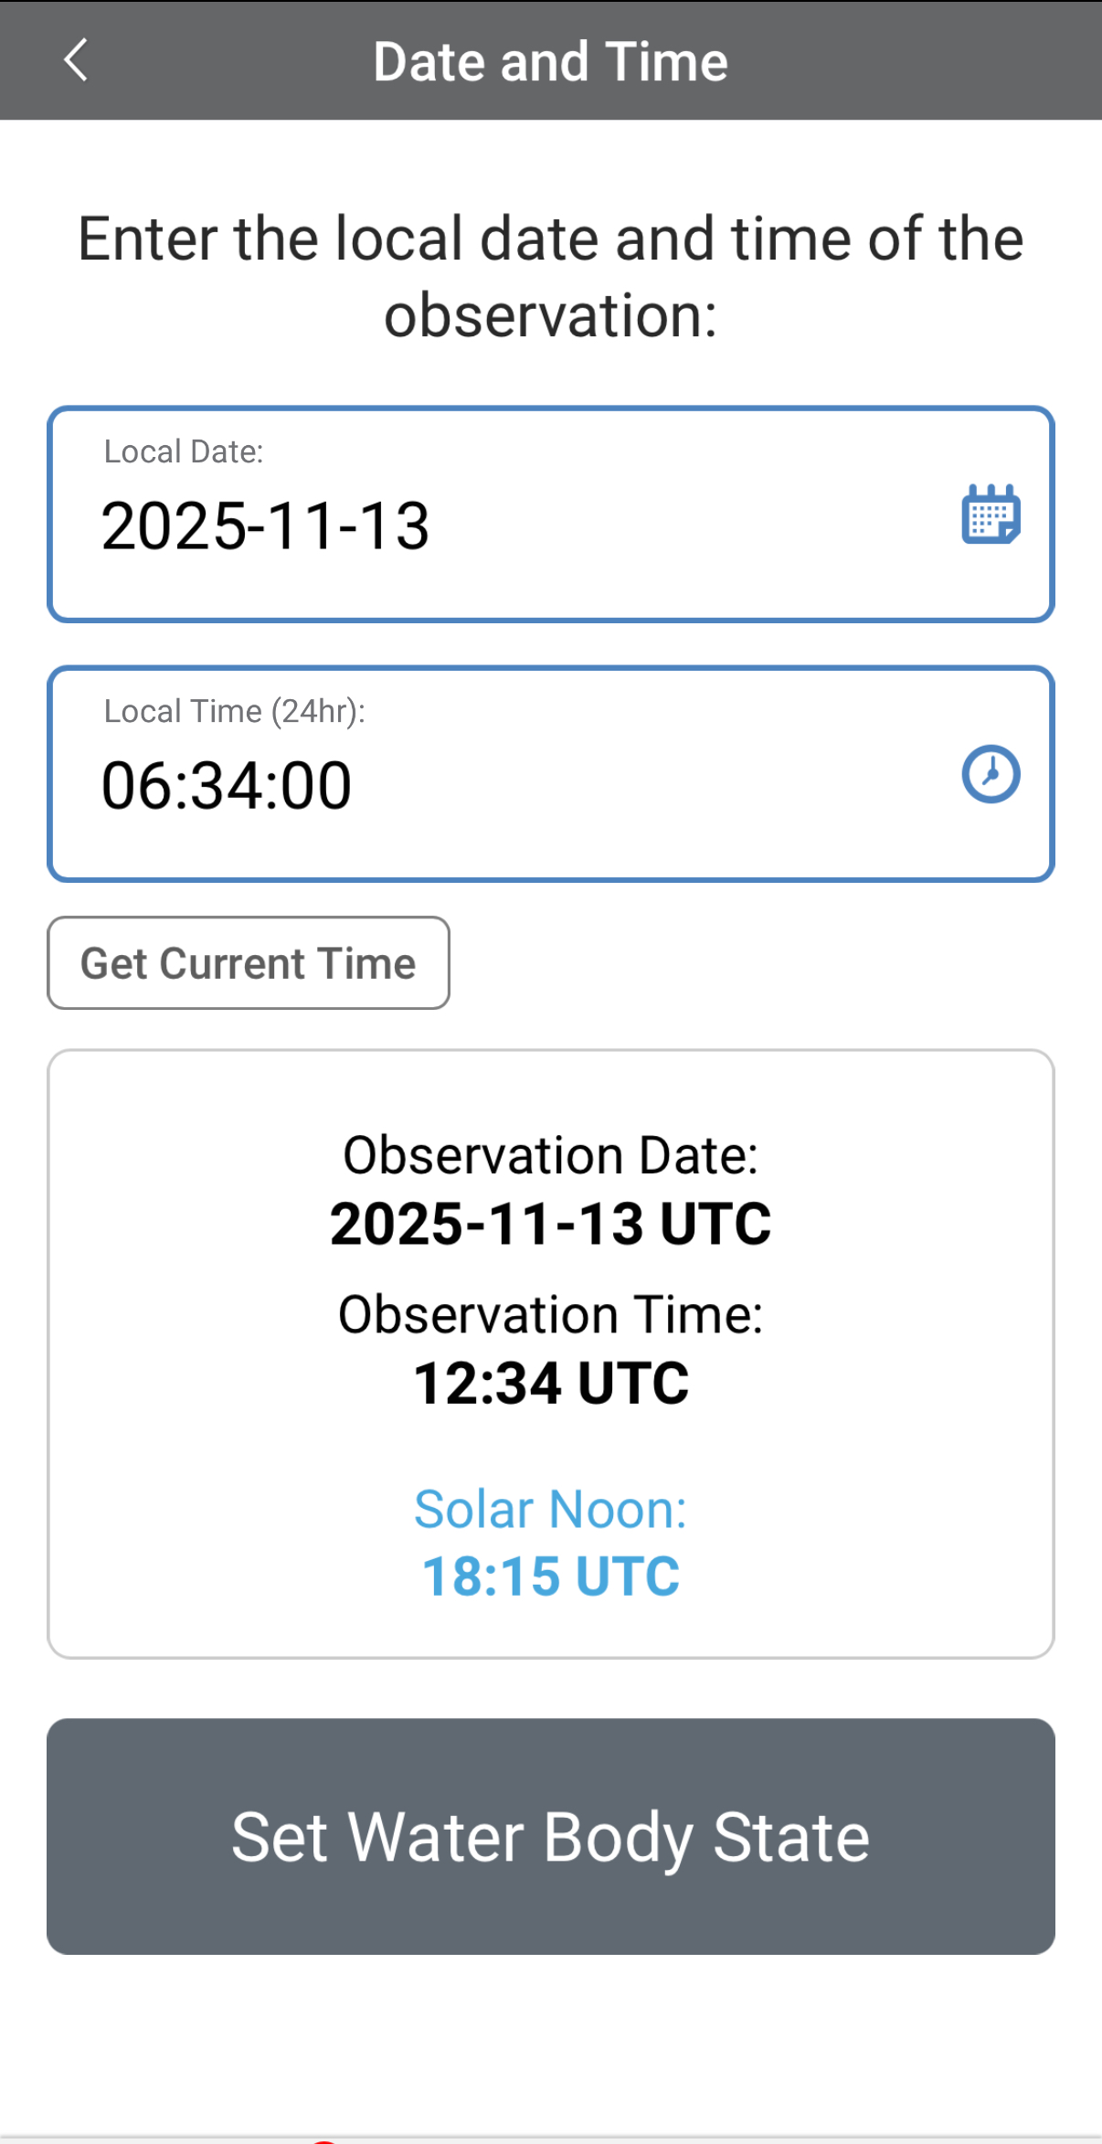
Entering Measurement Data
Enter the date and time you took the measurements.
Once you enter the date, select Set Water Body State to enter your data.

Slide 33
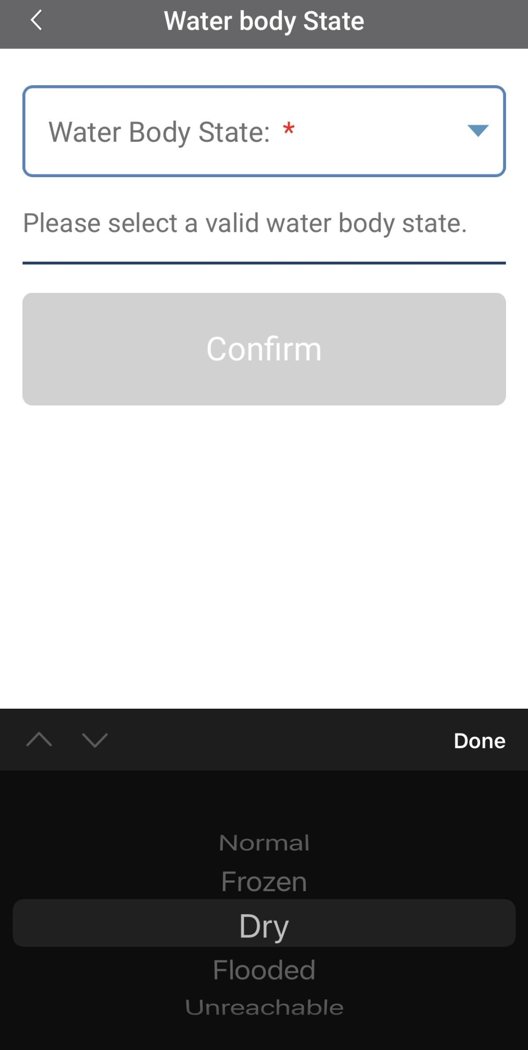
Enter the Water Body State
Select the Water Body State from the dropdown list of options.
Data entry is allowed only when the state is set as “normal.” If the water body is dry, frozen or flooded, the system will not allow the measurements to be entered.

Slide 34
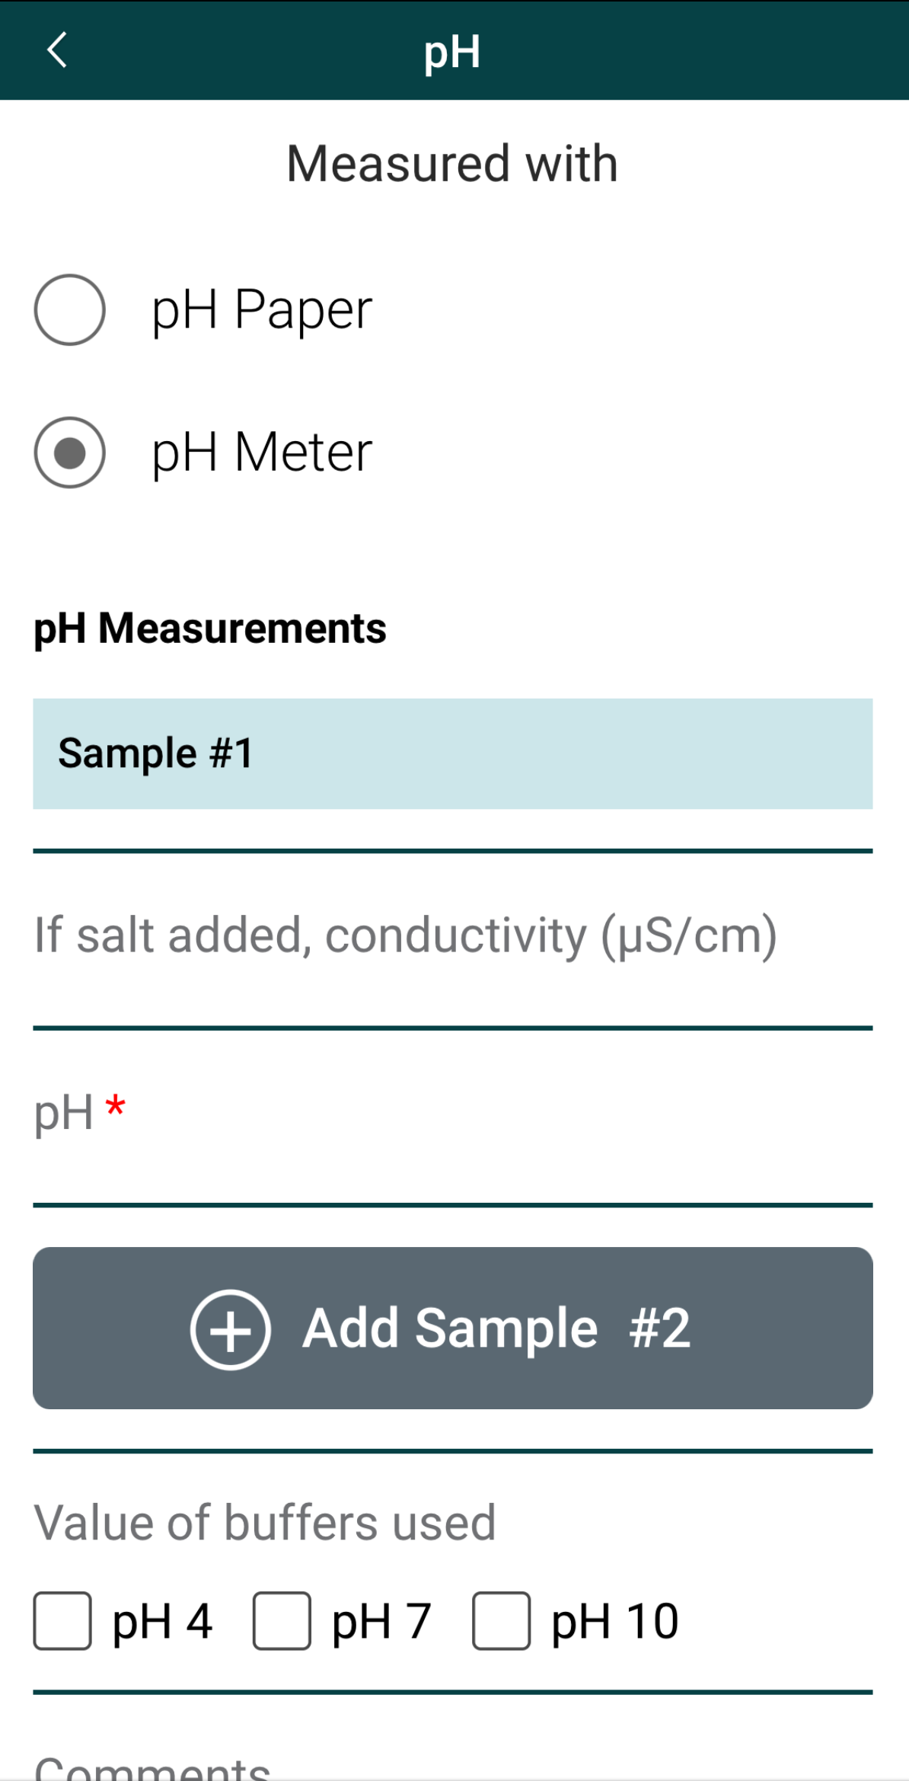
Enter Water pH Measurement Data
Select pH Meter as the type of instrument used.
If you added salt to the water sample, enter the conductivity.
Enter the pH measurement.
Select the pH value of buffers used.

Slide 35
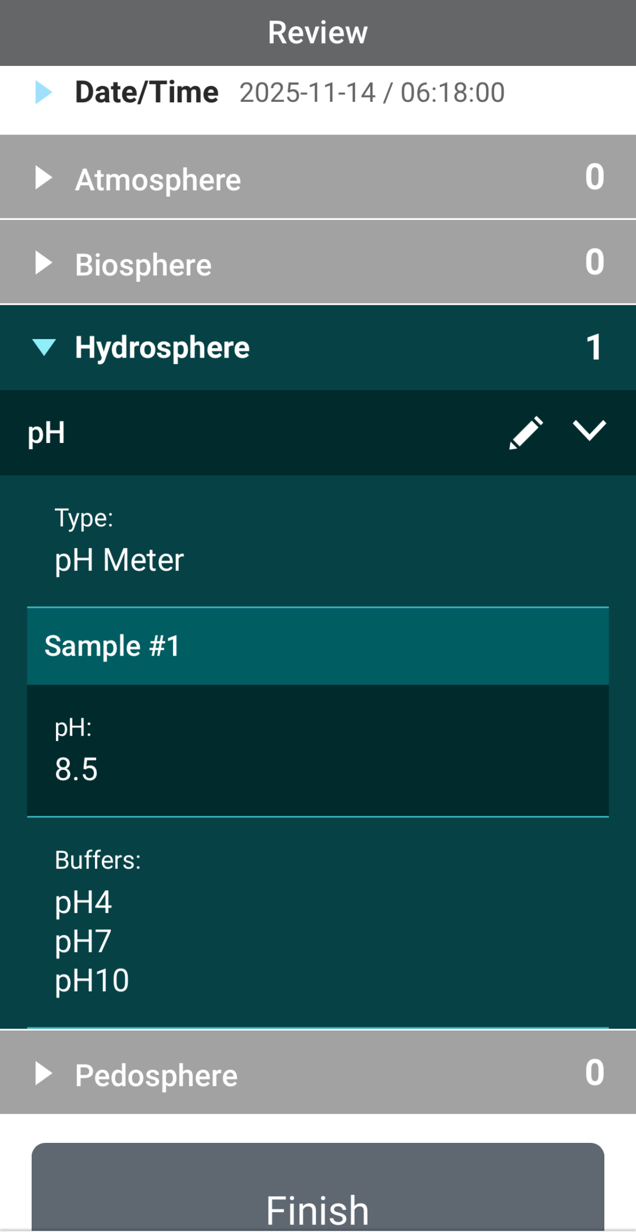
Review Data Entry and Send Data
Review the data you entered and check for errors.
When complete, select Finish to complete the send the observation to GLOBE.

Slide 36
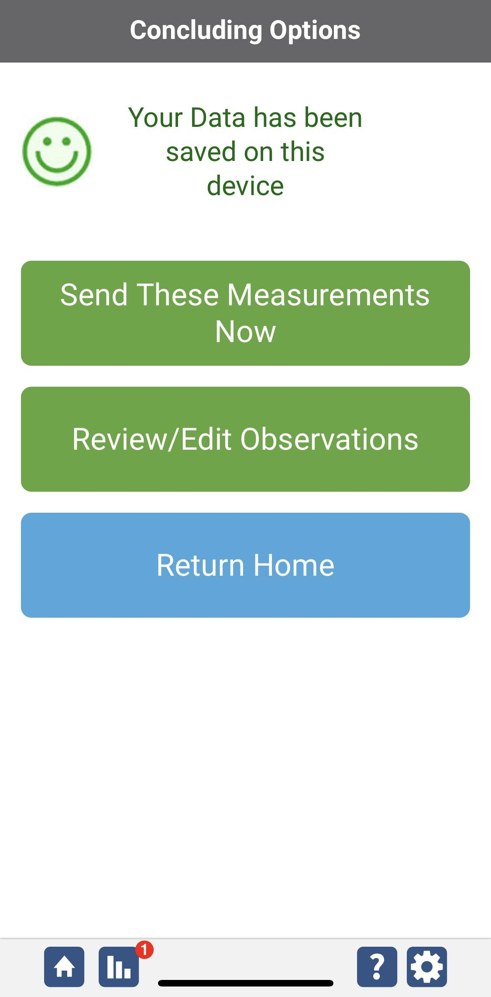
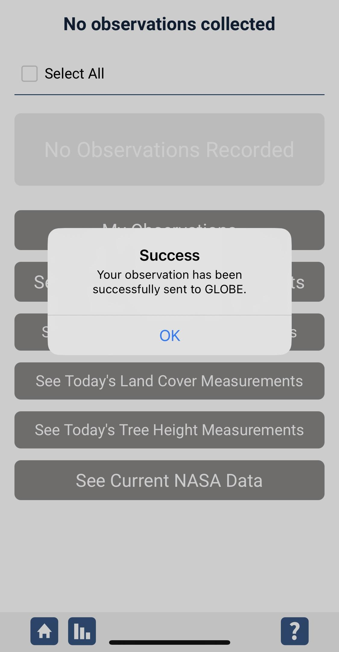
Data System Responses
If your observations are within the appropriate ranges, you will see a green smiley face.
You can review or edit your observation if needed.
When ready, select “Send these measurements now” to send your data to GLOBE. When it has been sent, you will see a “Success” message.

Slide 37
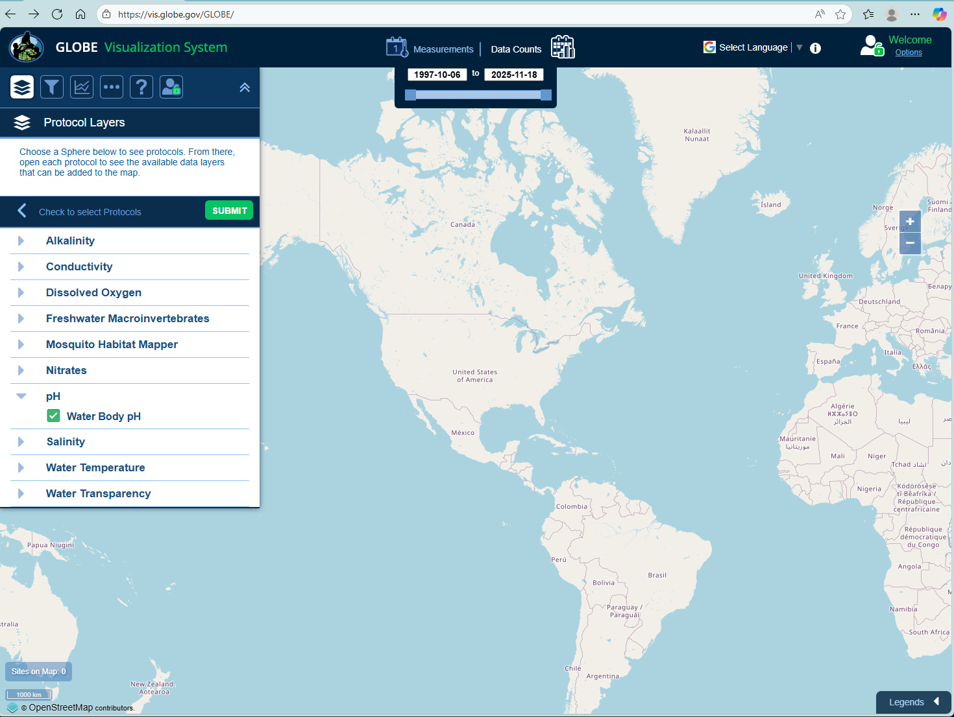
Visualize and Retrieve Water pH Data
GLOBE provides the ability to view and interact with data measured across the world. Select our visualization tool to map, graph, filter and export pH data that have been measured across GLOBE protocols since 1995. Here are screenshots steps you will use when you use the visualization tool:
Select Water Body pH from drop down menu, then click “Submit”
Link to step-by-step tutorial on using the GLOBE Data Visualization Tool

Slide 38
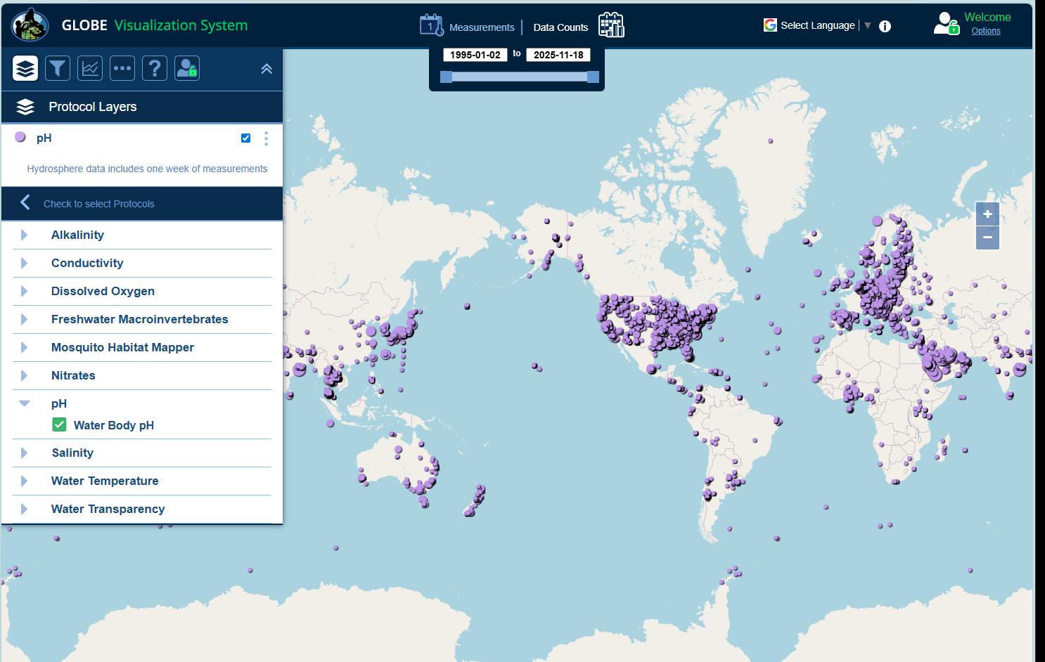
Visualize and Retrieve Water pH Data
Select the date for which you need pH data, add layer and you can see where data is available.
Locations where pH data is available for the week you selected

Slide 39
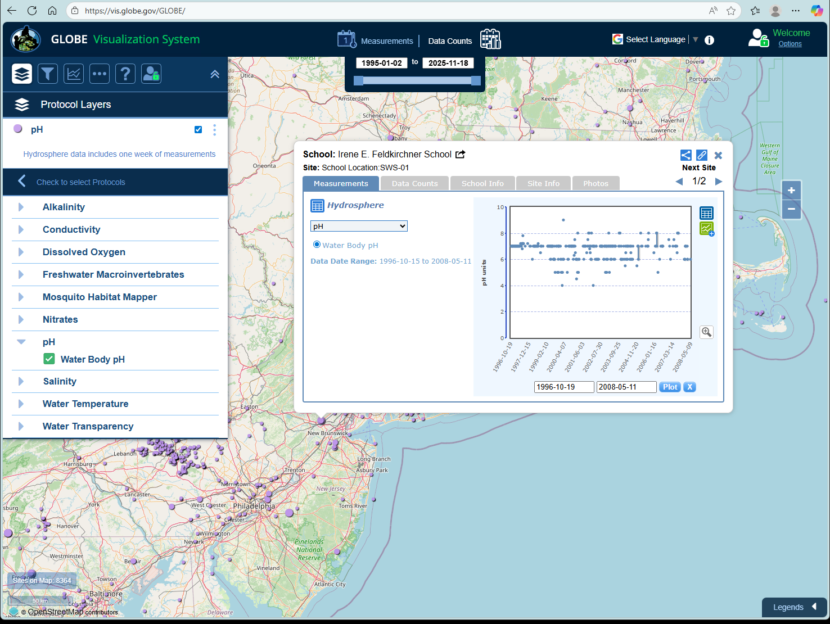
Visualize and Retrieve Water pH Data
Select the sampling site for which you need pH data, and a box will open with data summary for that site.
Clicking on a location will open to a map note providing pH data for that location and time.

Slide 40
You have now completed the slide stack. If you are ready to take the quiz, sign on and take the quiz corresponding to Water pH Protocol.
You can also review the slide stack, post questions on the discussion board, or look at the FAQs on the next page.
When you pass the quiz, you are ready to take Water pH Protocol measurements!

Slide 41

Review questions to help you prepare to conduct the Hydrosphere pH Protocol
What is the importance of pH to aquatic life?
What is a logarithmic scale? Why is it a useful way to report pH?
True/False pH affects the solubility and biological availability of nutrients.
In a water body, what happens to aquatic life in waters with pH values below 4.0 or above 10.0?
What other measurement, in addition to pH, must you do to ensure that your pH paper or meter is reporting accurately?
What are the safety precautions you should take when doing any of the hydrology protocols?
What is the acceptable range of error of the three replicate samples you take?
What kinds of environmental events could change water pH?
Which pH value is more acid: a pH value of 1 or a pH value of 14?
What is the pH value of pure water?

Slide 42
FAQ: Frequently Asked Questions
Does water temperature affect my pH reading?
A change in water temperature can actually change the pH value of your water. Since we want to know the actual pH value, we do not correct for this change.
Temperature can also affect the performance of the meter. The electrode is designed so there is no temperature sensitivity when the pH is 7.0. As the pH moves away from this value, the water temperature affects meter accuracy. Meters with automatic temperature compensation (ATC) correct for the temperature of the water at values above and below 7.0 by a factor of 0.003 pH/ ̊C/pH unit away from pH 7. They correct for meter error.
Does high salt concentration affect pH?
Salt concentration can affect pH. As salt concentration increases, pH can increase. This is not a linear relationship, but can be important in estuaries, where the salinity varies with the tide. Taking into account salinity or conductivity data may be useful in understanding variations in your pH measurements.

Slide 43
FAQ: Frequently Asked Questions
Why may pH measurements be inaccurate in low conductivity waters?
To measure the hydrogen ion concentration, you are actually measuring the potential of the hydrogen ions. Other ions have to be present to pass the current to make this measurement. When they are at too low of a concentration the meter slowly drifts and if the drift is really slow, the meter locks in on an incorrect measurement
Can I use a pH meter that connects to my Smart Phone?
Yes, pH meters that connect to iPhones, iPads and other Smart devices can be considered pH meters. For most of these meters an app is required.

Slide 44

We want your Feedback!
Please provide us with feedback about this module. This is a community project and we welcome your comments, suggestions and edits! Please take a minute to comment here: Training@nasaglobe.org
Credits:
Slides:
Russanne Low, Ph.D., University of Nebraska-Lincoln, USA
Rebecca Boger, Ph.D., Brooklyn College, NYC, USA
Photos: Russanne Low
Art: Jenn Glaser, ScribeArts
More Information:
GLOBE Program, NASA Earth Science
NASA Global Climate Change: Vital Signs of the Planet
The GLOBE Program is sponsored by these organizations:
Version 11/17/25. Modified by GLOBE Implementation Office – Science, Training, Education, and Public Engagement. If you edit and modify this slide set for use for educational purposes, please note “modified by (and your name and date)" on this page. Thank you.

