Slide 1

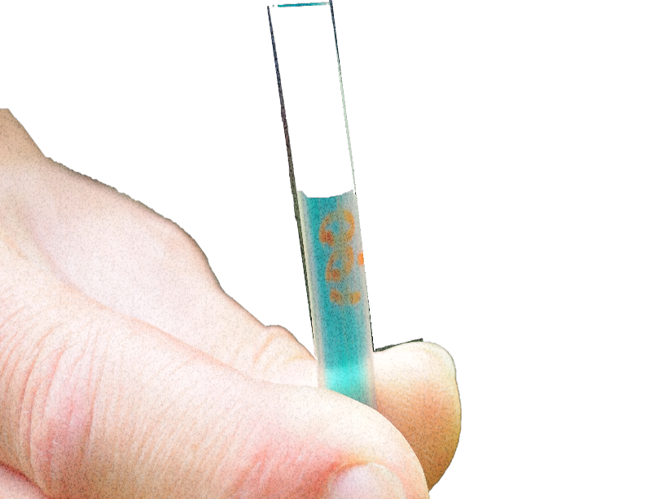
A. Why measure frost depth?
B. Properties that affect frost depth.
C. When & where to measure.
D. Required materials.
E. Making a frost tube.
F. Installing a frost tube.
G. Measuring frost depth.
H. Report data to GLOBE.
I. Data Visualization.
J. Additional Information.

Slide 2



Frost Tube Overview & Learning Objectives
Soil (Pedosphere) Frost Tube
A. Why measure frost depth?
B. Properties that affect frost depth.
C. When & where to measure.
D. Required materials.
E. Making a frost tube.
F. Installing a frost tube.
G. Measuring frost depth.
H. Report data to GLOBE.
I. Data Visualization.
J. Additional Information.
Frost tube measures the depth of freezing in soils that seasonally freeze and thaw.
The soil frost tube protocol allows GLOBE students and scientists to see what part of the soil freezes and when the freezing starts and thaws in different seasons and parts of the world.
Learning Objectives:
After completing this module, you will be able to
Explain why depth of freezing is worth measuring
Decide where to install a Frost Tube
Determine a schedule for taking Frost Tube measurements
Measure frost depth using a Frost Tube
Report these data to GLOBE
Estimated time needed for completion of this module: 1.5 hours

Slide 3

Soil (Pedosphere) Frost Tube
A. Why measure frost depth?
B. Properties that affect frost depth.
C. When & where to measure.
D. Required materials.
E. Making a frost tube.
F. Installing a frost tube.
G. Measuring frost depth.
H. Report data to GLOBE.
I. Data Visualization.
J. Additional Information.
What is frost depth?
Frost depth (also known as the depth of freezing) is the depth below the soil surface to which soil is frozen. The soil underneath this depth is unfrozen.
Students use a Frost Tube to measure the depth of freezing as the ground cools.
The boundary in the inner tube between
clear ice and colored unfrozen water
indicates depth of freezing measured
from the soil surface to the underlying
unfrozen soil.

Slide 4

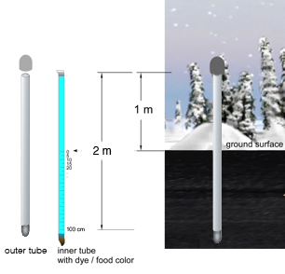
Why measure frost depth?
Soil (Pedosphere) Frost Tube
A. Why measure frost depth?
B. Properties that affect frost depth.
C. When & where to measure.
D. Required materials.
E. Making a frost tube.
F. Installing a frost tube.
G. Measuring frost depth.
H. Report data to GLOBE.
I. Data Visualization.
J. Additional Information.
Changes in frost depth, timing of freezing, and length of freezing period are important because of their effects on
  Plant growth and stability of vegetation
  Floods
  Construction
  Transportation
  Frost heave
  Grave digging
  Permafrost

Slide 5
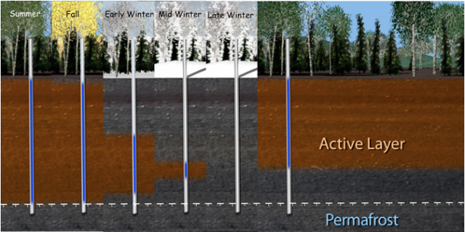
In areas with permafrost , almost all biological activity takes place in the active layer.
Soil (Pedosphere) Frost Tube
A. Why measure frost depth?
B. Properties that affect frost depth.
C. When & where to measure.
D. Required materials.
E. Making a frost tube.
F. Installing a frost tube.
G. Measuring frost depth.
H. Report data to GLOBE.
I. Data Visualization.
J. Additional Information.
As permafrost thaws, the active layer above it becomes larger, releasing carbon that had been stored for hundreds of thousands of years.
Studying the active layer helps scientists predict feedbacks and rates of climate change.
The layer of soil that seasonally freezes and thaws underlain by permafrost is called the
Earth materials that remain at or below 0°C for at least two consecutive years is

Slide 6
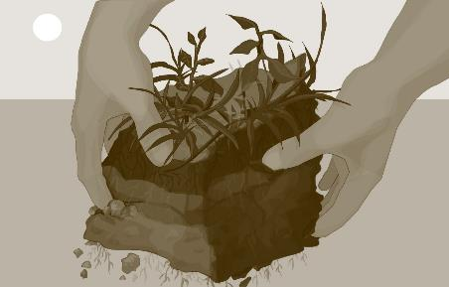
Properties that affect frost depth
Soil (Pedosphere) Frost Tube
A. Why measure frost depth?
B. Properties that affect frost depth.
C. When & where to measure.
D. Required materials.
E. Making a frost tube.
F. Installing a frost tube.
G. Measuring frost depth.
H. Report data to GLOBE.
I. Data Visualization.
J. Additional Information.
Temperature of the atmosphere. When air temperatures are
< or = 0°C, soils freeze from the top down.
Aspect (e.g. North-facing slope)
Moss, leaf litter, organic layer thickness
Snow depth
Soil texture
Soil moisture content
Bulk density
Permafrost
Salinity

Slide 7
Overview of Protocol
Soil (Pedosphere) Frost Tube
A. Why measure frost depth?
B. Properties that affect frost depth.
C. When & where to measure.
D. Required materials.
E. Making a frost tube.
F. Installing a frost tube.
G. Measuring frost depth.
H. Report data to GLOBE.
I. Data Visualization.
J. Additional Information.
Where | Anywhere that soil or ground seasonally freezes and thaws. Undisturbed and un-compacted soil on a flat slope.
Time | Construction of Frost Tube: 1 hour Selection of site, set up, installation of Frost Tube in summer/early fall: 1 - 2 hrs. Visits to and from site: 10 minutes (5 minutes to the site and 5 minutes to return) Time to read measurements: 5 minutes
Frequency | Measure at the same time of day (preferably within one hour of solar noon) once a week beginning when air temperatures reach freezing
Documents Needed | Frost Tube Site Definition Field Guide, Frost Tube Site Definition Sheet, Frost Tube Field Guide at Air Temperatures Warmer Than -20 C, Frost Tube Field Guide at Air Temperatures Colder Than -20 C, Frost Tube Data Sheet, GPS Protocol Field Guide (if using a new site), GPS Protocol Data Sheet, Optional protocols (air temp, surface temp, snowpack)

Slide 8
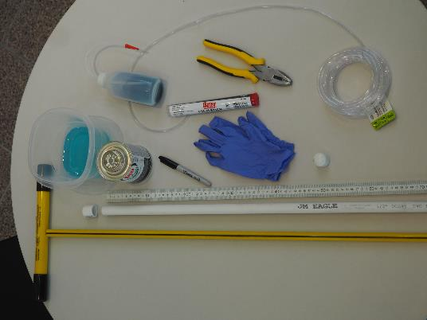
Soil (Pedosphere) Frost Tube
A. Why measure frost depth?
B. Properties that affect frost depth.
C. When & where to measure.
D. Required materials.
E. Making a frost tube.
F. Installing a frost tube.
G. Measuring frost depth.
H. Report data to GLOBE.
I. Data Visualization.
J. Additional Information.
Materials
Inner tube of clear tubing
Outer tube of PVC pipe
PVC cap for top
PVC or epoxy plug for bottom
PVC cement
Gas burner, alcohol lamp, or lighter
Pliers
Gloves
Food coloring and water
Black waterproof marker
Meter stick
Soil probe or steel rod
Flag
Frost Tube Definition Sheet

Slide 9
Make a Frost Tube
Soil (Pedosphere) Frost Tube
A. Why measure frost depth?
B. Properties that affect frost depth.
C. When & where to measure.
D. Required materials.
E. Making a frost tube.
F. Installing a frost tube.
G. Measuring frost depth.
H. Report data to GLOBE.
I. Data Visualization.
J. Additional Information.

Slide 10
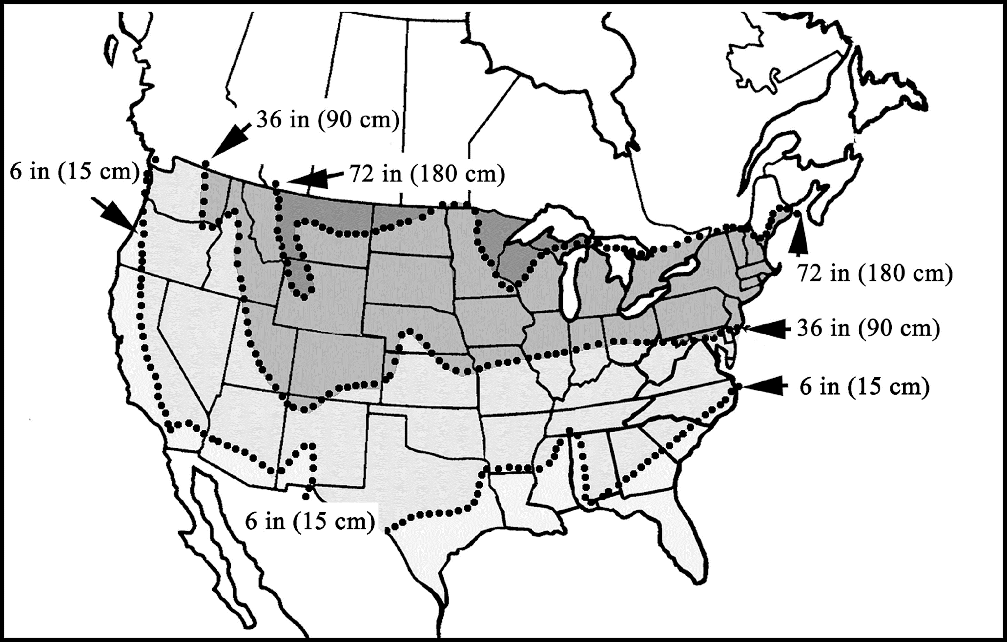
Step 1: Determine the Length of the Frost Tube
Soil (Pedosphere) Frost Tube
A. Why measure frost depth?
B. Properties that affect frost depth.
C. When & where to measure.
D. Required materials.
E. Making a frost tube.
F. Installing a frost tube.
G. Measuring frost depth.
H. Report data to GLOBE.
I. Data Visualization.
J. Additional Information.
In areas of seasonally frozen ground: The length of the Frost Tube should be a little longer than the depth to which the ground freezes in winter. A length of 1 m below the ground may be long enough.
Source: National Snow & Ice Data Center https://nsidc.org/sites/nsidc.org/files/images/NA_permafrost_0.jpg

Slide 11
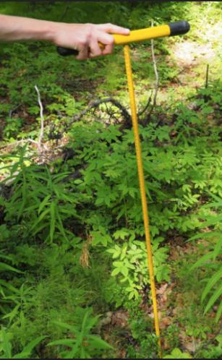
Step 1: Determine the Length of the Frost Tube
Soil (Pedosphere) Frost Tube
A. Why measure frost depth?
B. Properties that affect frost depth.
C. When & where to measure.
D. Required materials.
E. Making a frost tube.
F. Installing a frost tube.
G. Measuring frost depth.
H. Report data to GLOBE.
I. Data Visualization.
J. Additional Information.
In areas with permafrost: The length of the Frost Tube depends on the depth of the active layer.
The layer of soil above permafrost that seasonally freezes and thaws is called the active layer.
Check the thickness of the active layer using a steel stick (thaw probe) at the end of the summer.
Pound the probe into the ground until you hit permafrost. It will feel like you have hit rock or something very hard.

Slide 12
Step 2 & 3: Cut & Seal Outer Tube
Soil (Pedosphere) Frost Tube
A. Why measure frost depth?
B. Properties that affect frost depth.
C. When & where to measure.
D. Required materials.
E. Making a frost tube.
F. Installing a frost tube.
G. Measuring frost depth.
H. Report data to GLOBE.
I. Data Visualization.
J. Additional Information.
^{Add} 1 meter to the estimated below-ground length. The height of 1 m above ground allows the top of the Frost Tube to stick out of the snow (in most areas), be protected from runoff and animals, and be accessible.
Cut both tubes (inner and outer tubes) to the final length.
Use a PVC end plug or cap and/or epoxy to seal the bottom of the outer tube. Wear gloves. Secure the end plug/cap to the pipe with PVC cement.

Slide 13
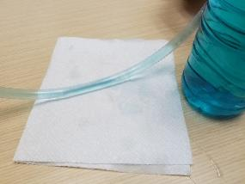
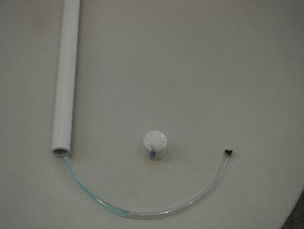
Step 4-8: Add colored water & seal inner tube
Soil (Pedosphere) Frost Tube
A. Why measure frost depth?
B. Properties that affect frost depth.
C. When & where to measure.
D. Required materials.
E. Making a frost tube.
F. Installing a frost tube.
G. Measuring frost depth.
H. Report data to GLOBE.
I. Data Visualization.
J. Additional Information.
In a large bowl mix water and food coloring to make bright but transparent color.
Fill inner tube with the colored water up to 15 cm from the top. (careful to keep it from pouring out)
Seal both ends using gas burner, clamping with pliers
Cap top of outer tube

Slide 14
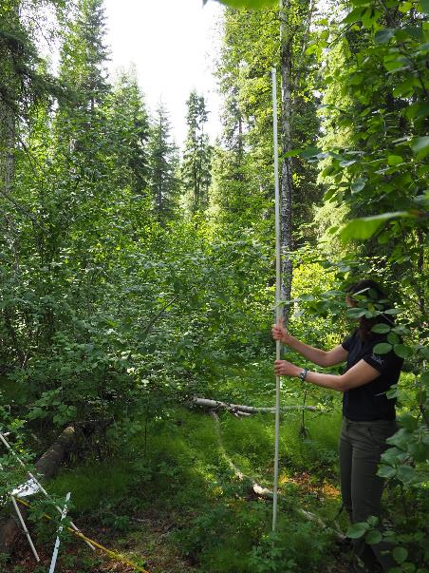
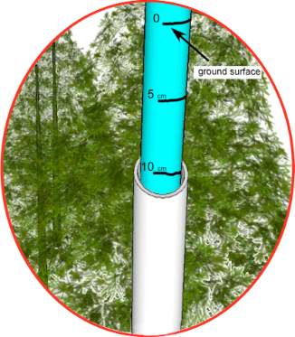
Soil (Pedosphere) Frost Tube
A. Why measure frost depth?
B. Properties that affect frost depth.
C. When & where to measure.
D. Required materials.
E. Making a frost tube.
F. Installing a frost tube.
G. Measuring frost depth.
H. Report data to GLOBE.
I. Data Visualization.
J. Additional Information.
Make hole in ground with probe
Insert Frost Tube
Label ground surface on outer tube
Pull out inner tube, mark ground surface & 5 cm increments

Slide 15
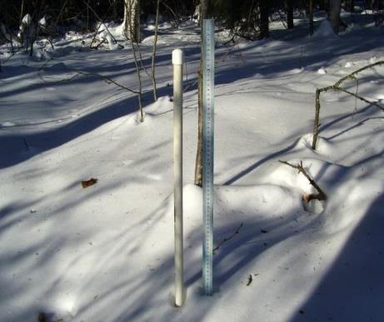
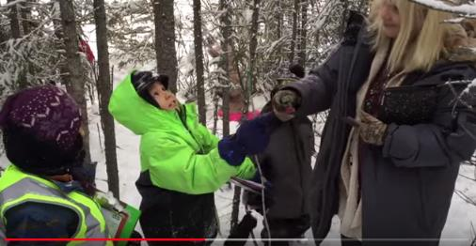
Install in Summer, Measure in Fall, Winter, Spring
Soil (Pedosphere) Frost Tube
A. Why measure frost depth?
B. Properties that affect frost depth.
C. When & where to measure.
D. Required materials.
E. Making a frost tube.
F. Installing a frost tube.
G. Measuring frost depth.
H. Report data to GLOBE.
I. Data Visualization.
J. Additional Information.
Venetie, Alaska
GLOBE students checking Frost Tube
NASA Explorers: CryoKids bonus episode
https://www.youtube.com/watch?v=uu-_K_S4IOA&list=PL2aBZuCeDwlQqXdZ_hXEX0OSI1vX_p9Cj&index=12&t=150s

Slide 16

Install in Summer. Measure in Fall, Winter, Spring
Soil (Pedosphere) Frost Tube
A. Why measure frost depth?
B. Properties that affect frost depth.
C. When & where to measure.
D. Required materials.
E. Making a frost tube.
F. Installing a frost tube.
G. Measuring frost depth.
H. Report data to GLOBE.
I. Data Visualization.
J. Additional Information.
Find the boundary between the ice at the top of the clear tubing and the water below it.
The ice appears relatively clear while the water is colored.
Measure the depth of this boundary to the nearest centimeter (by holding meter stick next to the inner tube).

Slide 17
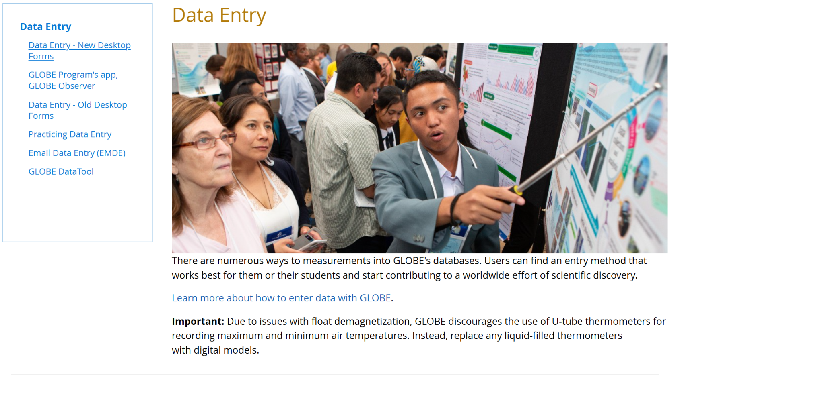
Soil (Pedosphere) Frost Tube
A. Why measure frost depth?
B. Properties that affect frost depth.
C. When & where to measure.
D. Required materials.
E. Making a frost tube.
F. Installing a frost tube.
G. Measuring frost depth.
H. Report data to GLOBE.
I. Data Visualization.
J. Additional Information.
Step 1: Go to data entry: https://www.globe.gov/globe-data/data-entry
Step 2: Click on “Data Entry - New Desktop Forms.”
Once your site is established, you can click on New Observation(s) from the Data Entry page.

Slide 18

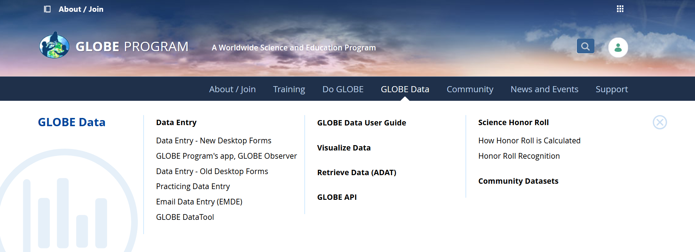
Reporting Data to GLOBE
Soil (Pedosphere) Frost Tube
A. Why measure frost depth?
B. Properties that affect frost depth.
C. When & where to measure.
D. Required materials.
E. Making a frost tube.
F. Installing a frost tube.
G. Measuring frost depth.
H. Report data to GLOBE.
I. Data Visualization.
J. Additional Information.
Two Options for Uploading Data:
These methods all allow users to submit environmental data – collected at defined sites, according to protocol, and using approved instrumentation – for entry into the official GLOBE science database.
Download the GLOBE Observer mobile app from the App Store.
Data Entry: Visit globe.gov, click on the “GLOBE Data” tab, then underneath “Data Entry” click on “Data Entry – New Desktop Forms”.

Slide 19
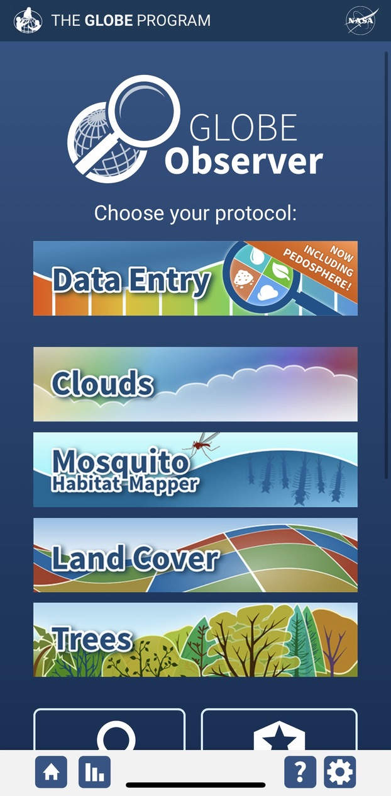
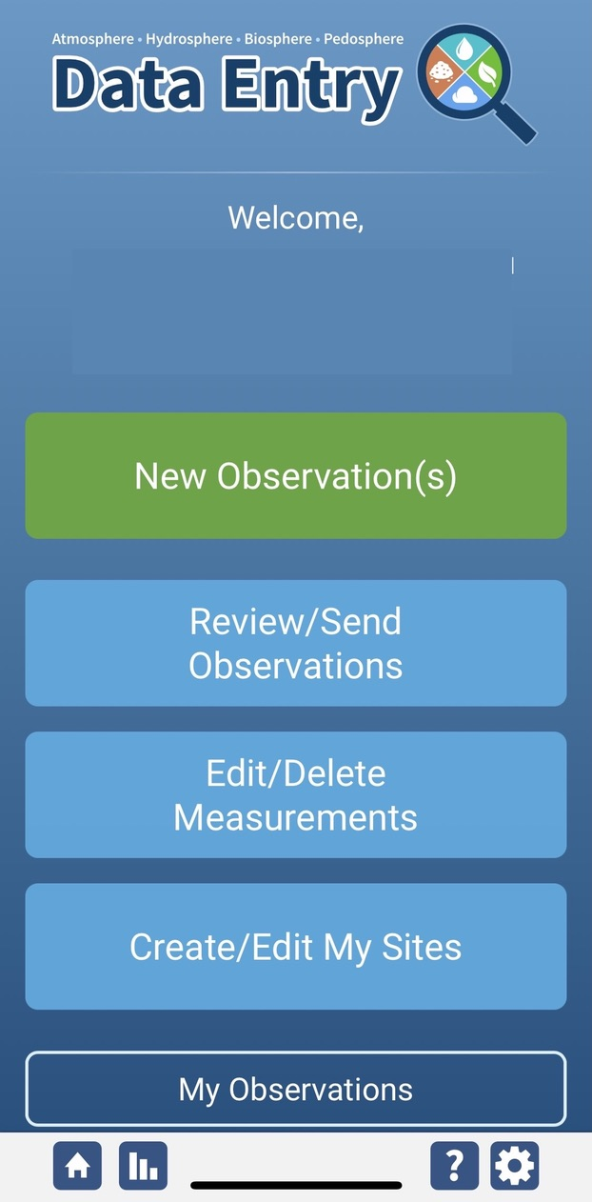
Frost Tube Site Creation
Soil (Pedosphere) Frost Tube
A. Why measure frost depth?
B. Properties that affect frost depth.
C. When & where to measure.
D. Required materials.
E. Making a frost tube.
F. Installing a frost tube.
G. Measuring frost depth.
H. Report data to GLOBE.
I. Data Visualization.
J. Additional Information.
If this is your first time making Frost Tube observations at this location, you will need to create a new site before entering data.
Open the GLOBE Observer App and select “Data Entry”.
Next, click “Create/Edit My Sites”

Slide 20
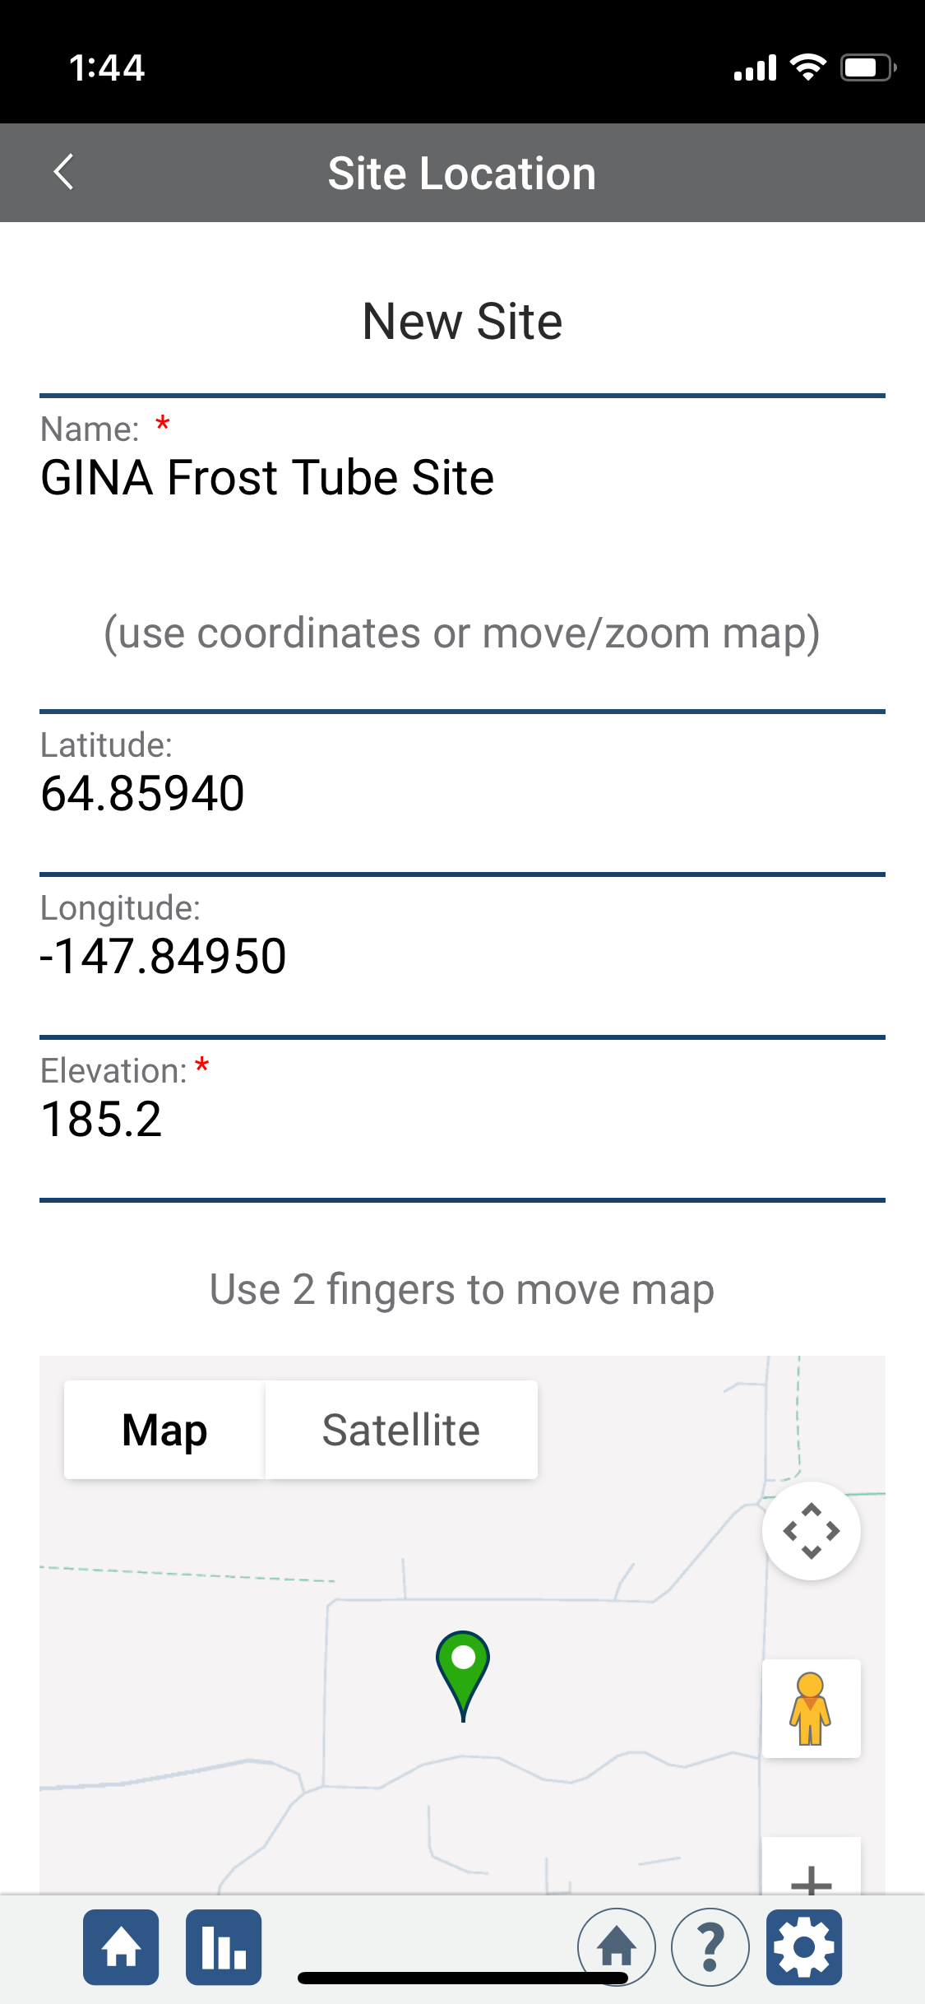
Frost Tube Site Creation
Soil (Pedosphere) Frost Tube
A. Why measure frost depth?
B. Properties that affect frost depth.
C. When & where to measure.
D. Required materials.
E. Making a frost tube.
F. Installing a frost tube.
G. Measuring frost depth.
H. Report data to GLOBE.
I. Data Visualization.
J. Additional Information.
Enter a name for your new site.
Use the map box to make sure the green popup is in the correct site location.
If you used a separate GPS device to locate your site, you can enter the coordinates manually.

Slide 21
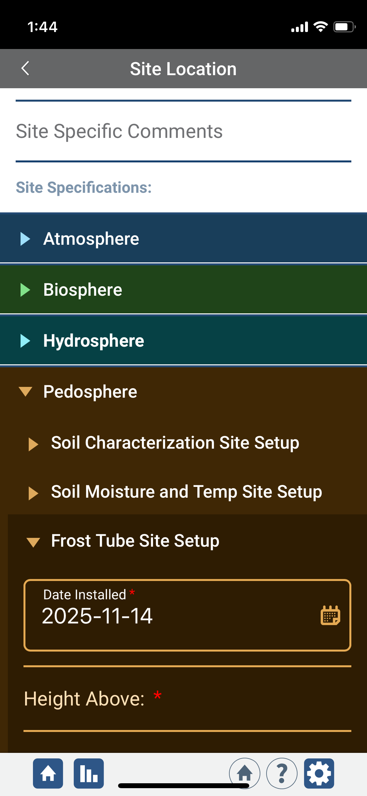
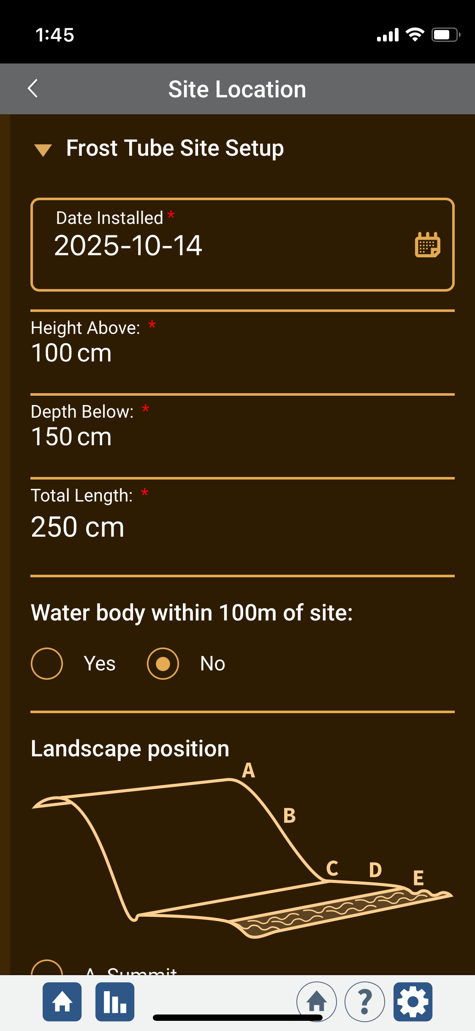
Frost Tube Site Creation
Soil (Pedosphere) Frost Tube
A. Why measure frost depth?
B. Properties that affect frost depth.
C. When & where to measure.
D. Required materials.
E. Making a frost tube.
F. Installing a frost tube.
G. Measuring frost depth.
H. Report data to GLOBE.
I. Data Visualization.
J. Additional Information.
Scroll down to the Pedosphere tab
Select Frost Tube Site Setup
Enter the installation date of your frost tube, the height, depth, and length of the tube, and landscape position.

Slide 22
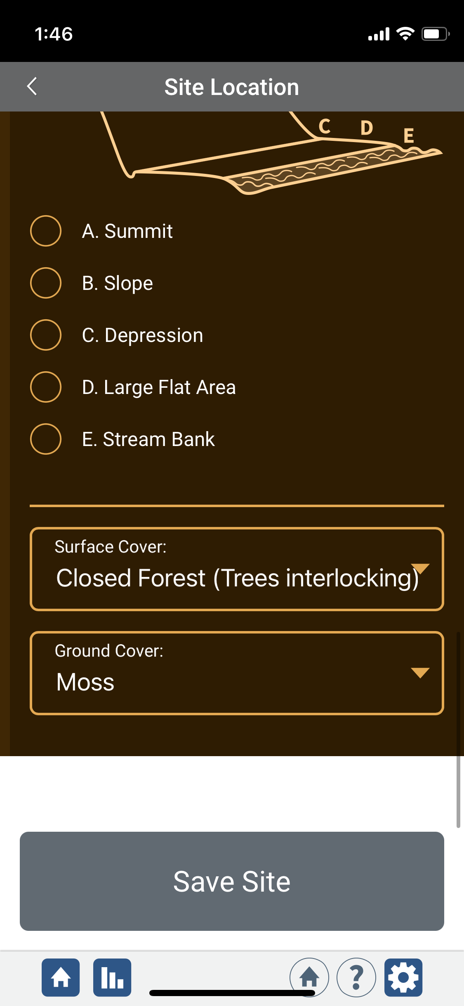
Frost Tube Site Creation
Soil (Pedosphere) Frost Tube
A. Why measure frost depth?
B. Properties that affect frost depth.
C. When & where to measure.
D. Required materials.
E. Making a frost tube.
F. Installing a frost tube.
G. Measuring frost depth.
H. Report data to GLOBE.
I. Data Visualization.
J. Additional Information.
Once you have entered all the site information for your frost tube, select “Save Site”

Slide 23
Frost Tube Data Entry
Soil (Pedosphere) Frost Tube
A. Why measure frost depth?
B. Properties that affect frost depth.
C. When & where to measure.
D. Required materials.
E. Making a frost tube.
F. Installing a frost tube.
G. Measuring frost depth.
H. Report data to GLOBE.
I. Data Visualization.
J. Additional Information.
To enter data, first return to the GLOBE Observer main page by clicking the home button in the bottom left.
Select “Data Entry”.
Next, click “New Observation(s)”

Slide 24
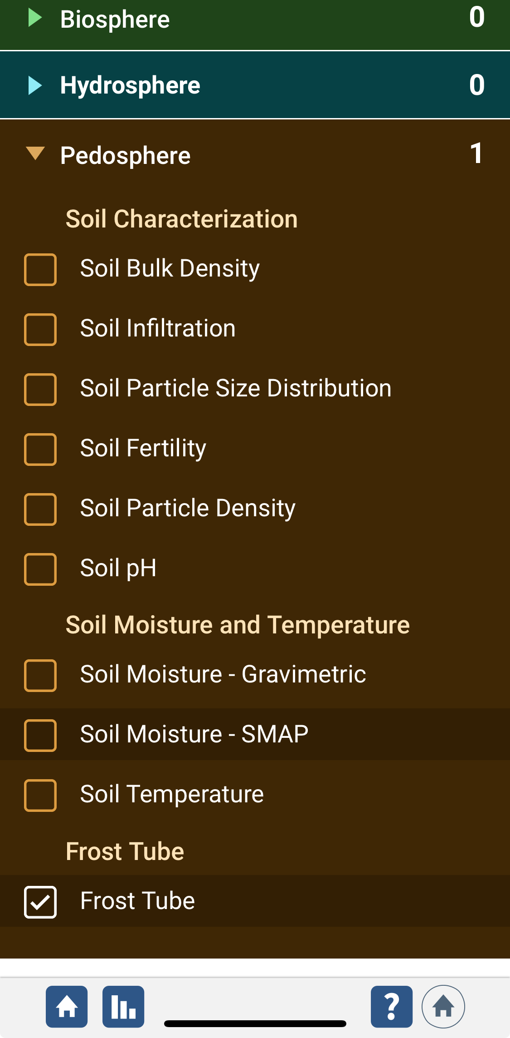
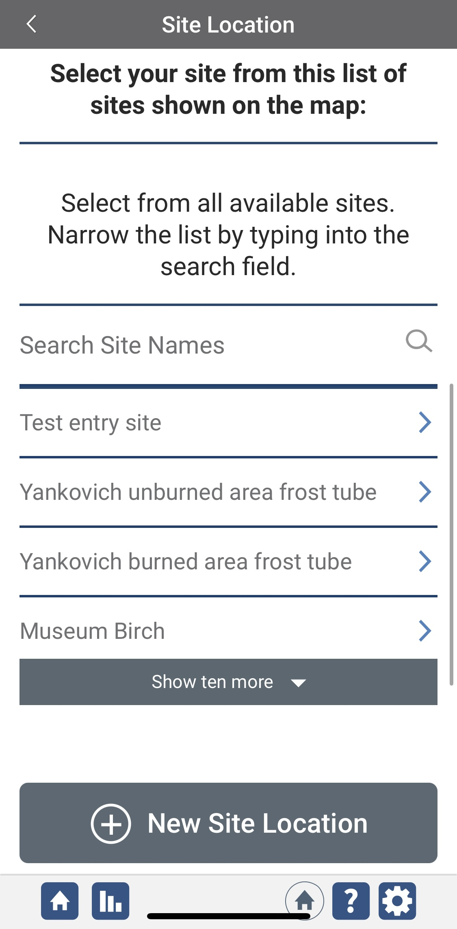
Frost Tube Data Entry
Soil (Pedosphere) Frost Tube
A. Why measure frost depth?
B. Properties that affect frost depth.
C. When & where to measure.
D. Required materials.
E. Making a frost tube.
F. Installing a frost tube.
G. Measuring frost depth.
H. Report data to GLOBE.
I. Data Visualization.
J. Additional Information.
Under the Pedosphere tab, select “Frost Tube” then click Continue at the bottom of the page.
Next, select your Frost Tube Site. Existing sites near you will show up below “Search Site Names”

Slide 25
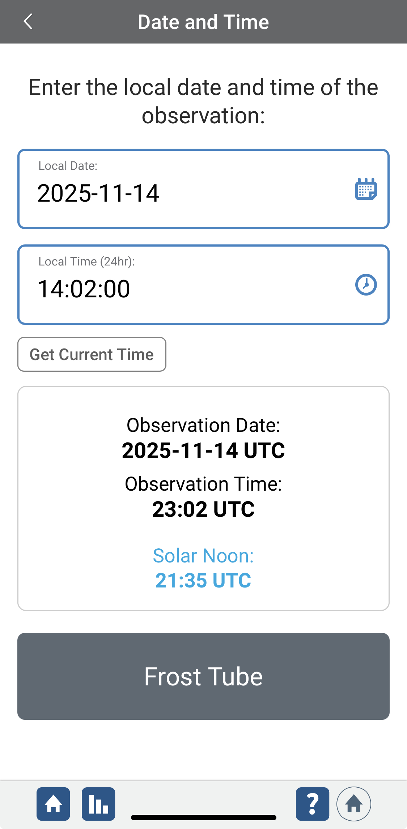
Frost Tube Data Entry
Soil (Pedosphere) Frost Tube
A. Why measure frost depth?
B. Properties that affect frost depth.
C. When & where to measure.
D. Required materials.
E. Making a frost tube.
F. Installing a frost tube.
G. Measuring frost depth.
H. Report data to GLOBE.
I. Data Visualization.
J. Additional Information.
Next, enter the date and time you took the measurements.
Select Frost Tube to enter your data.

Slide 26


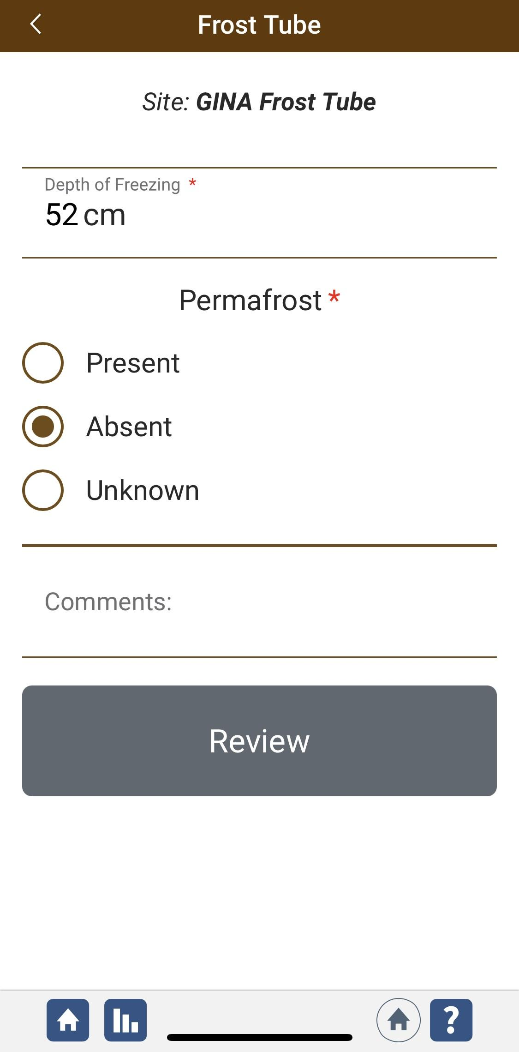
Frost Tube Data Entry
Soil (Pedosphere) Frost Tube
A. Why measure frost depth?
B. Properties that affect frost depth.
C. When & where to measure.
D. Required materials.
E. Making a frost tube.
F. Installing a frost tube.
G. Measuring frost depth.
H. Report data to GLOBE.
I. Data Visualization.
J. Additional Information.
Enter the depth of freezing in centimeters.
Select whether permafrost is present.
Add any additional comments or metadata in the Comments box.
Notes:
added “be” stored

Slide 27
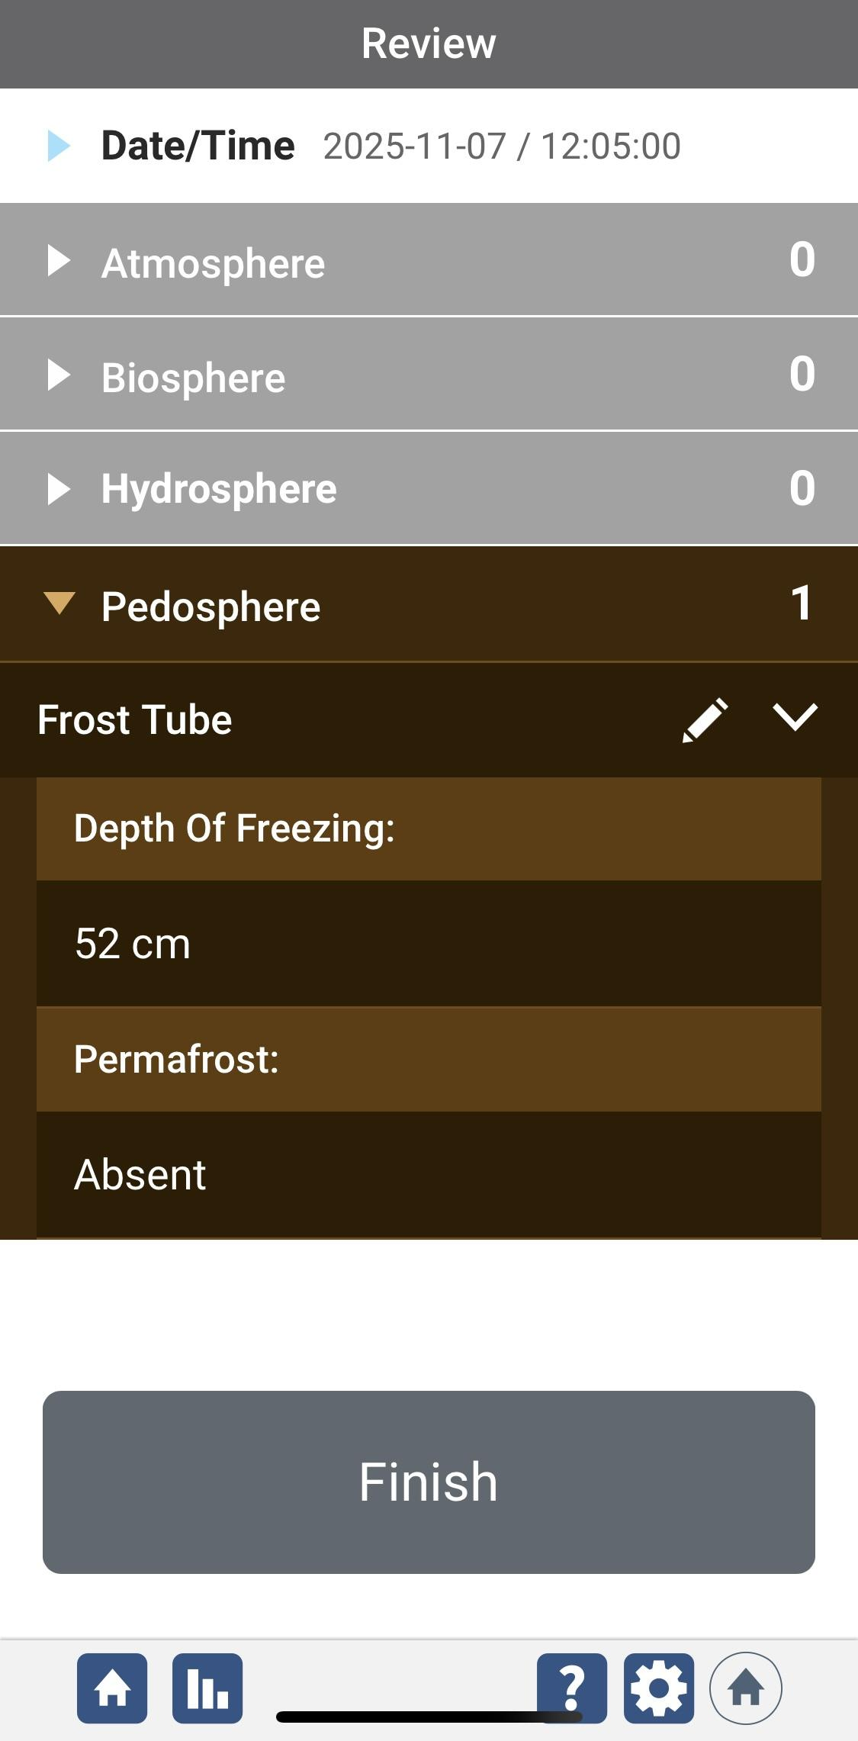
Frost Tube Data Entry
Soil (Pedosphere) Frost Tube
A. Why measure frost depth?
B. Properties that affect frost depth.
C. When & where to measure.
D. Required materials.
E. Making a frost tube.
F. Installing a frost tube.
G. Measuring frost depth.
H. Report data to GLOBE.
I. Data Visualization.
J. Additional Information.
Review the data you entered and check for errors.
When complete, select Finish to complete the send the observation to GLOBE.
Notes:
added “be” stored

Slide 28
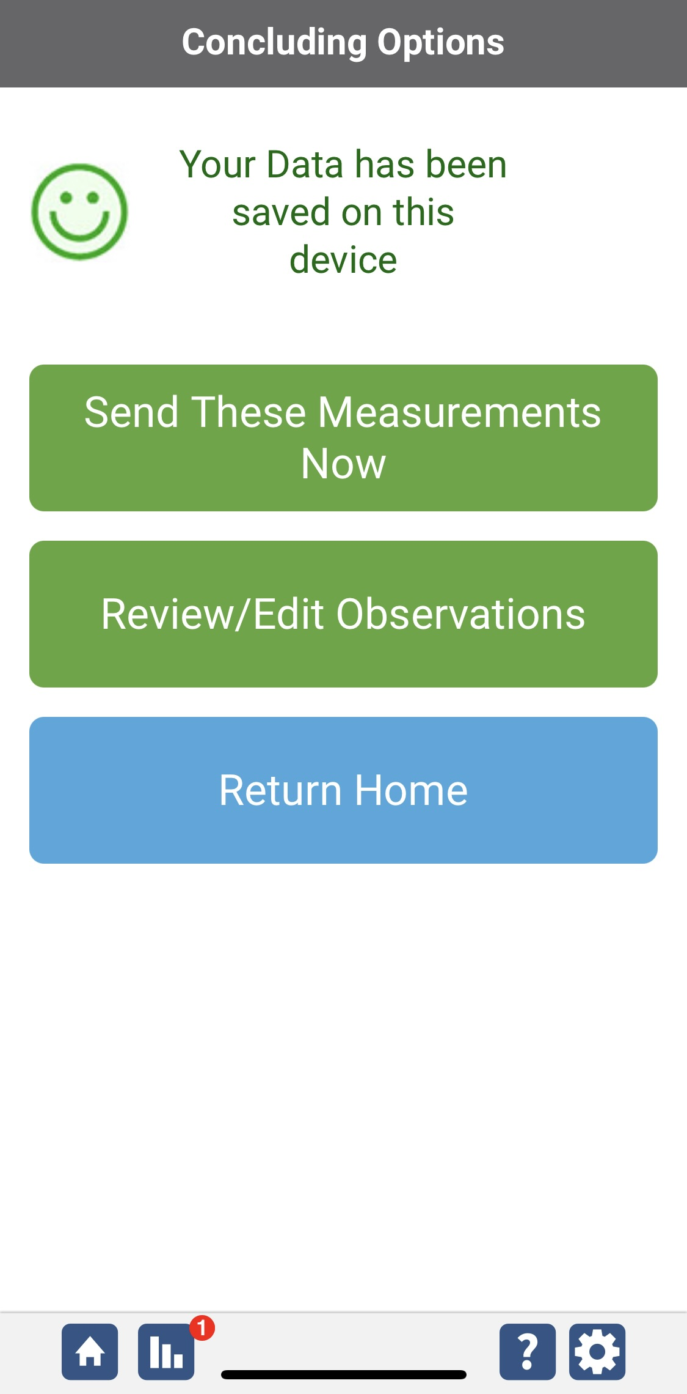
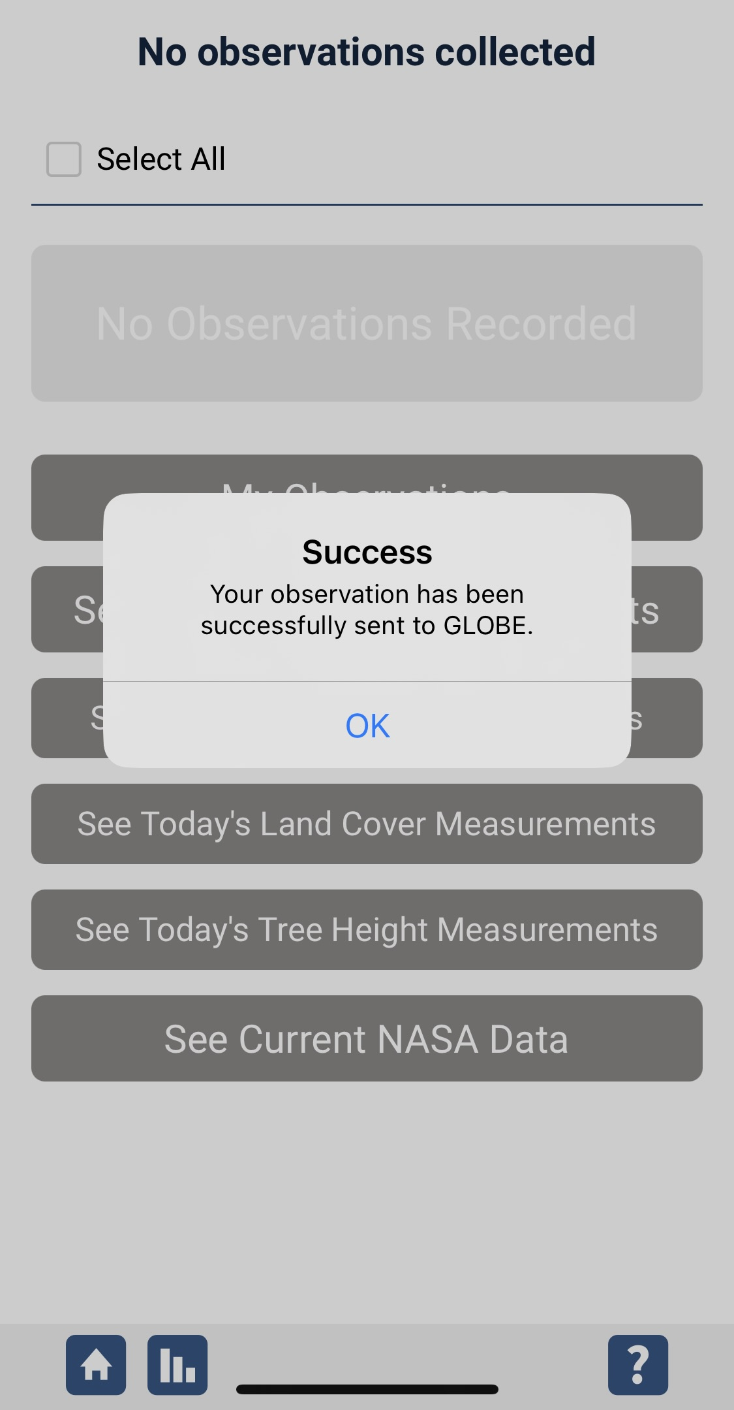
Data System Responses
Soil (Pedosphere) Frost Tube
A. Why measure frost depth?
B. Properties that affect frost depth.
C. When & where to measure.
D. Required materials.
E. Making a frost tube.
F. Installing a frost tube.
G. Measuring frost depth.
H. Report data to GLOBE.
I. Data Visualization.
J. Additional Information.
If your observations are within the appropriate ranges, you will see a green smiley face.
You can review or edit your observation if needed.
When ready, select “Send these measurements now” to send your data to GLOBE. When it has been sent, you will see a “Success” message.
Notes:
added “be” stored

Slide 29
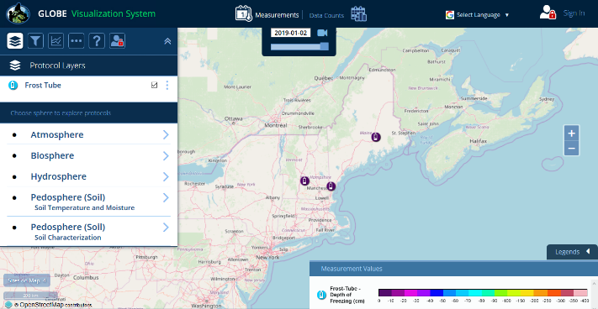
Soil (Pedosphere) Frost Tube
A. Why measure frost depth?
B. Properties that affect frost depth.
C. When & where to measure.
D. Required materials.
E. Making a frost tube.
F. Installing a frost tube.
G. Measuring frost depth.
H. Report data to GLOBE.
I. Data Visualization.
J. Additional Information.
Visualizing Data
Frost Tube is a Protocol under Pedosphere.
See Frost Tube measurements for the day selected.

Slide 30
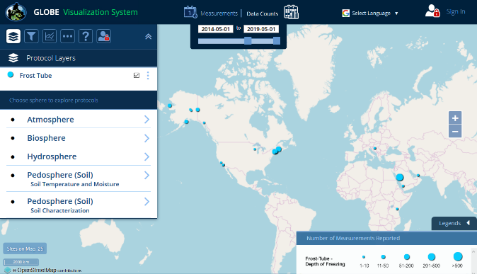
Visualizing Data
Soil (Pedosphere) Frost Tube
A. Why measure frost depth?
B. Properties that affect frost depth.
C. When & where to measure.
D. Required materials.
E. Making a frost tube.
F. Installing a frost tube.
G. Measuring frost depth.
H. Report data to GLOBE.
I. Data Visualization.
J. Additional Information.
You can see all the places monitoring frost depth by entering a date range.

Slide 31


Please provide us with feedback about this module. This is a community project and we welcome your comments, suggestions and edits!
Questions after reviewing this module? Contact GLOBE: help@nasaglobe.org
Soil (Pedosphere) Frost Tube
A. Why measure frost depth?
B. Properties that affect frost depth.
C. When & where to measure.
D. Required materials.
E. Making a frost tube.
F. Installing a frost tube.
G. Measuring frost depth.
H. Report data to GLOBE.
I. Data Visualization.
J. Additional Information.
Credits
Slides: Christina Buffington, Elena Sparrow, Kenji Yoshikawa, Amy Barfield
Photographs: Robin Ellis, Christina Buffington
Cover Art: Christina Buffington
Graphics: Kenji Yoshikawa, Robin Ellis, Jenn Glaser, ScribeArts
More Information:
GLOBE Program
Frost Tube Protocol, Field Guides, Data Sheet
NASA Explorers: Cryokids
The GLOBE Program is sponsored by these organizations:
Updated 04/10/26. GLOBE Implementation Office: Science, Training, Education, and Public Engagement Team.
If you edit and modify this slide set for use for educational purposes, please note “modified by (and your name and date)” on this page. Thank you.

