Slide 1
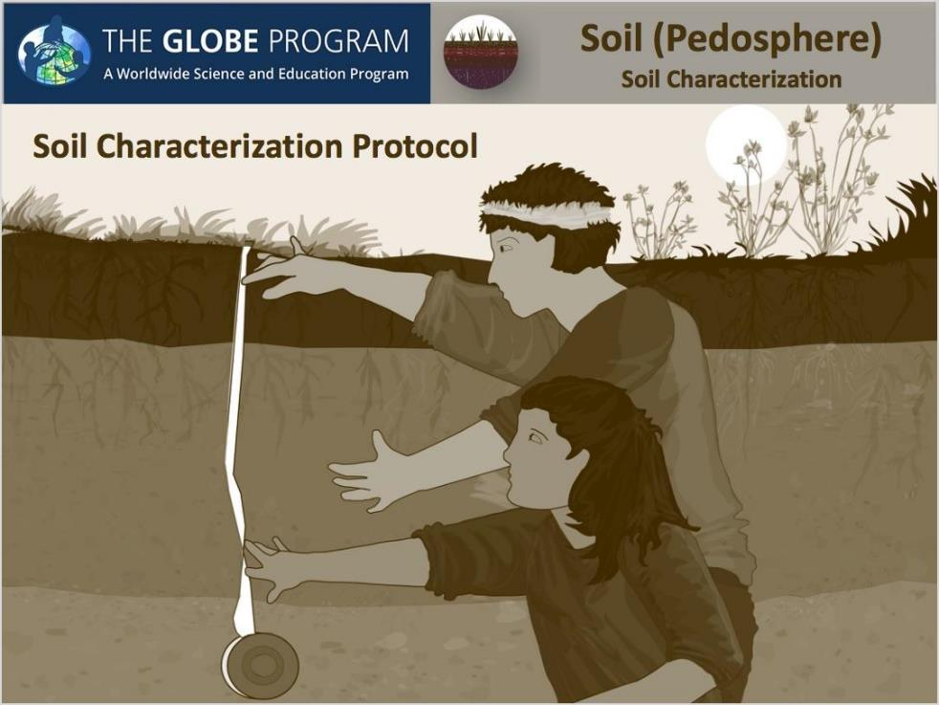

Slide 2

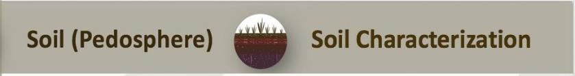
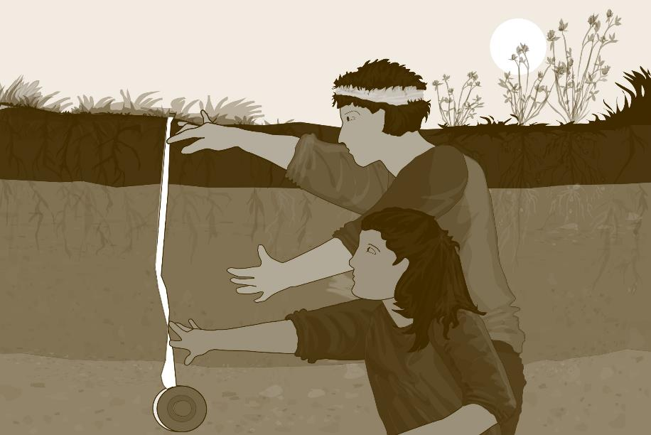
Goals and Objectives of this Module
Overview
This module:
Describes how defining a soil characterization site supports scientific understanding of the Earth system
Provides step-by-step instructions in how to characterize soils using this GLOBE protocol
Learning Objectives
After completing this module, you will be able to:
Explain why soil characteristics are important
Conduct soil characterization steps
Report these data to GLOBE
Visualize these data using GLOBE’s Visualization Site
Estimated time needed for completion of this module: 1.5 hours

Slide 3
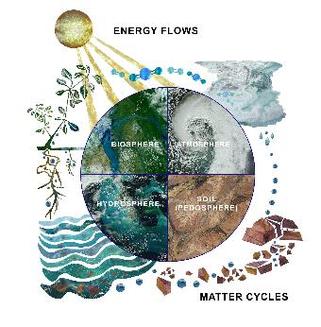
Why is defining soil characteristics important?
Soil characterization is a fundamental step in describing and analyzing soil as part of the Earth system. The characteristics you identify will help to explain the role of the soil in exchanging matter and transferring energy with the atmosphere, biosphere and hydrosphere.
Soil characterization measurements are taken for many reasons, including:
supporting the interpretation of soil moisture and temperature, land cover, and atmosphere measurements;
complementing and extending land cover mapping;
developing soil maps of a region; and
providing information for computer modeling.
Image: Jenn Glaser and Russanne Low

Slide 4
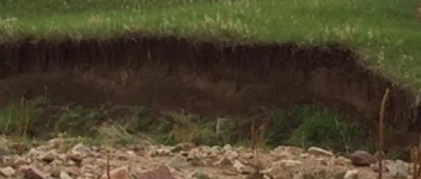
Introduction to Soil Characterization
Soil can be characterized by its structure, color, consistence, texture, and abundance of roots, rocks, and carbonates. These characteristics allow scientists to interpret how the ecosystem functions and make recommendations for soil use that have a minimal impact on the ecosystem. For example, soil characterization data can help determine whether a garden should be planted or a school should be built. Soil characterization data can help scientists predict the likelihood of flooding and drought. It can help them to determine the types of vegetation and land use best suited to a location. Soil characteristics also help explain patterns observed from satellite imagery, vegetation growth across the landscape, or trends of soil moisture and temperature that might be related to weather.
Soil profile, exposed during a flood in 2013. Boulder Colorado, USA

Slide 5
Overview of Protocol
Time:
Preparation: 2-3 45 minute class sessions
Field: 90 minutes
Experience Level: All
Frequency:
Soil characterization measurements are taken once for a specific soil site. Collected samples can be stored for study and analysis at another time during the school year.
Prerequisites:
Selecting and Defining a Site for Soil Characterization Protocols: Exposing a Soil Profile
Documents:
Soil Characterization Protocol
Site Definition Sheet OR use the Soil Characterization Data Sheet

Slide 6

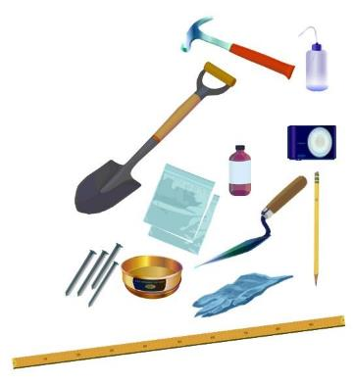
Required Materials
Spray bottle
Golf tees, nails or other horizon markers
Soil color book
Pencil, pen, marking pen
Paper towels
Trowel, shovel or other digging device
Meter stick or tape measure
Plastic bags
Camera
Latex gloves
Acid bottle filled with vinegar
Hammer
#10 sieve (2 mm mesh openings)
Sheets of paper or paper plates
GLOBE Site definition sheet

Slide 7

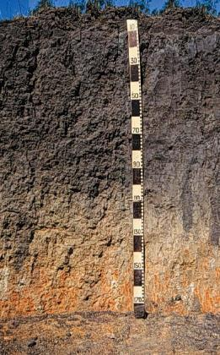
What Soil Characterization Reveals:
Characteristics of the different soil horizons at depth:
  determine how water is stored in and moves through the soil;
  indicate suitability for categories of land use;
  indicate whether there is adequate drainage;
  determine what plants will grow and what nutrients are available;
  reveal the history of a site - past climates and human settlement;
  influence the local ecology and may limit what can live there.
Grassland soil in Texas, USA. The dark color at the top, in the A horizon, evidences high organic content (fertility) resulting from centuries of root decomposition. Source: GLOBE Teacher’s Guide.

Slide 8
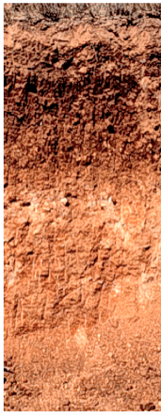
Characterization of an Exposed Soil Profile
Follow the instructions in the Selecting, Exposing, and Defining a Soil Characterization Protocol to expose a soil profile for characterization.
These instructions apply to an exposed profile found in a road cut or erosional feature, as well as profiles exposed using the Pit method. This method is adapted for profiles exposed using the Auger Method and will follow.
Starting from the top, observe the profile to determine properties and differences between horizons.

Slide 9
Identifying Soil Horizons
Starting from the top, you will observe the soil looking for differences between layers.
Look for: different colors and shapes, roots, the size and amount of rocks, small dark nodules (called concretions), worms or other small animals and insects, worm channels, and anything else that is noticeable.
To identify the top and bottom of each horizon, a golf tee or other marker is placed at each depth where you see a change in the appearance of the soil.
A soil layer must be at least 3 cm thick to be considered a Horizon. If you see a layer that is less than 3 cm thick, consider it a part of the horizon above or below and note this in your metadata.

Slide 10
Identifying the First Horizon
The top or first horizon always starts at the surface of the soil and is always measured as 0 cm.
The bottom of the first horizon is where a difference in color, consistence, structure, chemistry, or texture is evidenced by a change in appearance.
The bottom of one horizon is the top of the next horizon down. So, where Horizon 1 ends is where Horizon 2 begins.

Slide 11
Identifying the Second Horizon
The top or first horizon always starts at the surface of the soil and is always measured as 0 cm.
Where the soil changes appearance is the bottom of the first horizon and the top of the second horizon.
Where the soil again changes in appearance is the bottom of the second horizon.

Slide 12
Identifying the Second Horizon (Cont’d)
The top or first horizon always starts at the surface of the soil and is always measured as 0 cm.
Where the soil changes appearance is the bottom of the first horizon and the top of the second horizon.
Where the soil again changes in appearance is the bottom of the second horizon and the top of the third horizon.
Where the soil again changes in appearance is the bottom of the third horizon.
In this soil profile, the third horizon ends below 1 meter in depth. If your pit were only 1 meter deep, you would report in your metadata that the lowest horizon extended below your pit.

Slide 13
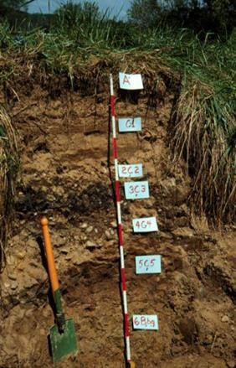
Describing Soil Horizons: Exposed Profile
Photograph the profile with a meter stick marking horizon depths and with horizons marked.
Place the 0 cm of the meter stick at the top of the profile.
Make sure the sun is shining on the profile to best show any differences in color or ped shape.
If you don’t have an exposed soil profile available, you can create a profile using an auger, as described in the following slides.
Pit Image courtesy Dr. Ray Weil, University of Maryland. Labels are specific to this profile only.

Slide 14
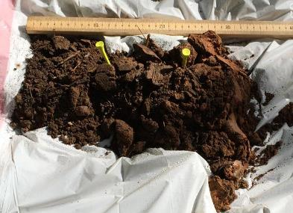
Describing Soil Horizons: Auger Profile
Once the augered profile is laid out, it will yield a soil profile like the soil below the surface.
Identify the top and bottom depths of the profile’s horizons and enter them into Data Entry App to set up your Soil Characterization Sample Site.
A soil layer must be at least 3 cm thick to be considered a Horizon.
If you see a layer that is less than 3 cm thick, consider it a part of the horizon above or below and note this in your metadata.
This photograph shows soil derived from auger sampling, laid out on a tarp, with soil depth adjusted according to instructions in the Selecting, Exposing and Defining a Soil Characterization Site Protocol. Golf tees are placed where each soil horizon begins and ends.

Slide 15
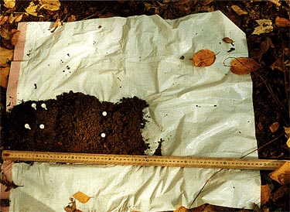
Measuring Soil Horizons in an Auger Profile
Remember, the top of the top horizon always starts with a measurement of 0 cm, so put the top of your ruler there.
The bottom of one horizon is the exact same depth as the top of the horizon directly below it.
These are the horizons you will be characterizing and sampling if you do laboratory analysis.
Once the profile has been analyzed and horizons identified, photograph the profile, making sure that the profile is equally illuminated by the sun (no shadows).
Augered soil profile with golf tees showing the horizons. Used with permission from Mid Valley Secondary Center, Throop, PA USA

Slide 16

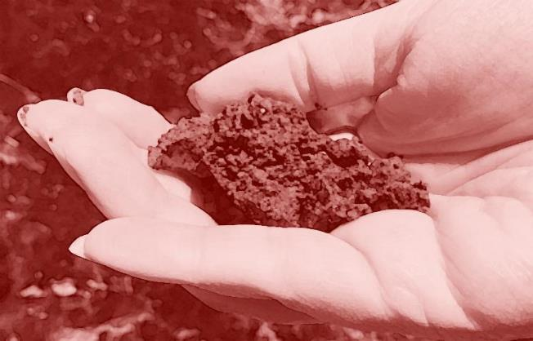
Horizon Properties: Soil Structure

Slide 17
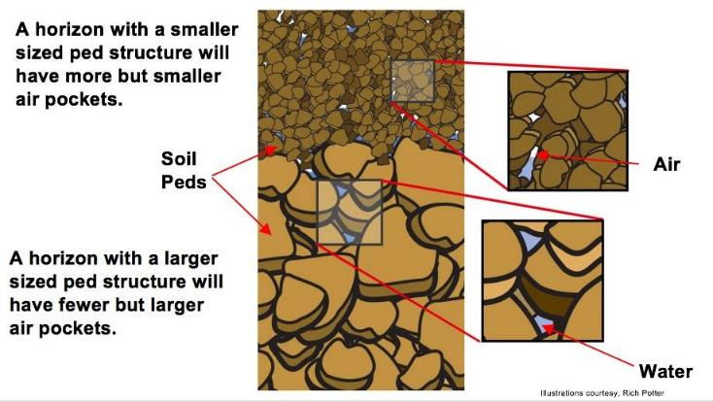
What is Soil Structure?
A soil horizon’s structure refers to the natural shape of aggregates of soil particles, called peds, in the soil. The soil structure provides information about the size and shape of pore spaces in the soil through which water and air flow, and in which plant roots grow.

Slide 18
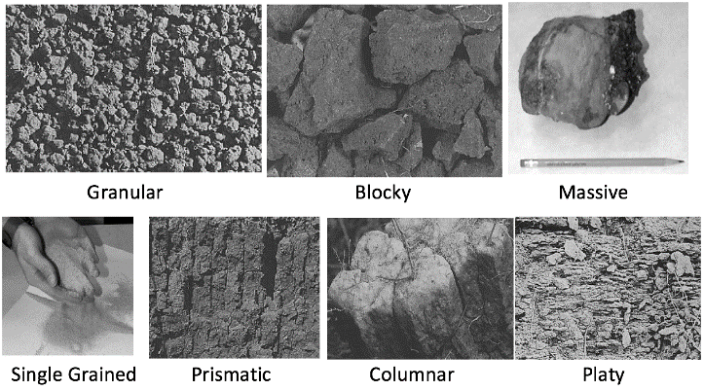
What Soil Structure Reveals
The soil structure provides information about the size and shape of pore spaces in the soil through which water and air flow, and in which plant roots grow. Here are the 7 Soil Structure Types:
Single Grained and Massive images courtesy Izolda Tracktenberg; other images courtesy NASA.

Slide 19
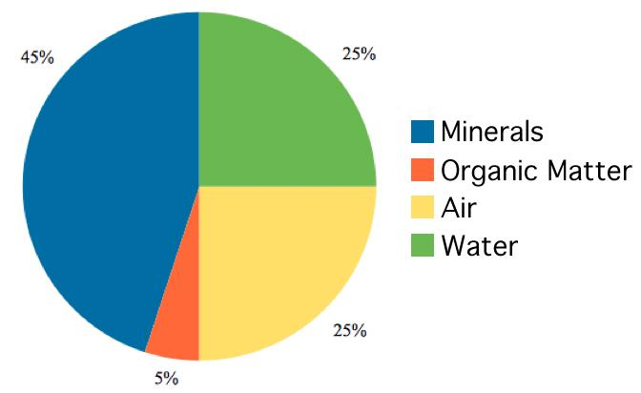
An Ideal Arable Soil
In an ideal arable soil, there is sufficient mineral content to allow growth and root purchase, there is sufficient water for plant water and nutrient uptake, and there is sufficient pore space for plant growth.

Slide 20
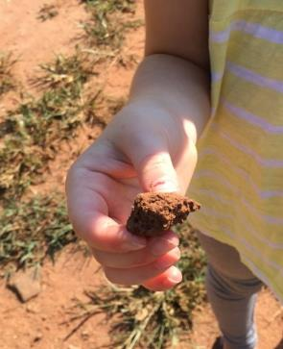
Examining a Ped
For each part of this protocol, start with a clump of soil, called a “ped”.
Remember, you can change a soil’s structure by doing anything other than looking at it.
Use a trowel or other digging device to remove a soil sample from the horizon being studied.
Hold the sample gently in your hand and look closely at the soil to examine its structure.
Identify the soil structure of the horizon you are examining. See options in the next slides.

Slide 21
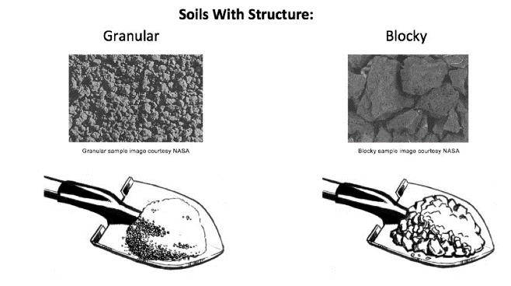
Granular and Block Structure
Granular: Resembles cookie crumbs and is usually less than 0.5 cm in diameter. Commonly found in surface horizons where roots have been growing
Blocky: Irregular blocks that are usually 1.5-5.0 cm in diameter.

Slide 22
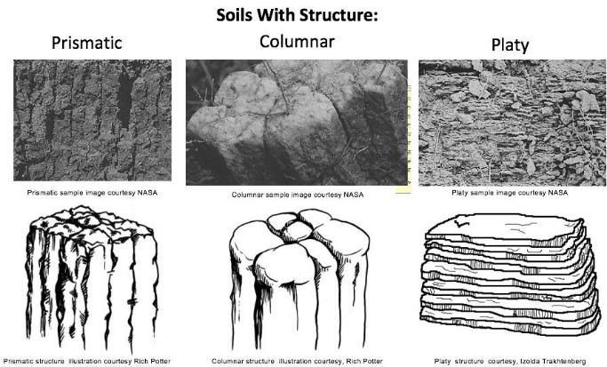
Prismatic, Columnar and Platy Structure
Prismatic: Vertical columns of soil; usually found in lower horizons.
Columnar: Vertical columns of soil that have a salt "cap" at the top. Found in soils of arid climates.
Platy: Thin, flat plates of soil that lie horizontally; usually found in compacted soil.

Slide 23
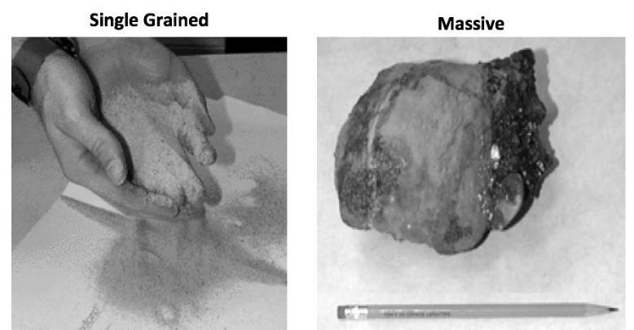
Soil Lacking Structure
If the soil lacks structure, it is described as either single grained or massive. Soil with “single grained” structure always has a loose consistence.

Slide 24

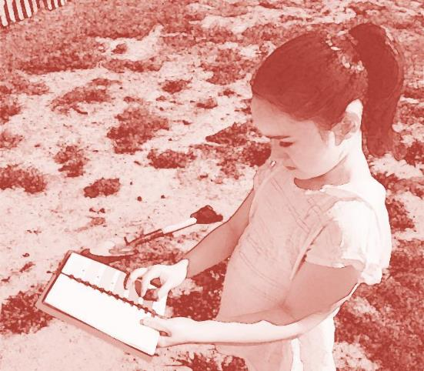
Horizon Properties: Soil Color

Slide 25
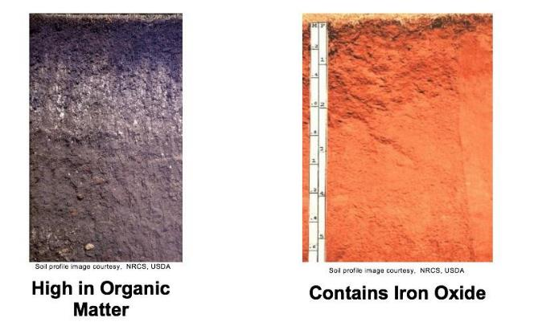
What Soil Color Reveals
Soil color indicates the chemical content of the soil or the coatings on the soil particles. For instance, dark colors usually indicate the presence of organic material. The presence of iron and some other minerals can produce red and yellow soils.

Slide 26
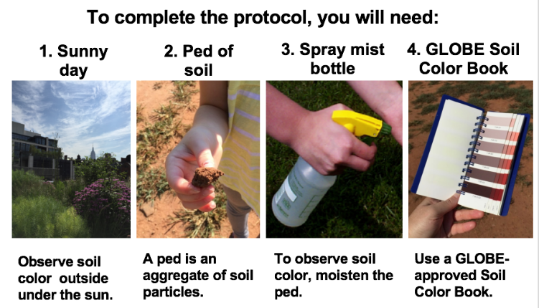
Soil Color- Required Conditions and Instruments
Instrument Specifications: A Soil Color Book designed especially for The GLOBE Program can be purchased. It contains at least 200 colors and uses the Munsell System of Color Notation.

Slide 27
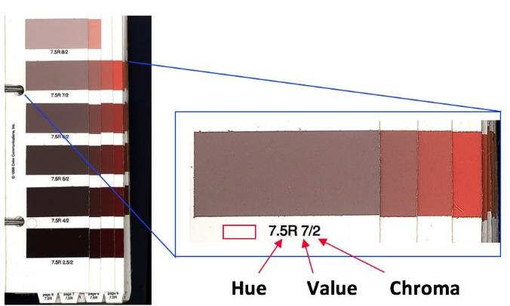
Soil Color- Munsell Notation
In the Munsell color system, colors are identified by three properties.

Slide 28
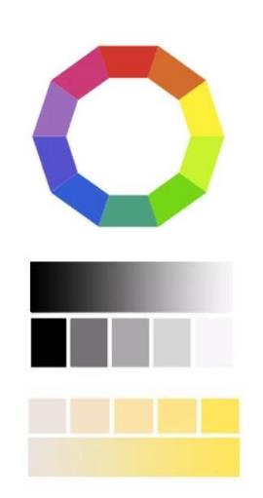
Soil Color- Hue, Value and Chroma
Hue is the color’s position on the Color Wheel
Value is the amount of black or white added to the color. The higher the Value, the lighter the color. The lower the Value, the darker the color.
Chroma is the amount of saturation of a color. The higher the Chroma, the more saturated the color.

Slide 29
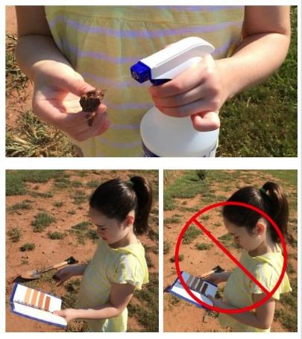
How to Observe Soil Color- Prepare the Ped
Take a ped of soil from a horizon and note on the data entry page whether it is moist, dry or wet.
If it is dry, moisten it slightly with water from your water bottle. Wait for a minute for the water to soak into the ped.
Stand with the sun over your shoulder so that sunlight shines on the color chart and the soil sample you are examining.
If the soil is too loose to form a single ped, place a sample on a trowel and complete the protocol.
Be sure no shadows fall on the color book.

Slide 30
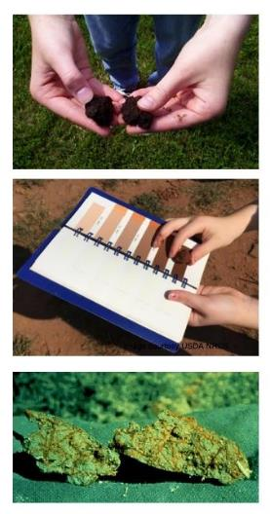
How to Observe Soil Color- Steps
Break the ped and compare the color of the inside surface with the soil color chart.
Look through the entire book as some similar soil colors appear throughout the book.
Sometimes, a soil sample may have more than one color. If so record a maximum of two colors, and indicate (1) the Main (dominant color) and (2) the Other (secondary) color. This is only when your sample contains two distinctly different colors. It is not two estimates for the same color

Slide 31
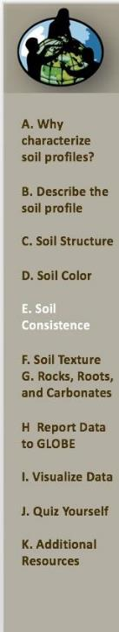
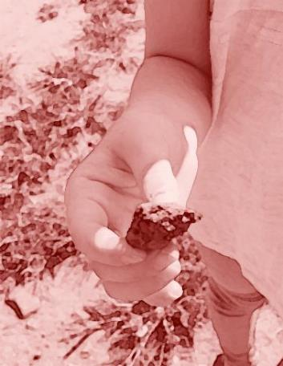
Horizon Properties: Soil Consistence

Slide 32
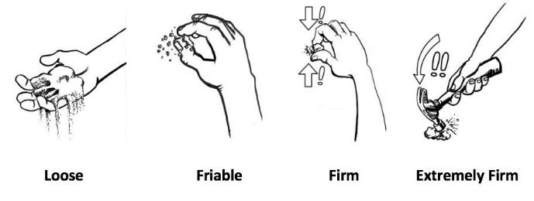
What Soil Consistence Reveals
Consistence is determined by how easily soil aggregates break apart
Whether a soil is Loose, Friable, Firm, or Extremely Firm determines how easy it is for roots, worms, or plows to pass through the soil.
It also indicates whether animals can create burrows in the ground or if the soil would collapse unless reinforced in some way.

Slide 33
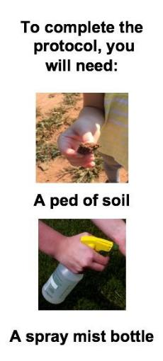
What is Soil Consistence?
Consistence describes the firmness of the individual peds and the ease with which they break apart.
The terms used to describe soil consistence are loose, friable, firm, and extremely firm.
For example, a soil with friable consistency will be easier for roots, shovels, or plows to move through than a soil with a firm consistency. On the other hand, a soil with extremely firm consistency will be harder for roots, shovels, and trowels to move through.

Slide 34
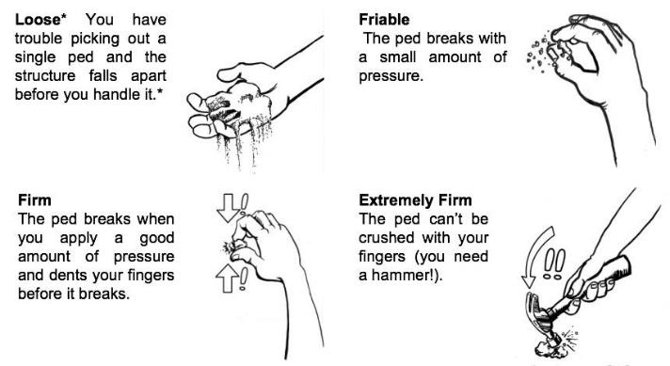
Identify Soil Consistence
Record one of the following categories of soil ped consistence on the Soil Characterization Data Entry Page.
* Soils with “single grained” structure always have loose consistence.

Slide 35
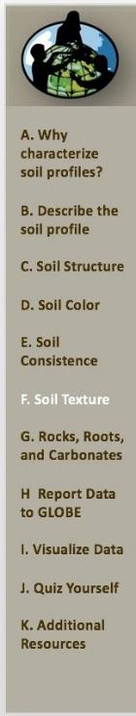
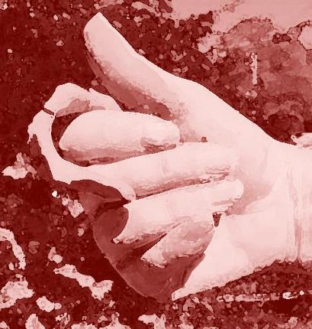
Horizon Properties: Soil Texture

Slide 36
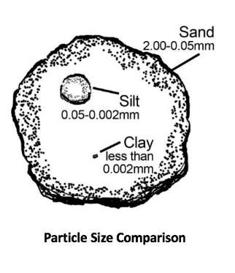
Definitions of Sand, Silt, and Clay
The way a soil “feels” is called soil texture.
Soil texture depends on the amount of each size of particle in the soil.
Sand, silt, and clay are names that describe the size of individual particles in the soil.
-Sand are the largest particles and they feel “gritty.”
-Silt are medium sized, and they feel soft, silky or “floury.”
-Clay are the smallest sized particles, and they feel “sticky,” and they are hard to squeeze.

Slide 37
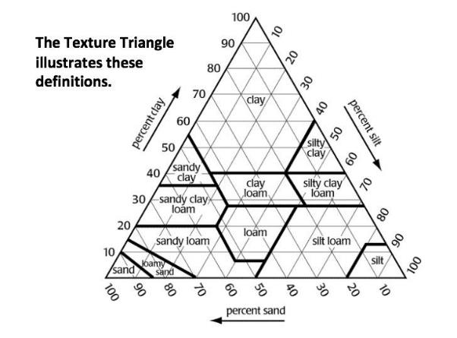
The Soil Texture Triangle
Soils are grouped into 12 texture class names depending on how much sand, silt, and clay is in each sample.
Textural Triangle courtesy, USDA NRCS

Slide 38
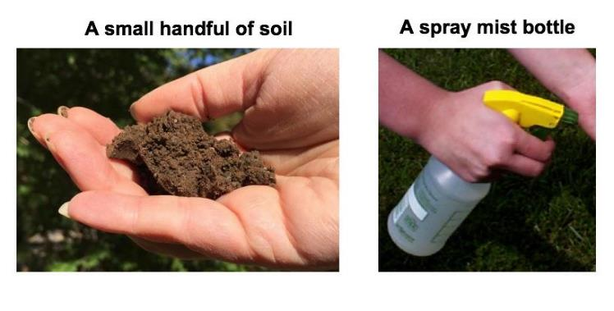
Soil Texture: Required Equipment
To determine this soil property, you will need:

Slide 39
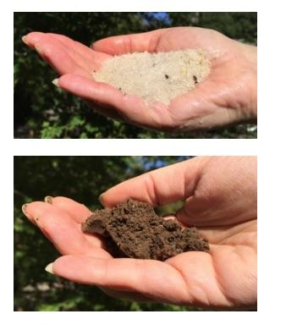
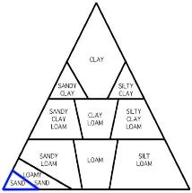
Determining Soil Texture: Step 1: Is it Sand?
To determine soil texture by feel, use this method. Take a handful of soil and moisten it. Let the water soak in and then work the soil with your fingers. Try to make a ball with the soil.
If it does not make a ball, it is sand.
Soil texture is complete. If the soil
Makes a ball, go to the next step.

Slide 40
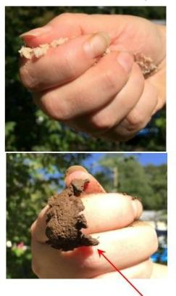
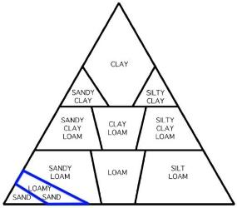
Determining Soil Texture: Step 2: Is it Loamy Sand?
Squeeze the soil ball, and try to make a ribbon between your two fingers.
If the soil does not make a ribbon, call it a Loamy Sand, and Soil Texture is complete.
If the soil makes a ribbon, go to the next steps. First the length of the ribbon will determine whether it is a Clay, a Clay Loam, or a Loam

Slide 41
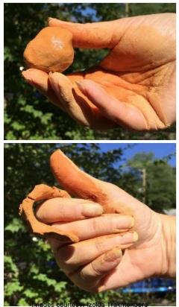
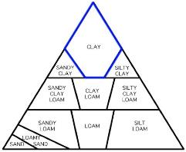
Determining Soil Texture: Step 3: Is it Clay?
Feel for clay. Does the soil stain your hands and keep its shape in your hand? Is it sticky and hard to squeeze? Is it shiny?
Does the sample make a long ribbon of about 5cm? If there is a lot of clay, it is a Clay, and you will feel for sand or silt in step 4.

Slide 42
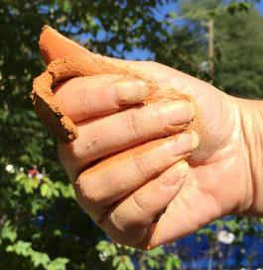
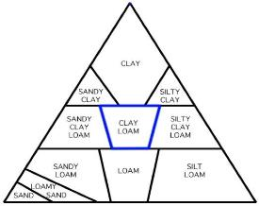
Determining Soil Texture: Step 3: Is it Clay Loam?
If there is some clay but it is softer than a dense clay and makes a ribbon that is about 2-5 cm long, it is a Clay Loam, and you will feel for sand or silt in step 4. If not, go to the next step.

Slide 43
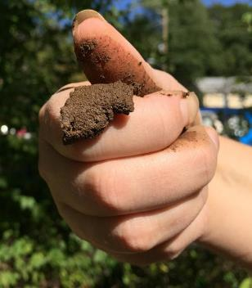
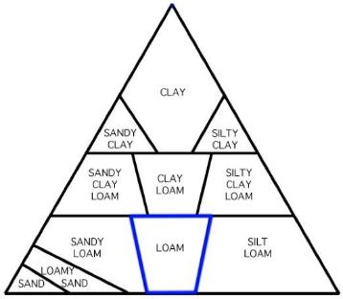
Determining Soil Texture: Step 3: Is it a Loam?
If it is very soft with just a little clay and makes a short ribbon of less than 2 cm, it is a Loam, and you will feel for sand or silt in step 4.

Slide 44
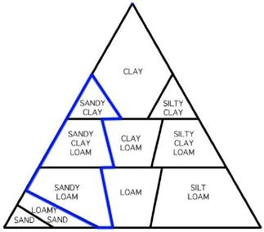
Determining Soil Texture: Step 4: Is it Sandy?
Wet a small pinch of the soil in your palm and rub it with a forefinger. If the soil feels very gritty, it is sandy.
Add the word “sandy” to your original soil texture name from step 3; it is either Sandy Clay, Sandy Clay Loam, or Sandy Loam. Soil Texture is complete.
If not, go to next step.

Slide 45
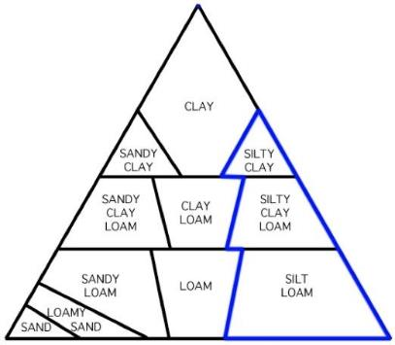
Determining Soil Texture: Step 4: Is it Silky?
If the soil feels very soft and smooth with no gritty feeling, it is silty.
Add the word Silt or Silty to the original classification from step 3; it is either Silty Clay, Silty Clay Loam, or Silt Loam.
If not, go to next step.

Slide 46
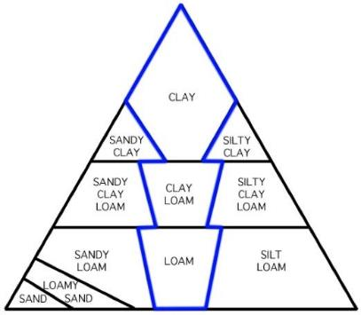
Determining Soil Texture: Step 4: Is it Neither Sandy or Silky?
If the soil feels neither very gritty nor very soft, it is Clay, Clay Loam, or Loam.
Soil Texture is complete.

Slide 47

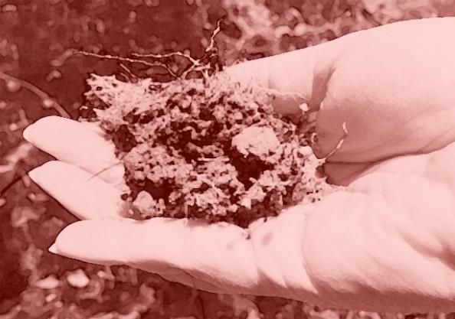
Horizon Properties: Roots, Rock and Carbonates

Slide 48

What the Presence of Roots, Rocks and Carbonates Reveals
Knowing the amount of roots in each horizon allows scientists to estimate the soil’s fertility, bulk density, water holding capacity, and depth.
An estimate of the number of rocks in each horizon helps to understand the movement of water, heat, and air through the soil, root growth, and the amount of soil material involved in chemical and physical reactions.
The presence of carbonates in soil may indicate a dry climate or a particular type of parent material rich in calcium, such as limestone.

Slide 49

Horizon Properties: Roots
An estimate of the roots in each horizon in a soil profile illustrates the depth to which roots go to obtain nutrients and water.
The more roots found in a horizon, the more water and nutrients are being removed from the soil, and the more organic matter being returned.
Observe and record if there are none, few or many roots or root fragments in each horizon.

Slide 50

Horizon Properties: Rocks
An estimate of the number of rocks in each horizon helps to understand the movement of water, heat, and air through the soil, root growth, and the amount of soil material involved in chemical and physical reactions.
Soil particles greater than 2 mm in size are considered to be rocks or pebbles.
Observe and record if there are none, few or many rocks or rock fragments in the horizon.

Slide 51

Horizon Properties: Free Carbonates
The presence of carbonates in soil may indicate a dry climate or a particular type of parent material rich in calcium, such as limestone. Free carbonates often coat soil particles in soils that are basic (pH>7).
If carbonates are present, there will be a chemical reaction between vinegar (a mild acid) and the carbonates (a base) producing carbon dioxide and causing the vinegar to bubble or effervesce.
The more carbonates present, the more effervescence occurs.
Set aside a portion of the exposed soil to use for the free carbonates test. Do not touch it with your bare hands.
Open the acid bottle and squirt vinegar on the soil particles. Start from the bottom of the profile and move up.
Be sure to use caution and point the bottle directly at the soil, not toward other people, especially toward eyes.

Slide 52

Observing Free Carbonates
Look carefully for the presence of effervescence. The more carbonates that are present, the more bubbles (effervescence) you will observe.
Observe and record whether the effervescence is none, slight or strong.
None: if you observe no reaction, the soil has no free carbonates present.
Slight: if you observe a very slight bubbling action; this indicates the presence of some carbonates.
Strong: if there is a strong reaction (many, and/or large bubbles); this indicates there may be many carbonates present.

Slide 53



Reporting Data to GLOBE
Two Options for Uploading Data:
These methods all allow users to submit environmental data – collected at defined sites, according to protocol, and using approved instrumentation – for entry into the official GLOBE science database.
Download the GLOBE Observer mobile app from the App Store.
Data Entry: Visit globe.gov, click on the “GLOBE Data” tab, then underneath “Data Entry” click on “Data Entry – New Desktop Forms”.

Slide 54


Soil Characterization Site Creation
To enter you soil characterization information, you will need to create a new site.
Open the GLOBE Observer App and select “Data Entry”.
Next, click “Create/Edit My Sites”

Slide 55

Soil Characterization Site Creation
Enter a name for your new site.
Use the map box to make sure the green popup is in the correct site location.
If you used a separate GPS device to locate your site, you can enter the coordinates manually.

Slide 56


Soil Characterization Site Creation
Scroll down to the Pedosphere tab
Select Soil Characterization Site Setup
Enter the site information for you new site.
Next, select “Add Horizon”

Slide 57


Soil Characterization Site Creation
Under “Horizon #1”, enter the depth, color, and other information about the horizon.
Add any additional information to the Comments box.
Select “Add Horizon” to enter information about the next horizon.
When finished, click “Save Site”

Slide 58



Soil Characterization Site Data Visualization
GLOBE Soil Characterization data visualization has several aspects that are different from the visualization of other types of data.
The map shows the data for the most recent soil characterization at every site since the start of this GLOBE protocol. Soil character changes slowly, often forming over centuries or longer.
If you change the date of the visualization, data taken more recently than this date will not be shown.
The depth of each horizon is important data; it is not just part of defining the horizon. So, there are visualizations of horizon depth for the top 5 horizons.
It is interesting and useful to know the soil properties for the horizons where soil moisture and temperature data are taken. There are visualizations showing which horizon occurs at these different measurement depths.
Data from multiple horizons may be displayed by opening multiple data layers and arranging them so that the layer with the smallest dots is on top. In this way, data from the layers appear in a stack (like a child’s toy).

Slide 59

Soil Horizon 1 Depth Data Visualization
Visualization of the first horizon data shows how deep the top layer extends.

Slide 60

Data Visualization of Horizons 1 & 2
The map dots are different sizes so that you can compare two or more horizons at the same time by adding two data layers. Be sure to have the Horizon 1 data layer on top.

Slide 61

Data Visualization of Horizons 1, 2, & 3
The map shows stacks of dots with horizon 1 on top surrounded by horizon 2 with horizon 3 outermost at sites with 3 horizons reported.

Slide 62

Which Soil Horizon Is at a Depth of 10 cm?
This visualization shows which soil horizon is found 10 cm deep in the soil.
Notice that most but not all sites in this region show Horizon 1 extending to more than 10 cm depth.

Slide 63

Which Soil Horizon Is at a Depth of 50 cm?
This visualization shows which soil horizon is found 50 cm deep in the soil.
This depth corresponds to the location of the deepest soil temperature sensor.

Slide 64

Which Soil Horizons Are at 30, 60, & 90 cm?
This visualization shows which soil horizons are found at the depths of the three deepest soil moisture measurements. Dots for the three depths are nested on top of one another.

Slide 65

Soil Structure Data Visualization
Visualization of the first horizon data shows the soil’s Structure values.

Slide 66

Soil Color Data Visualization
Visualization for the first horizon may provide clues as to the mineral and organic content of these soil samples.

Slide 67

Visualizing Soil Consistence Data
Visualization for the first horizon shows Soil Consistence Measurements.

Slide 68

Soil Texture Data Visualization
Visualization for the first horizon shows soil’s Texture By Feel.

Slide 69

Presence of Roots in Soil Data Visualization 1
Visualization for the first horizon shows the soil’s observed rock content.

Slide 70

Presence of Roots in Soil Data Visualization 2
Visualization for the first horizon shows the soil’s observed root content.

Slide 71


Quiz Yourself
What can you learn from soil characterization?
You should define your sampling site at least 3 m from path or construction area- why?
When would you use the near surface sampling method?
Why is it important to take three samples when doing the near surface sampling method?
What do you use a compass for in this protocol?
A soil sampling site with natural, undisturbed vegetation is ideal. When might you decide to identify a soil sampling site in an area with a lawn or another kind of vegetation?
What are the advantages of using the pit sampling method? The auger sampling method?

Slide 72


Questions for Further Investigation
What creates the different horizons in a soil profile?
What natural changes could alter the soil horizons?
How long might it take to alter the depths of the different horizons?
How do soil profiles change from one location to another?
How do soil horizons change from one location to another?

Slide 73


Frequently Asked Questions
What do the numbers and letters describing the soil color mean?
For GLOBE, the universal Munsell notation is used to identify the color of the soil.
The system is made up of 3 symbols representing the hue, value, and chroma of the soil color.
The hue is described by the first set of number and letter symbols in the Munsell system. Hue represents the position of the color on the color wheel (Y=Yellow, R=Red, G=Green, B=Blue, YR=Yellow Red, RY=Red Yellow).
The value is the number before the slash in the Munsell system. Value indicates the lightness of a color. The scale of value ranges from 0 for pure black to 10 for pure white.
The chroma is the number after the slash in the Munsell system. Chroma describes the “intensity” of a color. Colors of low chroma values are sometimes called weak, while those of high chroma are said to be highly saturated, strong, or vivid. The scale starts at zero, for neutral colors, but there is no arbitrary end to the scale.

Slide 74


Frequently Asked Questions (Cont’d)
What does it mean if I determine that my soil is a silty clay or a sandy loam?
The texture you determine from feeling your soil is a subjective measurement. This means that another person might not think that the soil has exactly the same texture as you do. The texture actually refers to the percentages of sand, silt, and clay present. The triangle below is called a textural triangle and can be used to determine the approximate percentages of sand, silt, and clay in your soil from the texture you determined. For a more objective measure of soil texture, you should perform the Particle Size Distribution Protocol in which you determine the actual percentages of sand, silt, and clay in the soil.

Slide 75




Please provide us with feedback about this module. This is a community project and we welcome your comments, suggestions and edits!
Questions abut this module: Contact GLOBE: help@nasaglobe.org
Slides: Izolda Trachtenberg, Dixon Butler, and Russanne Low
Photographs: Izolda Trachtenberg
Illustrations, unless otherwise identified: Rich Potter
Cover Art: Jenn Glaser, ScribeArts
More Information:
GLOBE Program
NASA Earth Science
NASA Global Climate Change: Vital Signs of the Planet
The GLOBE Program is sponsored by these organizations:
Updated 04/10/26. GLOBE Implementation Office: Science, Training, Education, and Public Engagement Team.
If you edit and modify this slide set for use for educational purposes, please note “modified by (and your name and date)” on this page. Thank you.

