Slide 1


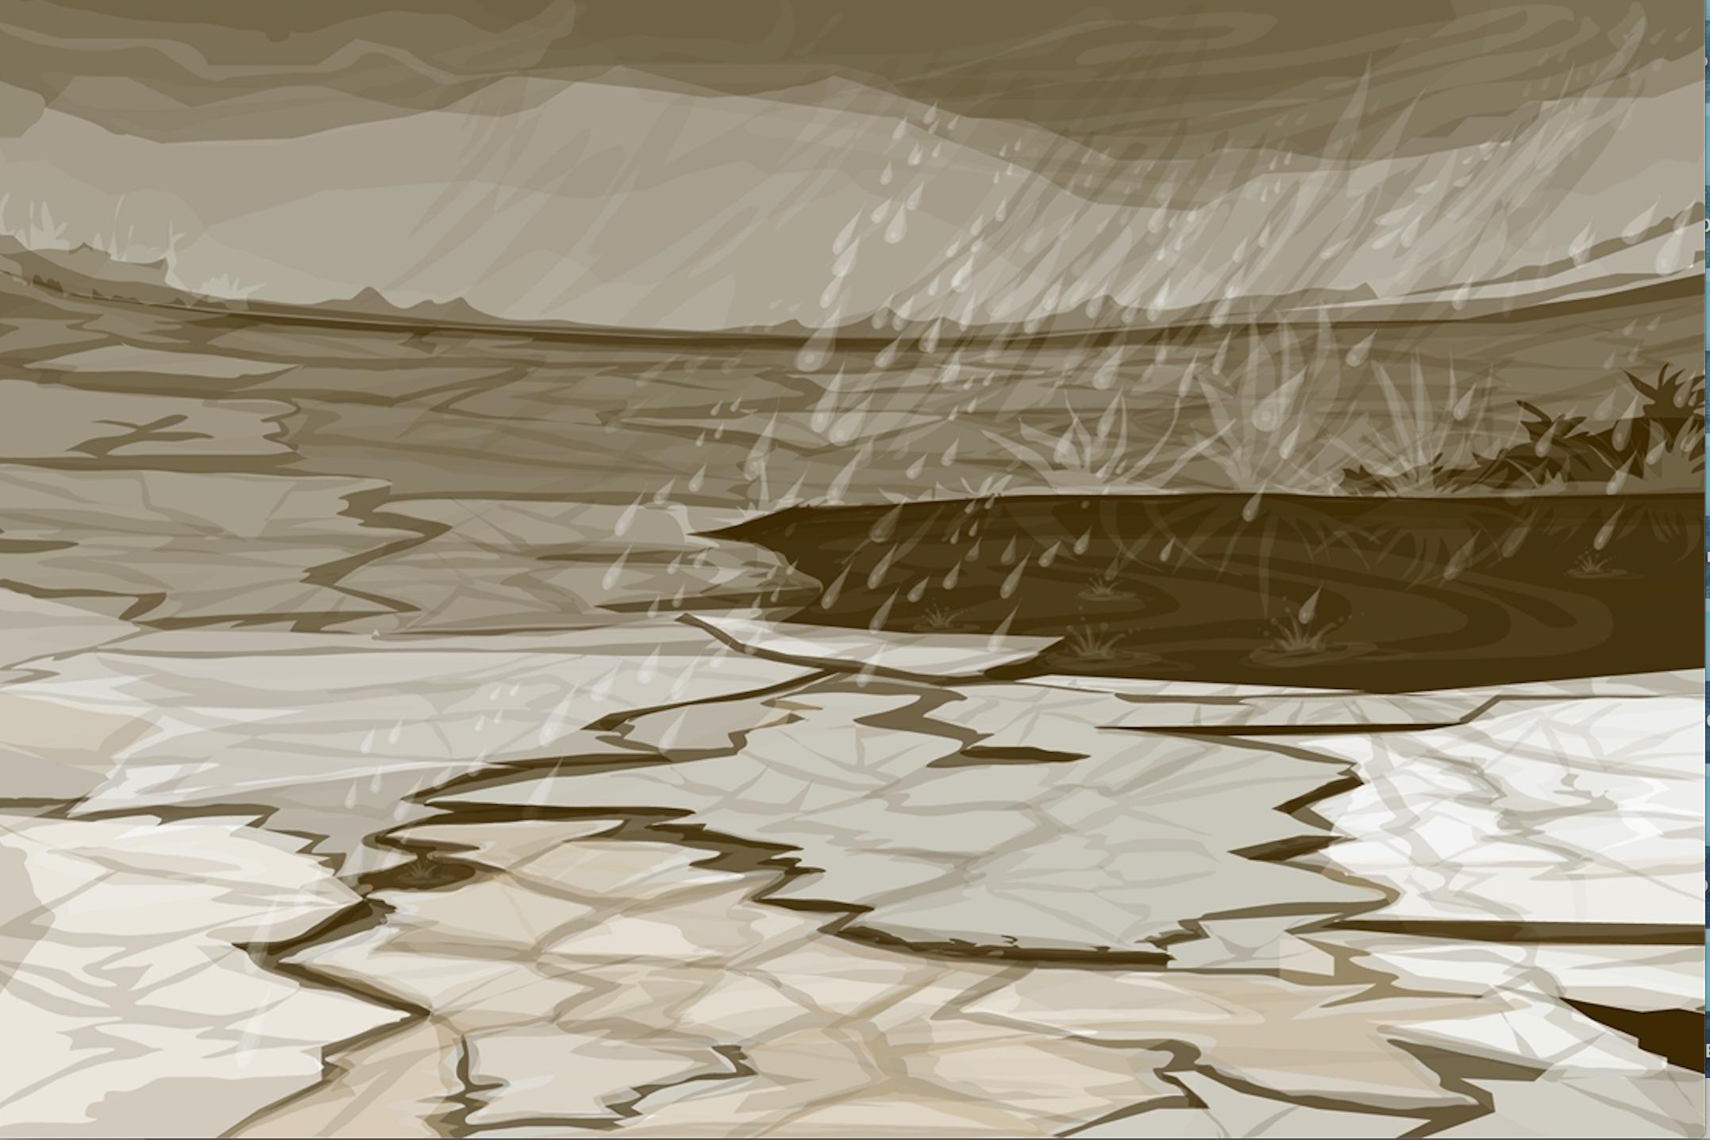
Slide 1
Soil (Pedosphere)
Infiltration Protocol

Slide 2
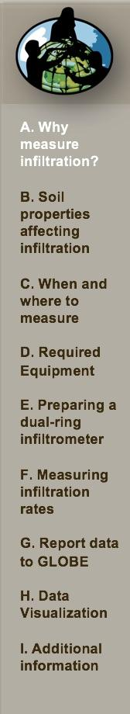
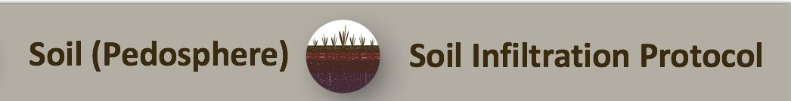
Overview and Learning Objectives
Soil infiltration is a measure of the rate at which soil is able to absorb rainfall or irrigation water. This module provides step-by-step instructions in how to do the Infiltration Protocol.
Learning Objectives:
After completing this module, you will be able to:
Explain why soil moisture is worth studying
Decide where to do an infiltration measurement
Determine a schedule for taking this measurement
Measure infiltration using a dual-ring infiltrometer
Measure gravimetric soil moisture content
Report these data to GLOBE
To complete the protocol, you will also need to learn either the Gravimetric Soil Moisture Protocol or SMAP Soil Moisture Protocol.
Estimated time needed for completion of this module: 1.5 hours

Slide 3
What is a Soil Infiltration Rate?
The infiltration rate is determined by measuring the time it takes for water sitting on a soil to drop a fixed distance. This rate changes with time as the soil pore spaces, filled originally with air, fill with water.
There are three flow rates:
Unsaturated flow is the initial flow rate and is high as the dry soil pore spaces fill with water.
Saturated flow is a steady flow rate that occurs as water moves into the soil at a rate determined by soil texture and structure.
Ponding is the flow rate that occurs when the ground becomes totally saturated and is no longer able to conduct water through its pores.

Slide 4
The Role of Soil Moisture in the Environment
Soil acts like a sponge spread across the land surface. It absorbs rain and snowmelt, slows run-off and helps to control flooding.
The absorbed water is held on soil particle surfaces and in pore spaces between particles. This water is available for use by plants.
Some of this water evaporates back into the air; some of this water is transpired by plants; some drains through the soil into groundwater.
The infiltration rate of water into soil changes depending upon the level of soil saturation. Water that is not stored in the ground evaporates or becomes runoff and may pool on the surface for a time. It is possible to determine how flood-prone an area is, based on the infiltration rate of the soil.

Slide 5
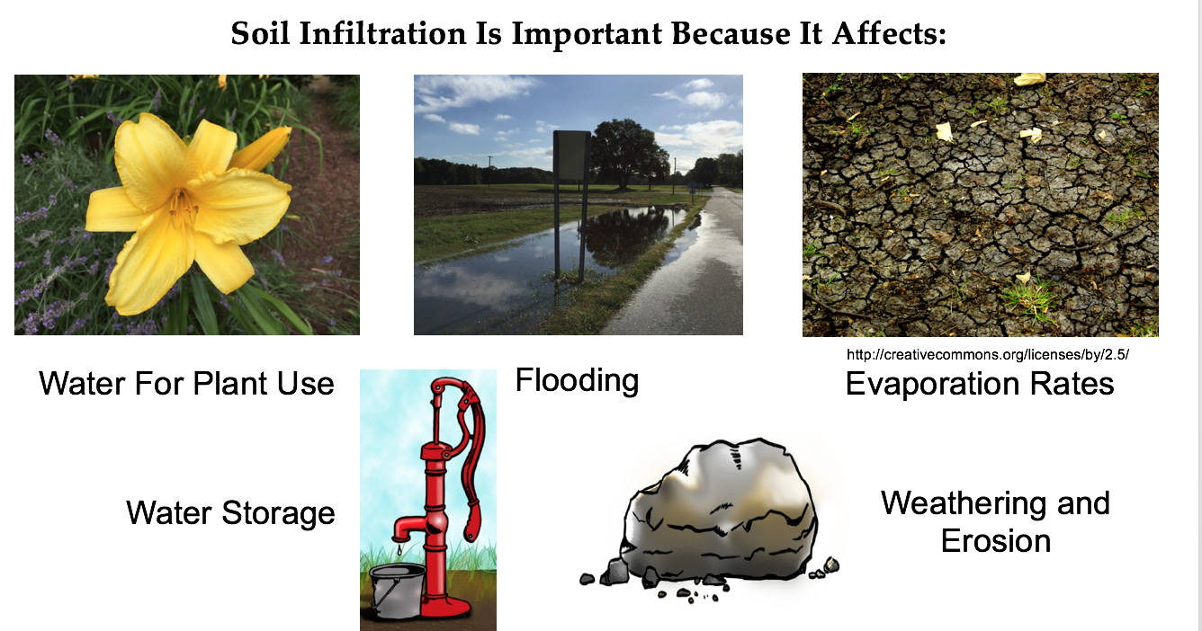
The Importance of Infiltration
The rate at which water flows through the soil affects how much water is available for plant use; how nutrients and other particles move through the soil; the amount of water available for use by animals; and the length of time the water will remain in the soil.

Slide 6
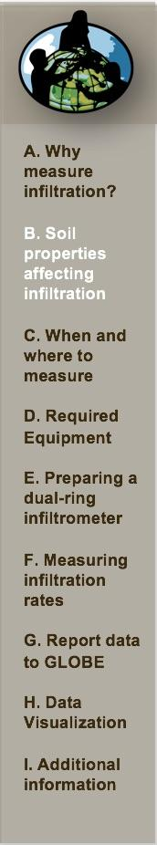
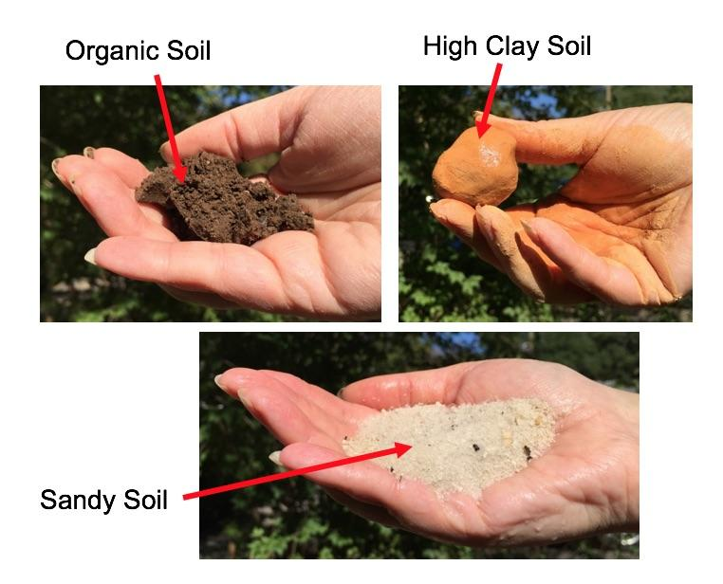
Soil Properties Affect Infiltration Rates
A soil’s structure, texture, density, and relative amount of organic material affect the speed at which water flows through soil.
If the soil is dense and/or compacted, water will likely move through it more slowly.
If the soil has relatively little pore space or is already saturated, flooding or run off will occur.

Slide 7
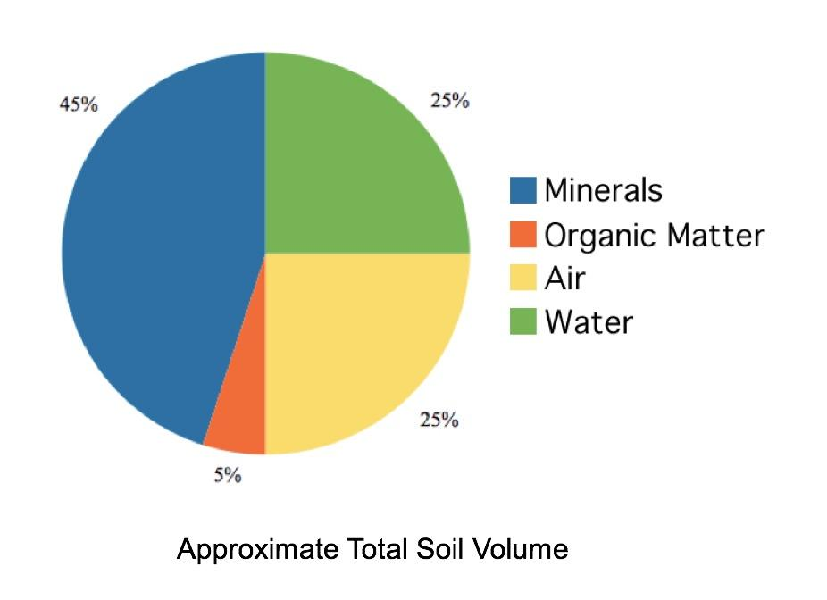
Ideal Soil Composition
The air and water in soil represent the soil’s pore space. Volumetrically, they should comprise approximately 50% of the soil’s volume.
The pore space allows for movement of air, water, and organisms through the soil.

Slide 8
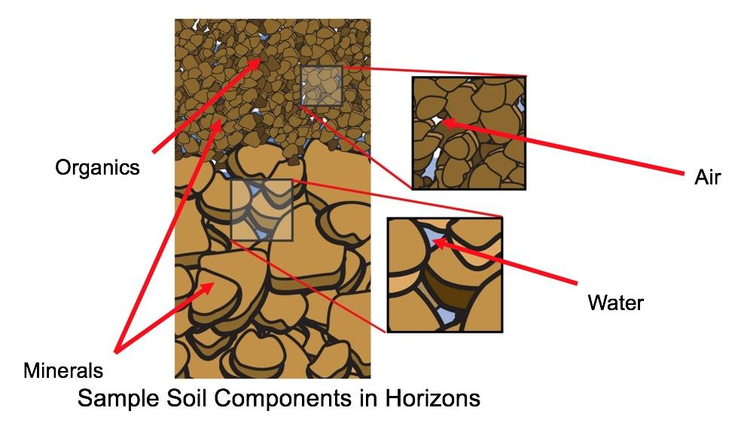
Sample Soil Components
If soil pore space increases and density decreases, water moves through soil more quickly. If the pore space decreases and soil’s density increases, water moves through the soil more slowly.
A high infiltration rate keeps water and nutrients available to plants for growth. A too-high rate might lead to unwanted chemicals and nutrients in the groundwater or other subsurface water.
A low infiltration rate might lead to increased run-off, which might also lead to flooding and erosion.

Slide 9
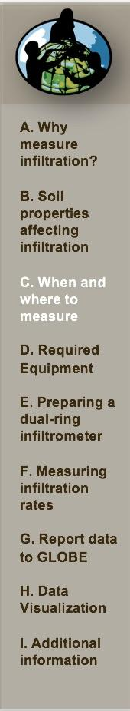
Overview of Protocol
Where | Conduct this protocol at your soil moisture study site and your soil characterization sample site, within 5 m of your sample site
Key Equipment | Infiltrometer, can be built using 2 different sized coffee cans
Time | One class period to build and test the double-rig infiltrometer; 45 minutes to make the measurement
Frequency | 3-4 times a year at Soil Moisture Study Site 1 time at Soil Characterization Sample Site
Documents needed | Soil Infiltration Protocol and Field Guide Soil Infiltration Data Sheet

Slide 10
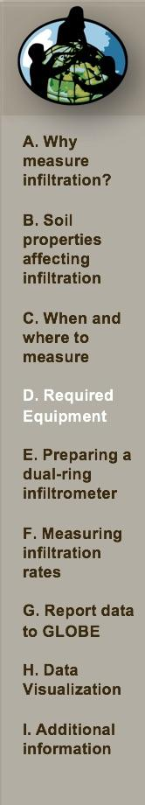
Required Materials
Metal ring with a diameter of 10 - 20 cm (Coffee cans work!)
Metal ring with a diameter of 15 - 25 cm (Coffee cans work!)
Buckets or other containers to transport at least 8 L of water to the site
Ruler
Waterproof marker
Stop watch or watch with a second hand
Block of wood
Hammer
Three soil sample containers suitable for soil moisture measurement
Grass clippers
- Funnel

Slide 11
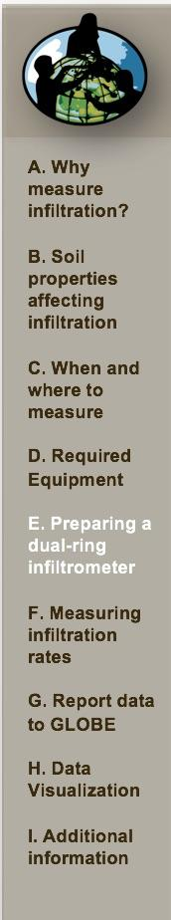
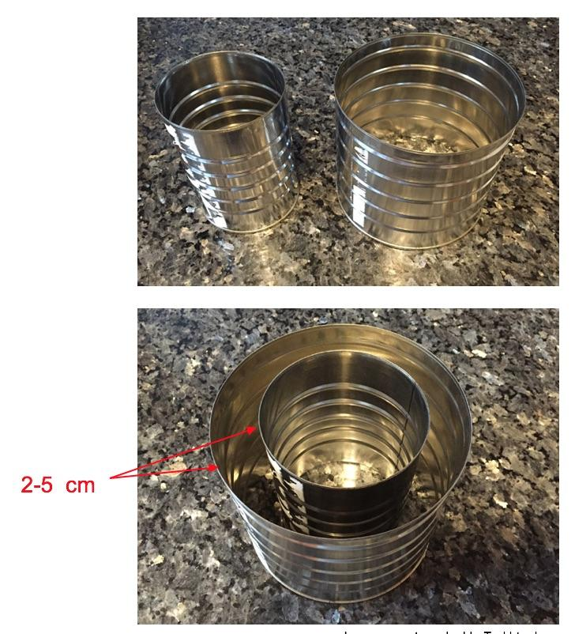
Constructing a Dual-Ring Infiltrometer
Cut out the bottom of your cans
Place one inside the other and be sure that the distance between the walls of the cans is between 2-5 cm.
Caution students when cutting the bottom of the cans, and when handling the cans when doing the infiltration protocol- the raw edges are sharp.

Slide 12
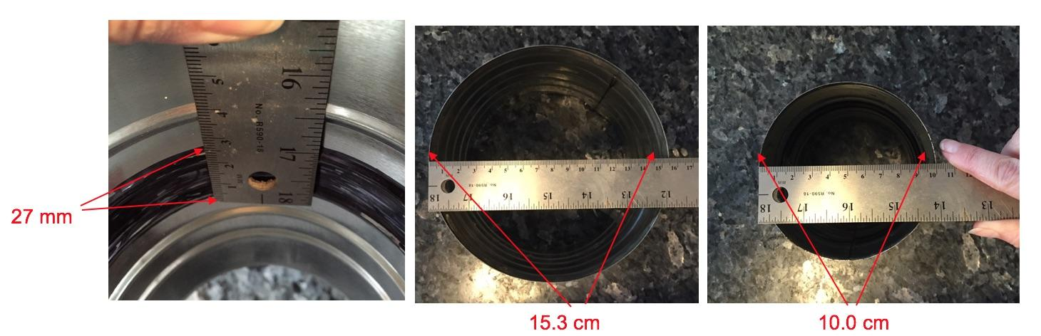
Measuring your Dual-Ring Infiltrometer
Measure and record the width of your reference band (in mm).
Measure and record the widths of your inner and outer rings (in cm- see below).

Slide 13
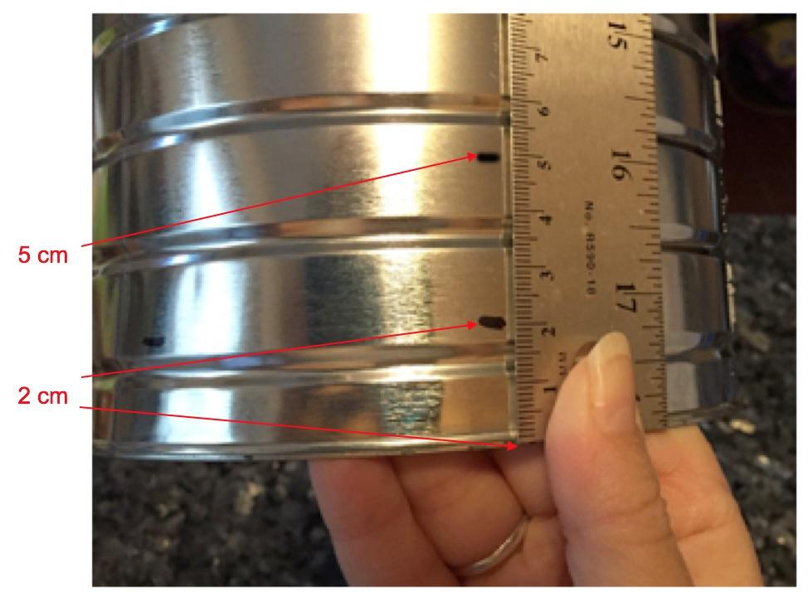
Marking the Outside of the Dual-Ring Infiltrometer
Mark 2 cm and 5 cm from the bottom of each can as a reference for when you will push the can into the soil at least 2 cm but not deeper than 5 cm.

Slide 14
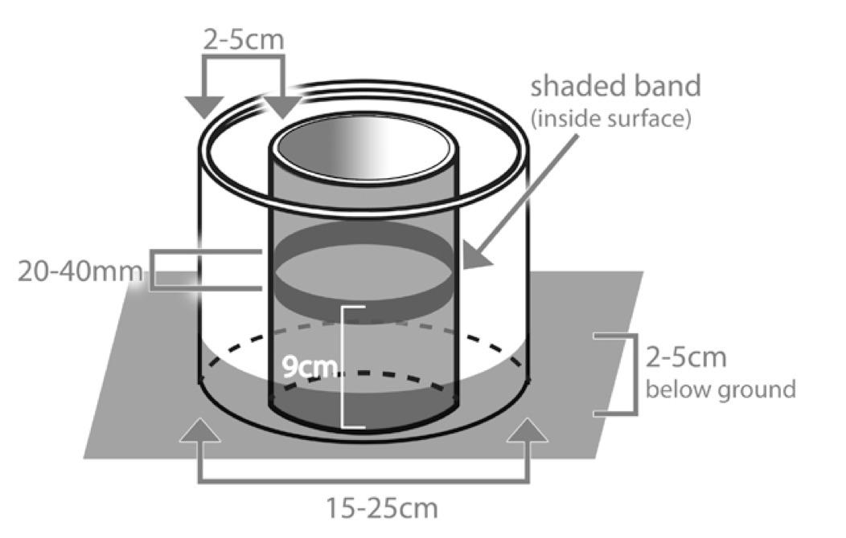
Diagram of the Finished Dual-Ring Infiltrometer
This illustration shows a fully constructed Dual Ring Infiltrometer in the soil.

Slide 15
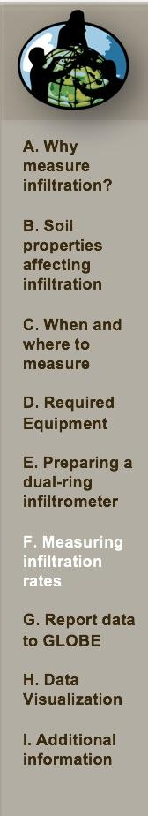
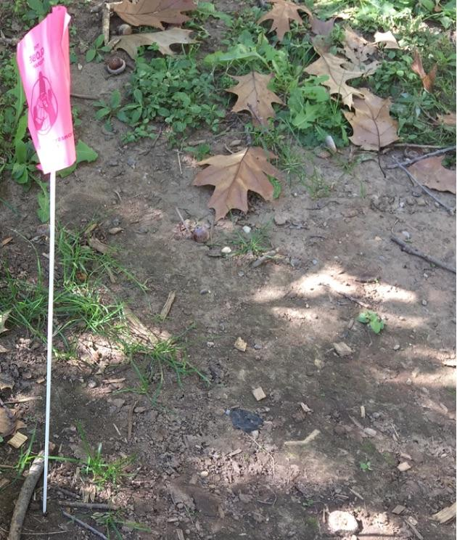
Measuring Infiltration Rates: Clear Vegetation
Clip any vegetation (grass) to the ground surface and remove all loose organic cover over an area just larger than your largest can. Try not to disturb the soil.

Slide 16
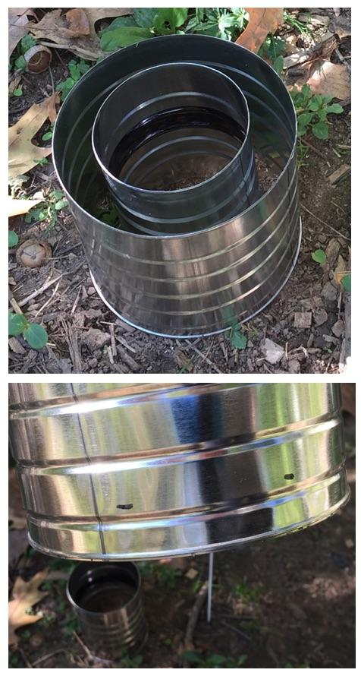
Push Cans into the Soil
Starting with the smaller can, twist the cans 2 - 5 cm into the soil.
Use the reference points you marked earlier as guides.

Slide 17
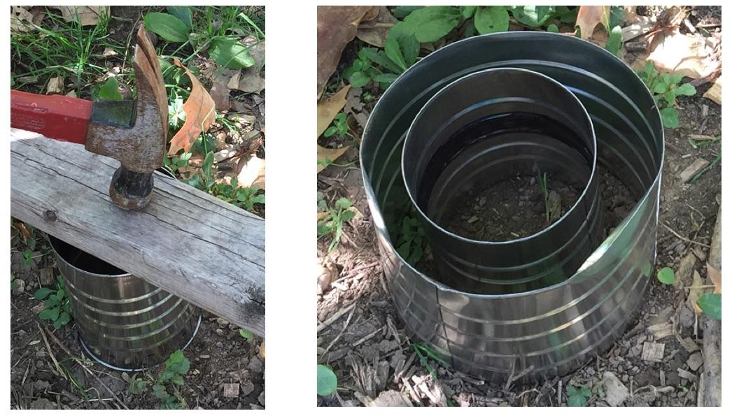
Instilling Cans in Hard Soil
You may use a hammer to pound the can into the surface. If you do, place a block of wood between the hammer and the top of the can to distribute the force of the hammering.
Do not hammer so hard that the can crumples, but a little bending at the top is okay.

Slide 18
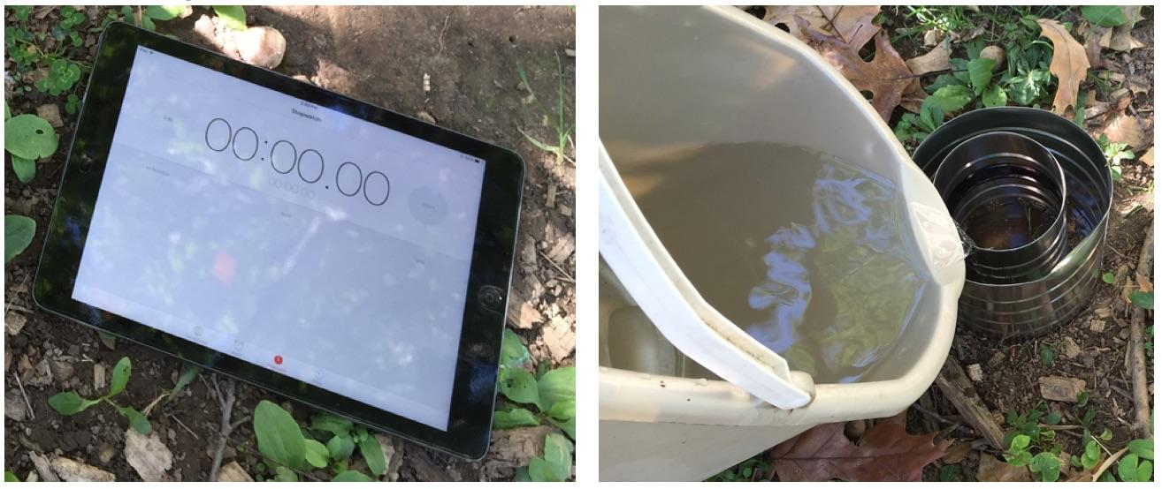
Overview of Measuring Soil Infiltration
Once the rings are in the soil, if you are using a stop watch, start it.
Pour water into both rings
When you pour water into the rings, the outer ring should not be leaking water to the surface around its rim. If it is, start over in another location, push the outer ring deeper into the soil, or pack mud around its base.
Prepare to record your data with the Data Entry app or on the Data Entry Sheet

Slide 19
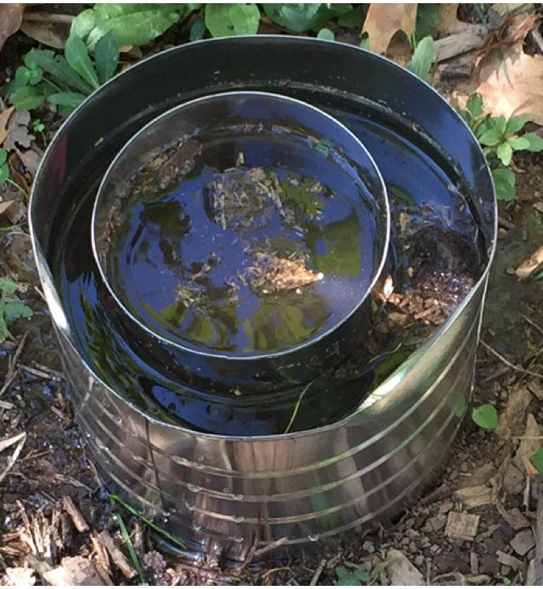
Pouring Water into the Rings
In the inner ring, pour water to just above the upper reference band and maintain the same water level of the outer ring.

Slide 20
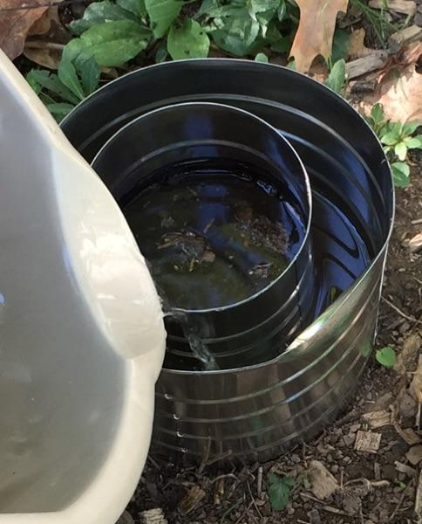
Topping up the Outer Ring
The level of the water in the outer ring tends to drop faster than the inner ring as water spreads outward and not just downward.
To keep the water in the inner ring flowing only downward it is important to keep the water level in the outer ring at the same level as the inner ring by adding water to the gap between the rings.

Slide 21
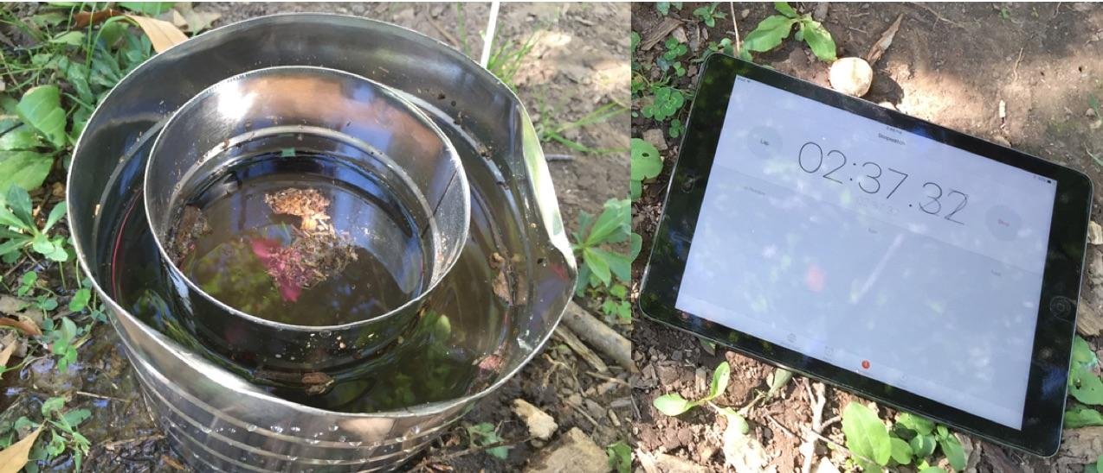
Begin Timing Infiltration Rate
As the water level in the inner ring reaches the upper reference mark of the band, read the stop watch or note the time to the second.
This is your start time.
Record this time in the Data Entry App, or on the Data Entry Sheet.

Slide 22
Maintain the Water Level in the Outer Ring Equal to the Water Level in the Inner Ring
During the timing interval, keep the water level in the outer ring approximately equal to the level in the inner ring.

Slide 23
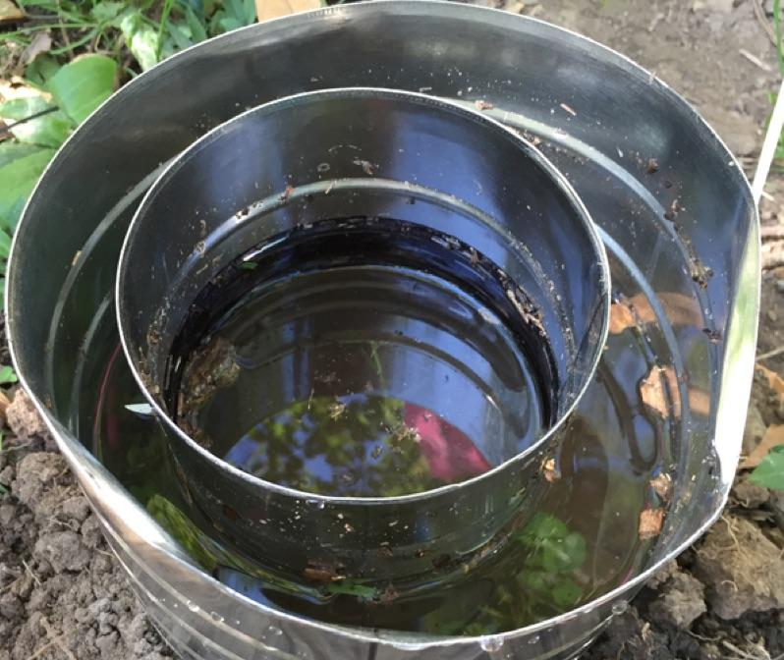
Record the End Time
As the water level in the inner can reaches the lower reference mark, note the time on the stop watch. This is your end time.
Be careful not to pour water into the inner ring (using a funnel can help).

Slide 24
Troubleshooting: Soils Impervious to Water Infiltration
At times, some clays and compacted soils will be impervious to water infiltration and your water level will not drop to the bottom of the marked band in a 45-minute time period.
In this case:
Record the time at which you stopped your observations as the end time.
Record the level to which the water fell and report it as the:
“Height Above Ground (Lower Mark)”.
Your infiltration measurement will consist of a single interval.

Slide 25
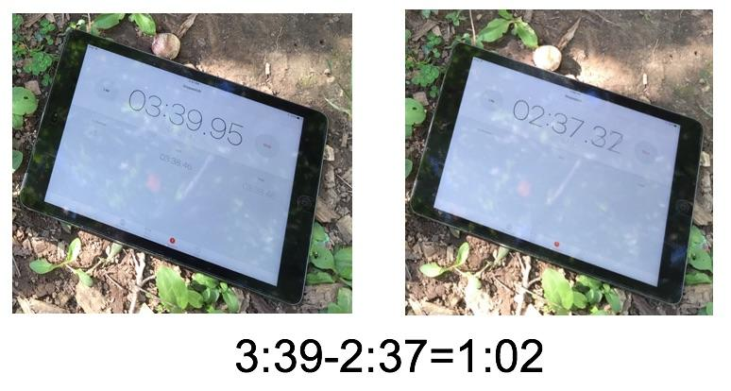
Recording and Calculating the Time Interval
Record your end time in the Data Entry App, or on the Data Entry Sheet.
Calculate the time interval by taking the difference between the start and end times.
Record this interval on the Data Entry App, or on the Data Entry Sheet.

Slide 26
Repeat Measurement
Refill the two cans to the level of the top of the band.
Repeat timing the fall of the water level in the inner ring for 45 minutes or until two consecutive interval times are within 10 seconds of one another.
After you have finished the previous steps, wait five minutes. If the water has not soaked into the soil, remove the cans.

Slide 27
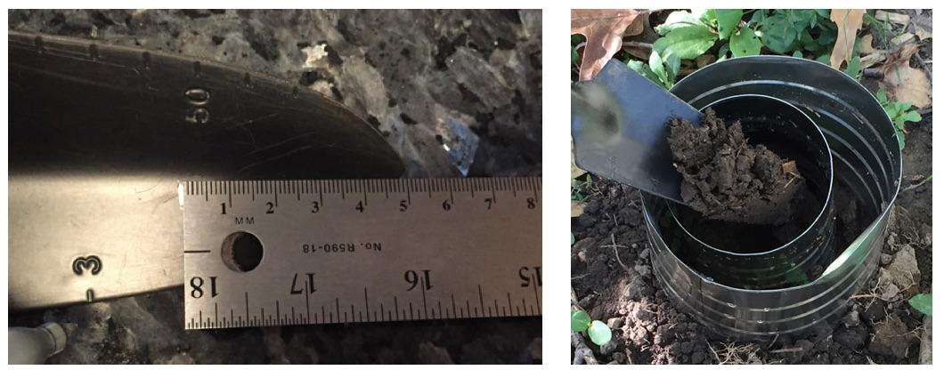
Infiltration Measurement of a Top 5 cm Soil Moisture Sample- 1
Take a single 0-5 cm soil moisture sample from where the inner ring sat.
Proceed to measure the gravimetric soil moisture of this sample following the Gravimetric Soil Moisture Protocol.

Slide 28
Infiltration Measurement of a Top 5 cm Soil Moisture Sample- 2
Make two other infiltration measurements within a 5 m diameter area of your first sample site. These measurements can be done at the same time using other groups or over several days (if the near-surface soil water content is not changed by rain).
It is not critical that multiple runs have the same number of reading sets, but do not submit runs that are incomplete (e.g. a run that was cut short due to lack of time).
Report your data to GLOBE even if you conduct one or two series of infiltration measurements. If you take more than three sets of measurements, enter your three best sets on the Data Entry App.

Slide 29
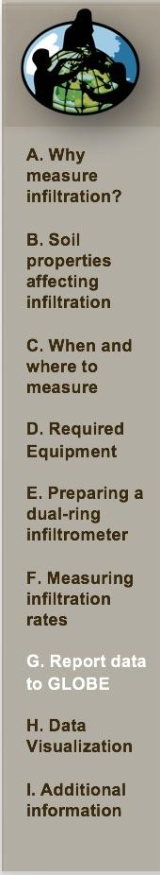

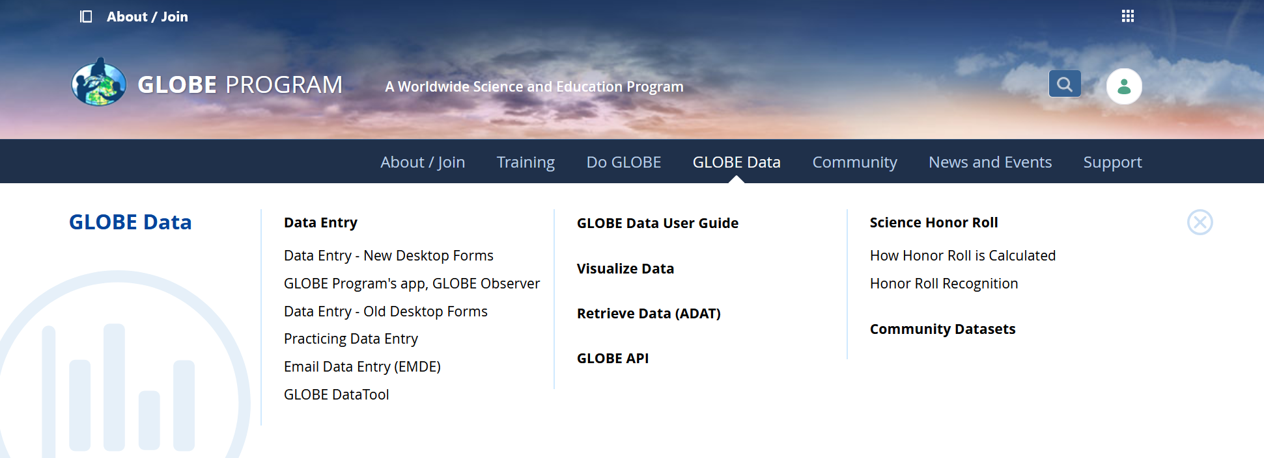
Reporting Data to GLOBE
Two Options for Uploading Data:
These methods all allow users to submit environmental data – collected at defined sites, according to protocol, and using approved instrumentation – for entry into the official GLOBE science database.
Download the GLOBE Observer mobile app from the App Store.
Data Entry: Visit globe.gov, click on the “GLOBE Data” tab, then underneath “Data Entry” click on “Data Entry – New Desktop Forms”.

Slide 30
Soil Infiltration Site Creation
If this is your first time making Soil Characterization observations at this location, you will need to create a new Soil Characterization site before entering data.
To do this, please review the Soil Characterization training.

Slide 31
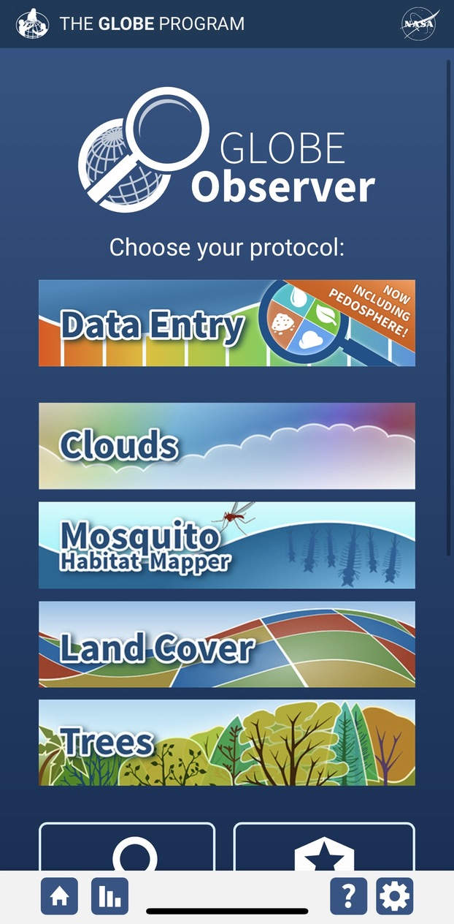
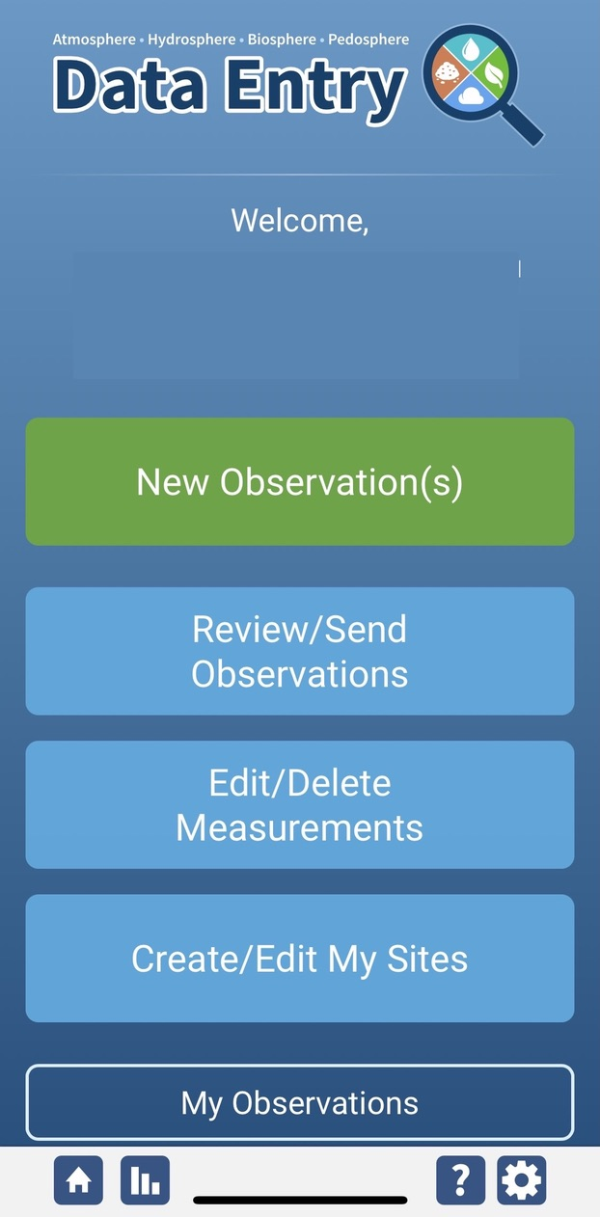
Soil Infiltration Protocol Data Entry
To enter data, first return to GLOBE Observer main page by clicking the home button in the bottom left.
Select “Data Entry”.
Next, click “New Observation(s)”

Slide 32
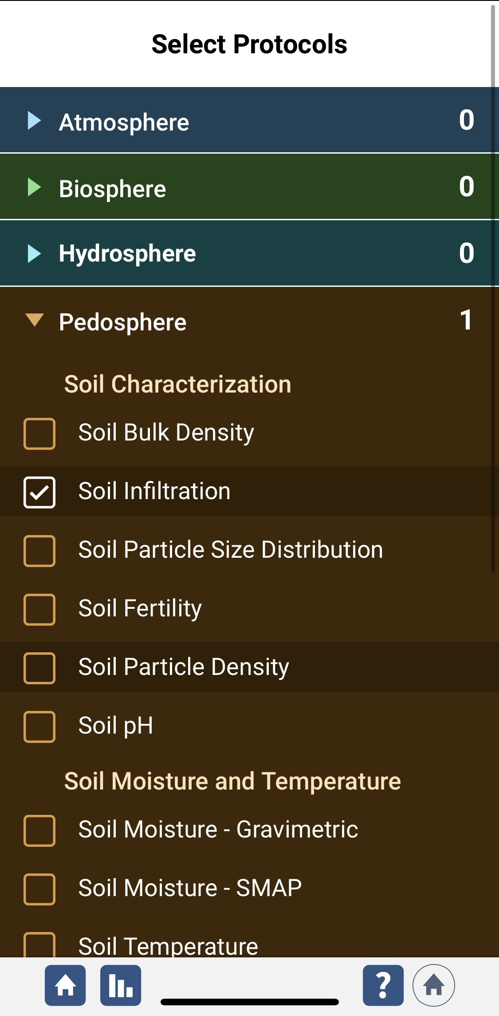
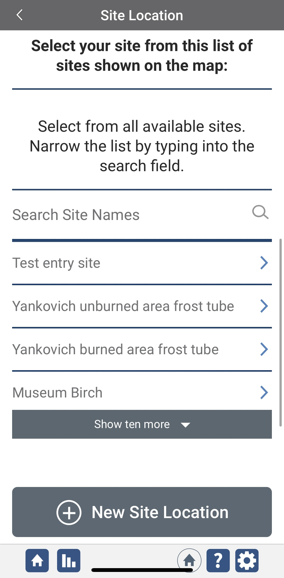
Entering Measurement Data
Under the Pedosphere tab, select “Soil Infiltration” then click Continue at the bottom of the page.
Next, select your Soil Characterization Site. Existing sites near you will show up below “Search Site Names”

Slide 33
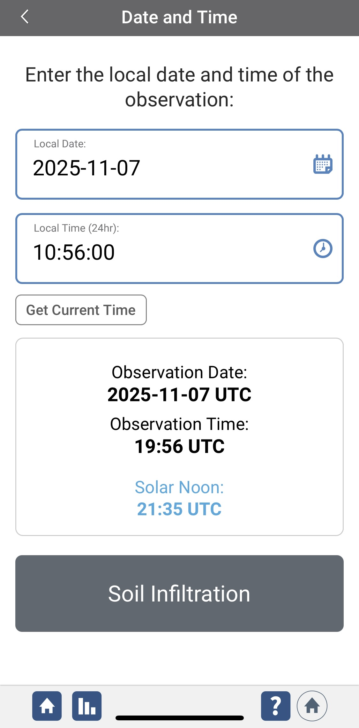
Entering Measurement Data
Enter the date and time you took the measurements.
Once you enter the date, select Soil Infiltration to enter your data.

Slide 34
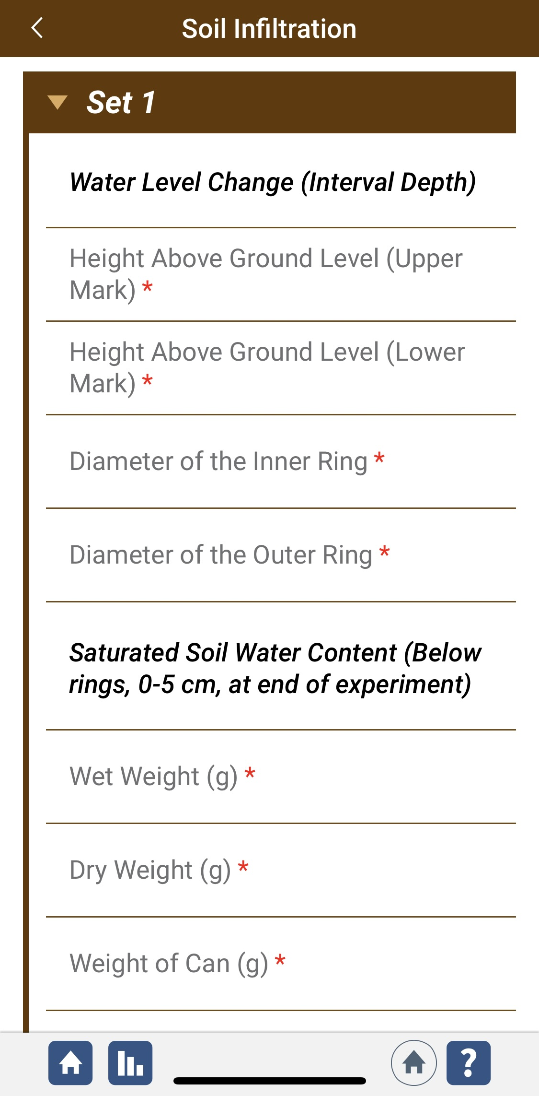
Enter Specifications of your Dual Ring Infiltrometer
Enter the soil moisture data you collect for the saturated soil from the center of the infiltrometer at the end of the protocol.

Slide 35
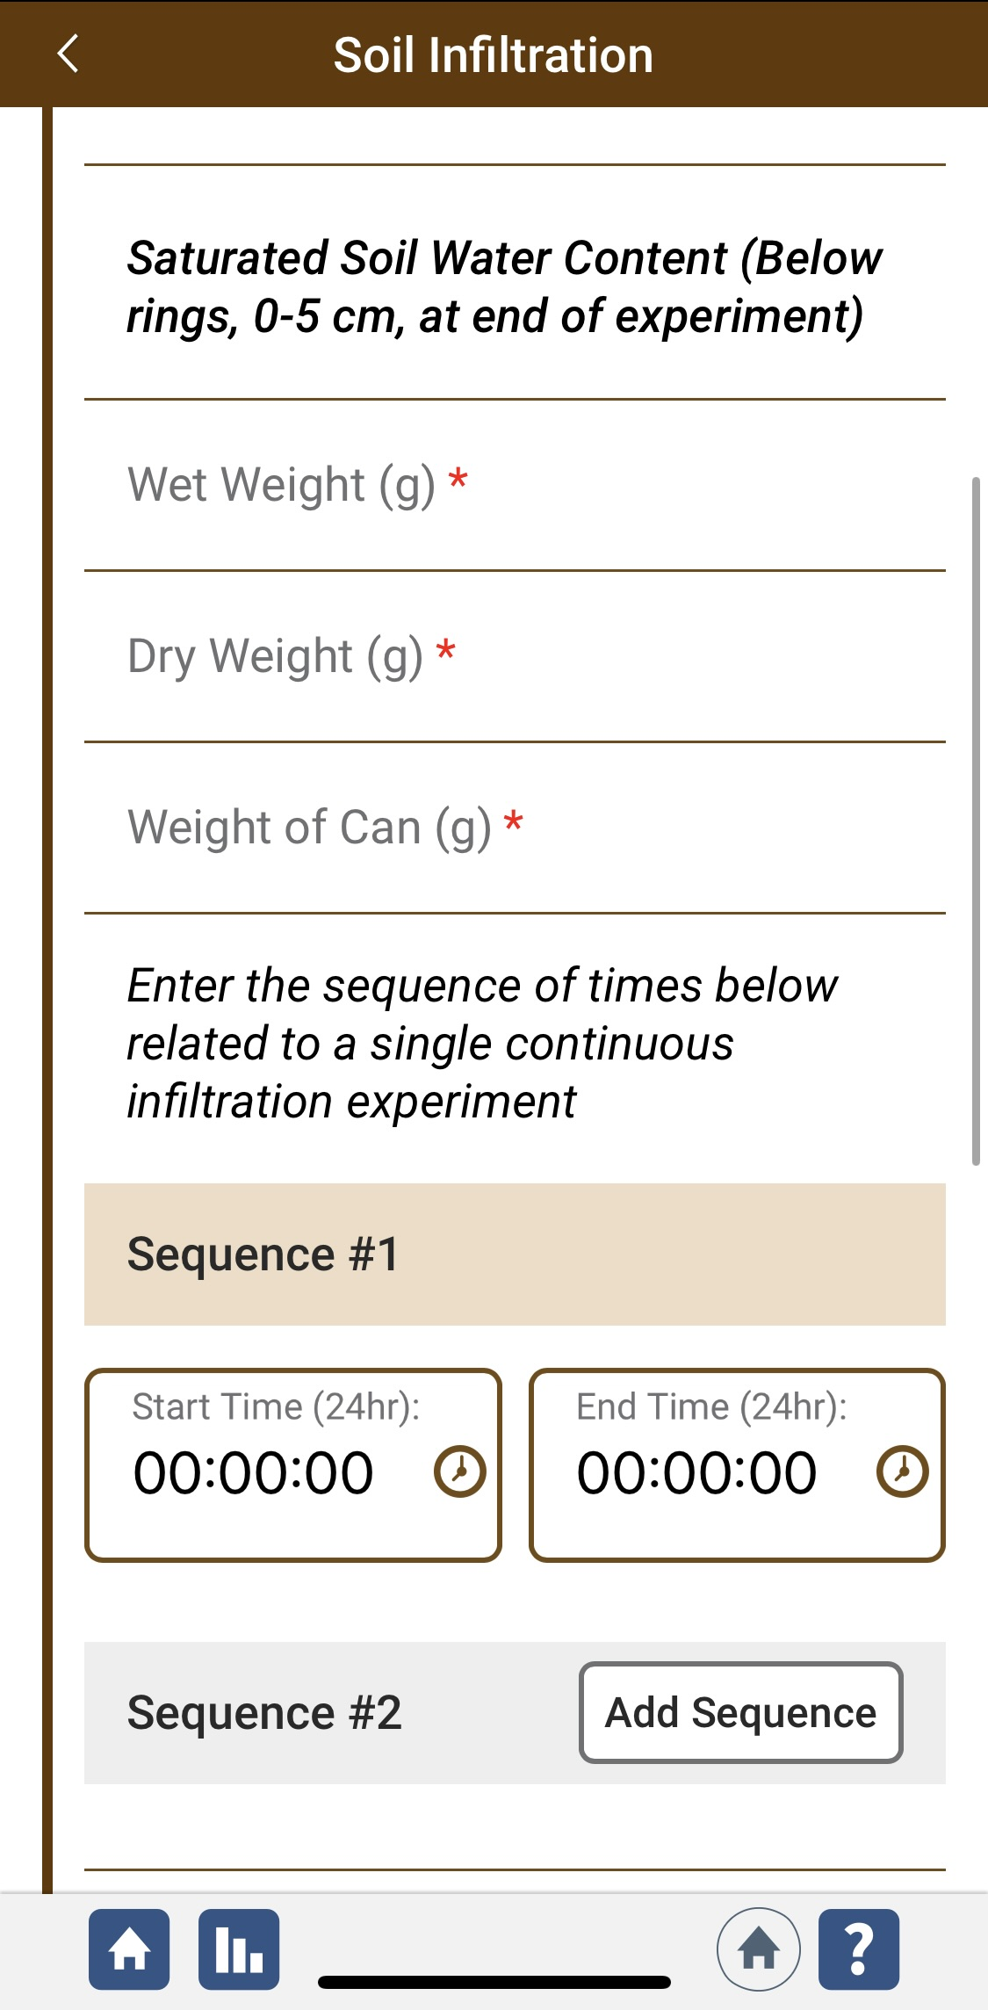
Adding Sequence Times
Add sequence start and end times.
Click “Add Sequence” to add another set of sequence times.

Slide 36
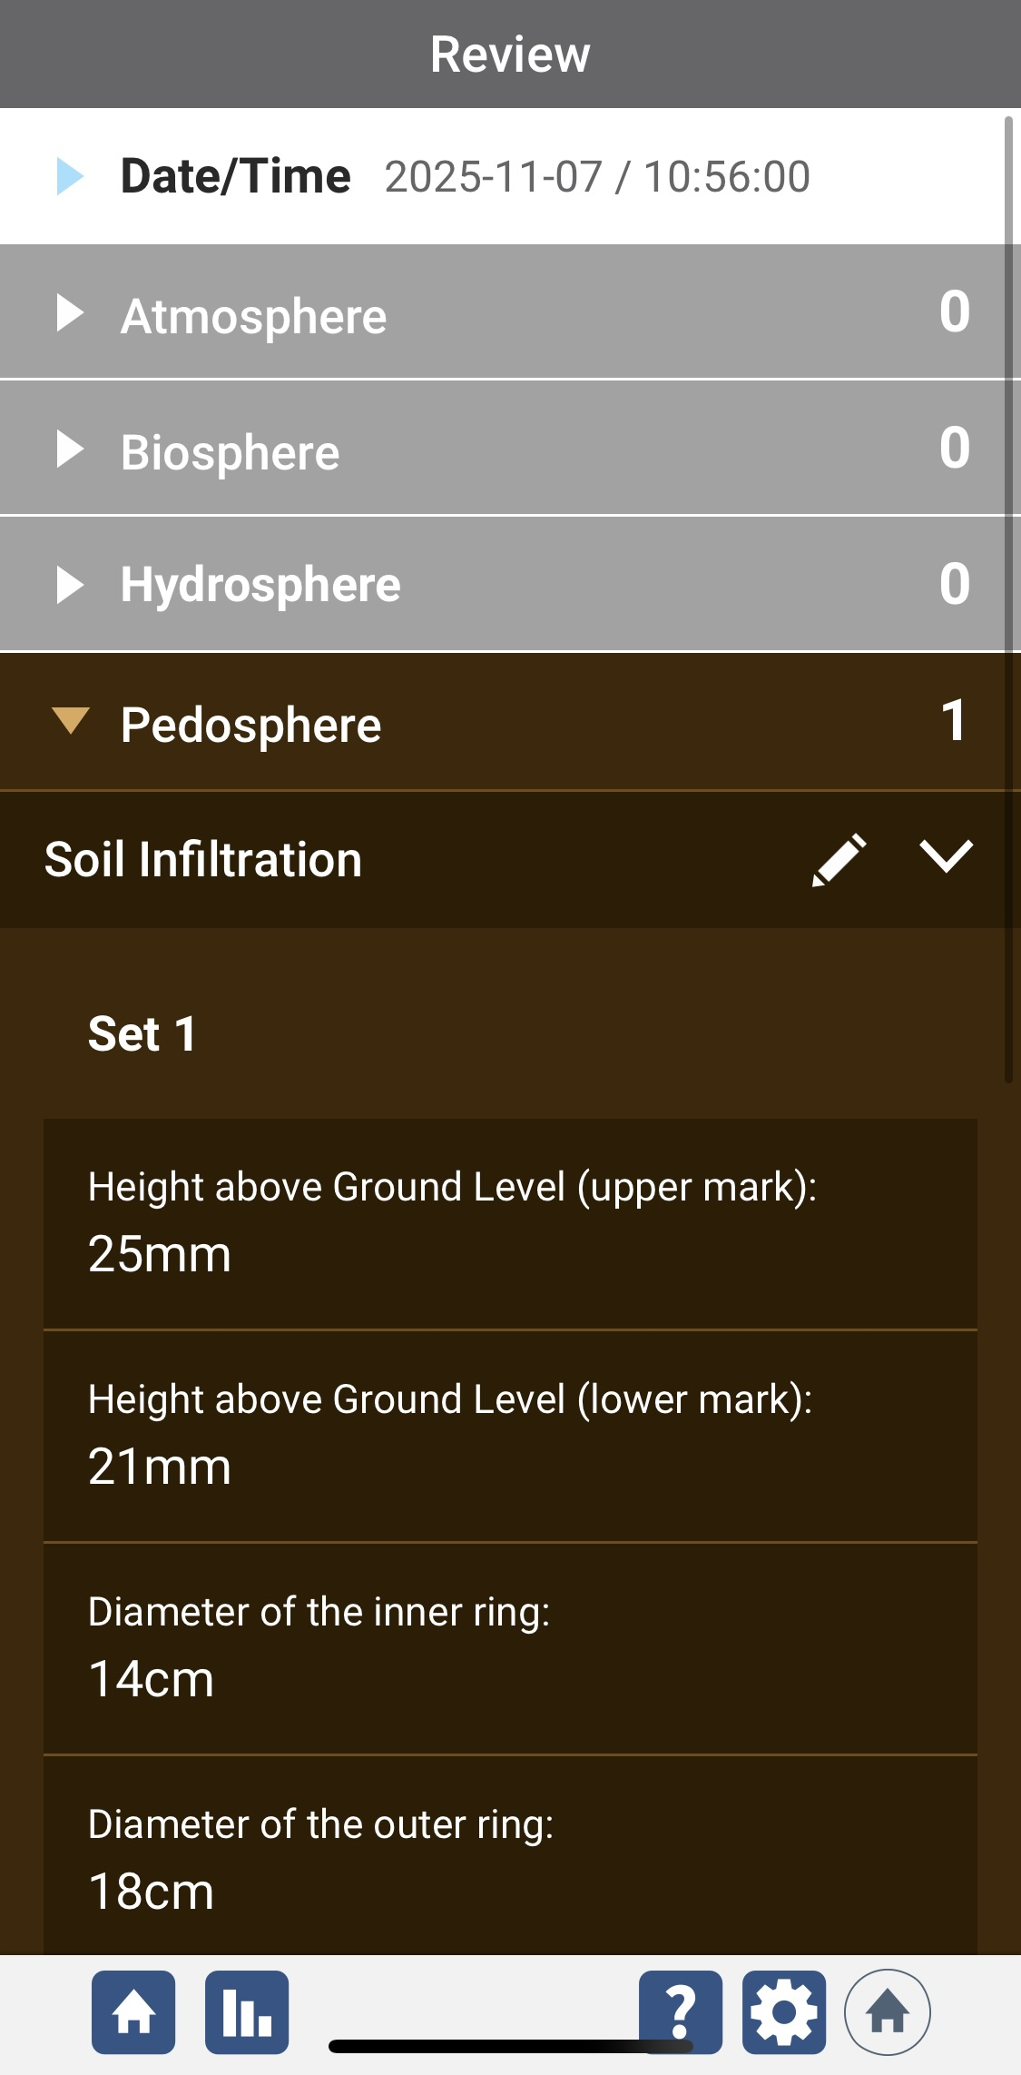
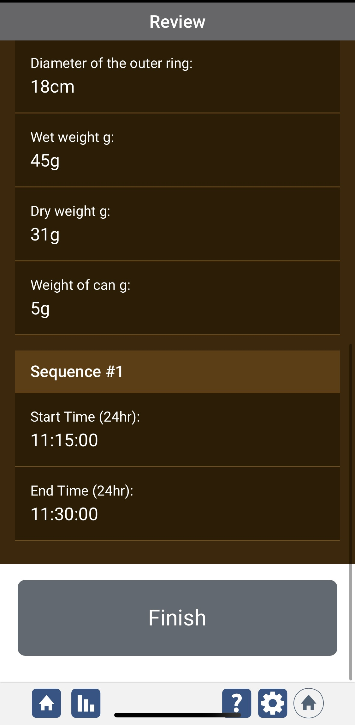
Review data entry and send data
Review the data you entered and check for errors.
When complete, select Finish to complete the send the observation to GLOBE.

Slide 37
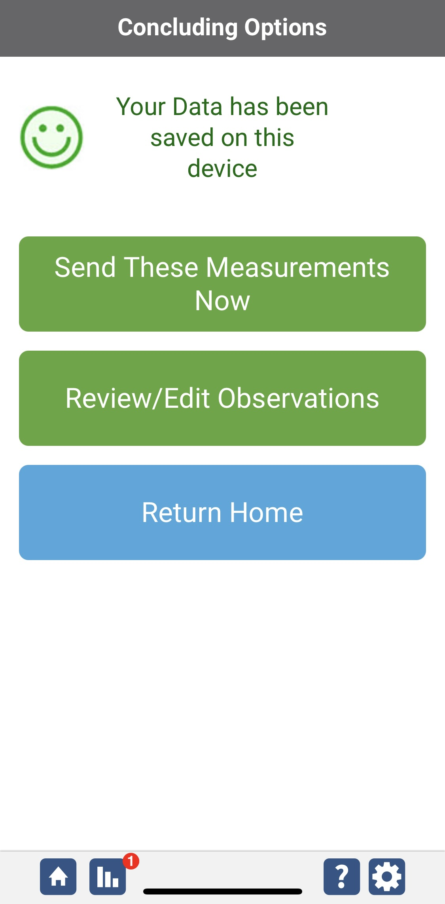
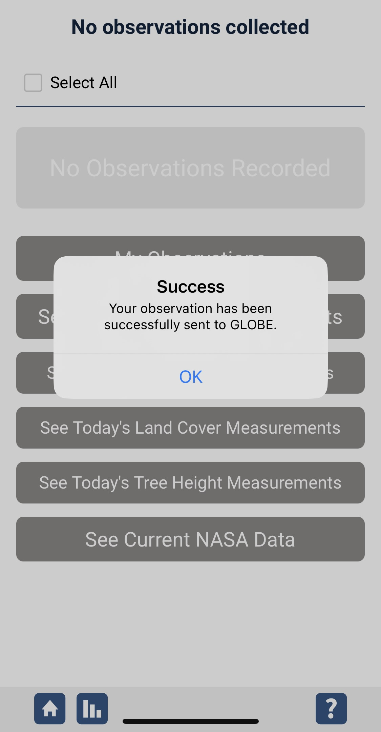
Data System Responses
If your observations are within the appropriate ranges, you will see a green smiley face.
You can review or edit your observation if needed.
When ready, select “Send these measurements now” to send your data to GLOBE. When it has been sent, you will see a “Success” message.

Slide 38

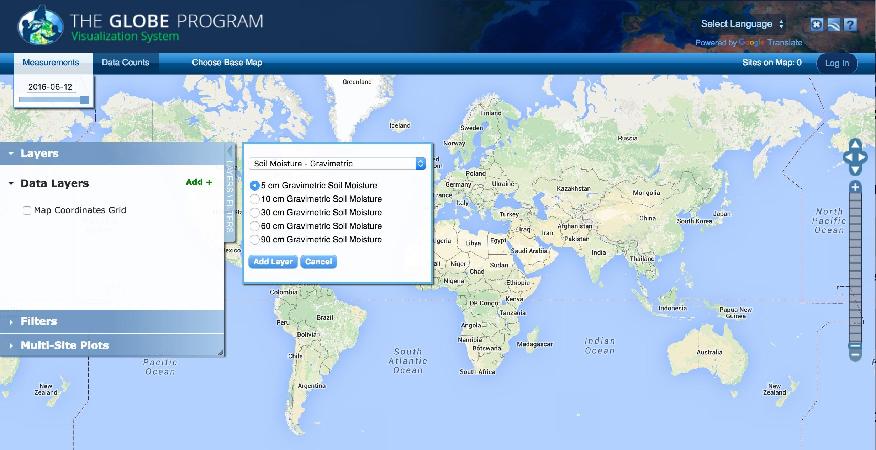
Visualizing Data-1
Currently soil infiltration data are not available in the GLOBE Visualization System. However, soil moisture data are available and are shown below.

Slide 39
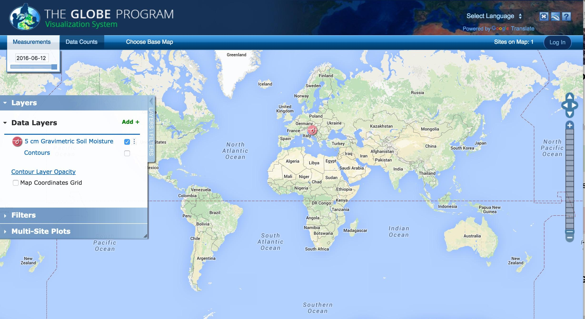
Visualizing Data-2
Currently soil infiltration data are not available in the GLOBE Visualization System. However, soil moisture data are available and are shown below.

Slide 40
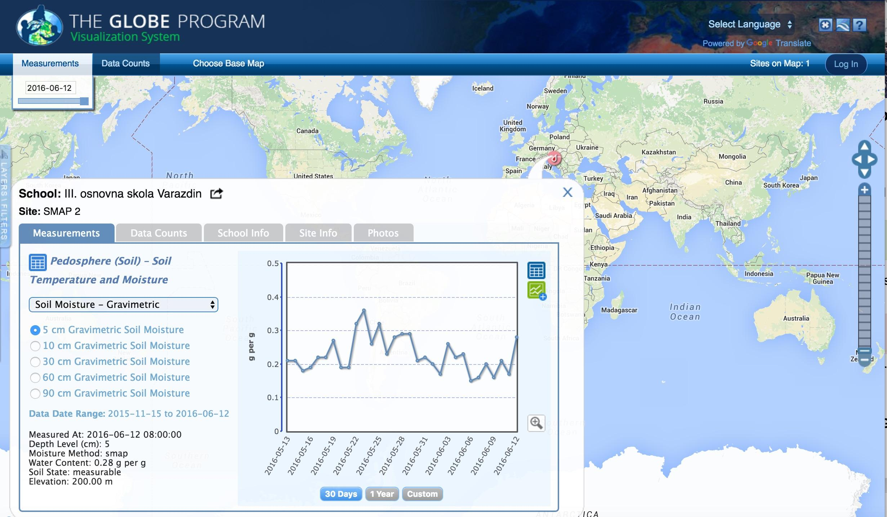
Visualizing Data- 3
Currently soil infiltration data are not available in the GLOBE Visualization System. However, soil moisture data are available and are shown as an example below.

Slide 41
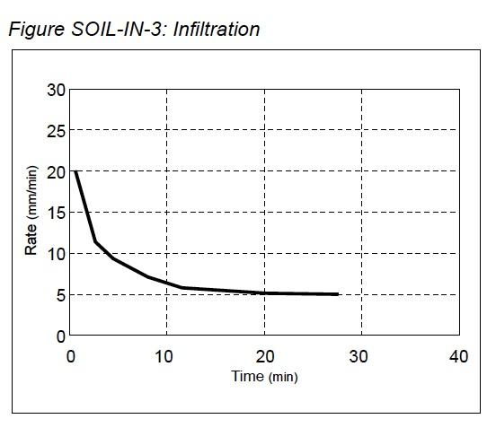
Looking at the Data
Infiltration rate is determined by dividing the distance that the water level decreases by the time required for this decrease. For GLOBE measurements this is equal to the width of the reference band on the infiltrometer divided by the difference between the start and end times for an interval.
The Infiltration Data Sheet can be used to record and help calculate the values needed to plot measurement results. The flow rate for each timing interval is the average value during an interval. The flow rate should be plotted at the midpoint of the interval times.
Infiltration should decrease with time and it is important to keep track of the cumulative time from when water was first poured into the inner ring. The table and graph below demonstrate how to calculate infiltration rates and plot them on a graph.

Slide 42
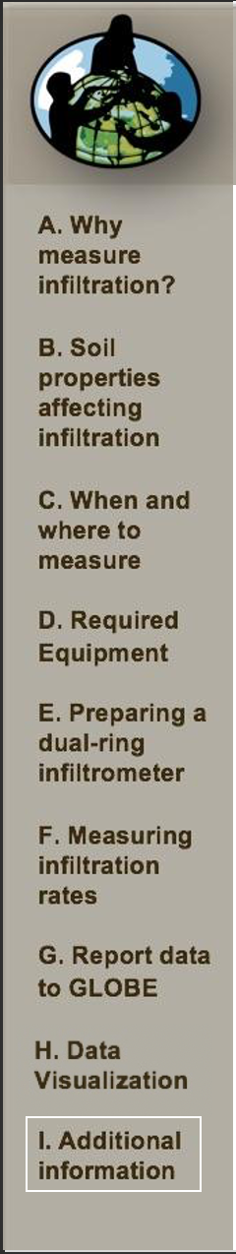
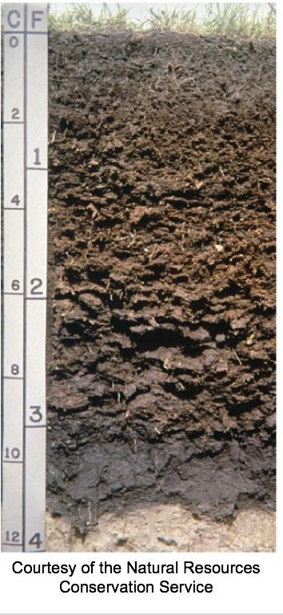
The Soils on Planet Earth
By studying the soil in your area and reporting these data to GLOBE, you will make an invaluable contribution to our knowledge of planet Earth.
As you take your soil measurements, remember that you are likely the only ones who will study your specific soil. For much of this critical information, there exists no other way to study the soil in your community. Your contribution to science will be important and unique.

Slide 43
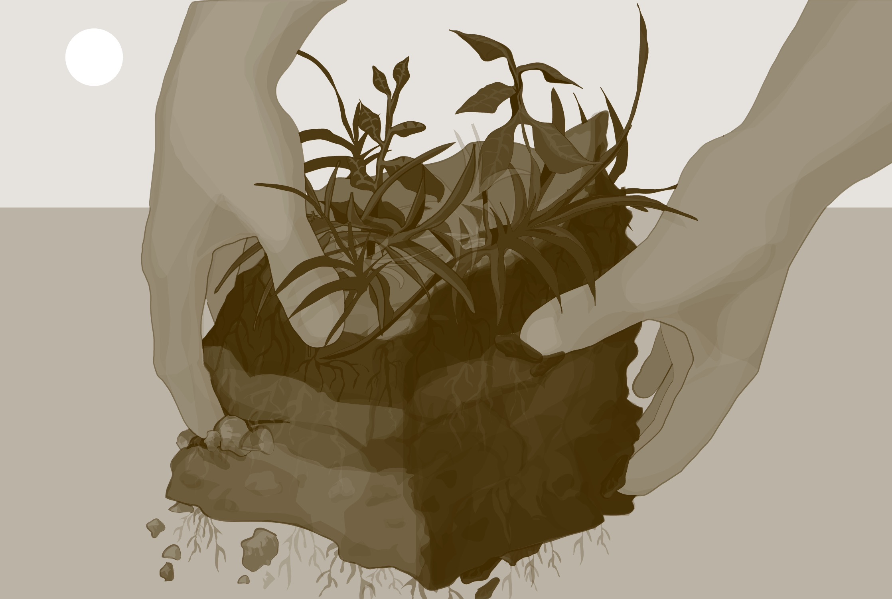
Frequently Asked Questions
How often should I conduct the soil protocols?
It depends on which soil property you are examining. Soil properties change over time on different timescales. Properties such as temperature, moisture content, and local composition of air change over a period of minutes or hours. Other properties change over months or years, including soil pH, soil color, soil structure, bulk density, soil organic matter, soil fertility, and the microorganisms, animals and plants in the soil. Over much longer timescales, that is, tens to hundreds and thousands of years, changes in mineral content, particle size distribution, horizons and particle density take place. These last measurements you need to do only once.

Slide 44
Frequently Asked Questions (Cont’d)
How can I use soil protocols with learners?
The GLOBE Implementation Guide provides an example of a classroom soil unit and many tips for using GLOBE investigations to meet your curriculum requirements.

Slide 45

Request for your feedback on this module! Please provide us with feedback about this module. This is a community project and we need your comments, suggestions and edits!
Questions after reviewing this module? Contact GLOBE: help@nasaglobe.org
Credits
Slides: Izolda Trachtenberg, Dixon Butler, Russanne Low
Photographs: Izolda Trachtenberg
Illustrations: Rich Potter
Cover Art: Jenn Glaser, ScribeArts
More Information:
GLOBE Program
NASA Earth Science
NASA Global Climate Change: Vital Signs of the Planet
The GLOBE Program is sponsored by these organizations:
November 2025. GLOBE Implementation Office: Science, Training, Education, and Public Engagement Team.
If you edit and modify this slide set for use for educational purposes, please note “modified by (and your name and date)” on this page. Thank you.

