Slide 1


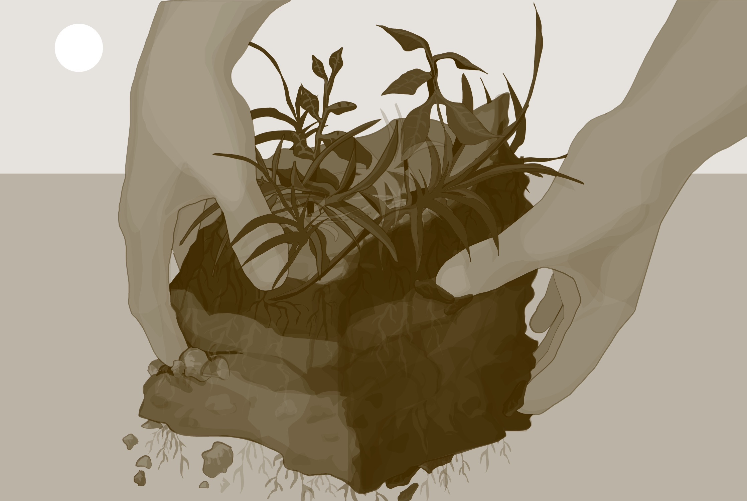
Intro Slide
Soil (Pedosphere)
Soil Moisture Gravimetric Protocol

Slide 2
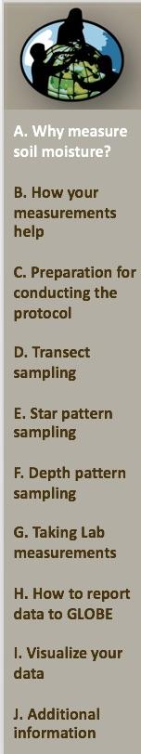
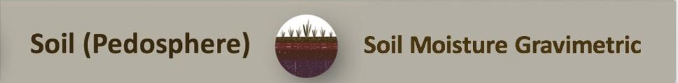
Overview
This module provides step-by-step instructions in how to determine soil moisture. Field samples of soil are collected and weighed, with water content, and after the soil has been dried. The difference is the weight of soil moisture. In this instance, gravimetric means determining the amount of moisture in the soil, by weight.
Learning Objectives:
After completing this module, you will be able to:
Explain why soil moisture is worth studying
Determine a schedule for taking this measurement
Choose a sampling pattern
Take soil moisture samples
Measure gravimetric soil moisture content
Report these data to GLOBE
Visualize these data using GLOBE’s Visualization Site
Estimated time needed for completion of this module: 1.5 hours

Slide 3
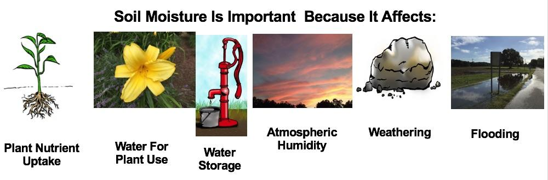
The Role of Soil Moisture in the Environment
Soil acts like a sponge spread across the land surface. It absorbs rain and snowmelt, slows run-off and helps to control flooding. The absorbed water is held on soil particle surfaces and in pore spaces between particles. This water is available for use by plants. Some of this water evaporates back into the air; some of this water is transpired by plants; some drains through the soil into groundwater.

Slide 4
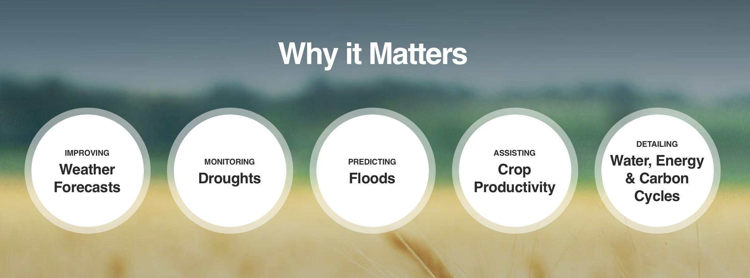
Why your measurements matter:
With this measurement, students may investigate how soil moisture:
  Relates to precipitation
  Relates to surface, soil, and/or air temperatures
  How soil moisture varies diurnally and annually as well as over days or weeks
  How soil moisture relates to plant phenology
Image credit: NASA

Slide 5
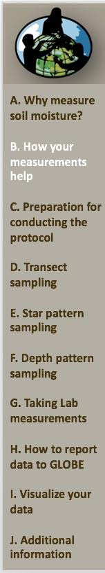
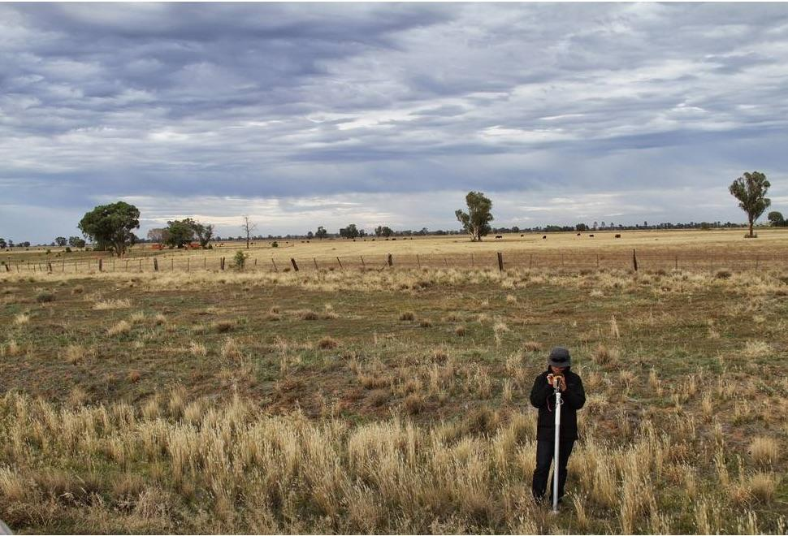
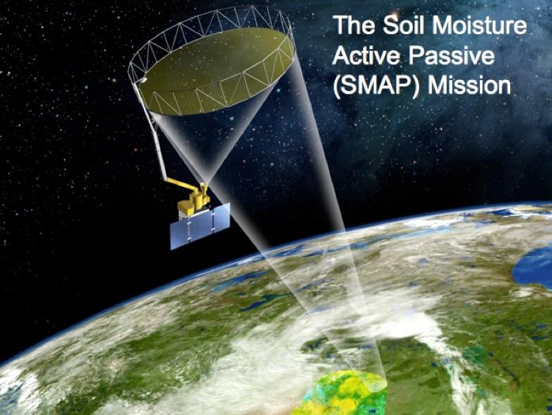
How your measurements can help us understand interactions of the soil with the rest of the Earth system
Soil data field campaign, Yanco, Australia. Both field measurements from the ground as well as remote sensing from air craft support our understanding of soil moisture. These are used in combination with satellite data from NASA missions such as GRACE and SMAP. Image credit: Amy McNally, NASA.
The SMAP satellite creates a global soil moisture map every three days. It measures the volumetric soil moisture in the top 5 cm of the soil. See the GLOBE SMAP Soil Moisture Protocol to work with scientists and provide needed on-the-ground measurements to help validate the satellite’s soil moisture estimates. Image credit: NASA.

Slide 6
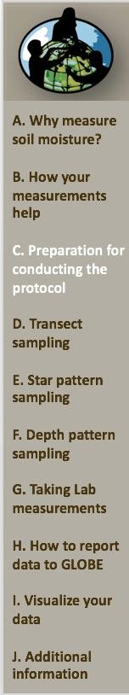
Summary of Protocol
Where | GLOBE Soil Moisture Site
Frequency | Ideally, 12 or more times per year at the same site, at daily, weekly or monthly intervals
Prerequisites | Site definition using the Site Definition Sheet
Needed Documents | Gravimetric Soil Moisture Protocol and
 | Soil Moisture Data Sheet-Star Pattern or
 | Soil Moisture Data Sheet-Transect Pattern or
 | Soil Moisture Data Sheet- Depth Profile
Time required | 5-10 minutes preparation before sampling 10-15 minutes to collect samples* 5 minutes to weigh wet samples 5 minutes to weigh dry samples Samples dry under heating lamps for 2 days or in a drying oven overnight. *Some sample collection methods may require additional time

Slide 7
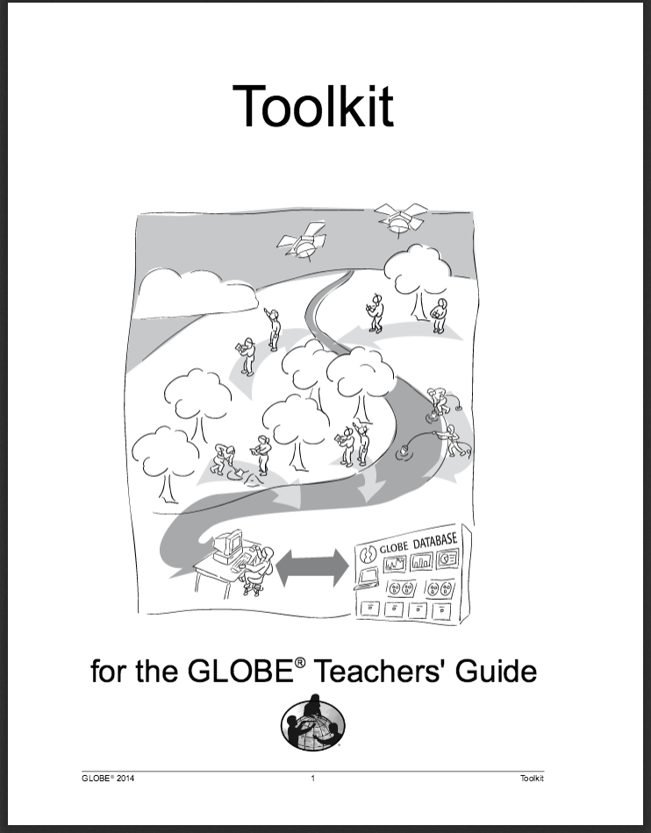
Instrument Specifications
The following resources summarize the measurements associated with each protocol, associated skill level, scientific specifications for the instruments, and how to access the equipment you need (purchase, build, or download).
By using instruments with GLOBE specifications, you ensure your data are accurate and comparable to GLOBE investigations conducted by others.
Where to find specifications for instruments used in GLOBE investigations

Slide 8
Required Equipment for Fieldwork and Sampling
For all sample patterns:
A defined Soil Moisture & Temperature Site marked with a permanent marker or flag
Marker flags (if you can keep them placed permanently)
Compass
Trowel (1 per student group)
Permanent marker
Heating lamp(s) or soil drying oven (for low-tech option, leave the soil out in the open air)
For Transects:
Rulers marked in millimeters (1 per student group)
13 sample containers (sealable bags or cans) labeled with date and a container number
50 meter tape or 50 meter rope marked every 5 meters
For Star Patterns :
6 soil sample containers
Meter stick marked in millimeters
For Depth Profiles:
5 soil sample containers
A meter stick
A soil auger
Note: Containers or plastic bags should be weighed and labeled with mass and container number before bringing to the field. Depending on the context, gloves and protective eyewear may be recommended.

Slide 9
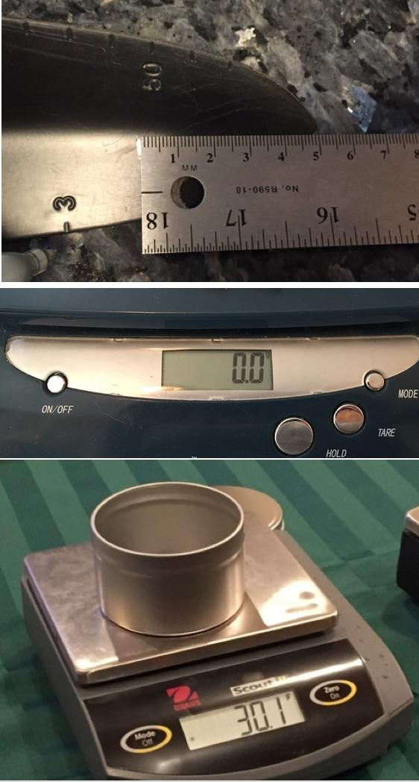
Preparations before you go to the field
Mark your trowel at the 5 cm mark from the tip to ensure you go no deeper when you take samples.
Calibrate the scale or balance according to the manufacturer’s directions. If using an electronic balance, check that the balance is measuring in grams and is zeroed properly. Measure and record the mass of each container (without the lid) or plastic bag to the nearest 0.1 g.
Label each container with:
Mass of the container or plastic bag to the nearest 0.1g
Container number

Slide 10
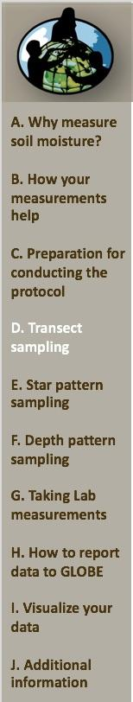
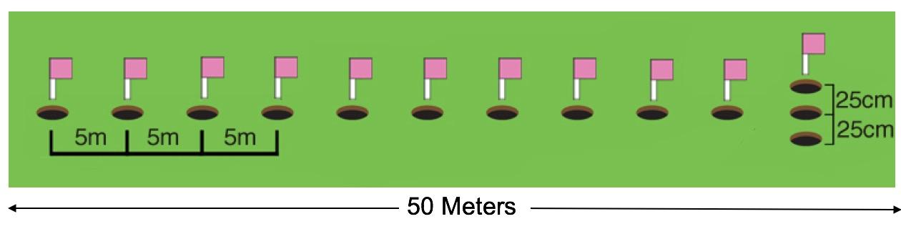
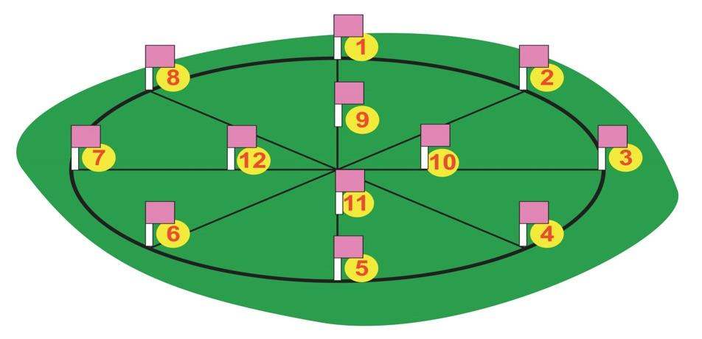
Select your Sampling Strategy Based on Research Goals: Choose One of the Three Options Below
Transect Pattern Sampling: This transect sample pattern will measure soil moisture over a large area. SMAP measurement techniques sense moisture contained in the top 5 cm of soil and their measurements are averaged over areas of 100’s of square meters or more. This sampling pattern allows students to see spatial variations in surface soil moisture measurements. It is also useful for comparison with soil moisture data collected remotely from satellites or aircraft.
The Star Pattern involves collecting soil samples from 12 different locations at twelve different time periods in a 2 m x 2 m star-shaped area. For each of the 12 locations, three spots are chosen within 25 cm of each other. Samples from the top 5 cm and from 10 cm deep are collected at each of the three spots, for a total of 6 samples at each location on the star. This sampling method can be easily coordinated with the Soil Temperature Protocol, whereby students collect their soil temperature measurements at the same depths and locations as the soil moisture measurements.
Depth Profile Pattern Sampling: Use the Star Pattern and take samples down a profile. Using an auger takes a bit of extra time, but this effort gathers valuable data and complements the Soil Characterization Protocol as well as The Digital Multi-Day Max/Min/Current Air and Soil Temperatures Protocol.

Slide 11
Option 1. Transect Pattern Sampling
This transect sample pattern will measure soil moisture over a large area. SMAP measurement techniques sense moisture contained in the top 5 cm of soil and their measurements are averaged over areas of 100’s of square meters or more. This sampling pattern allows students to see spatial variations in surface soil moisture measurements. It is also useful for comparison with soil moisture data collected remotely from satellites or aircraft.
Samples are taken every five meters over a 50 meter transect to capture soil moisture variation along a broad swath.
Each time you visit this transect you collect 13 samples of the top 5 cm of soil.
Off-set each sample set at least 25 cm from the previous ones.

Slide 12
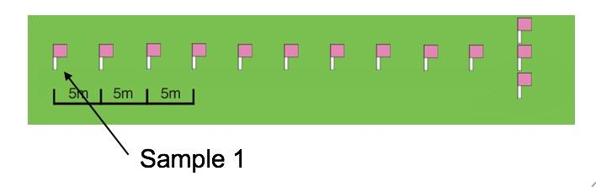
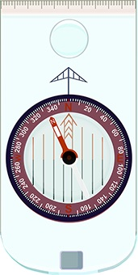
Laying out a transect
Stretch out your measuring tape or rope along the transect.
Sample points should be marked every 5 meters along the transect and numbered starting with 1.
Two extra points should be offset 25 cm from the end point as shown, and labeled 12 and 13.
Stand at the first sample and take a compass reading looking along the transect.
To take a compass reading, hold the compass level and stand at sampling point 1 facing sampling point 12. Point the compass toward sampling point 12 and rotate the compass’s bezel (azimuth ring) until the arrow inside the compass housing lines up with the red (north) end of the magnetic needle. Record the degree mark that aligns with the arrow as your compass reading.

Slide 13
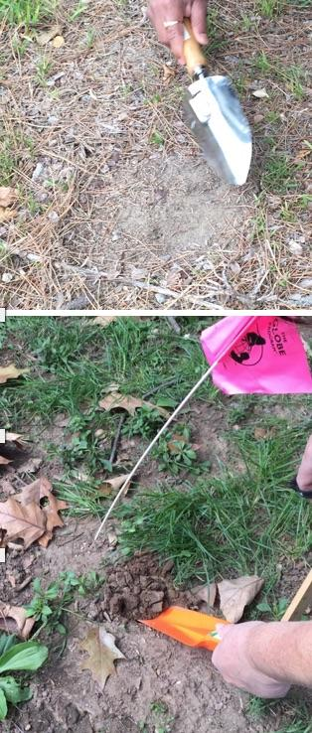
Taking samples along a transect
Cut or pull away any grass or groundcover above every sample point.
Dig a hole 10-15 cm in diameter down to 5 cm.
Leave this soil loose in the hole.
Remove any rocks larger than a pea (about 5 mm), large roots, worms, grubs, and other animals from the loose soil.

Slide 14
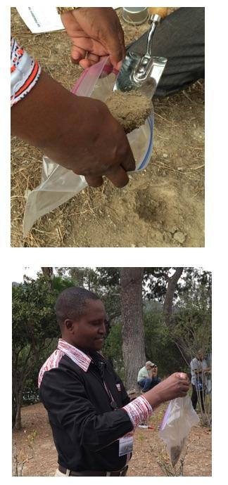
Collecting samples along a transect
Use your trowel to fill a soil container with at least 100 g of the loose soil.
Immediately seal the container to hold in the moisture.
If you are using resealable bags, label each bag with the date, site name, and location along the transect.

Slide 15
Repeat procedure for all 13 samples along the transect
Continue to collect a sample at each sampling point along the transect.
Remember to remove rocks, large roots, and animals.
Seal each container immediately.
Record the container number, mass, and distance to the start point of the transect on the Data Entry app or Data Entry Sheet next to the appropriate Sample Number.
You should have 13 containers of soil: 11 taken from along the transect plus two extras at the end. You are done!

Slide 16
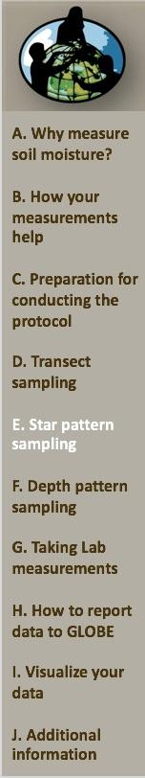
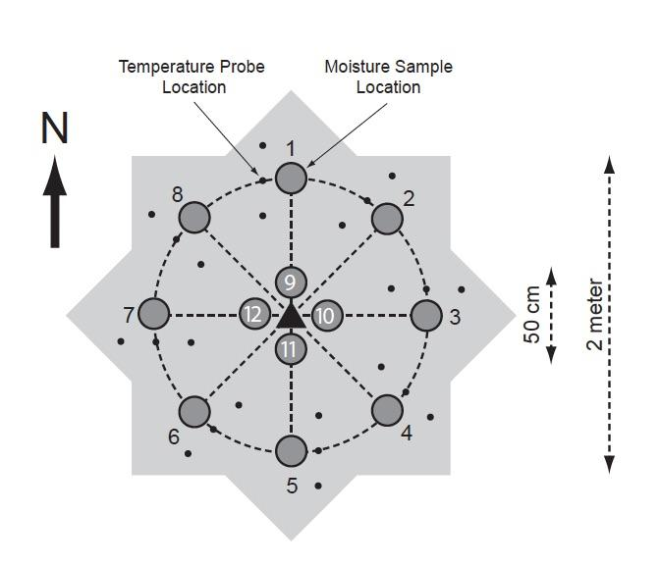
Option 2. Star Pattern Sampling Overview
The Star Pattern involves collecting soil samples from 12 different locations at twelve different time periods in a 2 m x 2 m star-shaped area. For each of the 12 locations, three spots are chosen within 25 cm of each other. Samples from the top 5 cm and from 10 cm deep are collected at each of the three spots, for a total of 6 samples at each location on the star. This sampling method can be easily coordinated with the Soil Temperature Protocol, whereby students collect their soil temperature measurements at the same depths and locations as the soil moisture measurements.

Slide 17
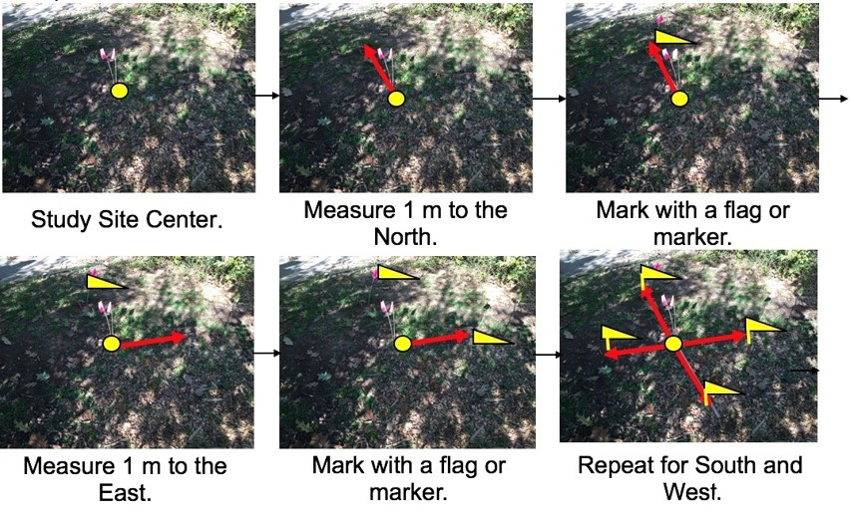
Set up the star pattern 1
Locate the place where you took the GPS reading as your center spot and mark it with some sort of permanent marker. With the Star Pattern, 1-3 pairs of samples are collected from 0-5 cm & 10 cm depth. (Note: only one pair of samples is needed at each location. Your students may wish to take up to three samples at each location to obtain information about the variation in soil conditions found at the sampling site.)
Each flag is a site around which soil samples will be taken.
If you are going to take measurements for only part of a year, time your measurements so they cross a drying/wetting seasonal cycle.

Slide 18
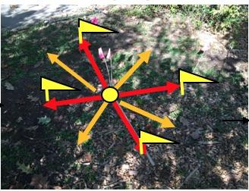
Set up the star pattern 2
Repeat the same process, this time marking out 1 m from the center of your star, using the directions NE, NW, SE and SW (in orange).

Slide 19
Marking the inner ring
In the four cardinal directions, measure 25 cm from the center and place a flag.

Slide 20
Taking samples in a star sampling pattern- 0-5 cm
Locate a sampling point on your sampling star.
Cut or pull away any grass or groundcover above every sample point.
Dig a hole 10-15 cm in diameter down to 5 cm.
Leave this soil loose in the hole.
Remove any rocks larger than a pea (about 5 mm), large roots, worms, grubs, and other animals from the loose soil.

Slide 21
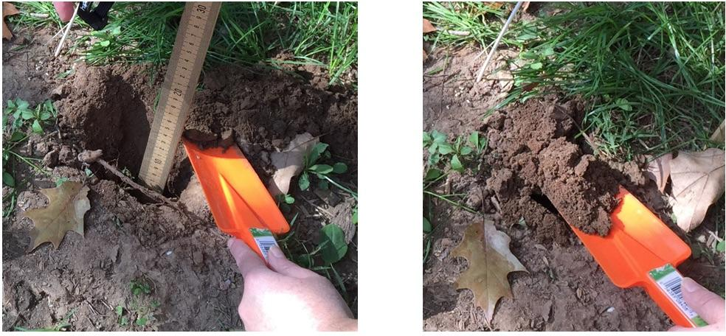
Taking samples at 10 cm depth
Remove all of the soil from the hole down to a depth of 8 cm.
Take a soil sample that contains the soil between 8 and 12 cm.
Remove any rocks larger than a pea (about 5 mm), large roots, worms, grubs, and other animals.

Slide 22
Taking two more sets of samples
Take samples from 0 – 5 cm and 10 cm from two more holes 25 cm from the first.
You should have a total of six soil samples from the three holes
Return remaining soil to the holes.
Replace the soil first out last in to minimize soil disturbance.

Slide 23
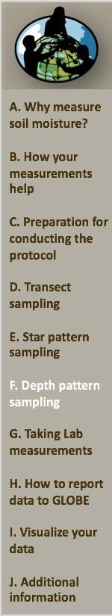
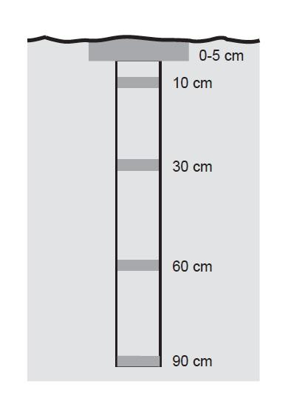
3. Depth Profile Pattern Sampling Overview
The Depth Profile involves taking a sample of the top 5 cm and the use of an auger to take soil samples at depths of 10 cm, 30 cm, 60 cm, and 90 cm. Using an auger takes a bit of extra time, but this effort gathers valuable data and complements the Soil Characterization Protocol as well as The Digital Multi-Day Max/Min/Current Air and Soil Temperatures Protocol.
For this protocol, use the Star Pattern Sampling.

Slide 24
Depth profile: star sampling pattern- 0-5 cm
Locate a sampling point on your sampling star.
Cut or pull away any grass or groundcover above every sample point.
Dig a hole 10-15 cm in diameter down to 5 cm.
Leave this soil loose in the hole.
Remove any rocks larger than a pea (about 5 mm), large roots, worms, grubs, and other animals from the loose soil.

Slide 25
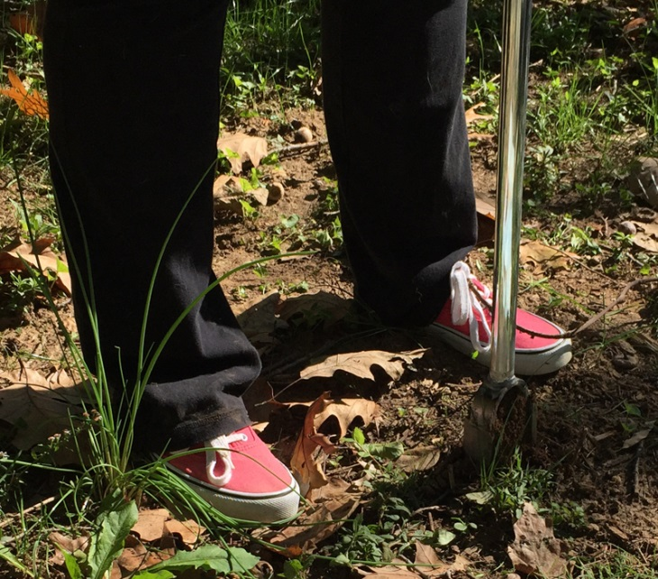
Depth Profile- taking samples at 30, 60, and 90 cm
Use the auger to obtain samples centered at 30, 60, and 90 cm

Slide 26
Place samples in containers
Use your trowel to fill a soil container with at least 100 g of the loose soil. If a soil oven will be used to dry the soil, a can (not a plastic bag) should be used as a sample container. Immediately seal the container to hold in the moisture.
If you are using resealable bags, label each bag with the date, site name, and location in your star sample grid.
Return remaining soil to the hole. Replace the soil - last out, first in-, to minimize disturbing the soil.
At the end of the sampling process, you should have 5 containers of soil taken from your depth profile.
You are done!

Slide 27
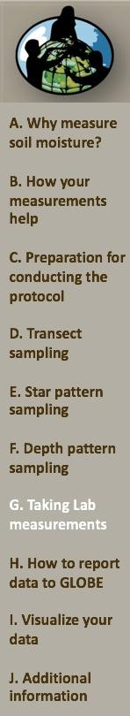
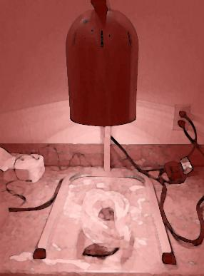
Soil Moisture Gravimetric – Lab Measurements

Slide 28
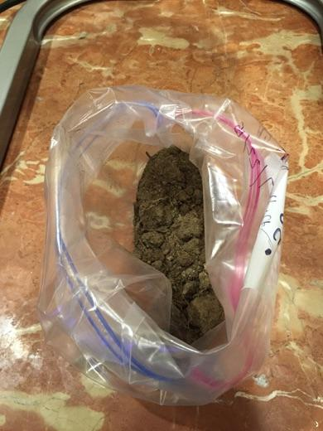
Required Materials for Lab Procedures 1
Soil drying method (either soil drying oven or approved warming/heat lights)
Thermometer capable of measuring to 110°C (if using a drying oven)
Soil Samples in containers suitable for your drying method
Balance or scale with 0.1 g sensitivity and at least 400 g capacity (600 g recommended)
Hot pads or oven mitts
GLOBE Data Entry app
Permanent marker

Slide 29
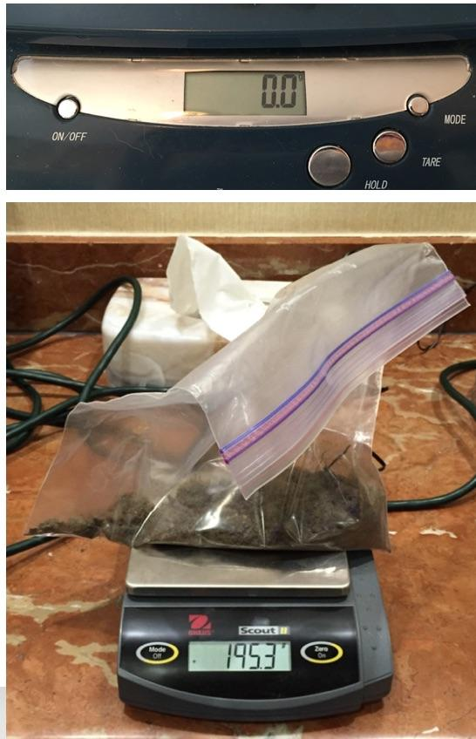
Soil Moisture Gravimetric Lab Procedure
If using an electronic balance, check that the balance measures in grams and is zeroed properly.
If you are using sample cans, remove the lids from each soil sample.
If you are using bags, get the mass with the bag closed.
Weigh each sample and record the mass to the nearest 0.1 g as the Wet Mass.
Select the Date Entry page that corresponds to your collection method – Star Pattern, Transect, or Depth Profile.
Note: Calibrate your scale or balance according to the manufacturer’s instructions.

Slide 30
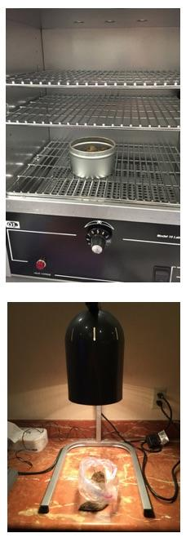
Drying Soil Samples
If using an oven, place the uncovered sample cans in the soil drying oven.
Set the temperature so that it doesn’t exceed 105 º C.
Samples are often dry after 10 hours at 105 º C.
For cooler ovens, allow more time.
If using heat lamps, place open sample bags under the 250 watt lamps.
Samples can take 2 - 3 days to dry completely.
If you can’t leave the lamps on overnight, turn them back on the next morning.
Carefully remove the samples from the drying source using the hot mitts.
If air drying, open the bag and place it in a dry area.
This method should dry the soil in 2 - 5+ days, depending on the indoor environmental conditions

Slide 31
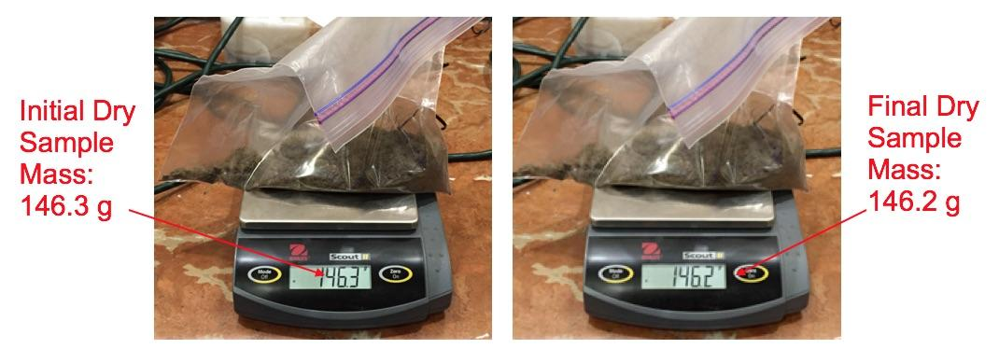
Determine if Samples are Dry
To test if the sample is dry, weigh it, and then dry it for an additional period of time (e.g. 30 minutes).
Weigh it again. If the mass of the sample has not changed by more than 0.3 g, the sample may be considered dry.
Repeat as necessary.
When your samples are dry, record the drying time and drying method in the Data Entry App or Data Entry Sheet.
Weigh and record the Dry Mass for each container.

Slide 32
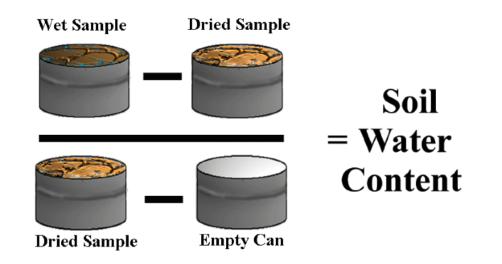
Determining Soil Water Content
Unless you will use these samples for other lab analyses, return the dried soil to the site to fill in holes so site may be used in future years.
Empty the soil from the containers.
Clean and dry each container. You may save the soil samples for further tests.
Use this formula to calculate Soil Water Content:

Slide 33


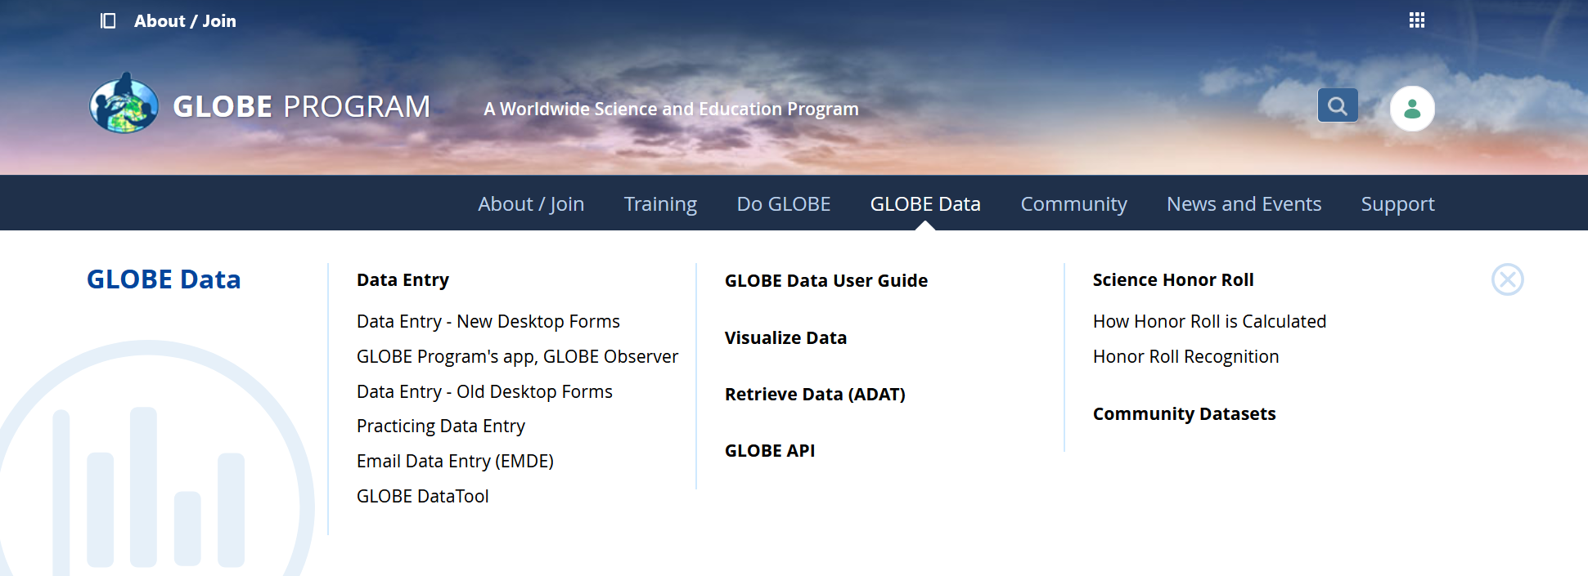
Reporting Data to GLOBE
Two Options for Uploading Data:
These methods all allow users to submit environmental data – collected at defined sites, according to protocol, and using approved instrumentation – for entry into the official GLOBE science database.
Download the GLOBE Observer mobile app from the App Store.
Data Entry: Visit globe.gov, click on the “GLOBE Data” tab, then underneath “Data Entry” click on “Data Entry – New Desktop Forms”.

Slide 34
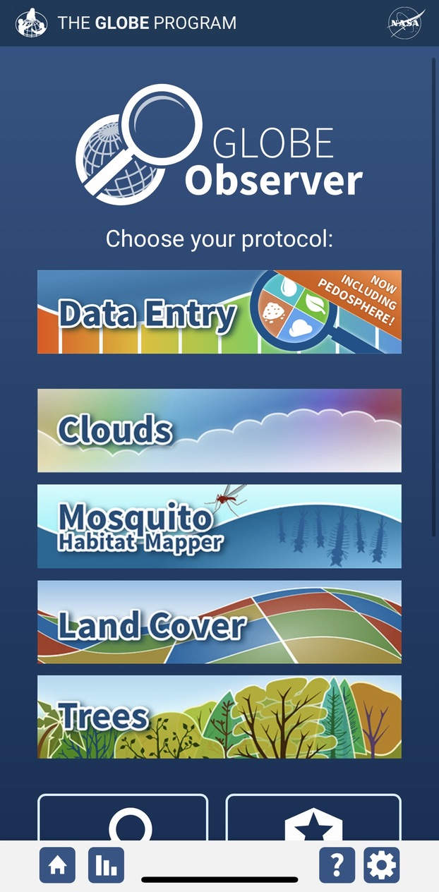
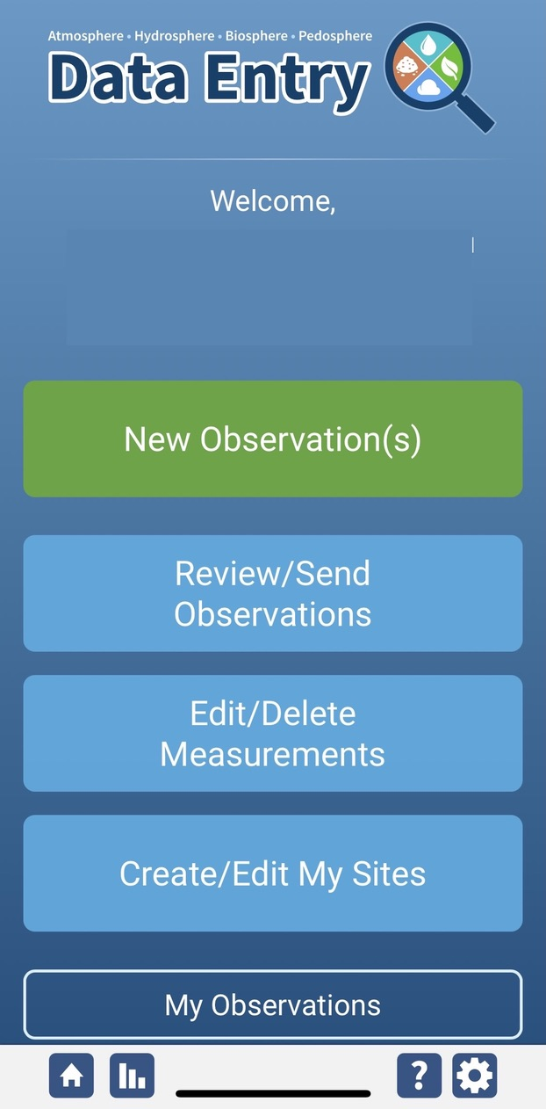
Soil Moisture Site Creation
If this is your first time making Soil Moisture or Temperature observations at this location, you will need to create a new site before entering data.
Open the GLOBE Observer App and select “Data Entry”.
Next, click “Create/Edit My Sites”

Slide 35
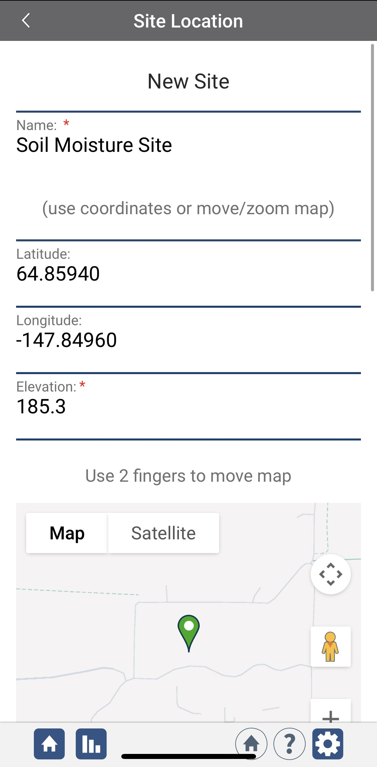
Soil Moisture Site Creation
Enter a name for your new site.
Use the map box to make sure the green popup is in the correct site location.
If you used a separate GPS device to locate your site, you can enter the coordinates manually.

Slide 36
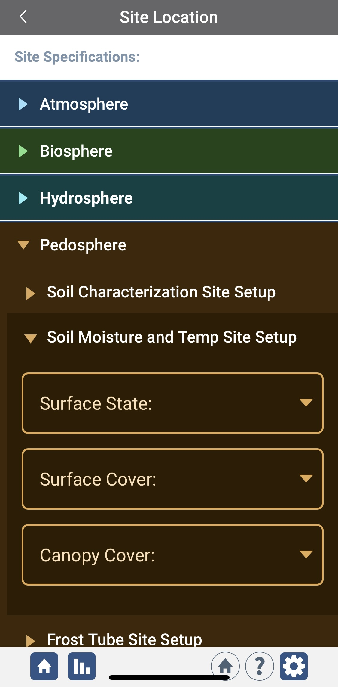
Soil Moisture Site Creation
Scroll down to the Pedosphere tab
Select Soil Moisture and Temp Site Setup
Enter the surface state, surface cover, and canopy cover information for you new site.
At the bottom of the page, select “Send Site”

Slide 37
Soil Moisture Gravimetric Data Entry
To enter data, first return to the GLOBE Observer main page by clicking the home button in the bottom left.
Select “Data Entry”.
Next, click “New Observation(s)”

Slide 38
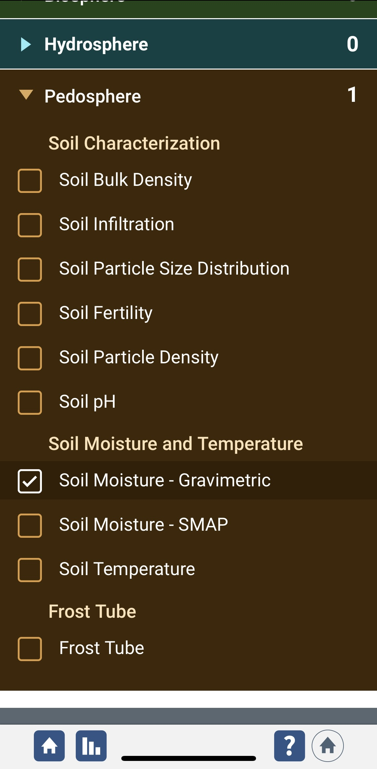
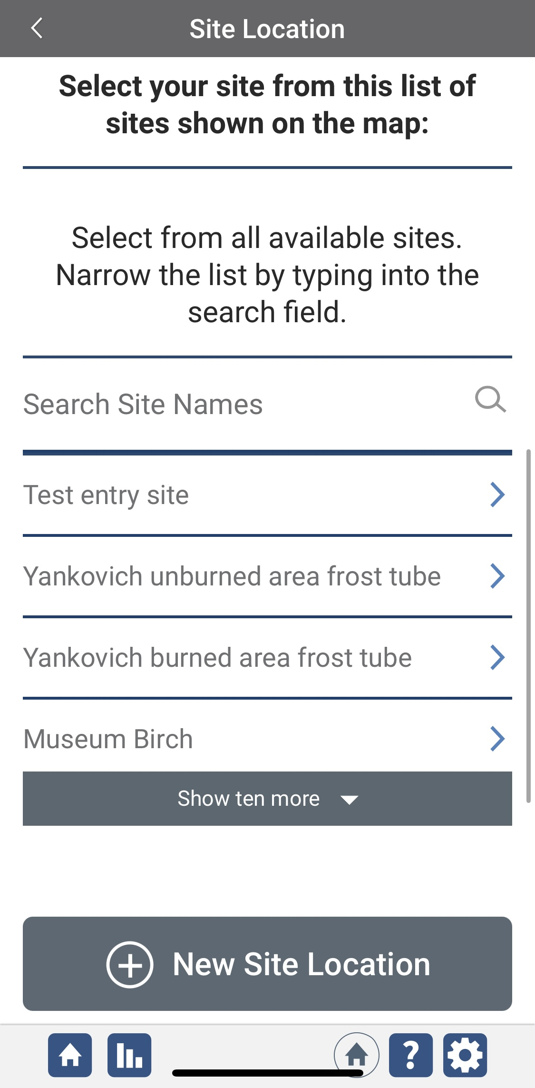
Soil Moisture Data Entry
Under the Pedosphere tab, select “Soil Moisture – Gravimetric” then click Continue at the bottom of the page.
Next, select your Soil Moisture Site. Existing sites near you will show up below “Search Site Names”

Slide 39
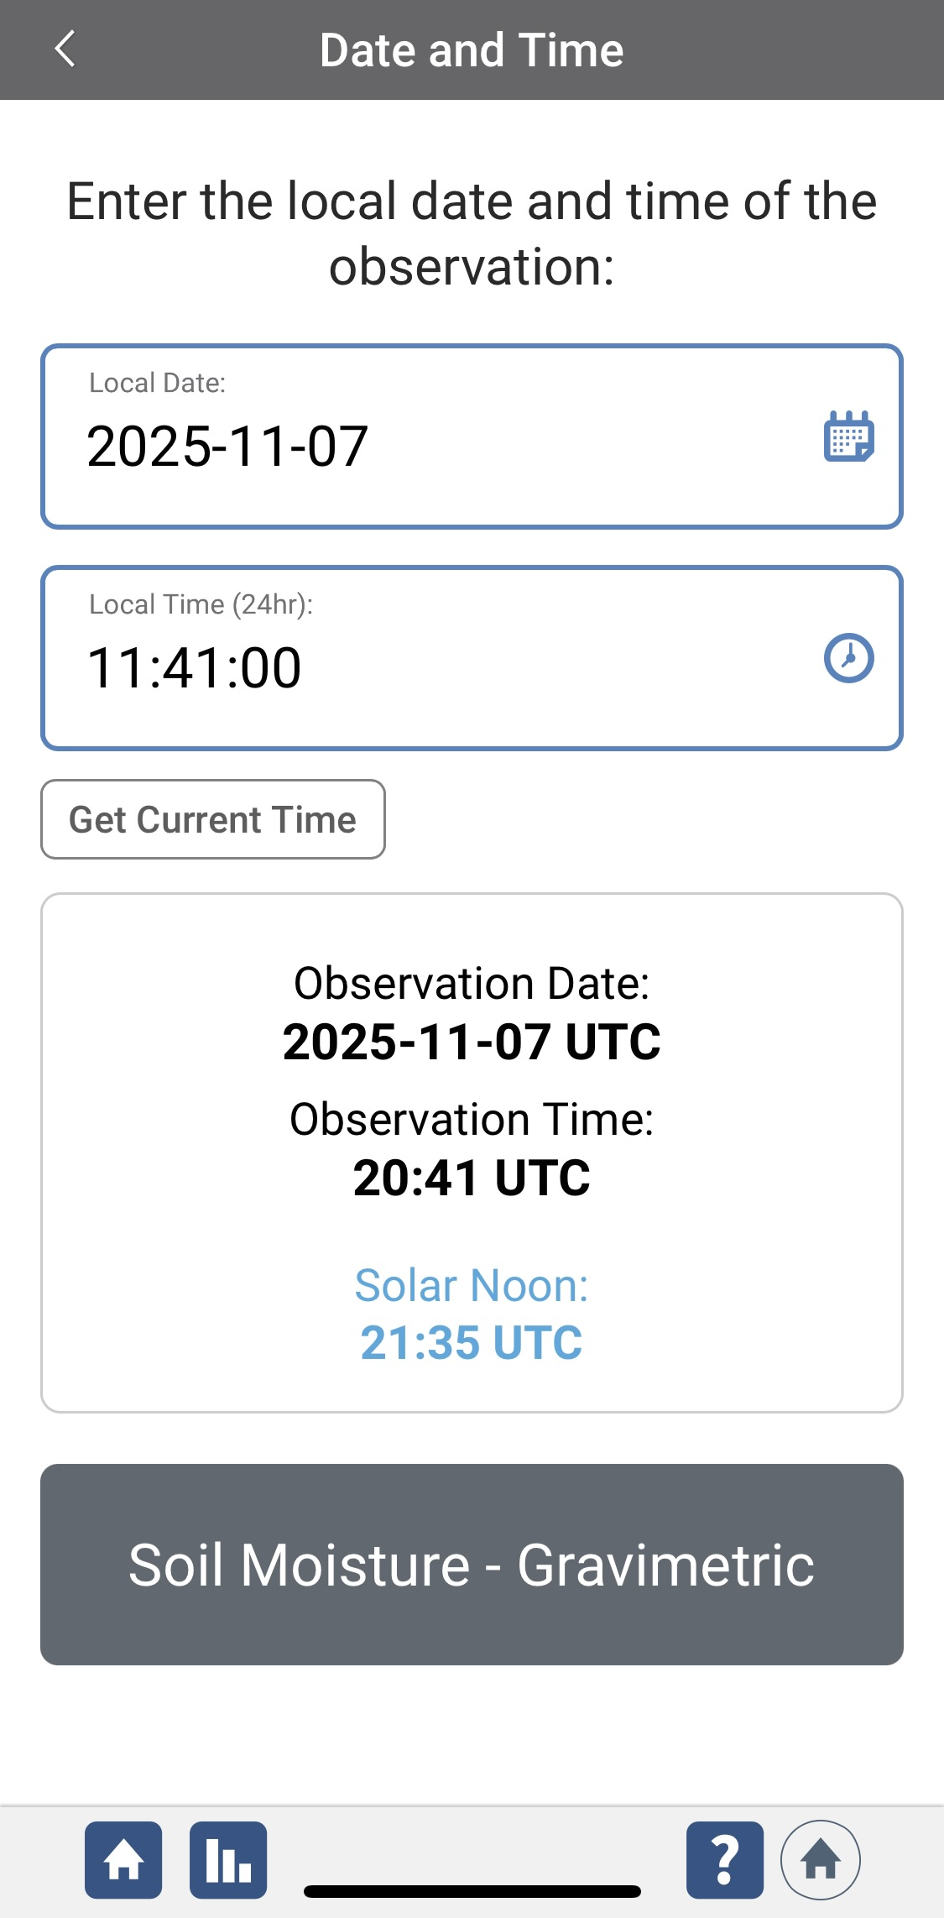
Soil Moisture Data Entry
Next, enter the date and time you took the measurements.
Select Soil Moisture - Gravimetric to enter your data.

Slide 40
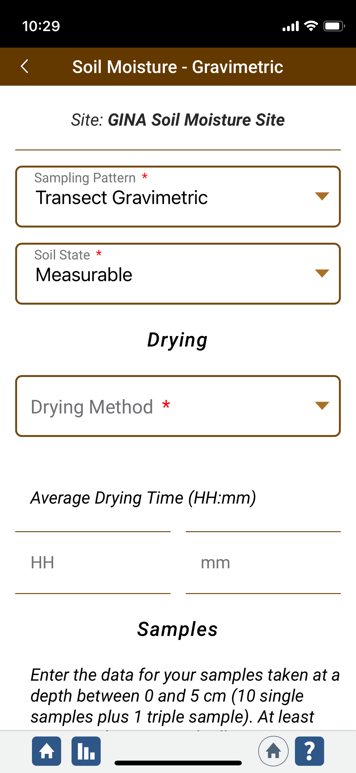
Transect Sampling Data Entry
If you sampled along a transect, select “Transect Gravimetric” under Sampling Pattern.
Next choose a soil state from the dropdown.
Under Drying, select your drying method and enter the average drying time.

Slide 41
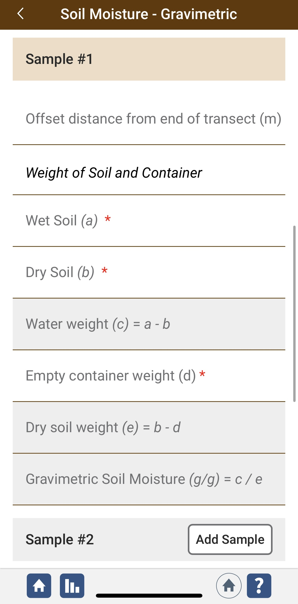
Example of Transect Data Entry
Enter the sample information for your first transect sample as directed.
Click “Add Sample” to start the next sample.
Continue adding samples until you have entered all your transect data.

Slide 42
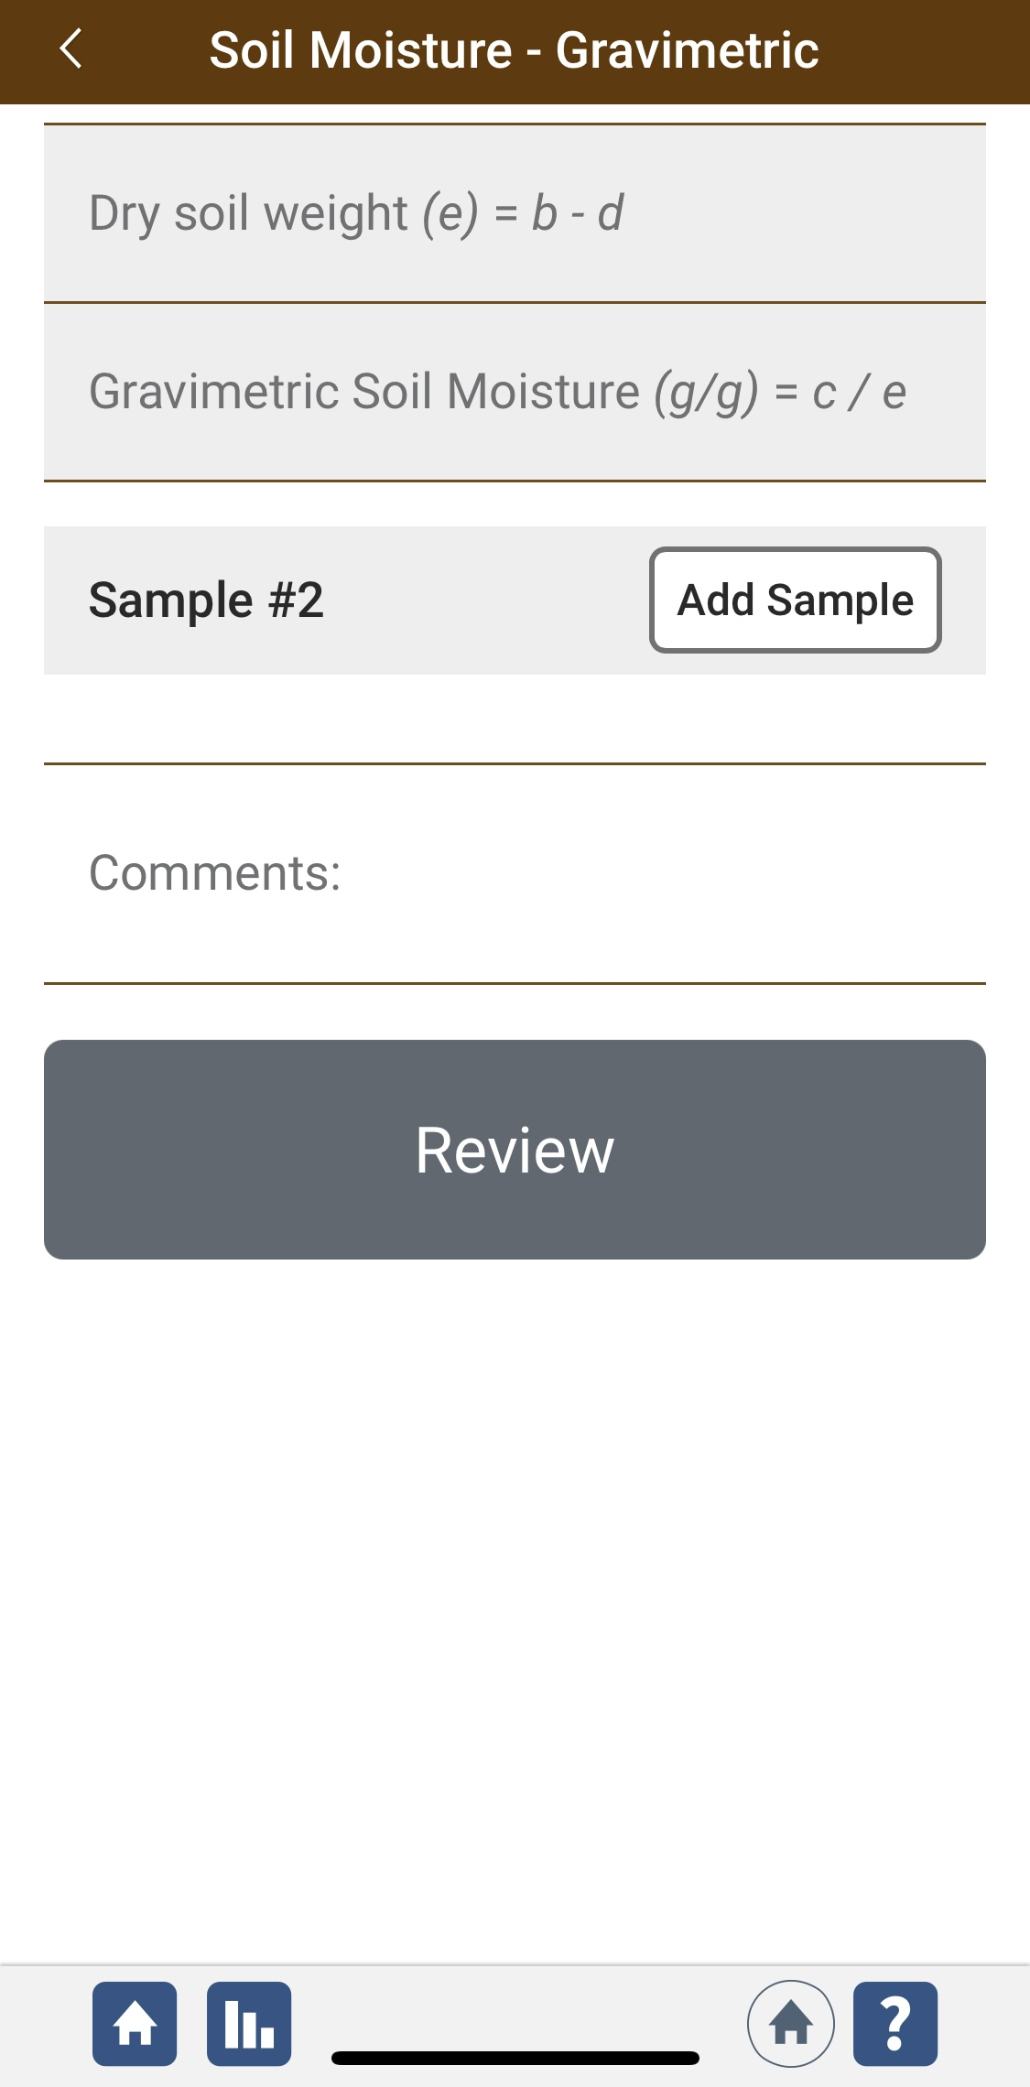
Example of Transect Data Entry
Add any comments or metadata related to your samples or site in the Comments box.
When you have finished, click “Review” to check that your entries are correct before submitting.

Slide 43
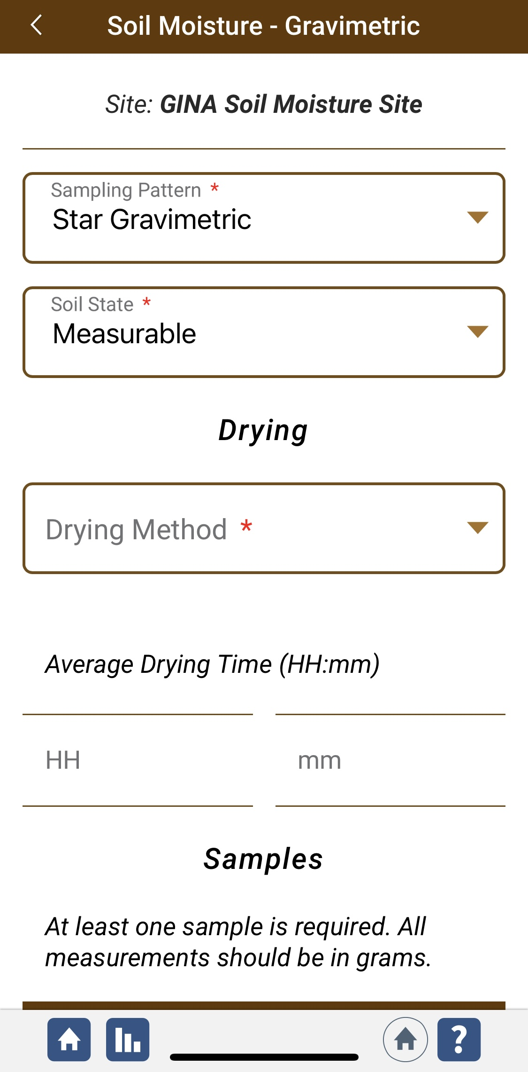
Star Sampling Pattern Data Entry
If you sampled using a star pattern, select “Star Gravimetric” under Sampling Pattern.
Next choose a soil state from the dropdown.
Under Drying, select your drying method and enter the average drying time.

Slide 44
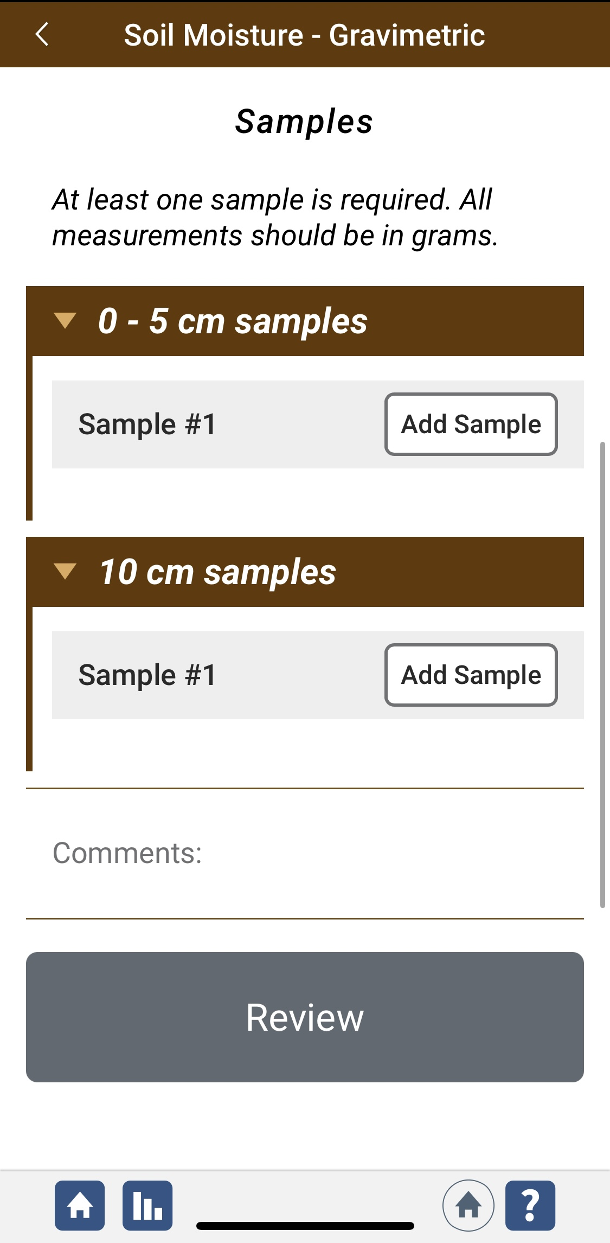
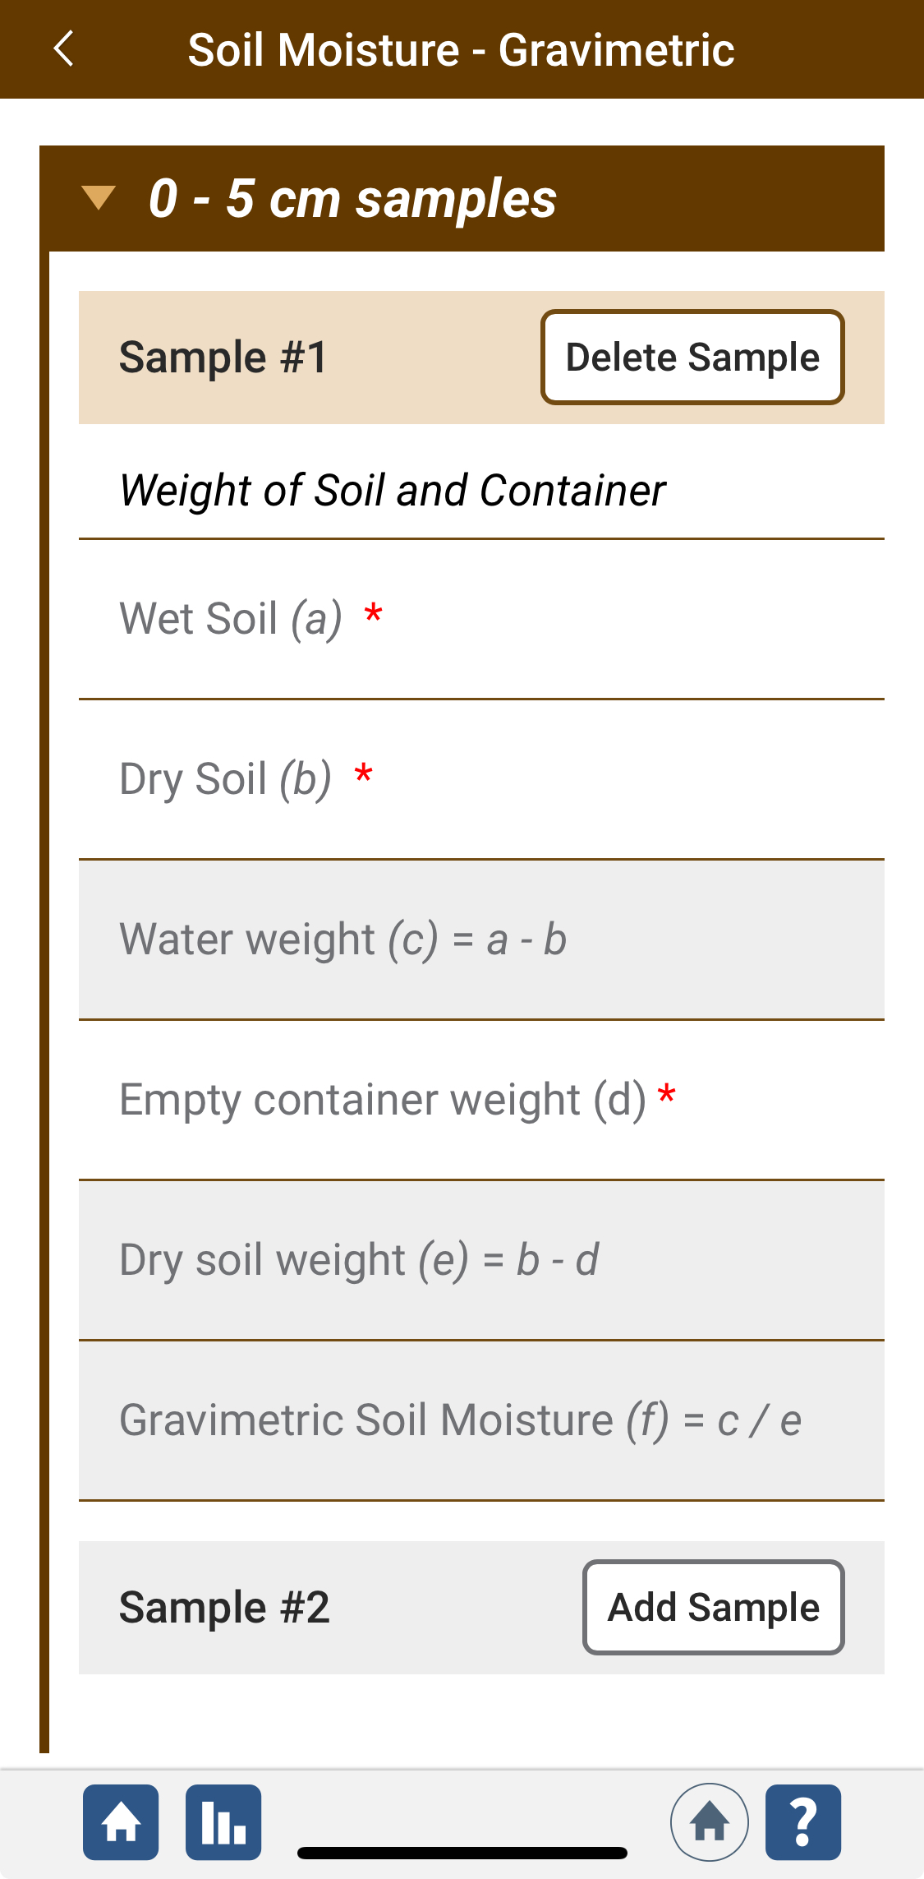
Star Sampling Pattern Data Entry
Next, click “Add Sample” to add a 0-5 cm sample.
Enter the sample information as directed.
Continue adding 0-5cm samples or 10cm samples until you have entered all your data.

Slide 45
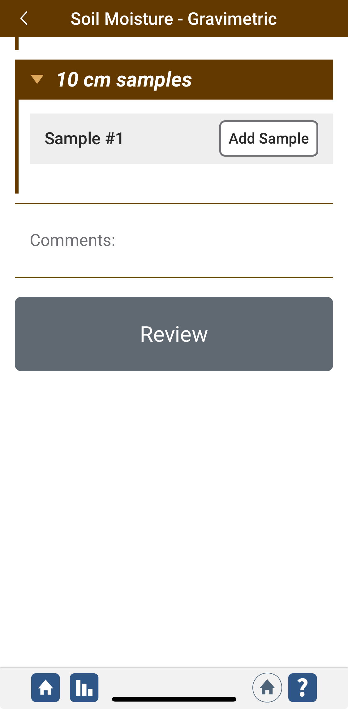
Star Sampling Pattern Data Entry
Add any comments or metadata related to your samples or site in the Comments box.
When you have finished, click “Review” to check that your entries are correct before submitting.

Slide 46
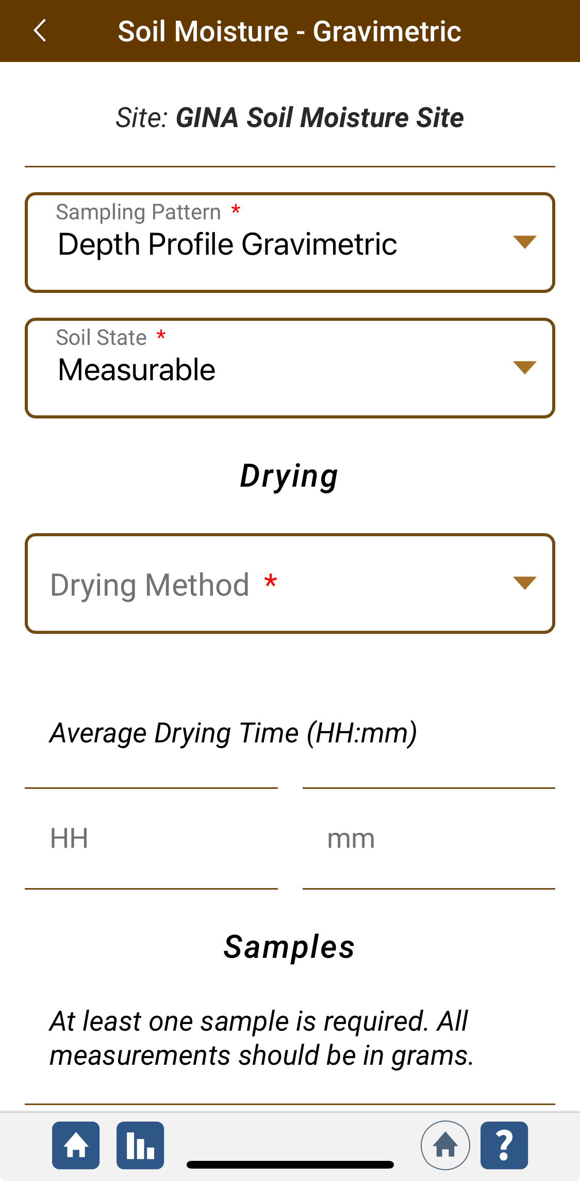
Depth Profile Data Entry
If you sampled using a depth profile, select “Depth Profile Gravimetric” under Sampling Pattern.
Next choose a soil state from the dropdown.
Under Drying, select your drying method and enter the average drying time.

Slide 47
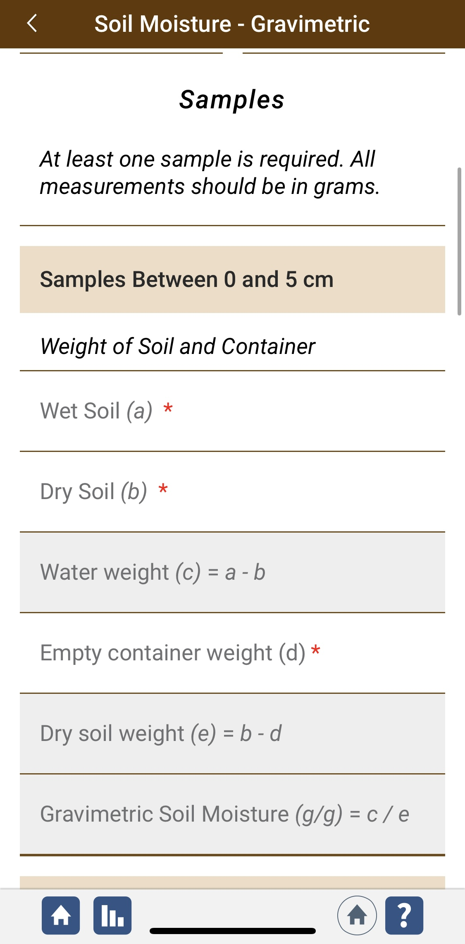

Depth Profile Data Entry
Under “Samples”, enter the sample information for samples between 0 and 5 cm.
Continue adding information for samples at each depth that you collected.

Slide 48

Depth Profile Data Entry
Add any comments or metadata related to your samples or site in the Comments box.
When you have finished, click “Review” to check that your entries are correct before submitting.

Slide 49


GLOBE Data System Response
If your observations are within the appropriate ranges, you will see a green smiley face.
You can review or edit your observation if needed.
When ready, select “Send these measurements now” to send your data to GLOBE. When it has been sent, you will see a “Success” message.

Slide 50


Soil Moisture Gravimetric 0 - 5 cm Data Visualization 1
Visualization for the first horizon shows the soil moisture for 0-5 cm.

Slide 51

Soil Moisture Gravimetric 0 - 5 cm Data Visualization 2
Visualization for the first horizon shows the soil moisture for 0-5 cm. Data from this protocol and the SMAP Protocol are combined.

Slide 52

Questions for Further Investigations
What other GLOBE schools have patterns of soil moisture similar to yours?
How many weeks of the year is your soil relatively wet or relatively dry?
Does soil moisture change during the winter?
Which areas around your school are usually dry or wet? Why?
Which holds the most water: clay, sand, or silt? Why?
Does the type of land cover affect the amount of water that enters the soil? Does it affect the rate at which soil dries out following a rainstorm?
How are soil moisture and relative humidity related?
How are soil moisture and soil, surface and air temperature related?
How does the porosity of a soil horizon relate to the amount of water that horizon can hold?
How does soil water content change from one horizon to another in the same profile?
What happens to the downward flow of water if there is a coarse textured (sandy) horizon overlying a horizon with high clay content? What happens to water flow if a clayey horizon is found over a sandy horizon?

Slide 53
Frequently Asked Questions
1. What should people do if they forgot to weigh the empty soil containers before filling them with samples in the field?
The soil collection containers can be weighed at the end of the soil moisture protocols after emptying the dried soil and cleaning the containers thoroughly. Remember that any dried soil left in the container will lead to an inaccurate container mass.
2. What should people do if the soil is frozen?
Take soil moisture measurements during times when the soil is thawed.
3. What should people do if the site was accidentally watered?
Take the data as usual, but check the flag on the Data Sheet to indicate artificially watered site. These data are still useful, and depending on conditions, the soil moisture may be affected by the watering for several days. If a large area, > 1 km2 within 3 km of your site is irrigated, record this as metadata and report it to GLOBE. This is important for interpretation of observations.
4. What should people do if the soil is snow covered?
If the soil is not frozen, brush off the snow and proceed with the sample collection.

Slide 54

Request for your feedback on this module! Please provide us with feedback about this module. This is a community project and we welcome your comments, suggestions and edits!
Questions after reviewing this module? Contact GLOBE: help@nasaglobe.org
Credits
Slides: Izolda Trachtenberg, Dixon Butler, Russanne Low
Photographs: Izolda Trachtenberg
Illustrations: Rich Potter
Cover Art: Jenn Glaser, ScribeArts
More Information:
GLOBE Program
NASA Earth Science
NASA Global Climate Change: Vital Signs of the Planet
The GLOBE Program is sponsored by these organizations:
November 2025. GLOBE Implementation Office: Science, Training, Education, and Public Engagement Team. If you edit and modify this slide set for use for educational purposes, please note “modified by (and your name and date) “ on this page. Thank you.

