Slide 1


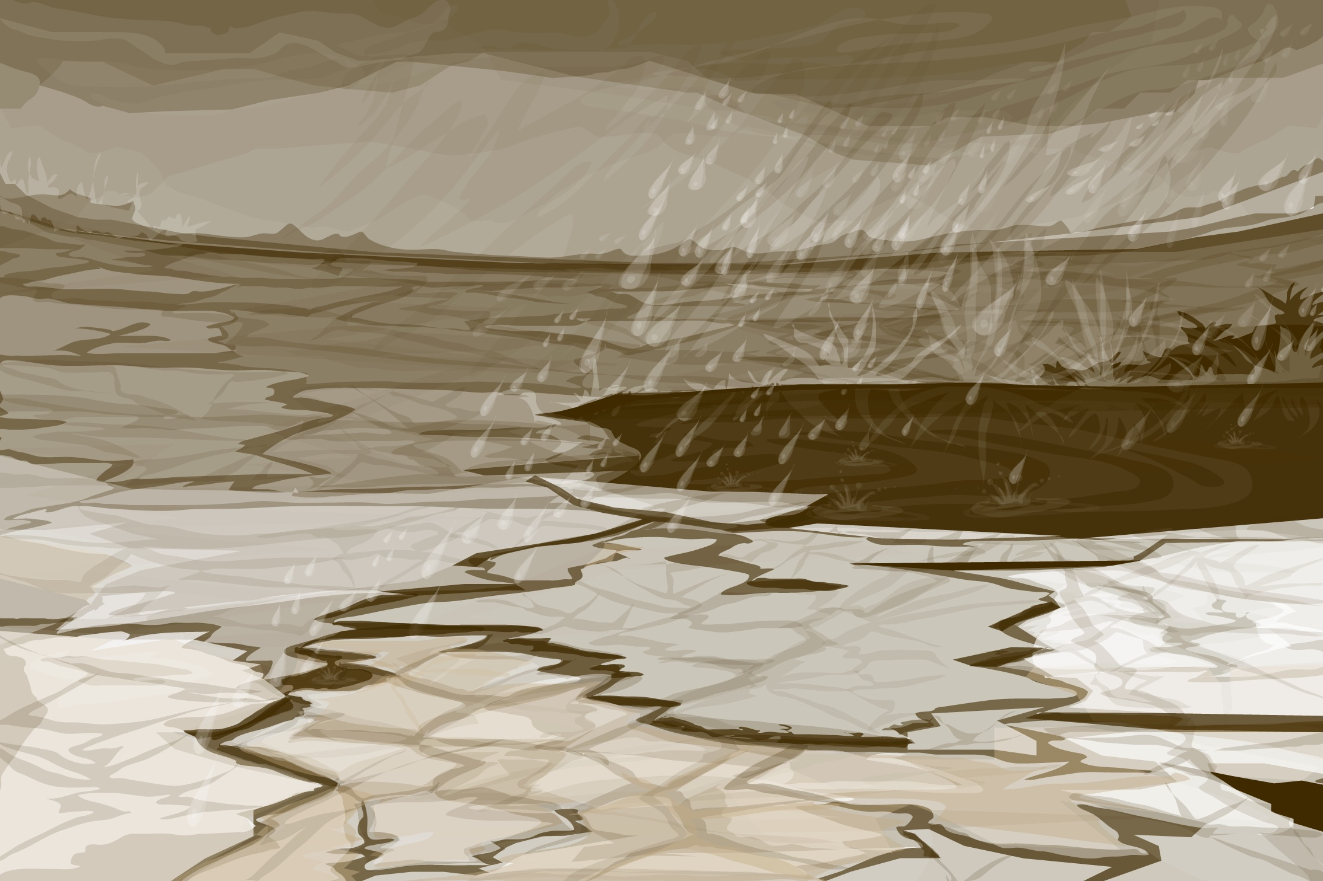
Intro Slide

Slide 2

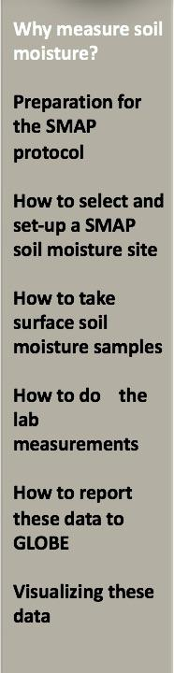
Goals and Objectives of this Module
Overview
This module:
Describes how taking surface soil moisture samples supports the SMAP mission
Provides step-by-step instructions in how to do the protocol
Learning Objectives
After completing this module, you will be able to
Explain why soil moisture is worth studying
Explain what the SMAP mission measures
Determine when to take measurements for comparison with SMAP
Define a Soil Moisture Site for taking SMAP Block Pattern data
Take soil moisture samples of the top 5 cm of soil
Measure gravimetric soil moisture content and sample bulk density
Calculate gravimetric and volumetric soil water content
Report these data to GLOBE
Visualize these data using GLOBE’s Visualization Site
Estimated time needed for completion of this module: 1.5 hours

Slide 3
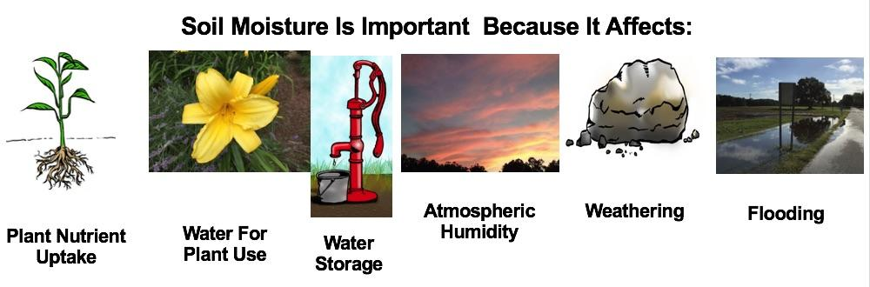
SMAP Soil Moisture Protocol
Soil acts like a sponge spread across the land surface. It absorbs rain and snowmelt, slows run- off and helps to control flooding.
The absorbed water is held on soil particle surfaces and in pore spaces between particles. This water is available for use by plants during times of little precipitation.
Some of this water evaporates back into the air; some drains through the soil into groundwater.

Slide 4
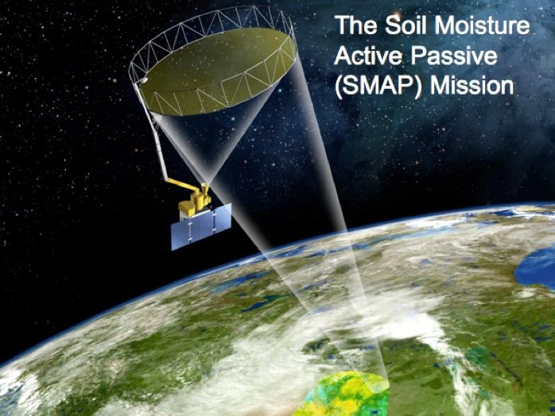
The Soil Moisture Active Passive (SMAP) Satellite
Image: NASA
The SMAP satellite creates a global soil moisture map every three days. It measures the volumetric soil moisture in the top 5 cm of the soil. The GLOBE SMAP Soil Moisture Protocol provides scientists with on-the-ground measurements to help validate the satellite’s soil moisture estimates.

Slide 5
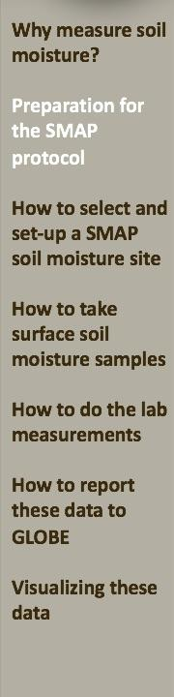

SMAP Soil Moisture Protocol Required Materials
Heating lamp that can reach a sustained 60-90°C (for 2 or 3 days) such as a 250 watt infrared food heating lamp (with one or two bulbs) or a room heating lamp; alternatively a soil drying oven may be used, but is not required
A balance or scale with 0.1 g sensitivity (600 g capacity recommended, 400 g minimum capacity required)
Sealable plastic bags (e.g., Zip-Lock bag)
Tin cans (repurposed cat food, tuna, or small pineapple cans 5 cm deep without a lid.) Note: edges may be sharp.
Plastic wrap to seal the tin cans; rubber bands to hold the wrap around the can.
A graduated cylinder with at least 100 mL capacity (500 mL recommended)
Trowel
GPS device for site definition
A meter stick and a ruler marked in millimeters
Permanent markers to label the soil containers
Define your sampling site before you go into the field to sample the soil. Locate your sampling site in the Data Entry app and be ready to enter all relevant data outside.

Slide 6
When to Take SMAP Soil Moisture Measurements
Determine your latitude and longitude.
Determine when SMAP will overfly your site by entering your latitude and longitude on the SMAP Overflights Tool.
Look for days when the satellite flies over your location in the morning.
Decide upon your sampling schedule.
Try to collect soil moisture samples as close as possible to 6:00 AM +/- three hours local time on SMAP morning overpass days.
SMAP flies in an orbit with an 8-day repeat pattern.
Image: NASA

Slide 7
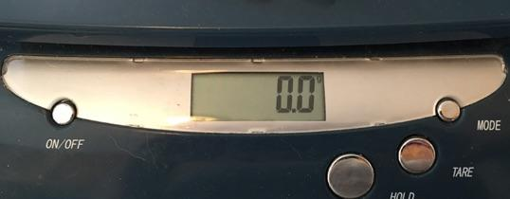
Calibrate Your Balance
Calibrate the balance according to the manufacturer’s directions. Record the standard mass used to calibrate the balance on the data entry app.
If using an electronic balance, check that the balance is measuring in grams and is zeroed properly.

Slide 8
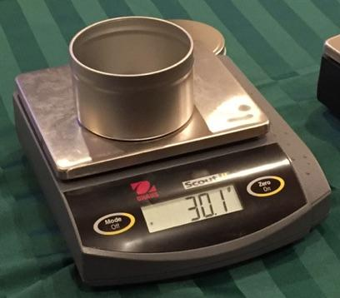
Preparing Your Sample Containers for the Field
Get the mass of each sampling container.
If you are using a can, get the mass without the lid.
Label the Container with:
The mass of the container
A unique identifying number In the Field.
if you are using bags, add:
Sampling date
Sampling time
Sample number
3. Record the mass to the nearest 0.1 g on the Data Entry app under, “Empty Container Mass.”

Slide 9
Final Preparations to Define Your Site and
Begin Measurements
Join the SMAP Community on the GLOBE website.
Complete the first part of the Data Entry app in Soil Moisture.
Mark your trowel 5 cm from the tip to ensure you go no deeper
when you take samples.
Gather the required equipment:
  Labeled sample can and lid or plastic wrap & rubber band
  Meter stick or tape measure
  GPS receiver or smart phone with GPS app
  Smart phone with GLOBE Data Entry app or data entry sheet
  Flags or other markers to define your site
Remember it is important to try to collect the soil moisture samples at approximately the same time every day to ensure measurement consistency. If you can, take soil moisture samples no later than 9:00 AM local time.

Slide 10
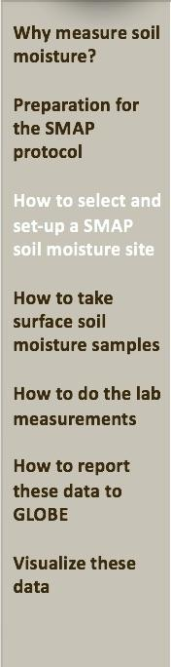
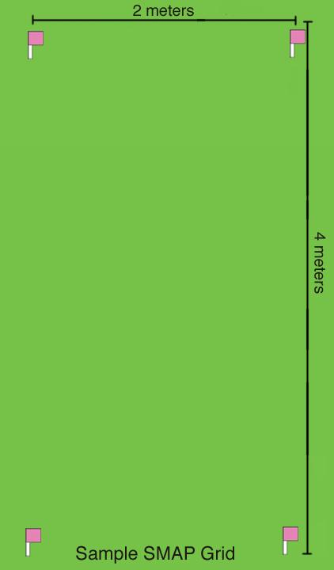
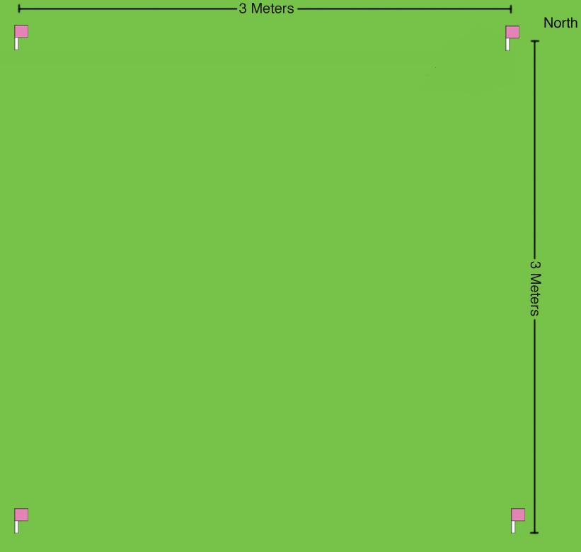

SMAP Soil Moisture Site Selection
Select a site that is large enough for one year of measurements spaced 25 cm apart and:
flat
uniform in surface cover
not under trees or other tall plants
relatively free of rocks
  Try to avoid an area that is irrigated unless it is located in a large field that is consistently irrigated.

Slide 11
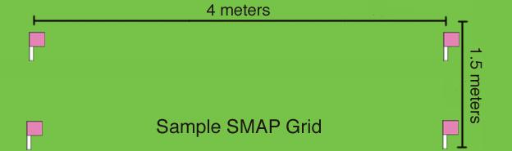
SMAP Soil Moisture Site Considerations
Note: SMAP sampling grids can be rectangular or other shapes as long as the sampling sites are as uniform as possible.
A site may be under trees, but the area should be free of surface roots and comparison with SMAP may be difficult.
A site that is representative or a large area such as a field is ideal where possible.

Slide 12
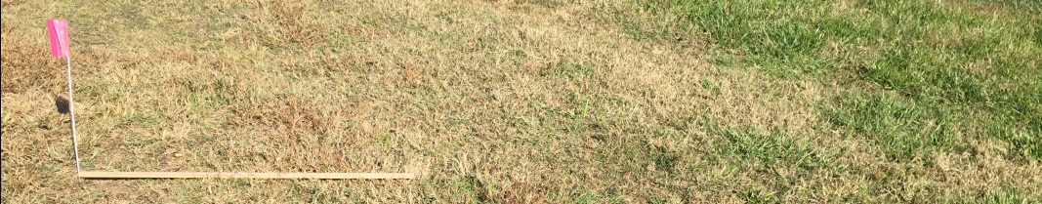
SMAP Soil Moisture Site Selection 1
Use a meter stick or tape measure to lay out the grid.
Mark all four corners of the grid with some sort of permanent markers.

Slide 13
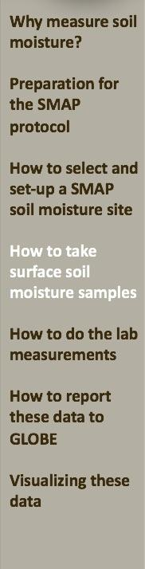
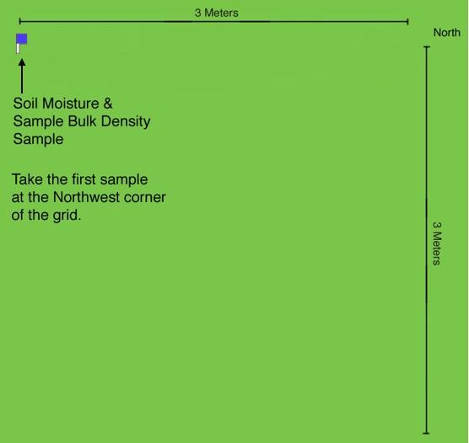
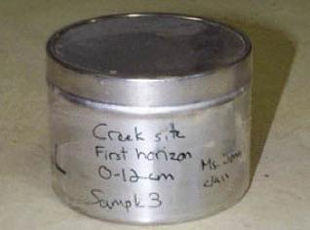
SMAP Sampling Instructions for Measuring
Sample Bulk Density
The first time you take a SMAP Soil Moisture sample and for every tenth sample after that, take a Sample Bulk Density Sample. See the next slide for instructions.
Note: sample for the first time at the Northwest corner of the grid.

Slide 14
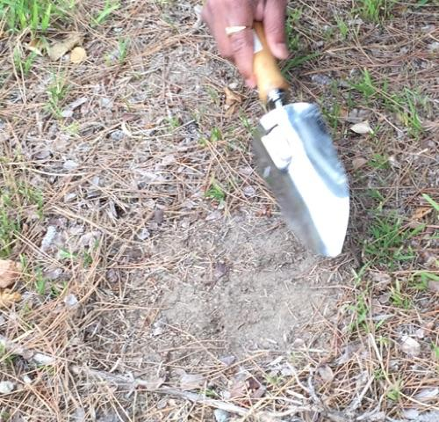
Prepare to Take a Soil Sample
At the sampling spot, remove any grass or other groundcover.

Slide 15
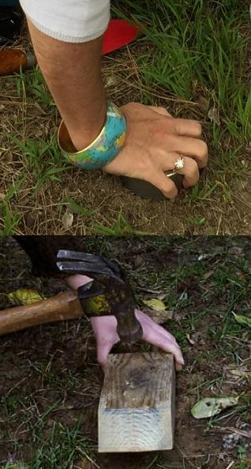
Taking a SMAP Soil Moisture Sample of Known Volume
Push the can all the way into the soil so the bottom of the can is even with the ground surface.
If the soil is hard, place a wooden block on top of the can and pound it into the soil with a hammer.
If the soil is so hard that pounding it into the ground will bend the sample can, take a sample using a trowel and sealable bag and wait until the ground has softened to take the can sample.

Slide 16
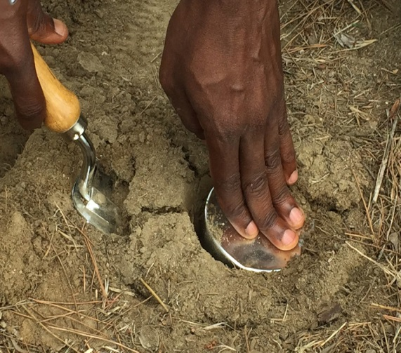
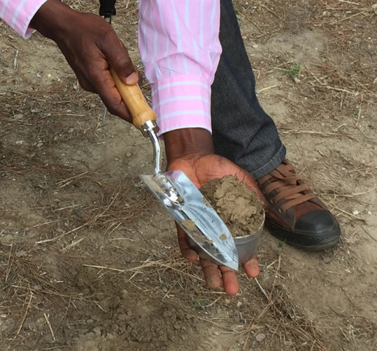
Removing the Sample Can from the Ground
Using a trowel or shovel, remove the can and the soil surrounding it.
Make sure you dig around the can to remove it. If your trowel is not fully under the can, you might lose soil sample during the extraction process.
Scrape off the soil to level it with the tome of the can.
If a rock or twig sticks out, discard this sample, wipe out the can, and take a fresh sample.
It is essential that the volume of the soil sample is the same as the volume of the can, so be sure to wipe off all soil clinging to the outside of the can.

Slide 17
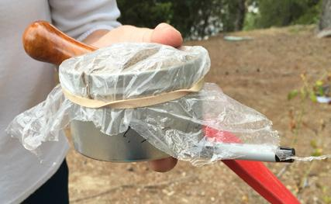
Seal the Can to Keep All the Moisture in the Sample
Cover the labeled can with the lid or other moisture tight cover.
Your sample is now ready for weighing and drying in the lab

Slide 18
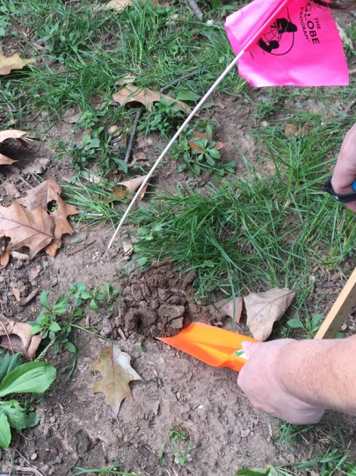
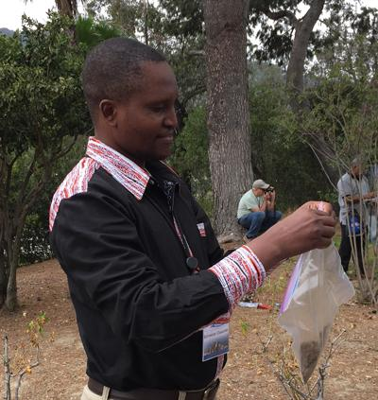
Routine Collection of a Surface Soil Sample
Dig your trowel 5 cm into the soil to loosen it.
Remove any rocks larger than a pea (about 5 mm), large roots, worms, grubs, and other animals
Scoop soil into the pre-marked, sealable bag.
Seal the bag containing the sample.

Slide 19
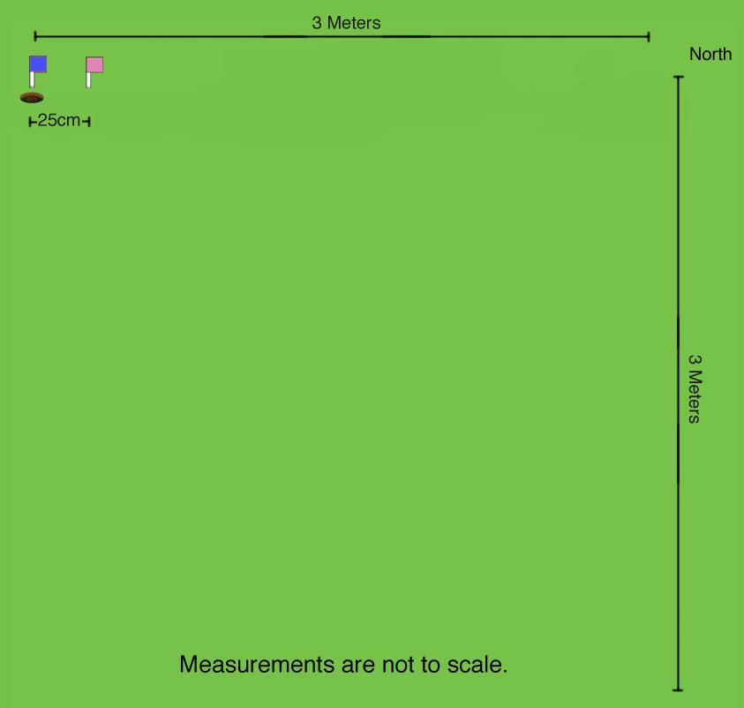
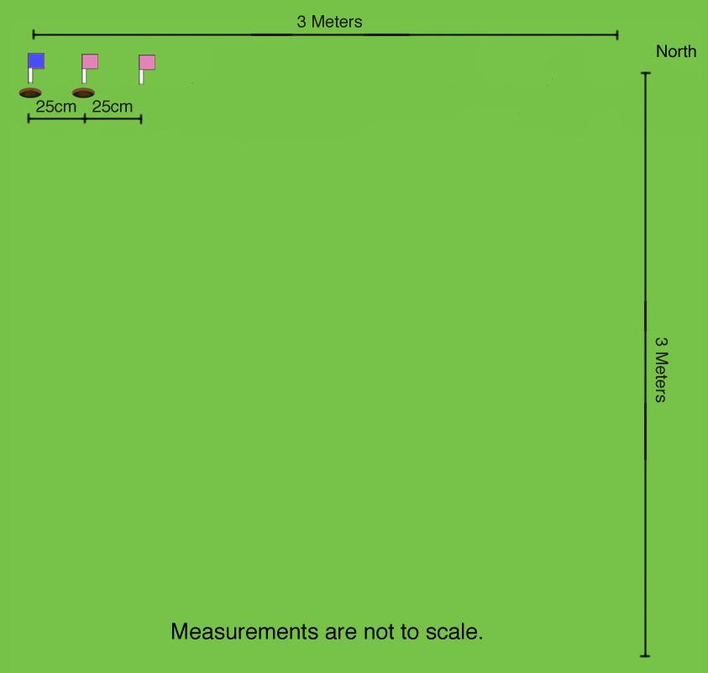
Spacing Your Samples
On the next SMAP overfly day, move 25 cm over from the previous sample.
During a year, no sample should be taken within 25 cm of any others.

Slide 20
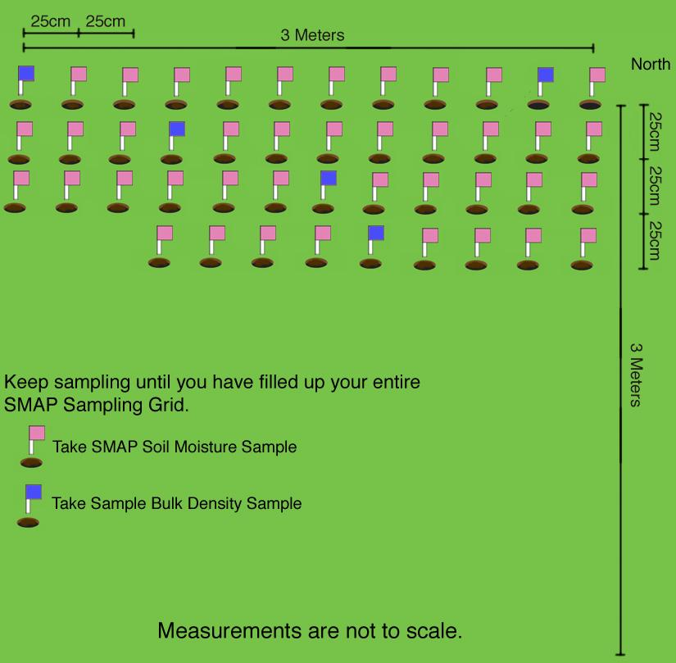
SMAP Soil Moisture Sampling Grid Example

Slide 21
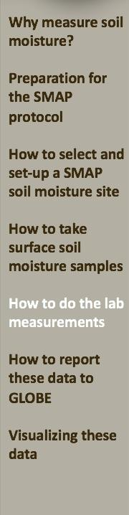
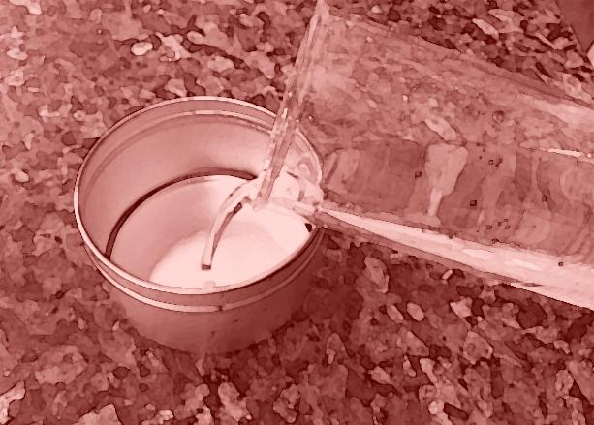
SMAP Soil Moisture Lab Measurements

Slide 22
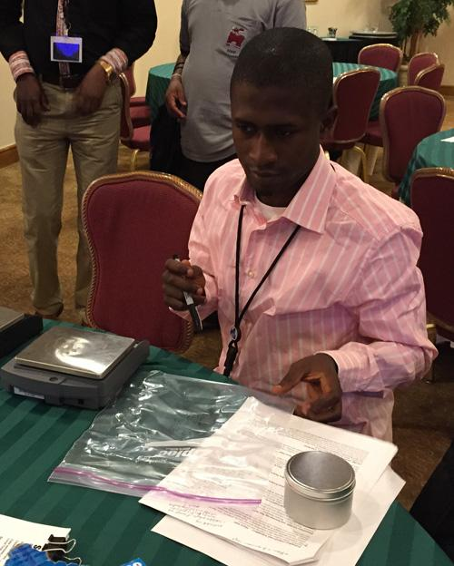
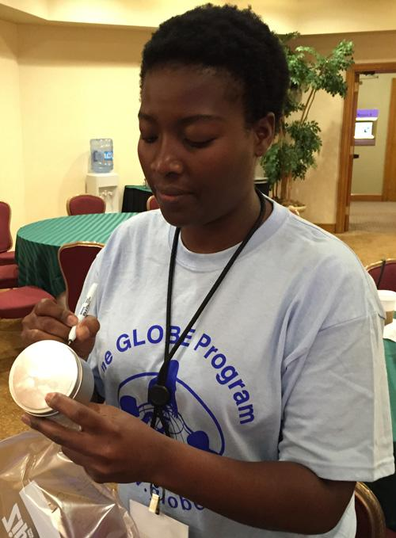
SMAP Soil Moisture – Lab Instructions
To finish the SMAP Soil Moisture Protocol and determine the gravimetric and volumetric soil moisture content of your samples, complete the following steps.

Slide 23
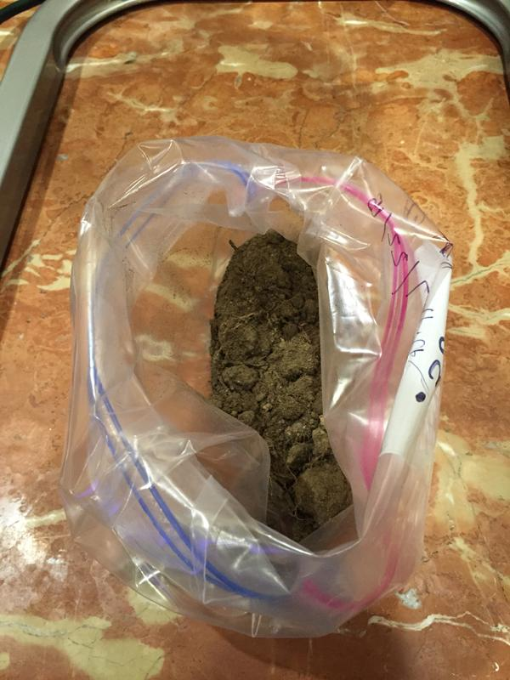
SMAP Soil Moisture Lab- Required Materials
Either a soil drying oven or heat lamps
Thermometer capable of measuring to 105°C (if using a conventional drying oven)
Soil Samples in containers suitable for your drying source
Balance or scale with 0.1g sensitivity and at least 400 g capacity (600 g recommend)
Hot pads or oven mitts
GLOBE Data Entry app or Data Sheet
Permanent marker

Slide 24
What to Do With Samples Collected in a Can
If you will be using heat lamps to dry your soil sample:
Label a sealable bag with:
  container (empty bag) mass
  sample number
  sample collection date
  site name
Uncover the can and immediately transfer the soil sample into the labeled bag. Be sure to transfer all the soil.
Weigh the sample in the bag. Record the mass to the nearest 0.1 g as the Wet Mass, next to the appropriate sample container number on the Data Entry app, or on the Data Sheet.

Slide 25
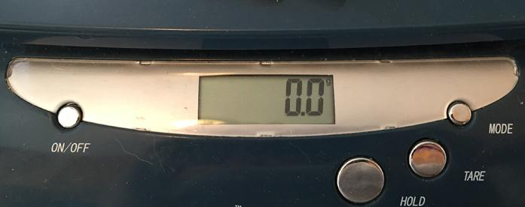
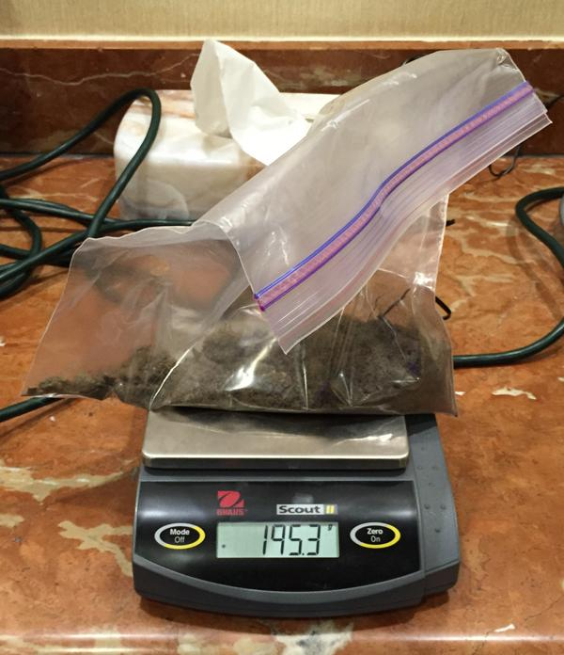
Measuring the Wet Mass of Samples
Calibrate the balance according to the manufacturer’s directions.
If using an electronic balance, check that the balance is measuring in grams and is zeroed properly.
Place the sample on the scale.
Record the mass to the nearest 0.1 g as the Wet Mass on the Data Entry app or Data Sheet.
If the sample is in a can, be sure to remove the lid before weighing.

Slide 26
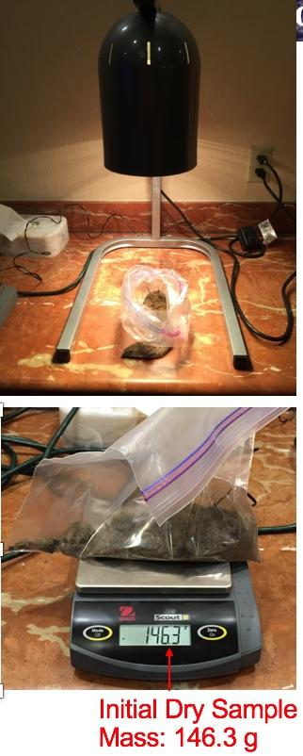
Drying Samples
Open the sample bag and roll the edges down to create a larger open area.
If the sample is in clumps, break them up with your hand outside the plastic bag. Do not touch the soil sample directly.
Dry your sample by placing the open bag 30-40 cm below the 250 watt infrared heating lamp or other drying source.
Carefully remove the sample from the drying source using hot mitts.
Weigh the sample after drying it for the recommended 2-3 days.

Slide 27
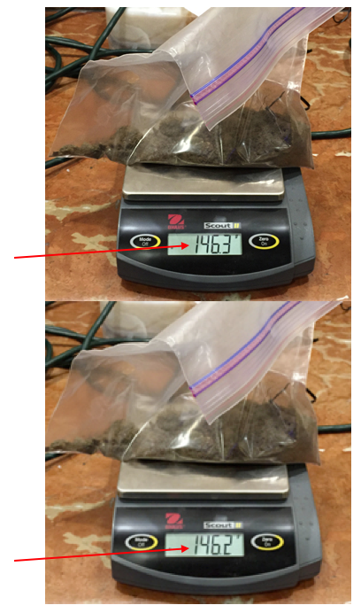
Determining That the Sample Is Dry
To determine if the water is gone, dry the sample for an additional period of two or more hours, and then weigh it again.
If the mass has changed by 0.3 g or more, dry the sample some more, and weigh it again.
Repeat these steps until the mass of the sample has not changed by 0.3 g.
Then the sample can be considered dry.
Initial Dry Sample Mass: 146.3 g
Final Dry Sample Mass: 146.2 g

Slide 28
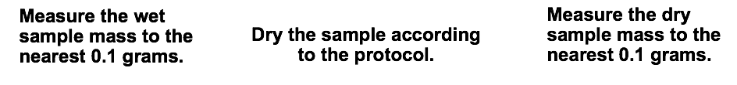
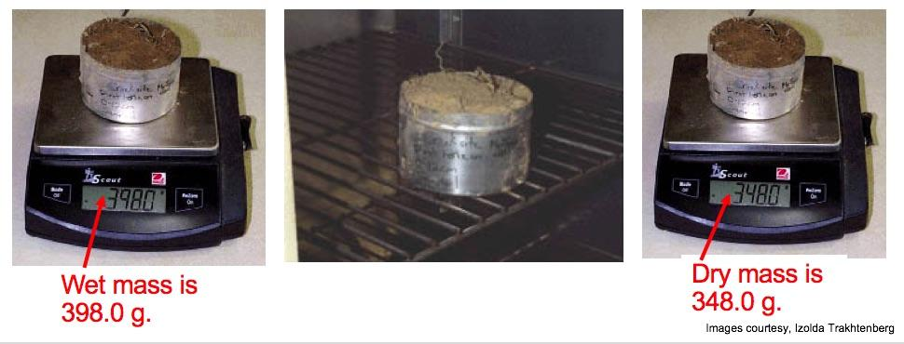
SMAP Soil Moisture – Sample Bulk Density Lab
Protocol For Samples Collected in a Can
If you have a soil drying oven, complete all soil collection and drying using sample cans. Measure sample bulk density every tenth time a sample is collected by pushing the can into the soil. For other times you can simply place soil in the sample can just as you would a bag.

Slide 29
Record the Dry Mass
When your sample is dry, on the Data Entry app or Data Sheet fill in:
The drying time and drying method
The Dry Mass next to the appropriate container number
The mass of the sealable bag

Slide 30
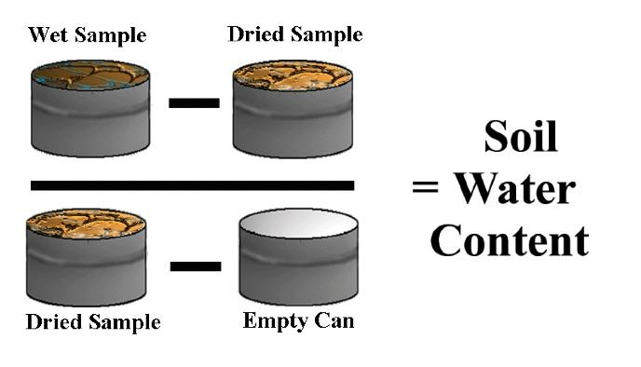
Calculating Gravimetric Soil Water Content
Use this formula to calculate Gravimetric Soil Water Content

Slide 31
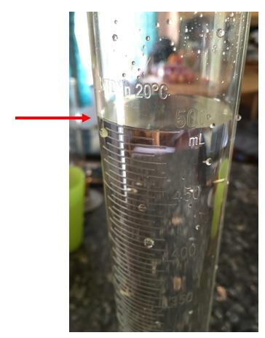
Measuring Sample Bulk Density – Filling the Graduated Cylinder
After all the soil in a can has been transferred to a bag or dried in a soil oven, weighed, and emptied, you will measure the volume of the clean, dry can by using a graduated cylinder filled with water.
GLOBE asks that this measurement be made three times.
Remember to read the bottom of the Meniscus.
Clean any drops off the rim of the graduated cylinder to avoid water entering the can that isn’t included in your measured volume.
Record your reading as the Initial Volume.
This volume is 500 mL.

Slide 32
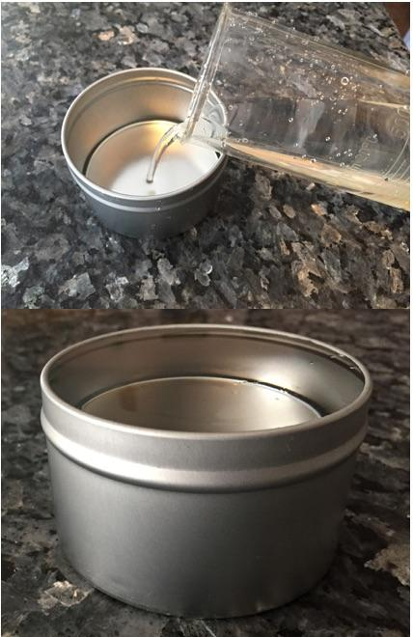
Measuring Sample Bulk Density – Filling the Can
Set the can on a level surface.
Ensure that the can rim is not dented so that the water will have a flat surface.
Pour the water into the can until it is full to the brim.

Slide 33
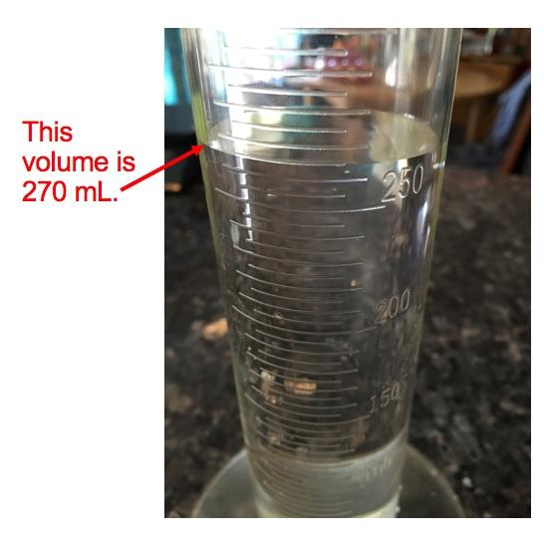
Measuring Sample Bulk Density – Reading the Final Volume
Record the volume left in the graduated cylinder as the final volume.
If you are using a graduated cylinder with a volume less than the sample can, the water in the graduated cylinder will not fill the can entirely.
In this case, fill the cylinder, record the volume, and empty it into the can. Repeat this, recording the volume each time. When the can is filled, read the amount of water left in the cylinder; this is your final volume. The initial volume is the sum of the starting amounts to which the cylinder was filled.

Slide 34
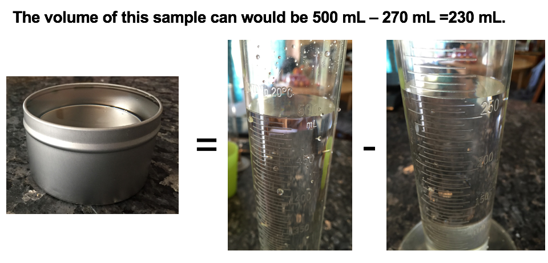
Calculating Can Volume
V_{can} = V_{initial} – V_{final}
If you filled the graduated cylinder twice, V_{can} = V₁ + V₂ – V_{final}
If you filled the cylinder three times, V_{can} = V₁ + V₂ + V₃ – V_{final}

Slide 35
Calculating Sample Bulk Density
The volume of the can is the average of the three measurements taken.
V_{avg} = (V_{can1} + V_{can2} + V_{can3}) / 3
The Sample Bulk Density is the mass of the dry soil divided by the volume of the sample.
Sample Bulk Density = (M_{dry} - M_{container}) / V_{avg3} (g/ml)
Note: 1 milliliter = 1 cubic centimeter so density units are also (g/cc)
The term “Sample Bulk Density” is used in GLOBE to distinguish this quantity from the bulk density measured following the Bulk Density Protocol, which requires sieving the dry sample and measuring the weight and volume of any rocks and sticks in the sample.

Slide 36
Calculating Volumetric Soil Moisture Content
SMAP measures volumetric soil moisture content, so the GLOBE gravimetric soil moisture content data must be converted for comparison with the satellite data.
Volumetric soil moisture content = Volume_{water} / Volume_{soil}
The density of water is approximately 1 g/ml.
V_{water} = Mass_{water} / Density_{water}
So the water volume in milliliters or cubic centimeters is equal to the water mass in grams.
Volume_{soil} = (Mass_{dry} - Mass_{container}) / Sample Bulk Density (g/ml)
OR
Volumetric soil moisture content = Volume_{water} / Volume_{can}

Slide 37
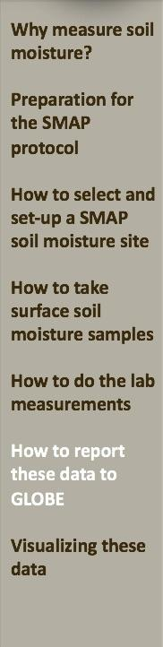

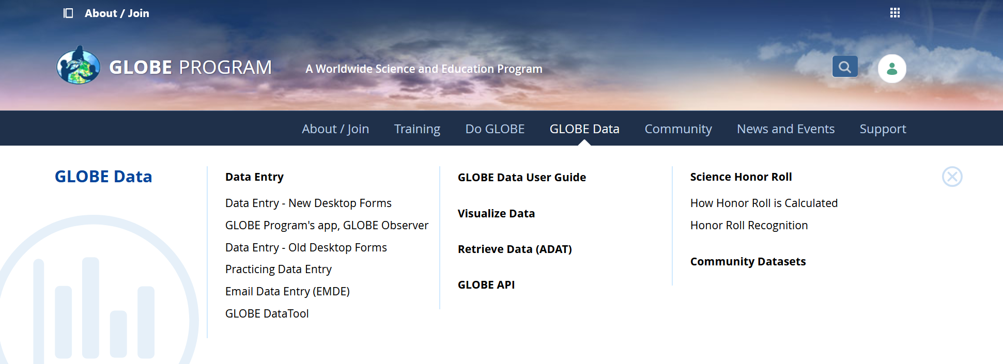
Reporting Data to GLOBE
Two Options for Uploading Data:
These methods all allow users to submit environmental data – collected at defined sites, according to protocol, and using approved instrumentation – for entry into the official GLOBE science database.
Download the GLOBE Observer mobile app from the App Store.
Data Entry: Visit globe.gov, click on the “GLOBE Data” tab, then underneath “Data Entry” click on “Data Entry – New Desktop Forms”.

Slide 38
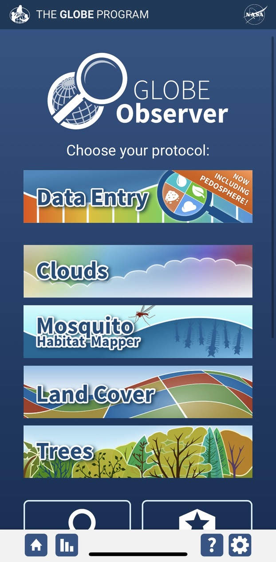
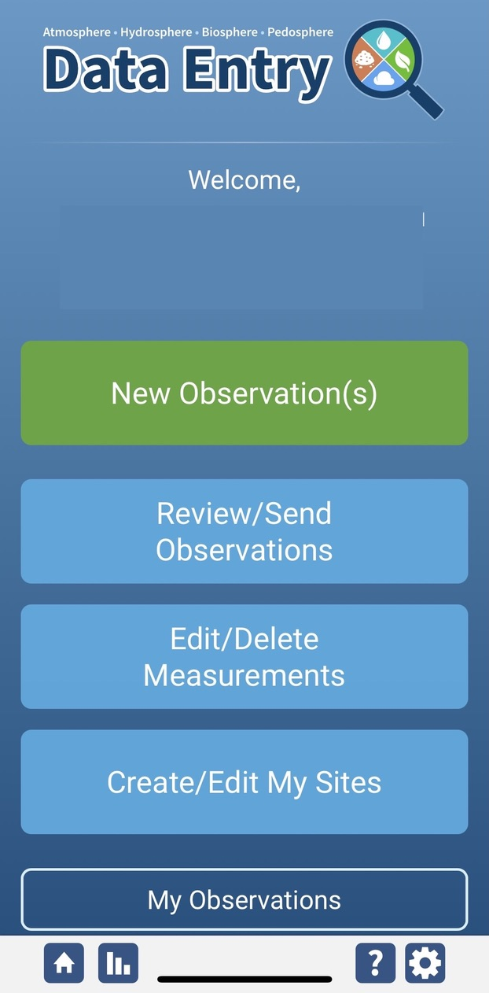
SMAP Soil Moisture Site Creation
If this is your first time making Soil Moisture or Temperature observations at this location, you will need to create a new site before entering data.
Open the GLOBE Observer App and select “Data Entry”.
Next, click “Create/Edit My Sites”

Slide 39
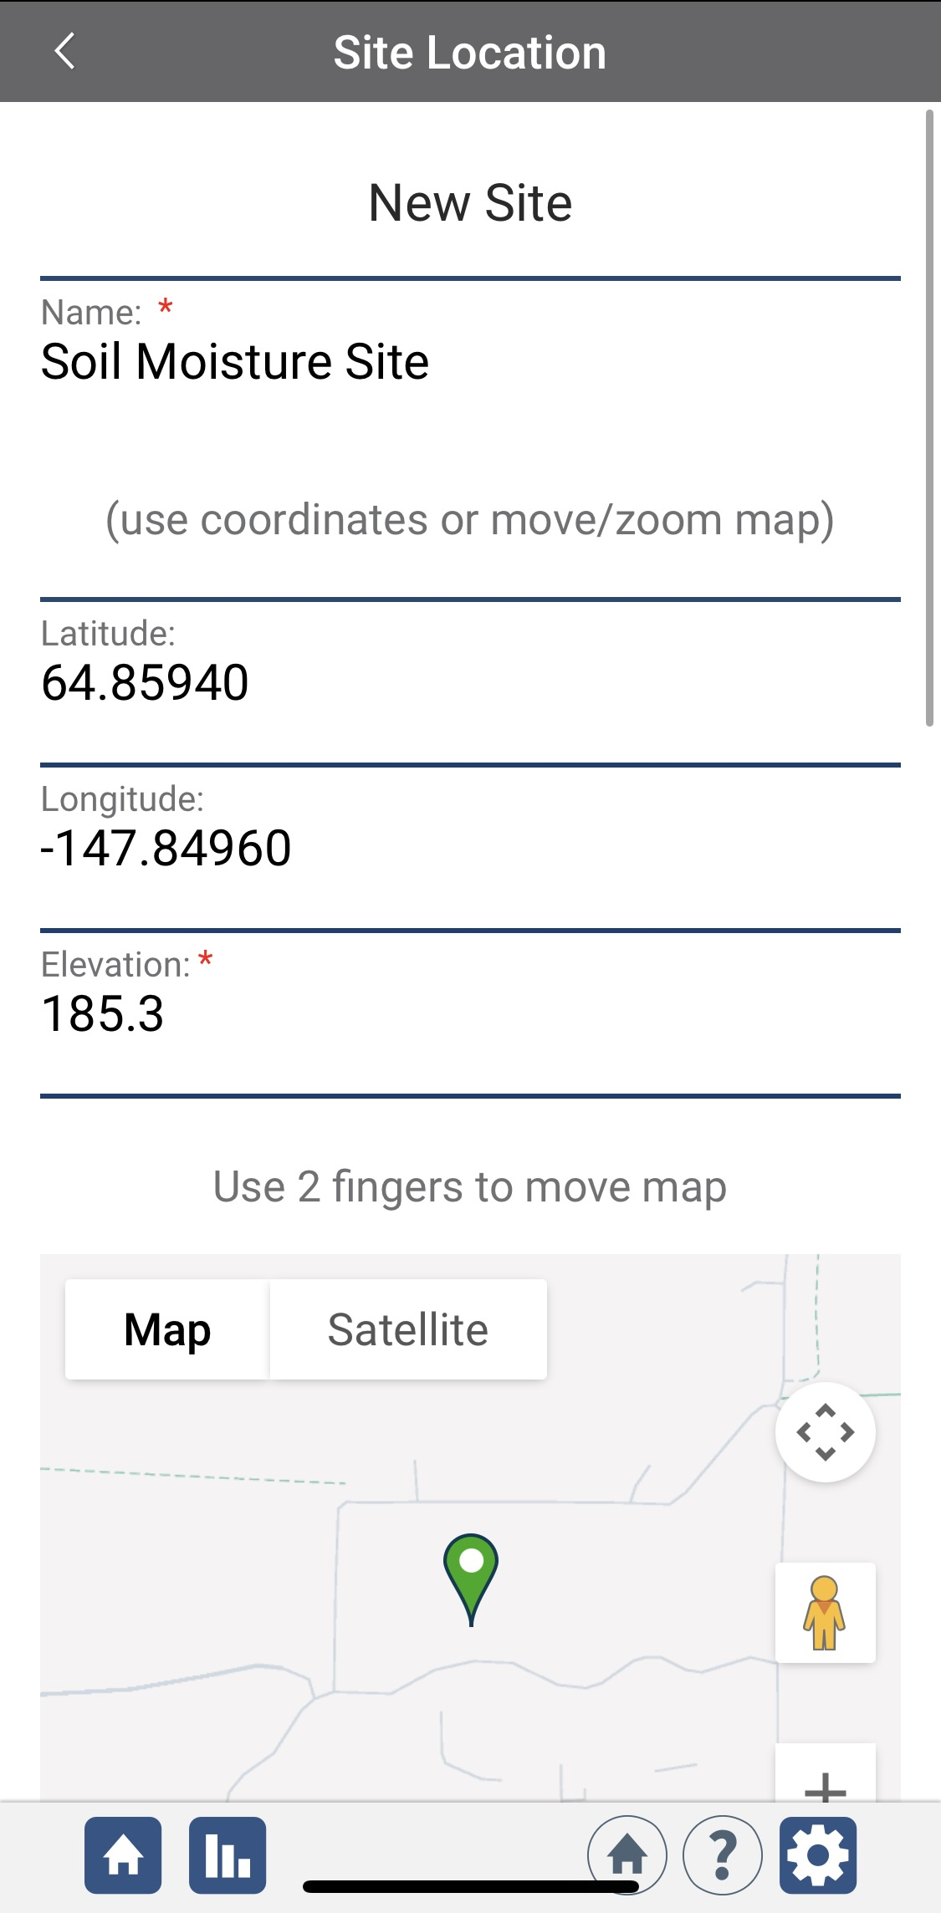
SMAP Soil Moisture Site Creation
Enter a name for your new site.
Use the map box to make sure the green popup is in the correct site location.
If you used a separate GPS device to locate your site, you can enter the coordinates manually.

Slide 40
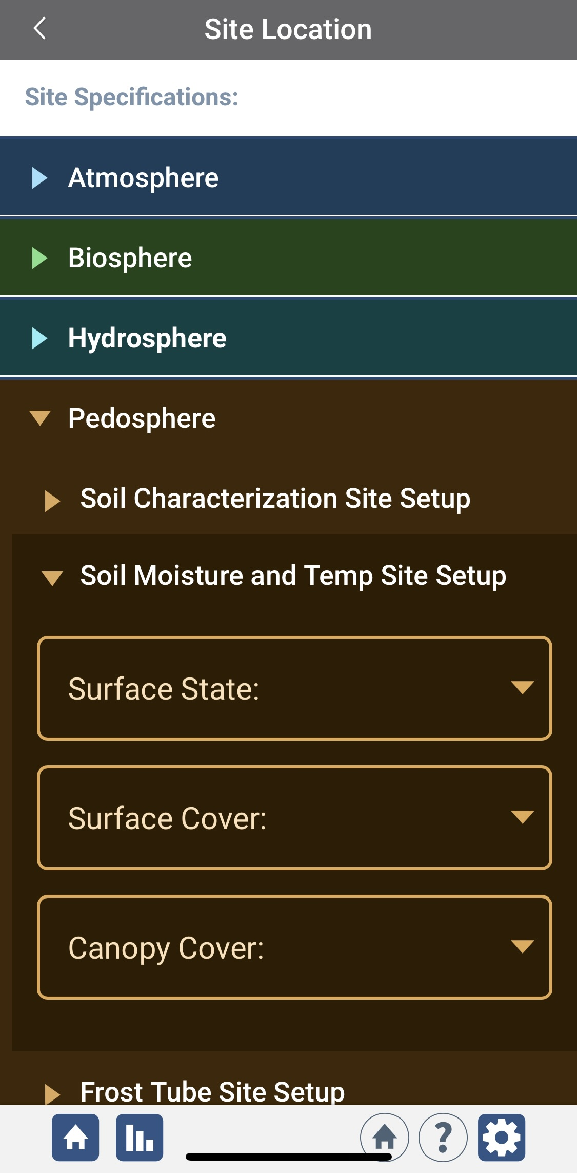
SMAP Soil Moisture Site Creation
Scroll down to the Pedosphere tab
Select Soil Moisture and Temp Site Setup
Enter the surface state, surface cover, and canopy cover information for you new site.
At the bottom of the page, select “Send Site”

Slide 41
SMAP Soil Moisture Data Entry
To enter data, first return to the GLOBE Observer main page by clicking the home button in the bottom left.
Select “Data Entry”.
Next, click “New Observation(s)”

Slide 42
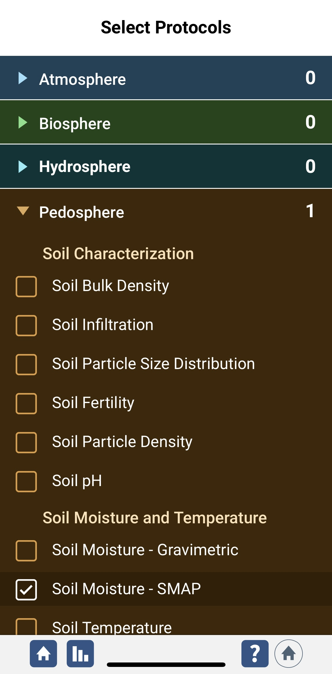
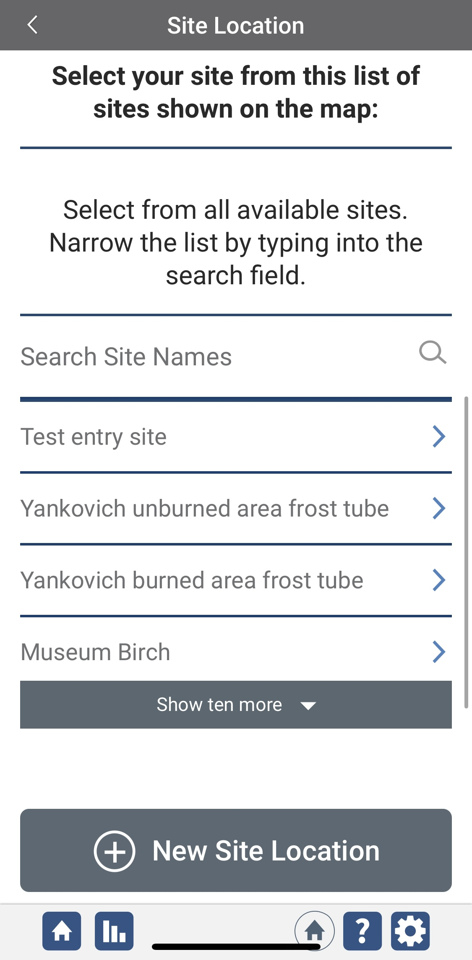
SMAP Soil Moisture Data Entry
Under the Pedosphere tab, select “Soil Moisture – SMAP” then click Continue at the bottom of the page.
Next, select your Soil Moisture Site. Existing sites near you will show up below “Search Site Names”

Slide 43
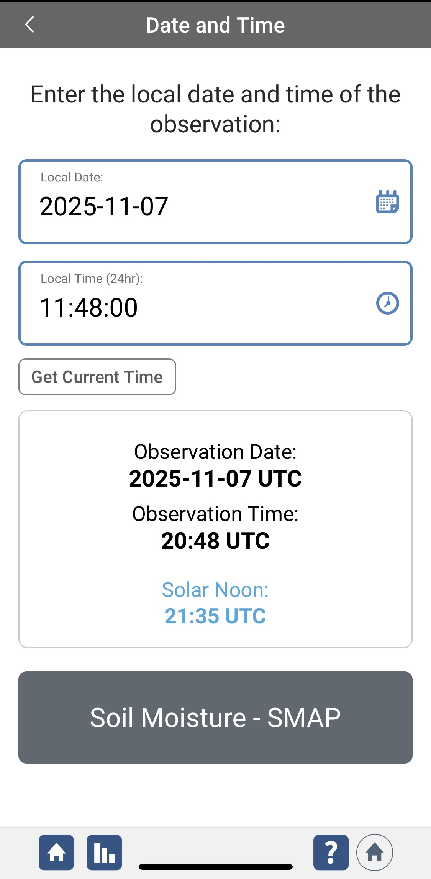
SMAP Soil Moisture Data Entry
Next, enter the date and time you took the measurements.
Select Soil Moisture - SMAP to enter your data.

Slide 44

SMAP Soil Moisture Data Entry
Select a soil state.
Select the method and temperature at which you dried your samples. Then enter how long you dried your soil samples.
Enter the weights of your wet and dry soil in grams, as well as your empty container weight.

Slide 45

Entering Container Volume Data
If you are reporting sample bulk density measurements, you will need to report the volume of your sampling can.

Slide 46


Entering Container Volume Data-Example
Enter your three sets of Initial and Final Volume data.
The website will calculate the average can volume and the volumetric soil moisture.
Make sure the calculated values match those you made
Add any additional metadata here

Slide 47


Data Entry System Responses
If your observations are within the appropriate ranges, you will see a green smiley face.
You can review or edit your observation if needed.
When ready, select “Send these measurements now” to send your data to GLOBE. When it has been sent, you will see a “Success” message.

Slide 48


Gravimetric Surface Soil Moisture Visualization
Visualization data layer for 0-5 cm gravimetric soil moisture

Slide 49

Volumetric Surface Soil Moisture Visualization
Visualization data layer for 0-5 cm volumetric soil moisture

Slide 50


Please provide us with feedback about this module. This is a community project and we welcome your comments, suggestions and edits!
Questions about content in this module? Contact GLOBE: help@nasaglobe.org
Slides: Izolda Trachtenberg, Dixon Butler, Russanne Low
Photo Credits: Izolda Trachtenberg
Illustrations: Rich Potter
Cover Illustration: Jenn Glaser, ScribeArts
The GLOBE Program is sponsored by these organizations:
November 2025. GLOBE Implementation Office: Science, Training, Education, and Public Engagement Team.
If you edit and modify this slide set for use for educational purposes, please note “modified by (and your name and date)” on this page. Thank you.

