Slide 1
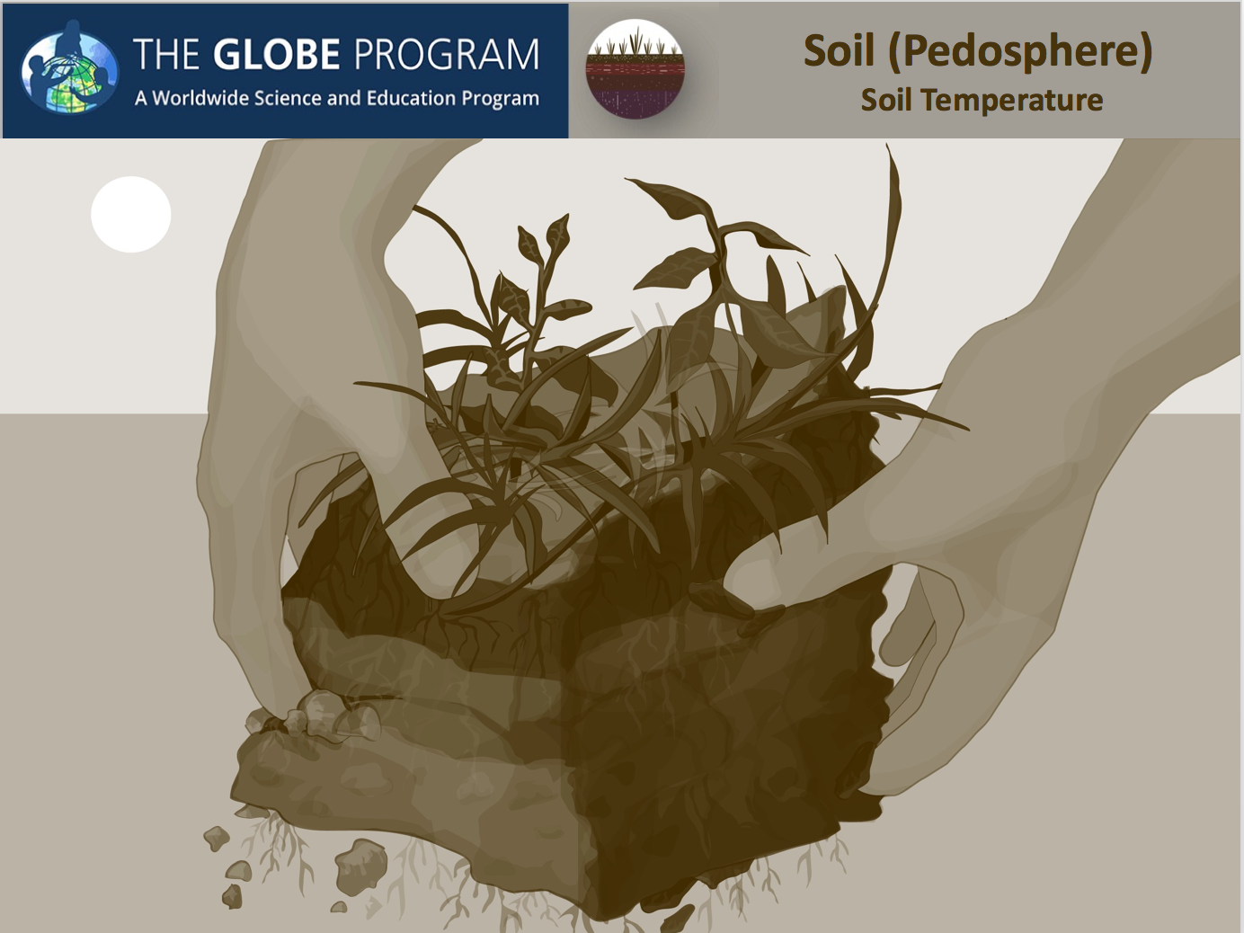


Slide 2
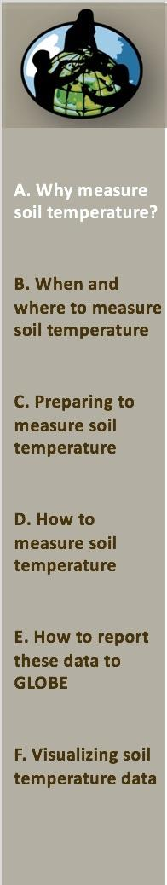
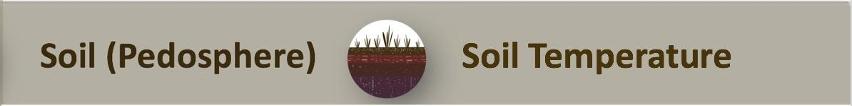
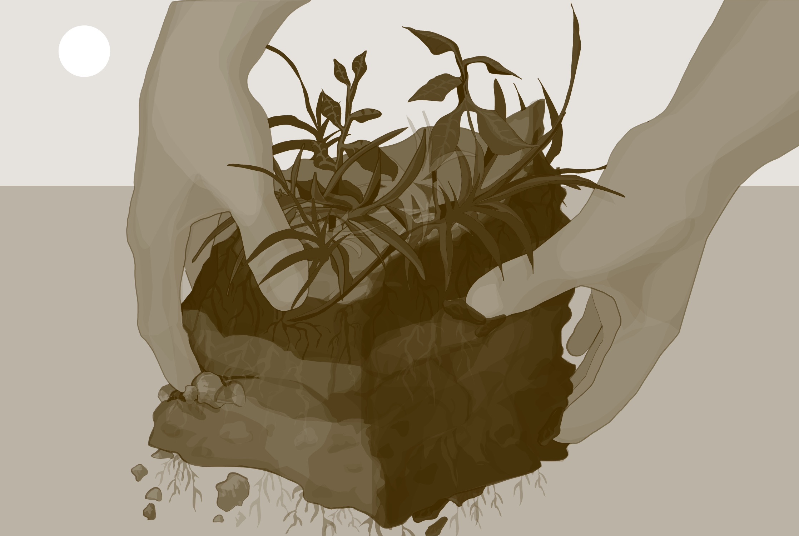
Soil Temperature Overview
This module:
Tells why to measure soil temperature
Provides a step-by-step introduction of the protocol
Learning Objectives
After completing this module, you will be able to:
Explain the role of soil temperature in the environment
Decide when and where to take soil temperature measurements
Correctly take soil temperature measurements
Upload these data to the GLOBE database
Visualize these data using GLOBE’s Visualization Site
Estimated time needed for completion of this module: 1.5 hours

Slide 3
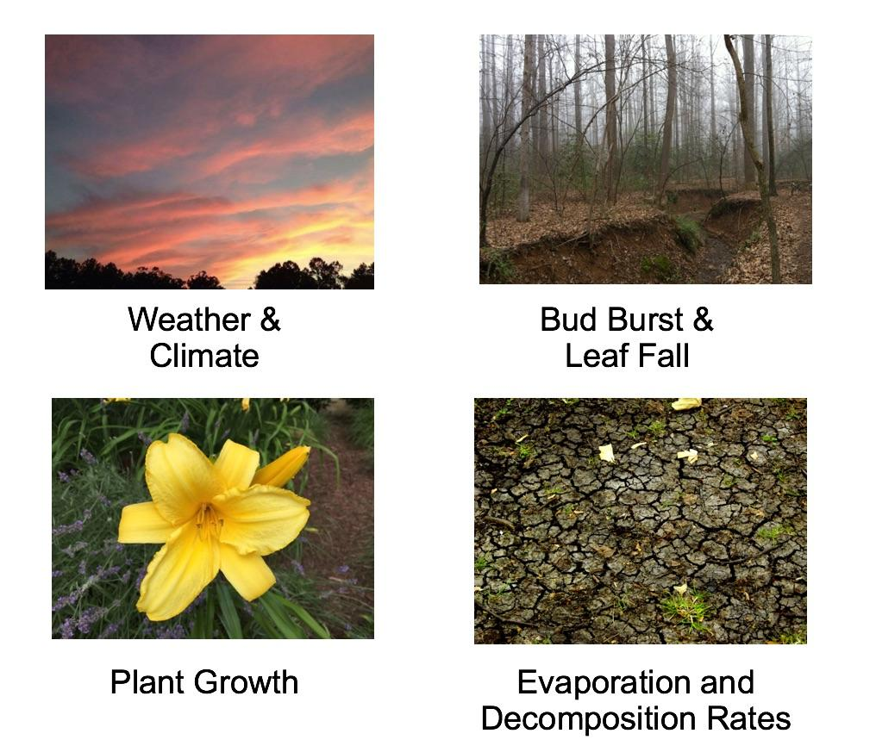
The Importance of Soil Temperature
Soil Temperature is a physical property that regulates chemical and biological processes taking place within the soil.
Other Images courtesy, Izolda Trakhtenberg
http://creativecommons.org/licenses/by/2.5/

Slide 4
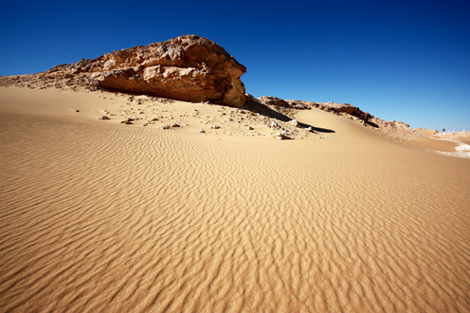
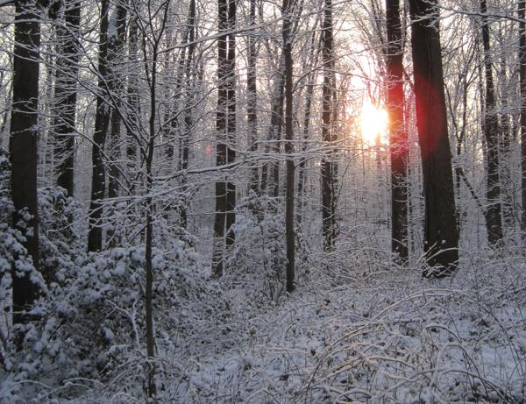
Soil Temperature is Linked to Air Temperature
The temperature of soil is directly linked to the temperature of the atmosphere because solar energy is primarily absorbed at Earth’s surface.
Soil is an insulator for heat flowing between the surface and the solid earth.
Soil and rocks have greater heat capacity (heat capacity is the number of heat units needed to raise the temperature of a body by one degree Celsius) than air, so soil temperatures are often cooler than the air in the summer and warmer than the air in the winter.
Soil temperatures can range from over 90 ̊ C for desert soils in direct sunlight (far warmer than the maximum air temperature) to values below freezing in the winter.
http://creativecommons.org/licenses/by/2.5/
Other Images courtesy, Izolda Trakhtenberg

Slide 5
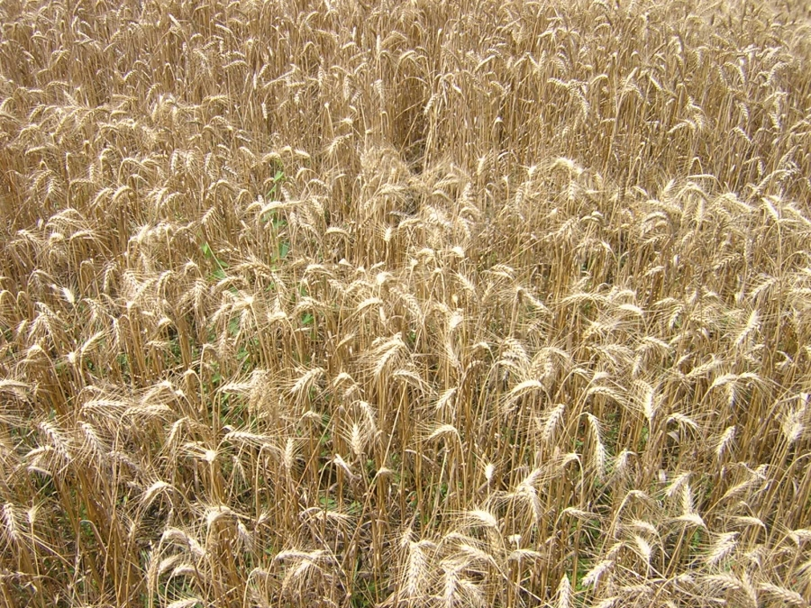
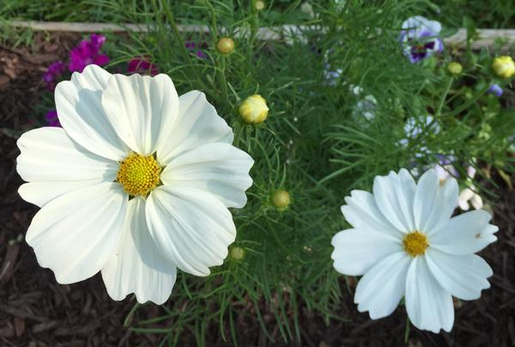
Soil Temperature
http://creativecommons.org/licenses/by/2.5/
Other Images courtesy, Izolda Trakhtenberg
Soil temperature has a significant effect on the budding and growth rates of plants as well as leaf fall and decomposition.
As soil temperature rises, it signals seeds that it is time to sprout. Farmers use soil temperature data, particularly at a depth of 10 cm, to predict when to plant crops.
As temperatures rise, chemical reactions speed up. Bacteria, worms, and fungi become more active and this accelerates decomposition of organic materials. Extreme high temperatures can effectively sterilize soil.

Slide 6
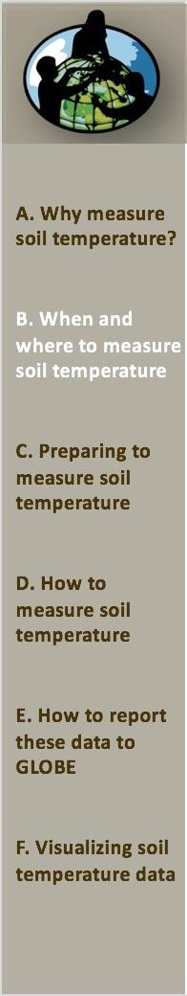
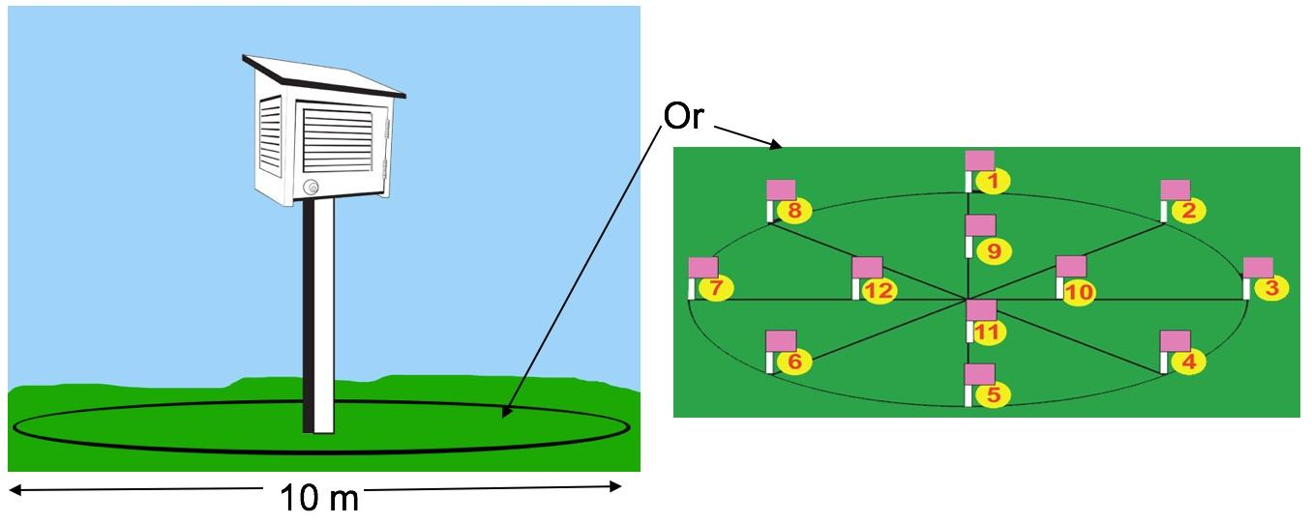
Soil Temperature: Measurement Frequency and Location
Measure Soil Temperature at least weekly at approximately the same time of day each time.
Take data within 10 m of the atmosphere shelter or near the soil moisture site if you are taking either of those measurements.
GLOBE encourages you to take Soil Temperature measurements daily, if you can, and to conduct the Soil Temperature Diurnal Measurement Protocol every three months.

Slide 7
Summary of Protocol
Where | Soil Temperature Site
Main instrument used | Dial or digital soil thermometer
Prerequisites | Site definition using the Site Definition Sheet
Needed Documents | Soil Temperature Protocol
 | Soil Temperature Data Sheet
Time Required | 1—15 minutes
Level | All
Frequency | Soil temperature measurements can be taken daily or weekly. Seasonal measurements are taken every three months at 2-3 hour intervals for two consecutive days (diurnal cycle measurement).

Slide 8
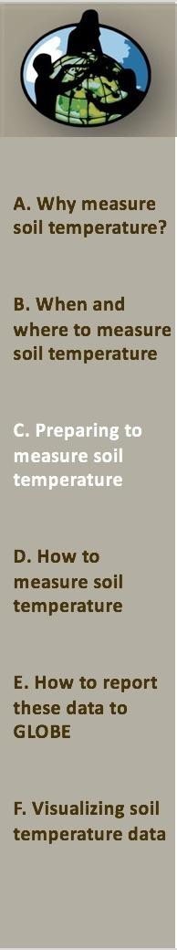
Required Equipment
For Soil Thermometer Calibration:
Calibrated Soil thermometer
Calibration thermometer (determined to be accurate to + 0.5 ̊ C using the ice bath method)
500-mL beaker
Water
Wrench that fits nut on soil thermometer
Watch or timer
For Soil Temperature Measurement:
A Defined Soil Temperature Sampling Site
Dial or Digital Thermometer (calibrated using a calibrated thermometer)
Thermometer spacers (for both 5 cm and 10 cm temperature measurements)
12 cm or longer nail marked at 5 cm, 7 cm, 10 cm and 12 cm from its point (if the soil is firm)
Watch
Science Log/Data Entry App
Pen or pencil
Hammer (if soil is extra firm)

Slide 9
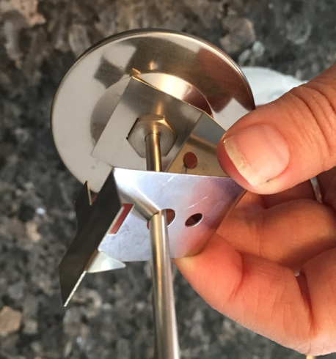
Soil Thermometer Calibration
Pour about 250 mL of water at room temperature into a beaker (enough to cover the lower 4 cm of your thermometers).
Place both the calibration thermometer and the digital or dial soil thermometer into the water.
Wait 2 minutes.
Read the temperatures from both thermometers. If the temperature difference between the thermometers is less than 2 ̊ C, stop; your soil thermometer is calibrated.
If the temperature difference is greater than 2 ̊ C, wait two more minutes.
If the temperature difference is still greater than 2 ̊ C, adjust the soil thermometer by turning the calibration nut at the base of the dial with the wrench until the soil thermometer reading matches the calibration thermometer.
Keep the thermometer sensor (the lower 4 cm) in the water as you adjust the calibration.

Slide 10
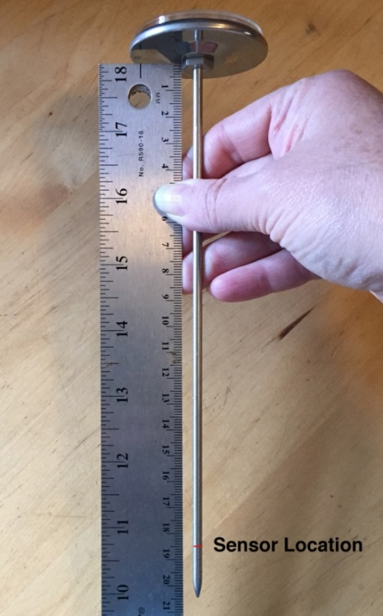
Soil Thermometer Spacers
The temperature sensor in the soil thermometer is 2 cm up from the tip so it is helpful to make spacers to position the thermometer correctly when inserting it into the soil.
To measure at 5 cm depth, the thermometer’s tip must go 7 cm into the soil.
To measure at 10 cm depth, the thermometer’s tip must go 12 cm into the soil.
PVC pipe that is 1.5 cm to 4.0 cm in diameter may be used. It will fit around the calibration screw under the face of the thermometer.
  You may also use wood blocks as your spacers.
  Drill holes in wood blocks that will allow both 7 cm and 12 cm to poke through the blocks.
Note that the holes in wood blocks will not accommodate the calibration screw under the face of the thermometer.

Slide 11
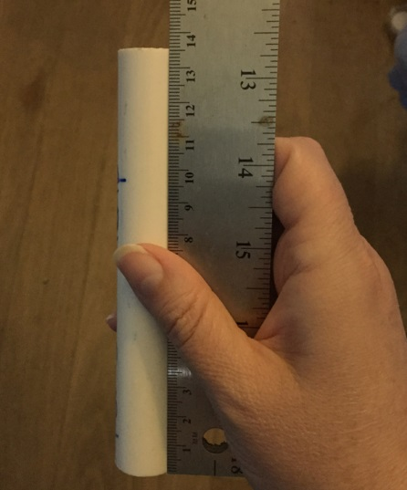
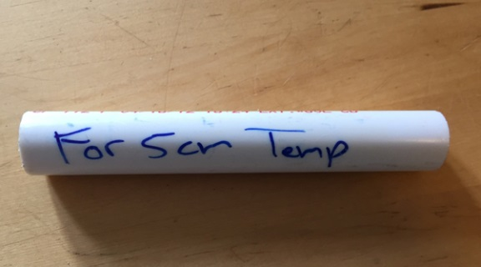
Constructing the Spacer for Measuring at 5 cm Depth
To measure soil temperature at a 5 cm depth, the thermometer must be inserted 7 cm into the soil.
The tip of the probe on the standard GLOBE Soil Thermometer is 20.5 cm from the underside of the instruments face, so to make the 5 cm measurement spacer the appropriate length, cut the PVC pipe to a length of 13.5 cm.
Label the spacer, “For 5 cm Temperature,” to ensure that you and those you instruct will measure the correct depth with it.

Slide 12
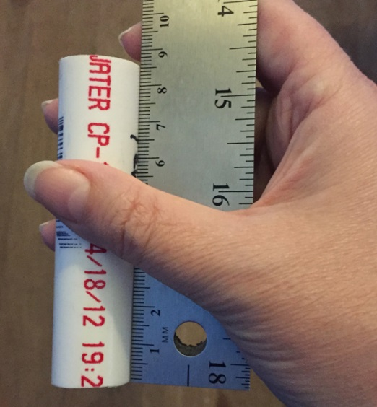
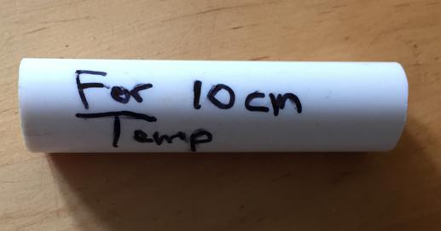
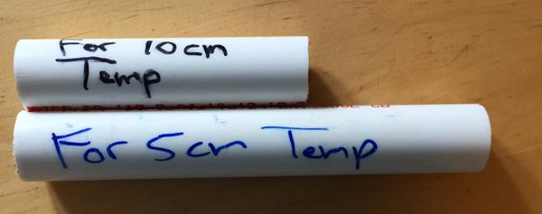
Constructing the Spacer for Measuring at 10 cm Depth
To measure soil temperature at a 10 cm depth, the thermometer must be inserted 12 cm into the soil.
To make the 10 cm measurement spacer the appropriate length, cut the PVC pipe to a length of 8.5 cm.
Label it, “For 10 cm Temperature,” to ensure that you will measure the correct depth with it.
Remember, the longer PVC pipe spacer helps measure the more shallow depth, and the shorter PVC pipe helps measure the deeper depth.

Slide 13
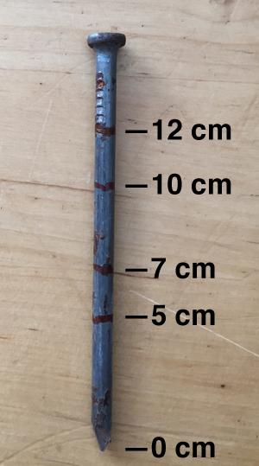
Preparing a Nail to Make Pilot Holes in Hard Soils
When the soil is hard, pushing the thermometer into the ground can damage the instrument. Use a nail to make sure that the thermometer is not damaged.
A nail that is the same diameter as the thermometer probe is used to make a pilot hole.
Mark a nail at 5 cm, 7 cm, 10 cm, and 12 cm from its tip.
Depending on the situation, pilot holes may be needed at these depths.

Slide 14
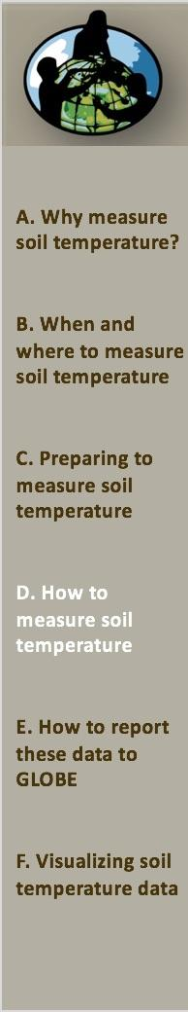
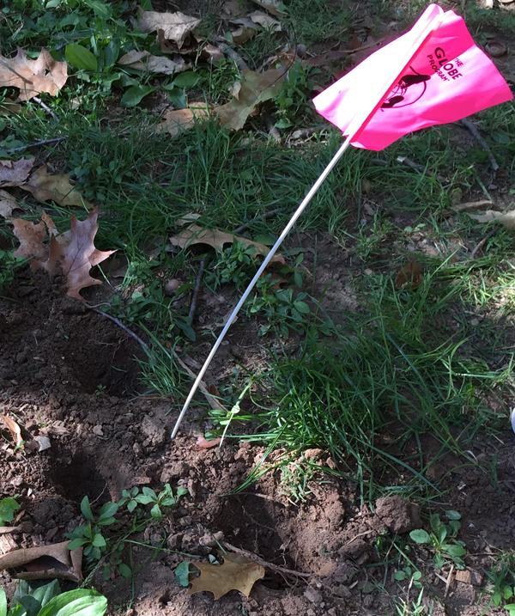
Soil Temperature Protocol 1
Define a Soil Moisture and Temperature Study Site following the procedures presented in the Pedosphere Introduction module.
At close to local solar noon or other measurement time, go to your site and locate your sampling point.
Enter the appropriate sample date and sampling event in the Data Entry app or record it on the Data Sheet.
See Soil Temperature Data Entry towards the end of this slide set.

Slide 15
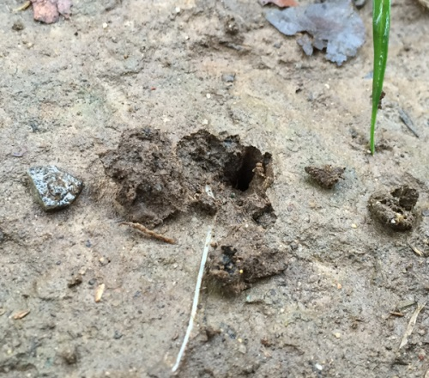
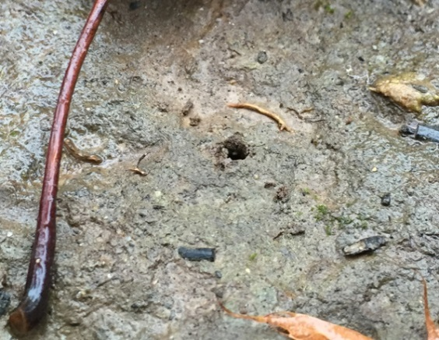
Soil Temperature Protocol 2
Use the nail to make a 5 cm deep pilot hole for the thermometer.
If the soil is so firm that you have to use a hammer, make the hole 7 cm deep.
Pull the nail out carefully, disturbing the soil as little as possible. Twisting as you pull may help. If the soil cracks or bulges up, move 25 cm and try again.
Broken, bulging hole. Move over 25 cm and try again.
Unbroken, non-bulging hole.

Slide 16
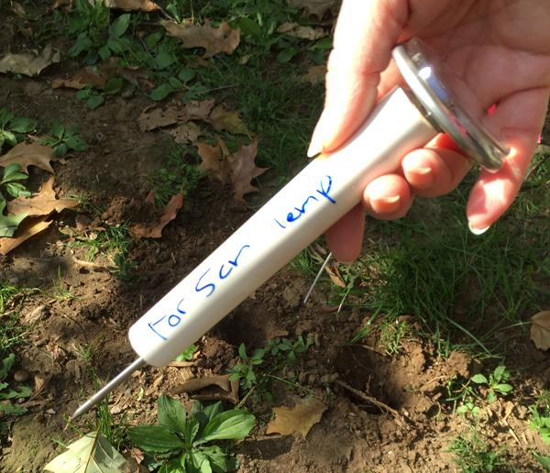
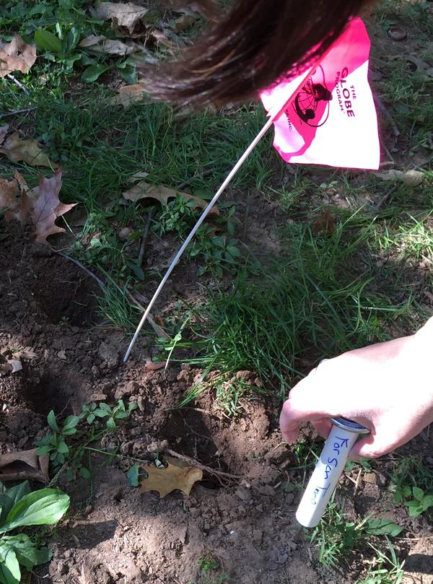
Inserting the Soil Thermometer for the 5 cm Measurement
Insert the thermometer through the longer spacer so that 7 cm of the probe extends below the bottom of the guide.
The back of the dial should be against the top of the spacer.
Gently push the thermometer into the soil.

Slide 17
Reading the 5 cm Soil Temperature
Wait 2 minutes. Record the temperature and time in your Science Log.
Wait an additional minute. Record the temperature and time in your Science Log.
If the 2 readings are within 1.0 ̊ C of each other, record this value and the time on the Soil Temperature Data Sheet as Sample 1, 5 cm reading.
If the 2 temperatures are not within 1.0 ̊ C, continue taking temperature readings at 1-minute intervals until 2 consecutive readings are within 1.0 ̊ C.
Enter that final temperature and the time into the Data Entry app under 5 cm Temperature.
Remove the thermometer from the hole.

Slide 18
Extending the Guide Hole for the 10 cm Measurement in Firm Soil
In the same hole, use the nail to make a 10 cm deep pilot hole for the thermometer.
If the soil is extra firm and you have to use a hammer, make the hole 12 cm deep.
Again, pull the nail out carefully, disturbing the soil as little as possible. Twisting as you pull may help.
Broken, bulging hole. Move over 25 cm and try again.
Unbroken, non-bulging hole.

Slide 19
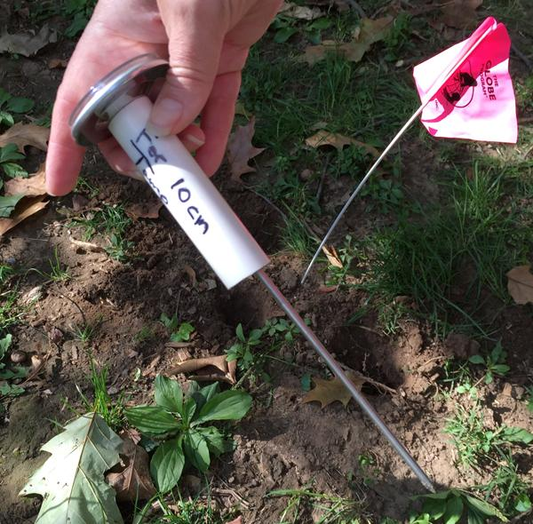
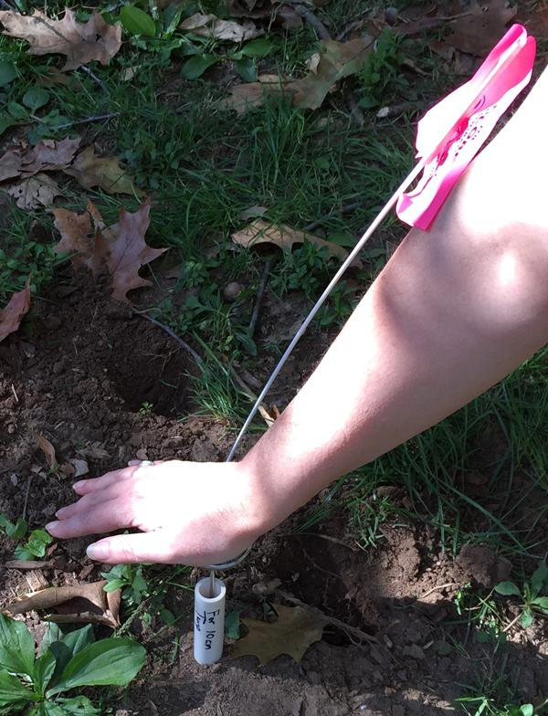
Inserting the Soil Thermometer for the 10 cm Measurement
Insert the thermometer through the shorter spacer so that 12 cm of the probe extends below the bottom of the guide.
The dial should be against the top of the spacer.
Gently push the thermometer into the soil.

Slide 20
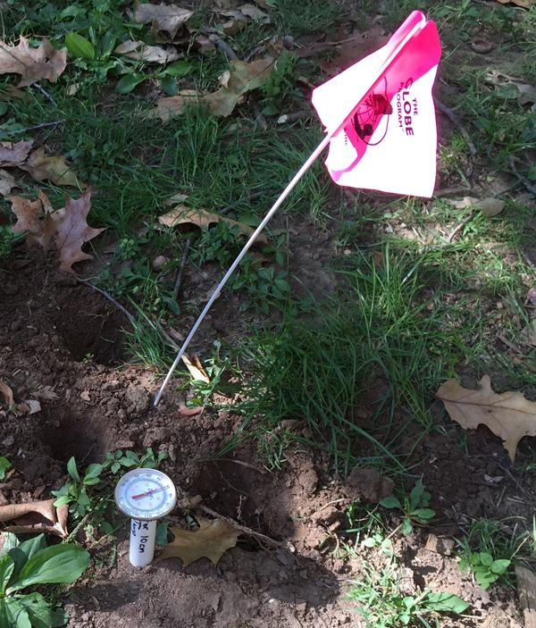
Reading the 10 cm Soil Temperature
Wait 2 minutes. Record the temperature and time in your Science Log.
Wait an additional minute. Record the temperature and time in your Science Log.
If the 2 readings are within 1.0 ̊ C of each other, record this value and the time on the Soil Temperature Data Sheet as Sample 1, 10 cm reading.
If the 2 temperatures are not within 1.0 ̊ C, continue taking temperature readings at 1-minute intervals until 2 consecutive readings are within 1.0 ̊ C.
Enter that final temperature into the Data Entry app under the 10 cm Temperature.
Remove the thermometer from the hole.

Slide 21
Take Two More Pairs of Soil Temperature Readings
Repeat steps above for 2 other holes 25 cm away from the first hole. Record these data on the Soil Temperature Data Sheet as Sample 2, 5 and 10 cm and Sample 3, 5 and 10 cm.
These three sets of measurements must all be taken within 20 minutes.
If possible, read and record the current air temperature from the thermometer in the instrument shelter or by following the Current Temperature Protocol in the Atmosphere Investigation.
Also if possible measure, record, and report the surface temperature following the Surface Temperature Protocol in the Atmosphere Investigation.
Wipe and clean all the equipment.

Slide 22
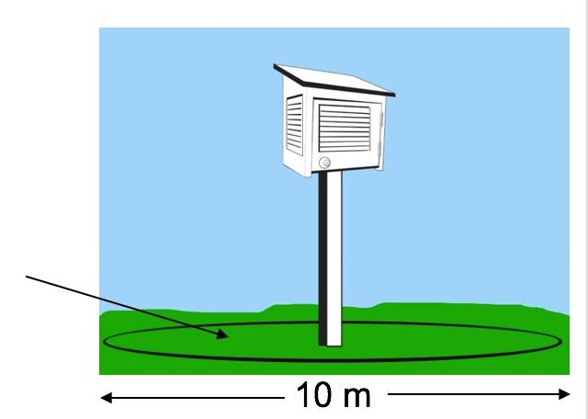
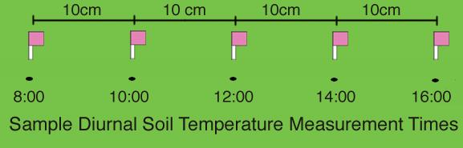
Diurnal Soil Temperature Sampling Frequency and Location
Seasonally (4 times a year), measure soil temperature every few hours during the day for 2 consecutive days.
If you can, take the diurnal soil temperature measurements in March, June, September, and December.
Take data within 10 m of the atmosphere shelter or near the soil moisture site if you are taking either of those measurements.
Offset the measurement locations by 10 cm.

Slide 23
Diurnal Soil Temperature Sampling
When finished, wipe clean all the equipment.
The second day, repeat the measurements at about the same times.
Each time, if possible, measure, record and report:
Surface temperature following the Surface Temperature Protocol from the Atmosphere Investigation and
Current air temperature from the thermometer in the instrument shelter or by following the Current Temperature Protocol in the Atmosphere Investigation.
Be sure to record all measurements in degrees Celsius.
While a typical diurnal cycle is a full 24 hours, the intention for this protocol is to measure soil temperature during the day.

Slide 24
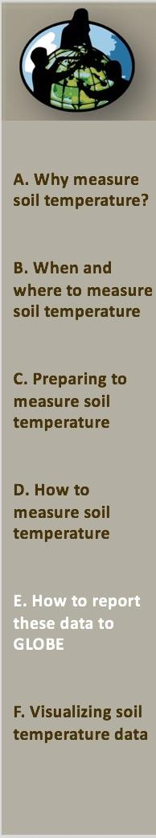

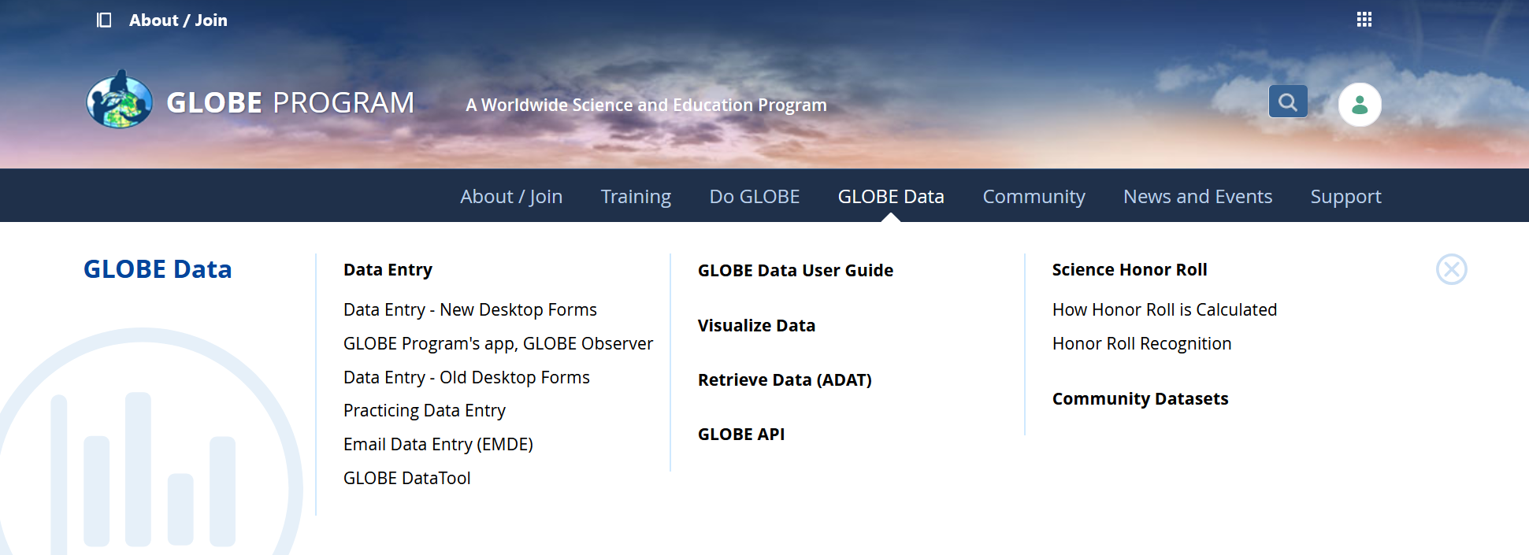
Reporting Data to GLOBE
Two Options for Uploading Data:
These methods all allow users to submit environmental data – collected at defined sites, according to protocol, and using approved instrumentation – for entry into the official GLOBE science database.
Download the GLOBE Observer mobile app from the App Store.
Data Entry: Visit globe.gov, click on the “GLOBE Data” tab, then underneath “Data Entry” click on “Data Entry – New Desktop Forms”.

Slide 25
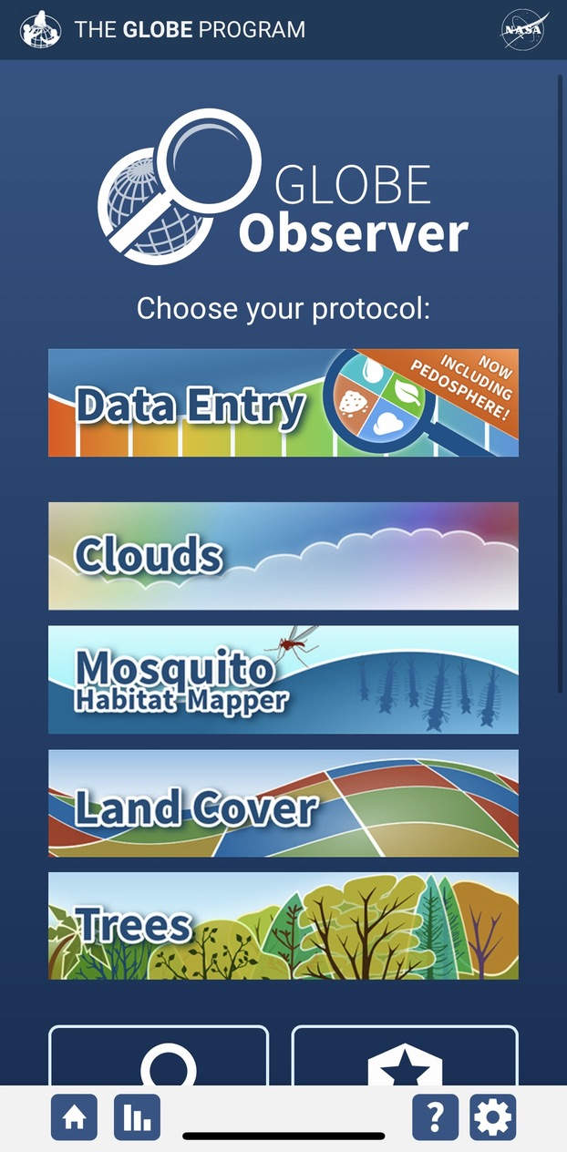
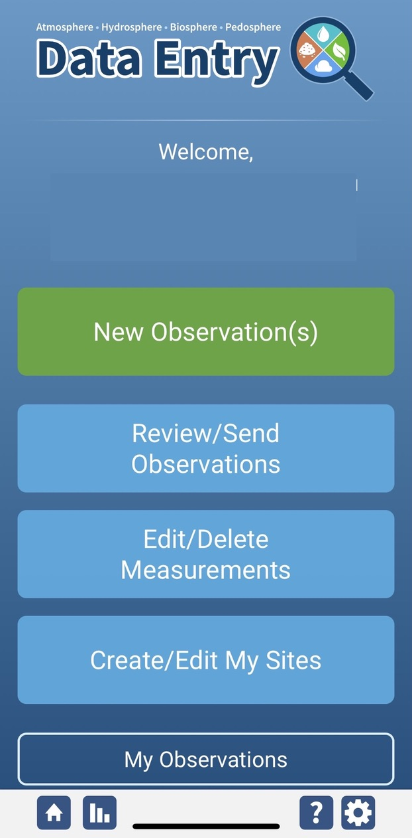
Soil Temperature Site Creation
If this is your first time making Soil Moisture observations at this location, you will need to create a new site before entering data.
Open the GLOBE Observer App and select “Data Entry”.
Next, click “Create/Edit My Sites”

Slide 26
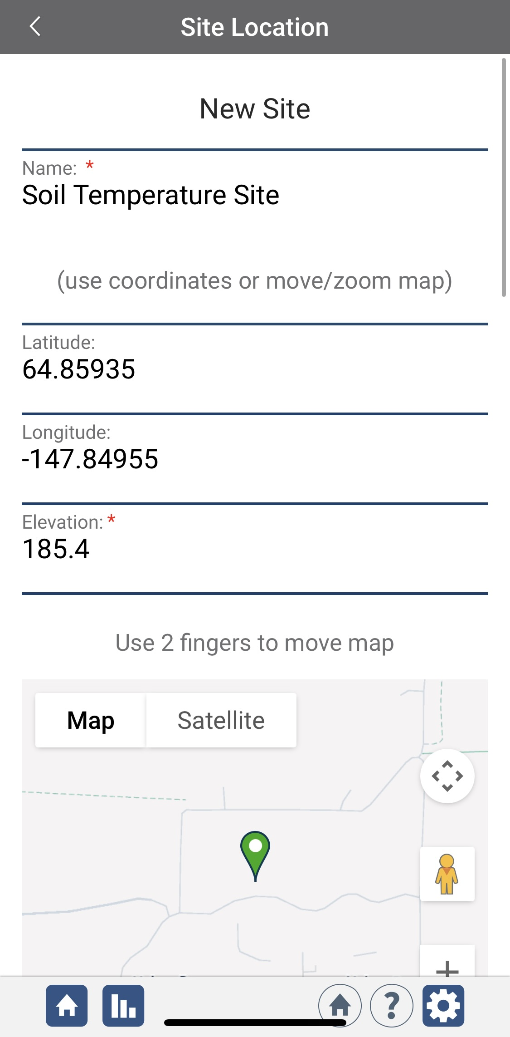
Soil Temperature Site Creation
Enter a name for your new site.
Use the map box to make sure the green popup is in the correct site location.
If you used a separate GPS device to locate your site, you can enter the coordinates manually.

Slide 27
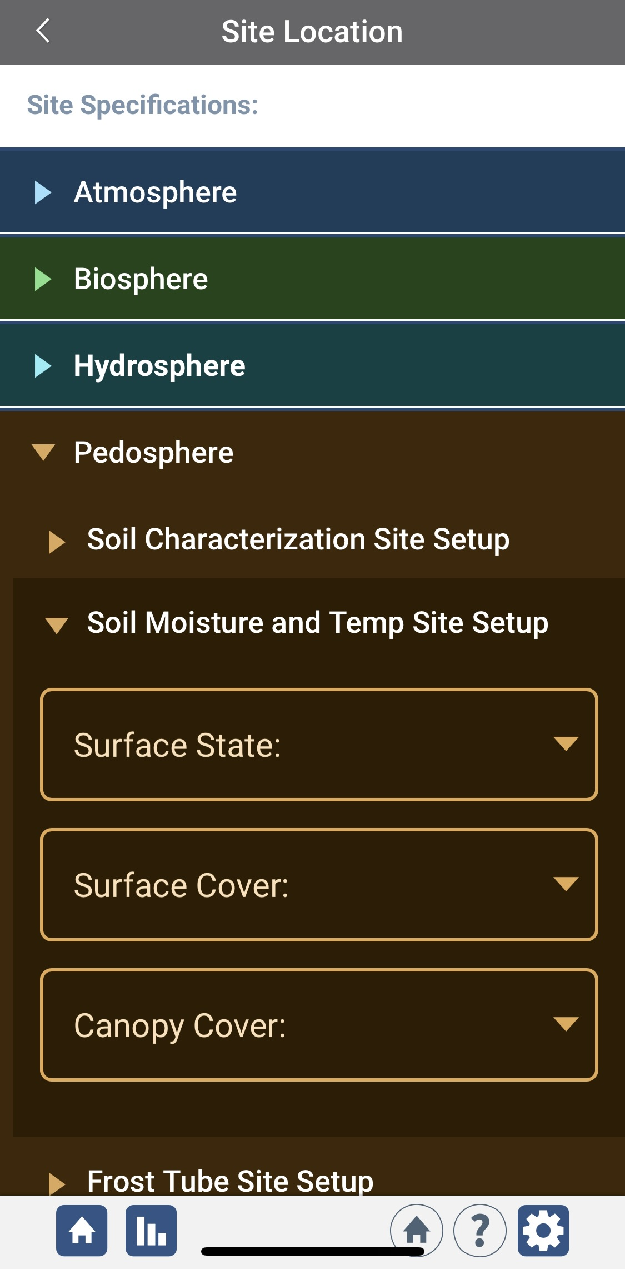
Soil Temperature Site Creation
Scroll down to the Pedosphere tab
Select Soil Moisture and Temp Site Setup
Enter the surface state, surface cover, and canopy cover information for you new site.
At the bottom of the page, select “Send Site”

Slide 28
Soil Temperature Data Entry
To enter data, first return to the GLOBE Observer main page by clicking the home button in the bottom left.
Select “Data Entry”.
Next, click “New Observation(s)”

Slide 29
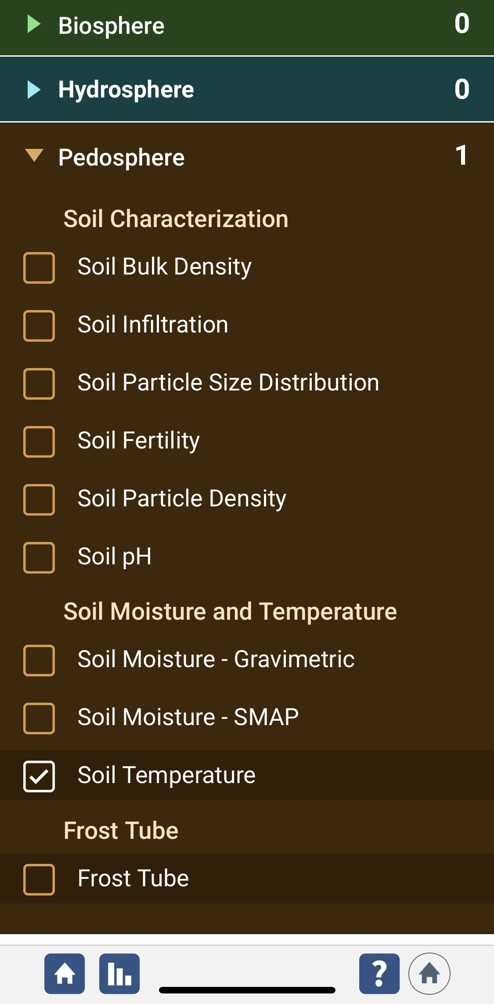
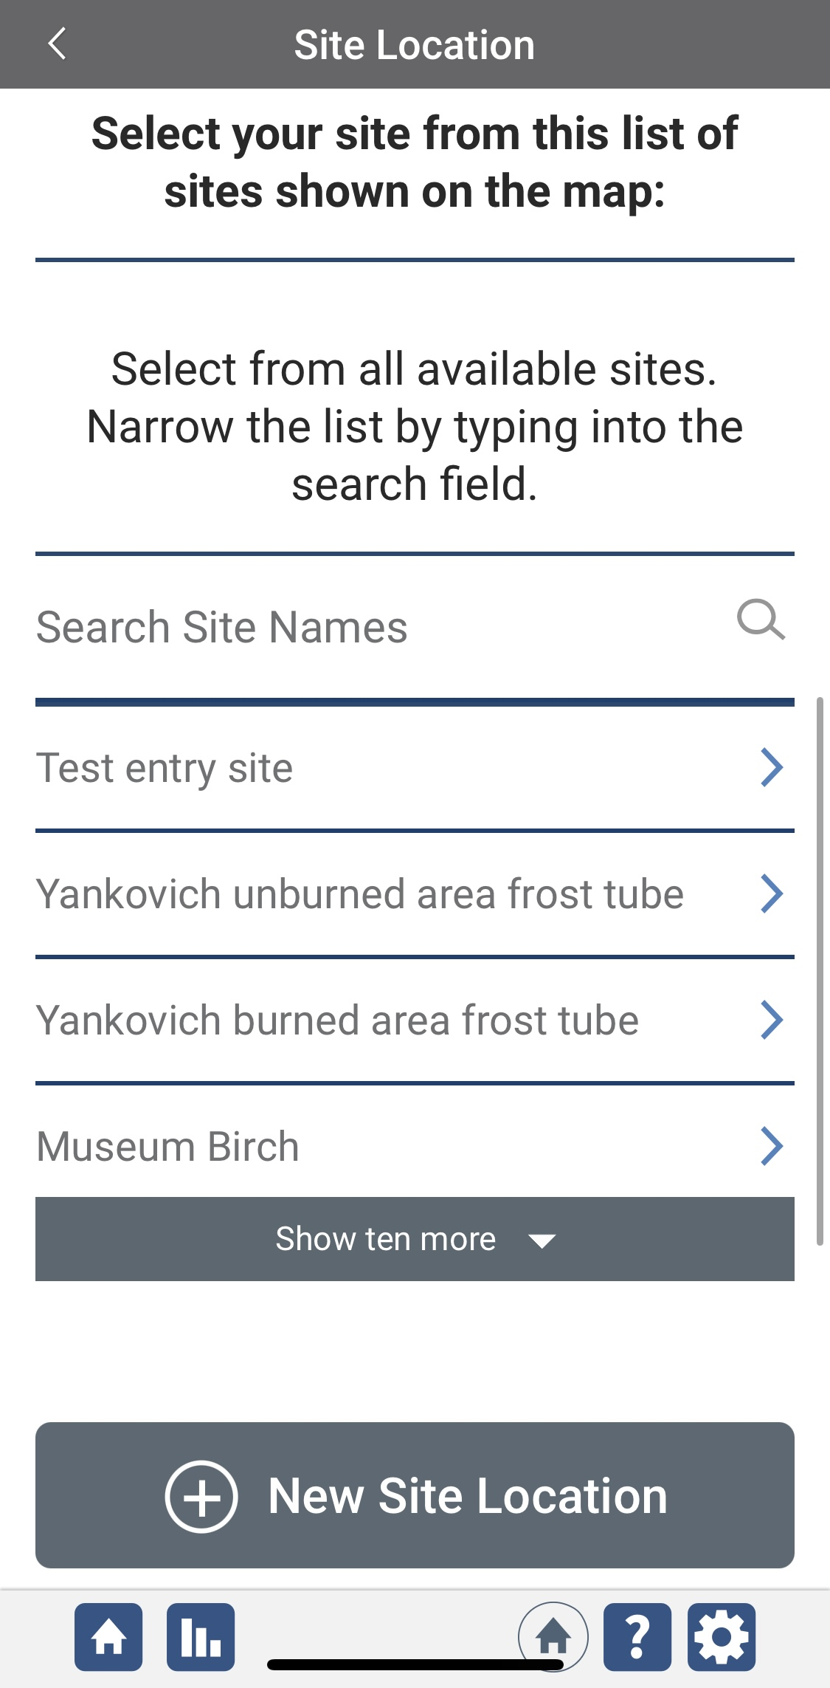
Soil Temperature Data Entry
Under the Pedosphere tab, select “Soil Temperature” then click Continue at the bottom of the page.
Next, select your Soil Temperature Site. Existing sites near you will show up below “Search Site Names”

Slide 30
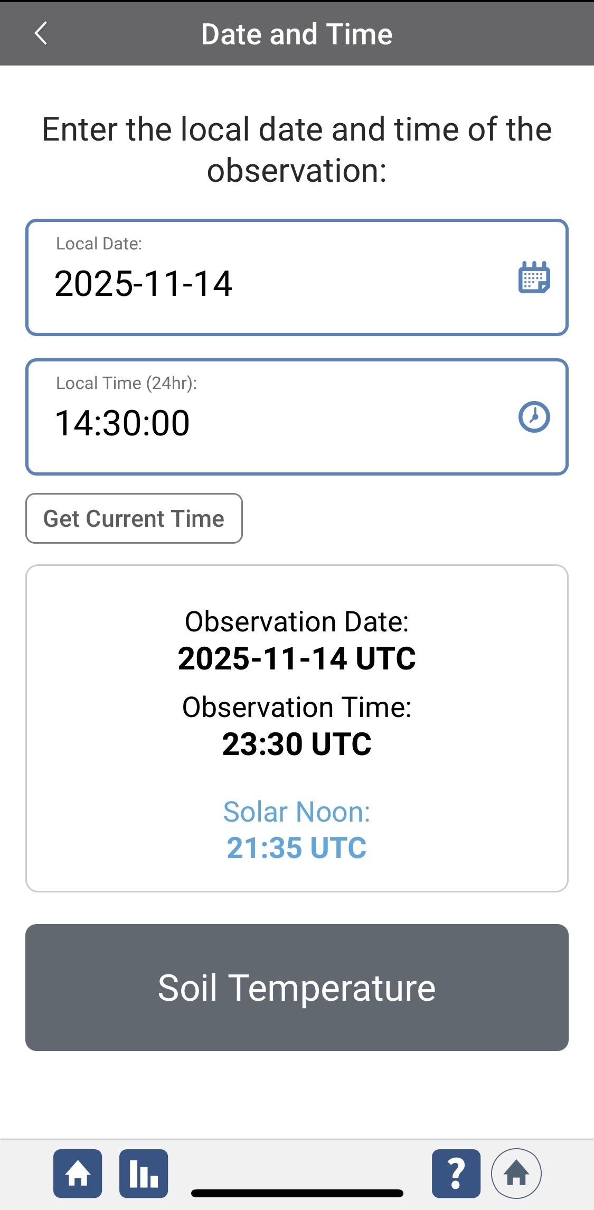
Soil Temperature Data Entry
Next, enter the date and time you took the measurements.
Select Soil Temperature to enter your data.

Slide 31
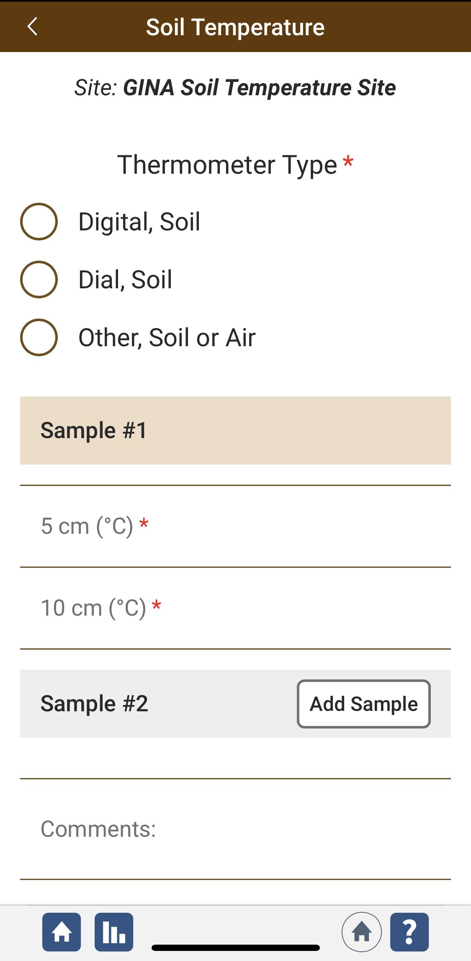
Soil Temperature Data Entry
Select your thermometer type, then enter the temperatures measured at 5 cm and 10 cm depths.
Click “Add Sample” to add another observation.
Add any comments or additional metadata to the Comments box.
Click Review to review your data before submitting.

Slide 32
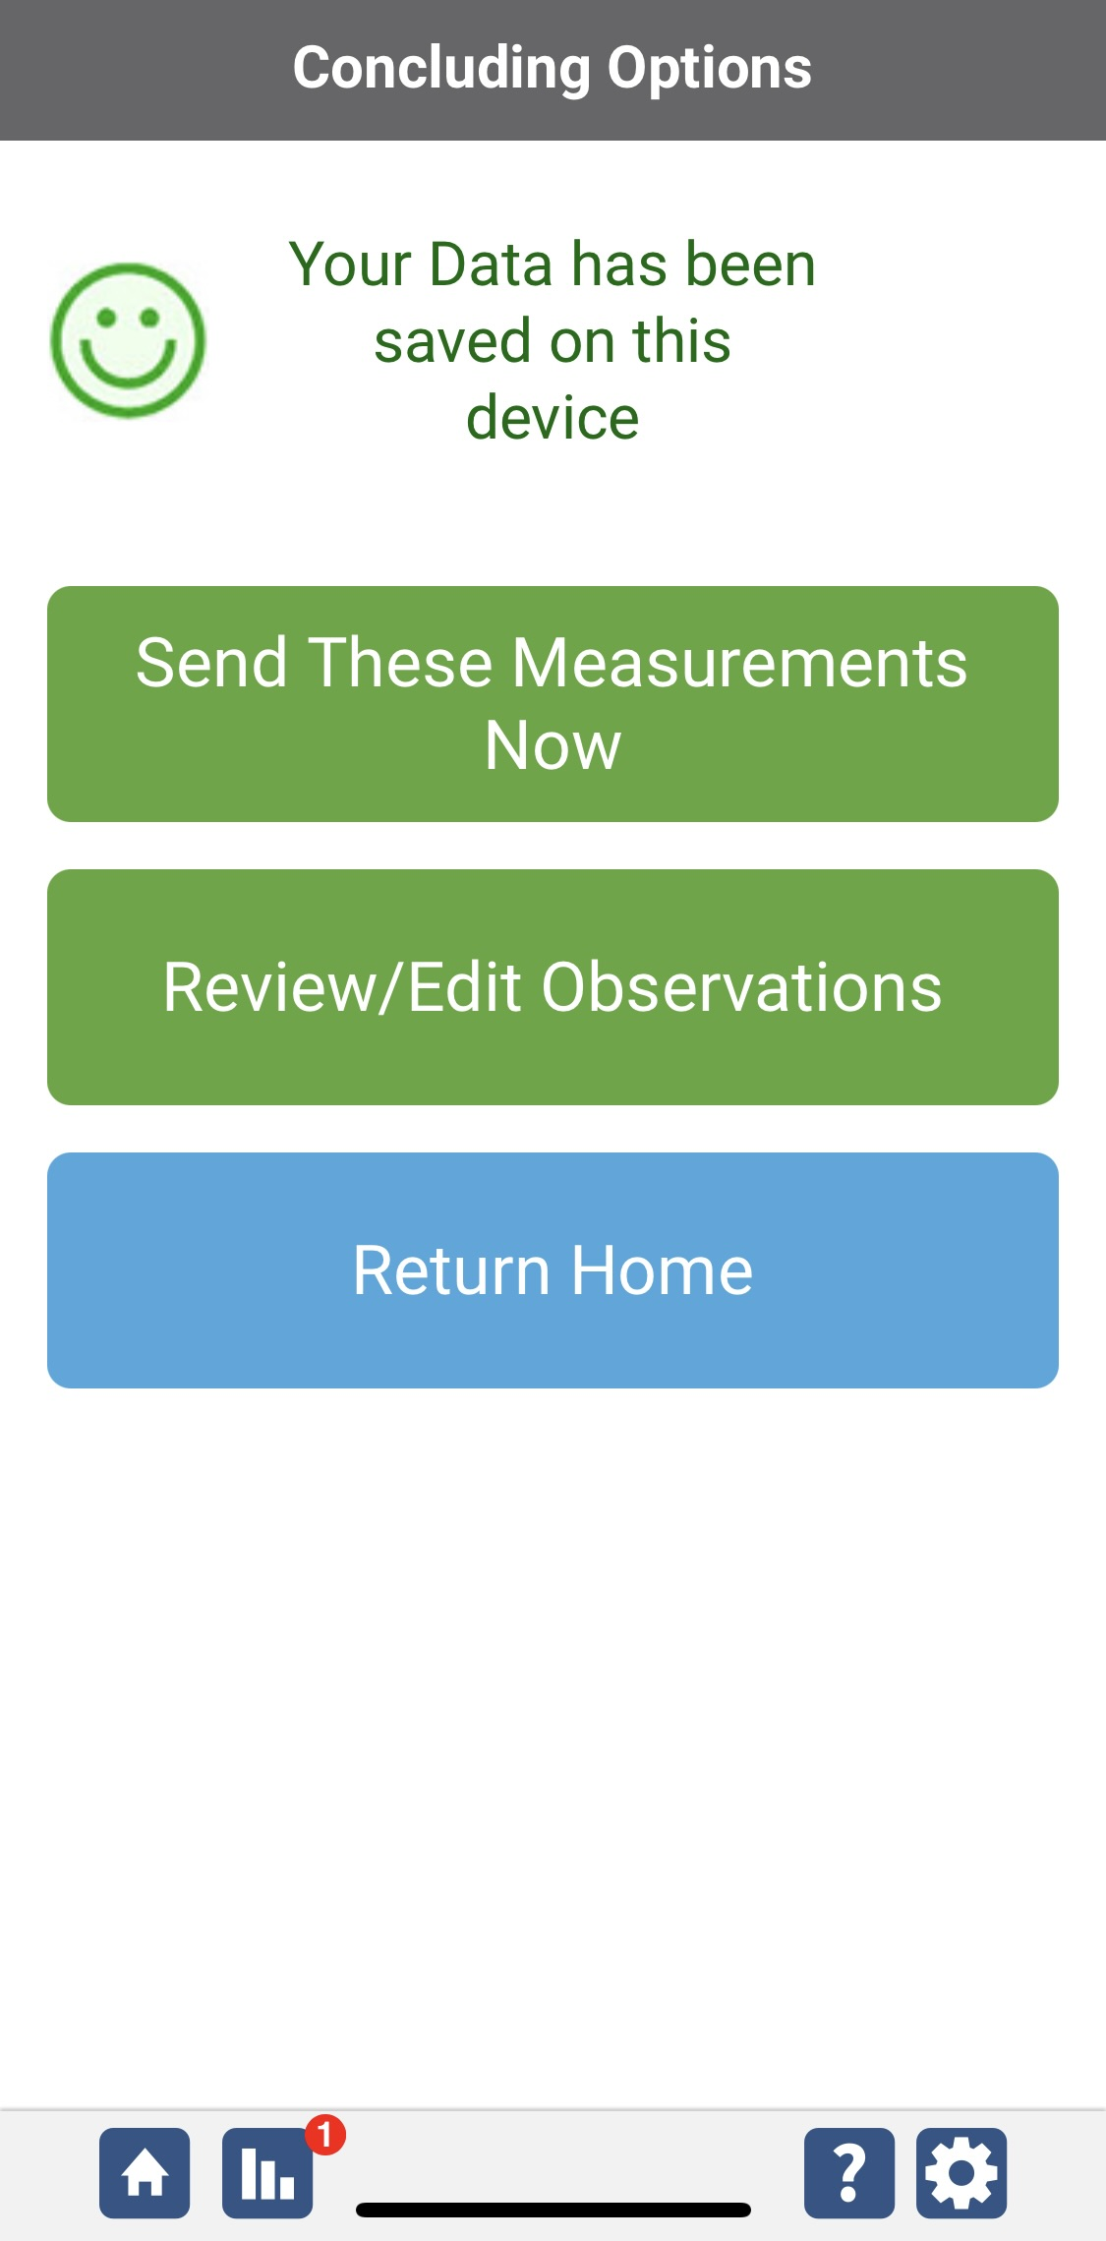
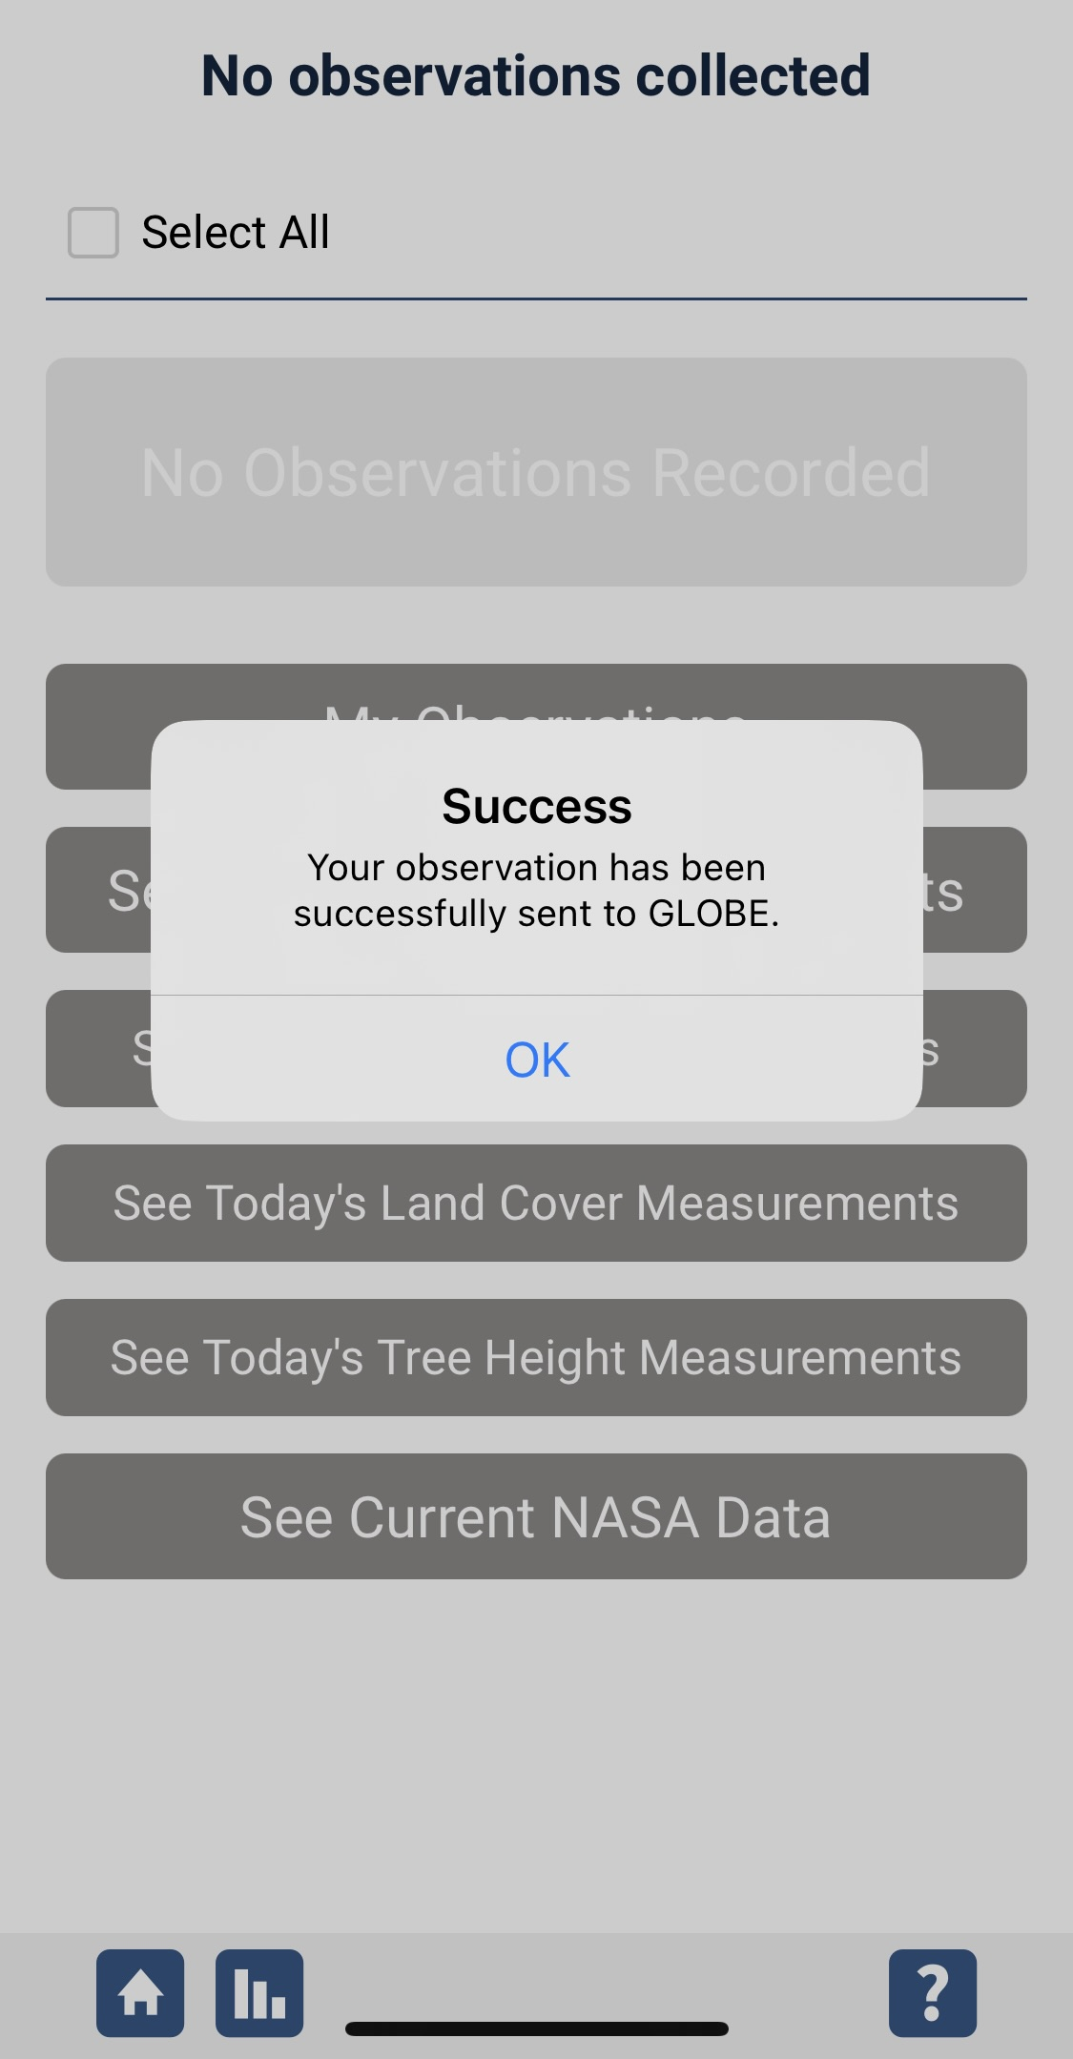
Data Entry System Responses
If your observations are within the appropriate ranges, you will see a green smiley face.
You can review or edit your observation if needed.
When ready, select “Send these measurements now” to send your data to GLOBE. When it has been sent, you will see a “Success” message.

Slide 33
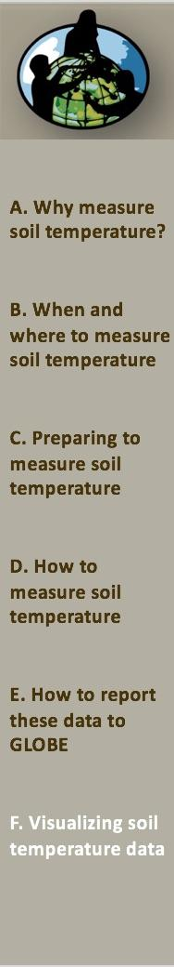
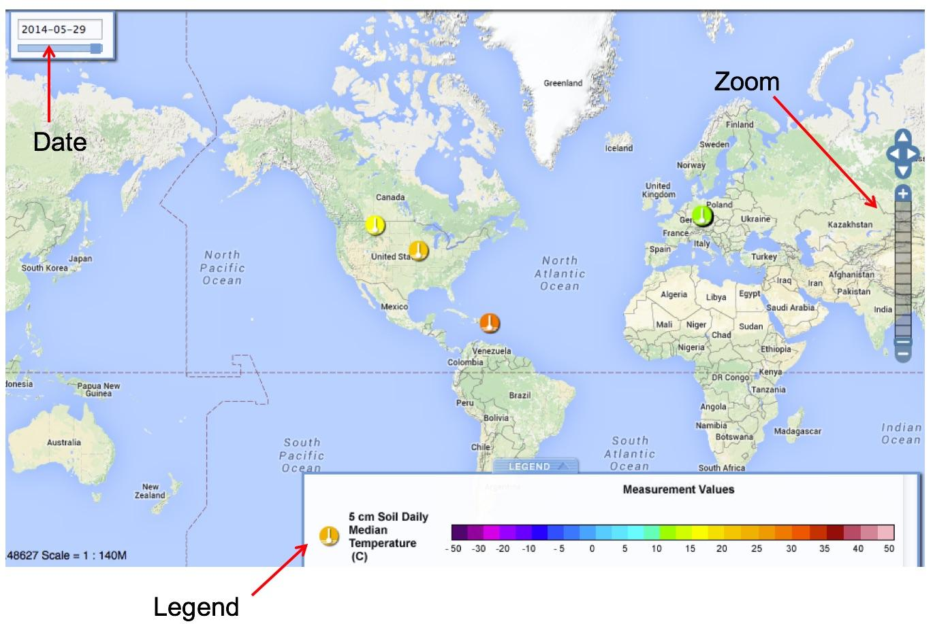
Soil Temperature Data Visualization – 5 cm 1

Slide 34
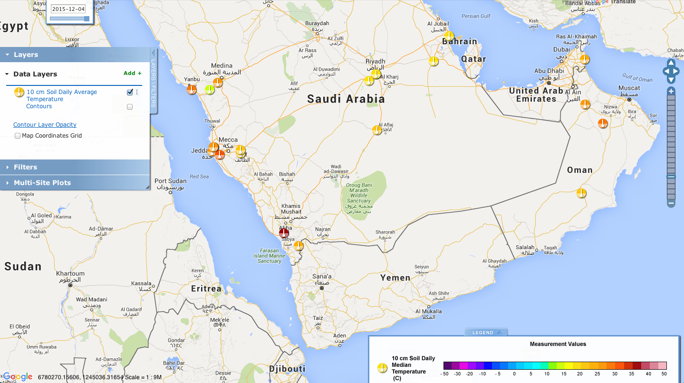
Soil Temperature Data Visualization – 10 cm2
Data for December 4, 2015 for the Arabian Peninsula

Slide 35
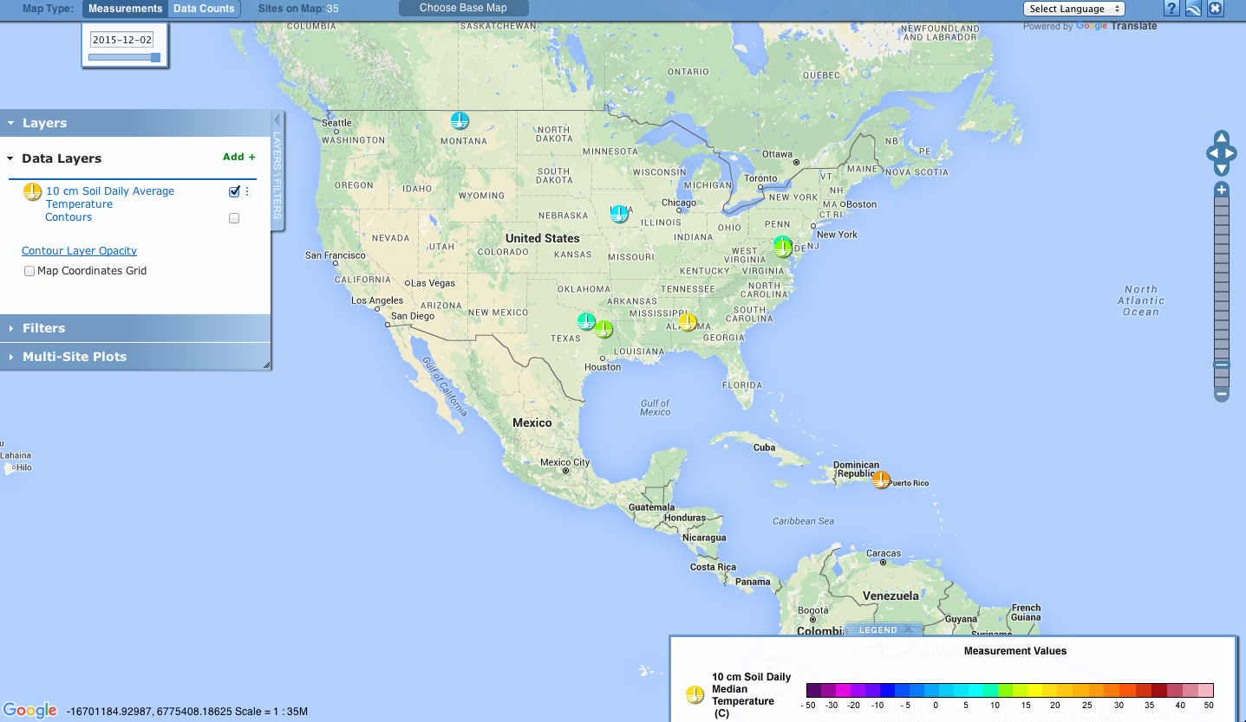
Soil Temperature Data Visualization –10 cm (Cont’d)
Data for December 2, 2015 for North America

Slide 36

Please provide us with feedback about this module. This is a community project and we welcome your comments, suggestions and edits!
Questions after reviewing this module? Contact GLOBE: help@nasaglobe.org
Credits
Slides: Izolda Trachtenberg, Dixon Butler, Russanne Low
Photographs: Izolda Trachtenberg
Cover Art: Jenn Glaser, ScribeArts
More Information:
GLOBE Program
NASA Earth Science
NASA Global Climate Change: Vital Signs of the Planet
The GLOBE Program is sponsored by these organizations:
November 2025. GLOBE Implementation Office: Science, Training, Education, and Public Engagement Team.
If you edit and modify this slide set for use for educational purposes, please note “modified by (and your name and date)” on this page. Thank you.

